Slide 1
Hydrogen Applications
Extra Information For Teachers
Content created by
<Partner logo>
Last updated 18th October 2019

Slide 2
Applications of hydrogen fuel cells
Automotive using a fuel cell as main energy producer (≈100 kW)
1.1 Chassis architectures of FCV: Toyota, Hyundai, Honda, Mercedes, Audi…
Automotive with a low power fuel cell (≈10 kW): niche products or range extender
2.1 Chassis architectures of FCV: Symbio, Micro cab, Riversimple…
Handling sector: Fork lift
Bus & coach
Railway: hydrogen trains
Space industry
Combined Heat Power (CHP) for the energy sector
Small CHP for houses
Light electric vehicles like bicycles, scooters, drones…
Didactic demonstrations

Slide 3
First vehicles & prototypes – chassis design
Hydrogen cars look like other cars
Performances of hydrogen cars are similar to other cars
Hydrogen cars are hybrid vehicles including a big fuel cell and a small high voltage battery
The motor delivers a maximum power around 100 kW
The fuel cell delivers a maximum power around 100 kW
The fuel consumption of a hydrogen car is around 1kg H₂ for 100 km
Hydrogen is generally stored in pressure tanks
The tanks can store at least 5 kg of hydrogen for assuming a driving range of at least 500 km
The safety level of hydrogen cars is the same as other cars using conventional fuels like gasoline or diesel

Slide 4
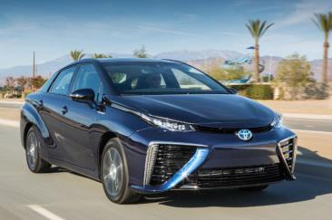
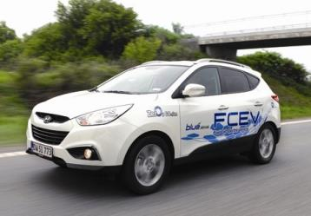
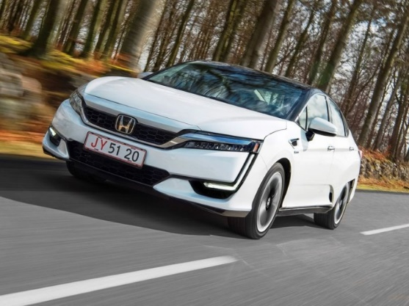
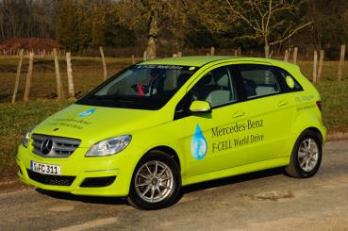
First vehicles & prototypes – chassis design
Characteristics | Toyota Mirai | Hyundai ix35 | Honda Clarity | Mercedes B
Motor power (kW) | 113 | 100 | 130 | 100
FC power (kW) | 114 | 100 | 103 | 80
Energy in battery (kW.h) | 1.6 | 0.95 | 1.7 | 1.4
Mass H₂ (kg) | 5.8 | 5.6 | 5.5 | 5
Small production: 3000/year

Slide 5
First vehicles & prototypes – chassis design
All kinds of cars can be powered by a hydrogen powertrain
Examples are SEDAN, Station Wagon and SUV
There appears to be a standard design for SEDAN or Station Wagon
Pressure tanks at the rear of the vehicle
High voltage battery at the rear of the vehicle
Fuel cell in central position
Electric motor in front of the vehicle
Inverter above the electric motor
As the technology is improved, the fuel cell becomes more and more compact
It remains a future possibility to locate the FC under the bonnet in a SEDAN like in cars using combustion engines

Slide 6
First vehicles & prototypes – chassis design
HONDA (FCX concept V1 & V2)
Tanks and HV Battery at the rear
Central position for the Fuel Cell
Inverter & e-Motor in front
Is this a standard ?
Source: Honda - Educam

Slide 7
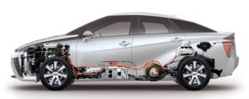
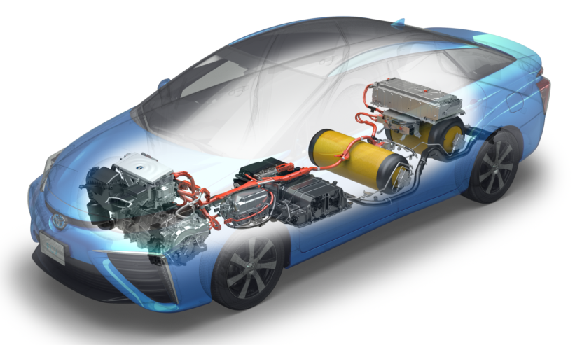
First vehicles & prototypes – chassis design
Fuel cell
It could be a standard for a Sedan
Tanks and HV Battery at the rear
Central position for the Fuel Cell
Inverter & e-Motor in front
Source: Toyota TME

Slide 8
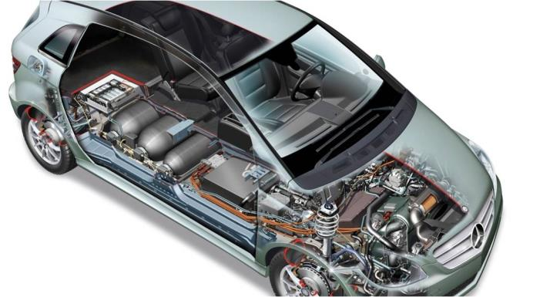
First vehicles & prototypes – chassis design
MERCEDES B-class Fuel Cell
Tanks and HV Battery at the rear
Central position for the Fuel Cell
Inverter & e-Motor in front
It could be a standard for a mid size
Source: Mercedes - Educam

Slide 9
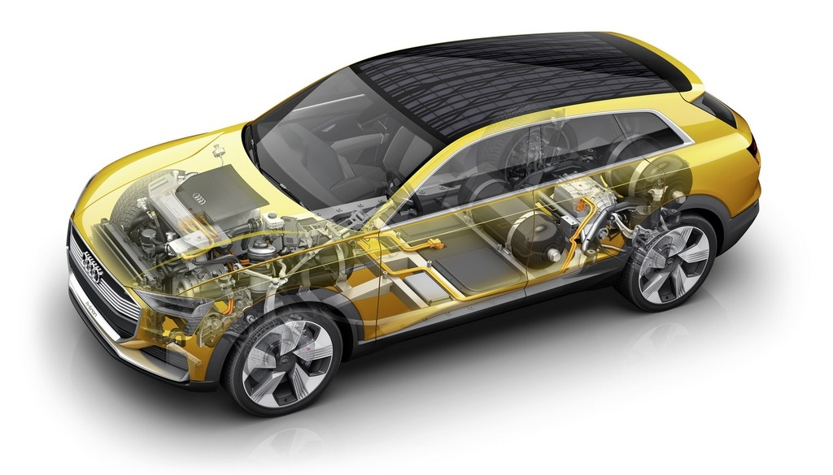
First vehicles & prototypes – chassis design
AUDI FCV concept
It could be a standard for a station wagon
Tanks and HV Battery at the rear
Central position for the Fuel Cell
Inverter & e-Motor in front
Source: Audi - Educam

Slide 10
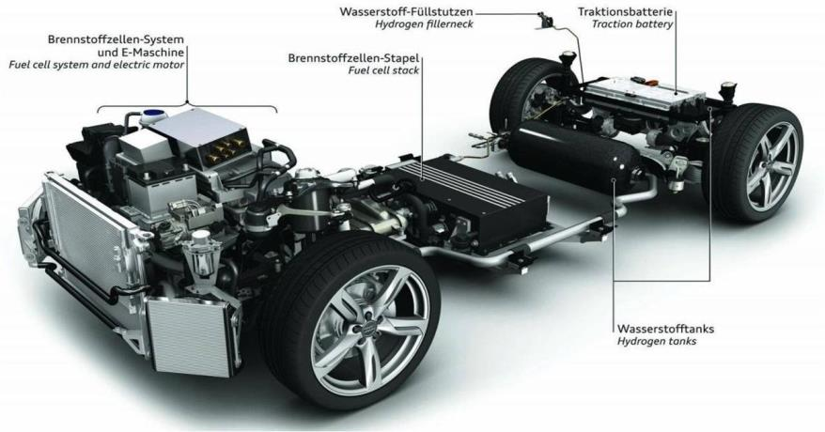
First vehicles & prototypes – chassis design
AUDI FCV concept
It could be a standard chassis…
Tanks and HV Battery at the rear
Central position for the Fuel Cell
Inverter & e-Motor in front
Source: Audi - Educam

Slide 11
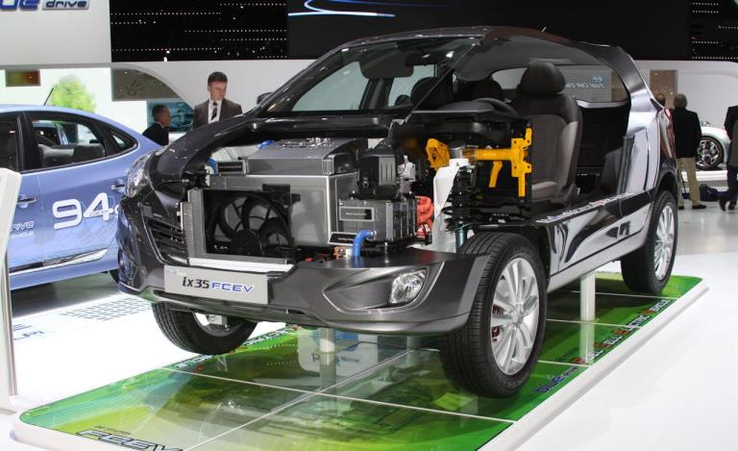
First vehicles & prototypes – chassis design
Another chassis design proposed by Hyundai with the IX35 FCV
Fuel cell
Another standard for a SUV, the fuel cell is located under the bonnet
Source: autocarhire.com

Slide 12
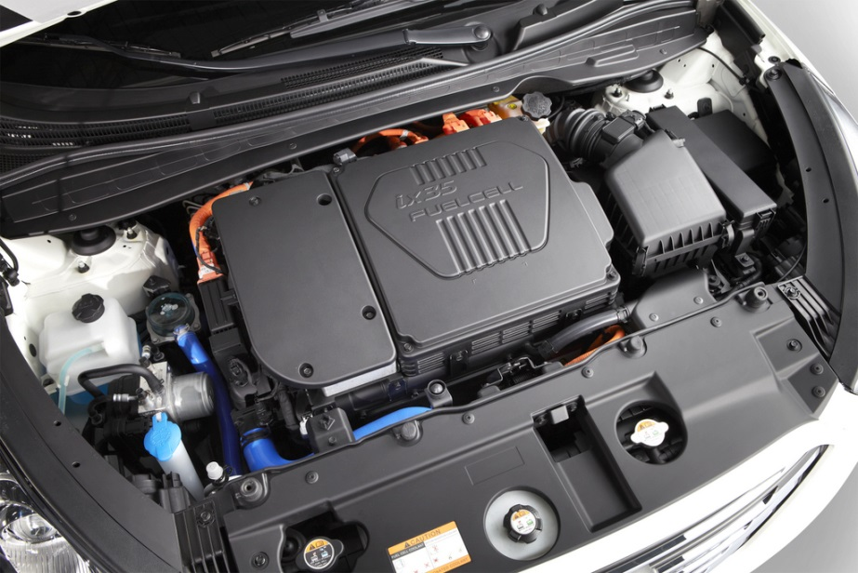
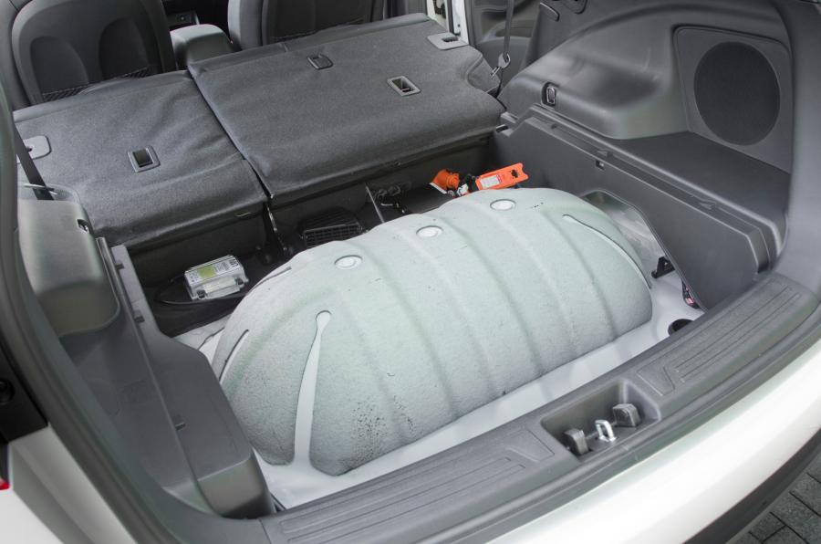
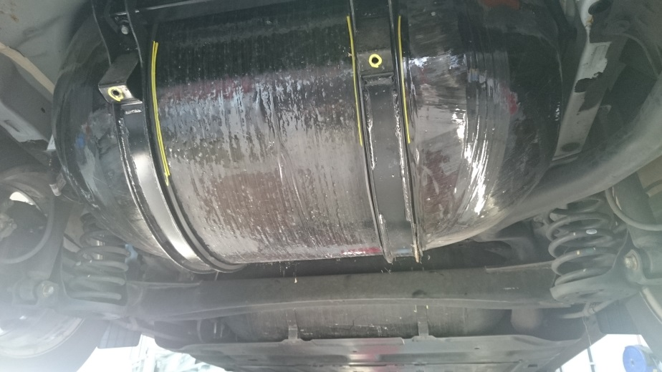
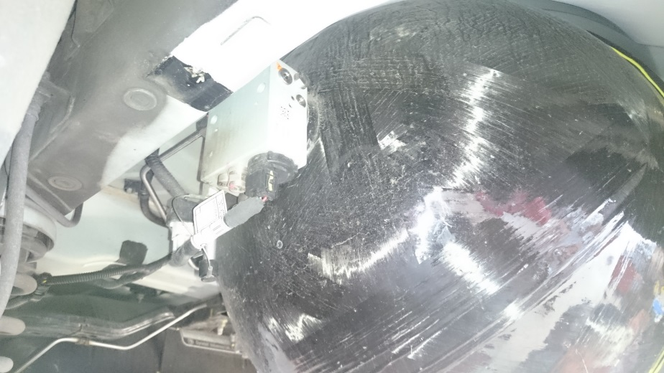
First vehicles & prototypes – chassis design
Other pictures of the Hyundai IX 35 FCV
Source: Waterstoffnet @ campus francorchamps

Slide 13
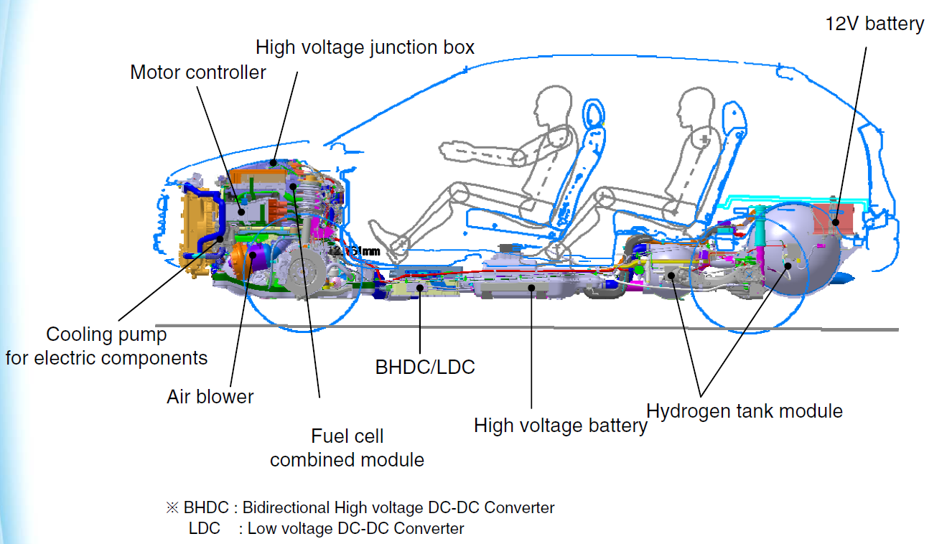
First vehicles & prototypes – chassis design
Other pictures of the Hyundai IX 35 FCV
Source: Hyundai emergency response guide
Source: https://h2tools.org/sites/default/files/ix35%20FCEV%20ERG_Eng.pdf

Slide 14
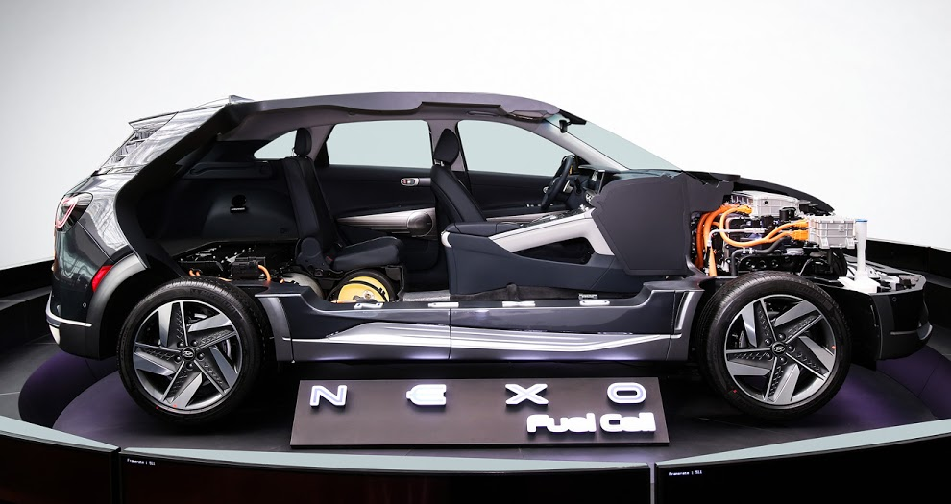
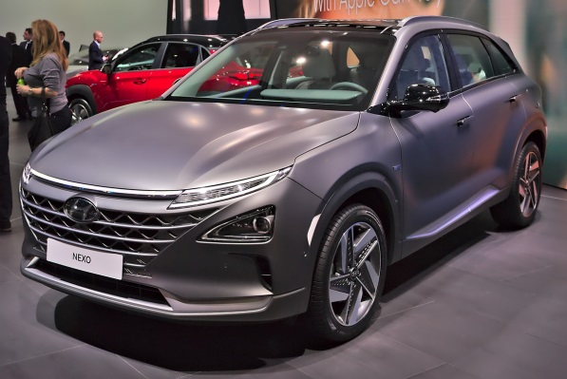
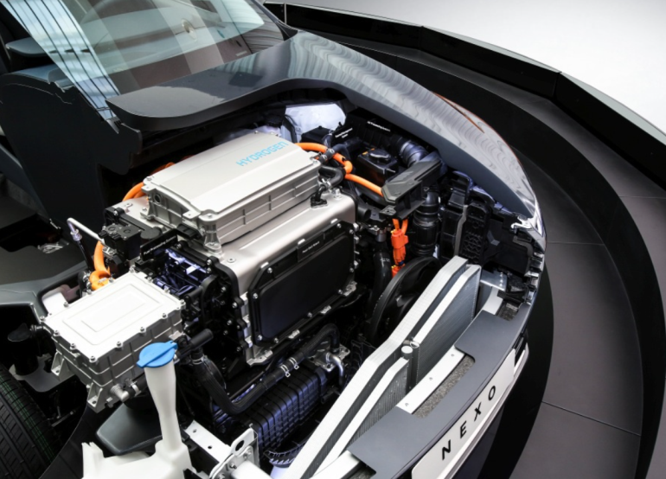
First vehicles & prototypes – chassis design
Hyundai NEXO
The new Hyundai NEXO is based on the same chassis design as the previous IX 35 FCV, the Fuel Cell is also located under the bonnet (SUV) and the high voltage battery is in a central position.
Source: www.auto-data.net

Slide 15
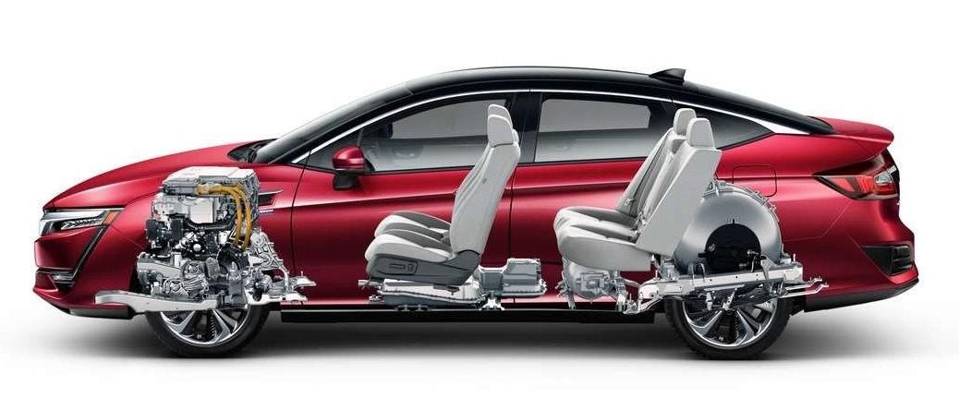
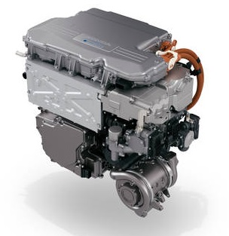
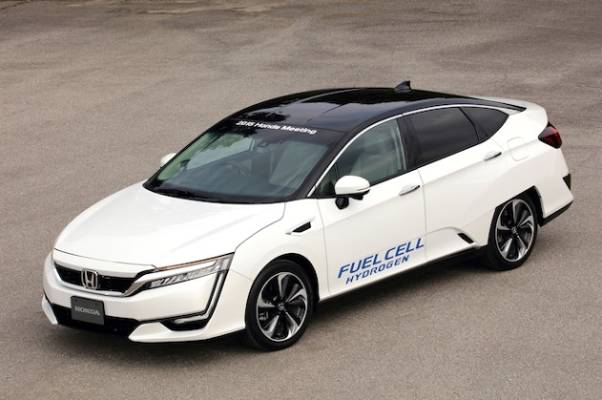
First vehicles & prototypes – chassis design
Honda Clarity FCX 2017
Only available in the USA !
H₂ pressure tank
High voltage battery
Fuel cell under the bonnet
(An exception for sedan or a future trend?)
Source: automobilemag.com

Slide 16
First vehicles & prototypes – chassis design
All kinds of cars can be powered by a hydrogen powertrain, including racing cars like the following LMP (Le Mans* Prototype)
The components are distributed to balance the masses
The power of the motor is huge in order to get high performances
The cooling system is very important
The chassis is as light as possible, using composite materials like carbon
The height of the car is as small as possible to reduce the front surface
The driving range must be the same as with other fuels in order to compete in the same conditions
* A 24 hour sports car endurance race

Slide 17
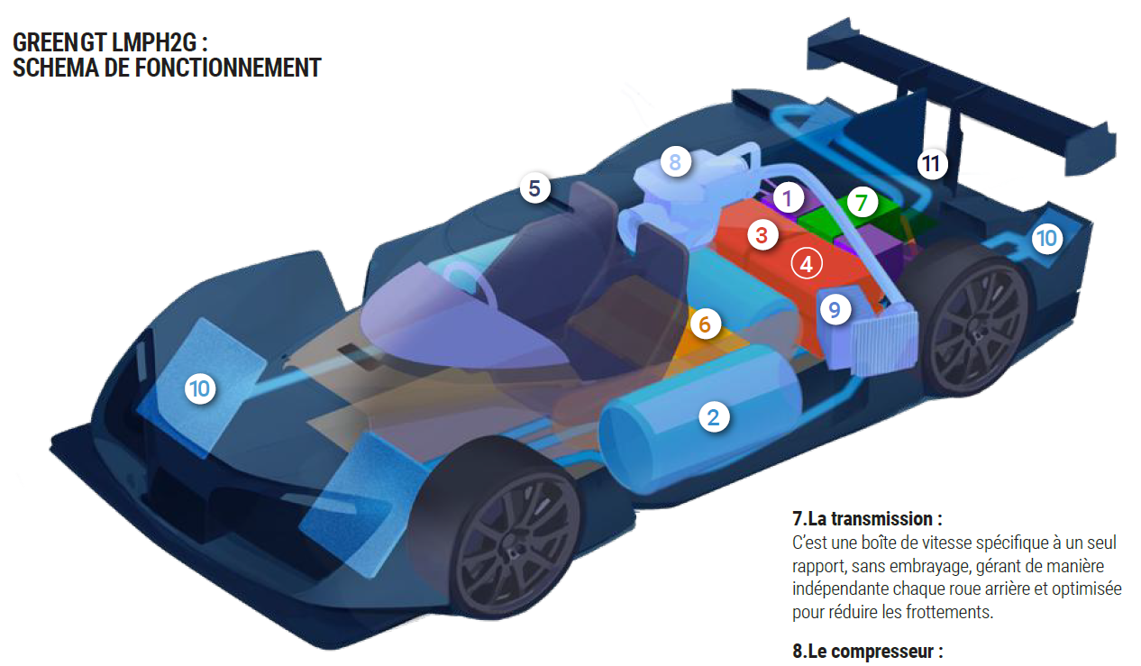
Niche product, racing: Mission H24 by ACO
exhaust
Air compressor
How does it work ?
Air intake
radiators
radiators
humidifier
battery
tanks
3 and 4 Fuel cell module
Source: press conference greengt @ spa francorchamps

Slide 18
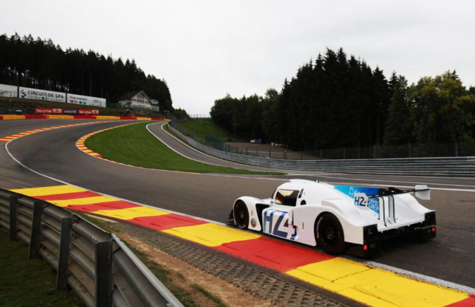
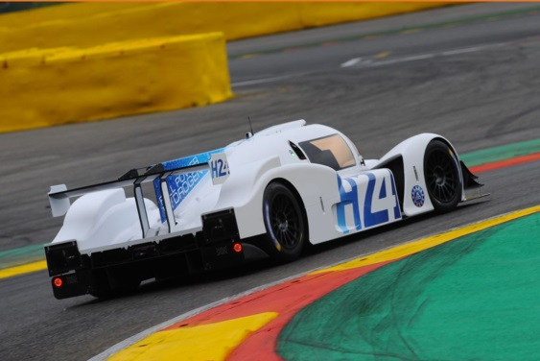
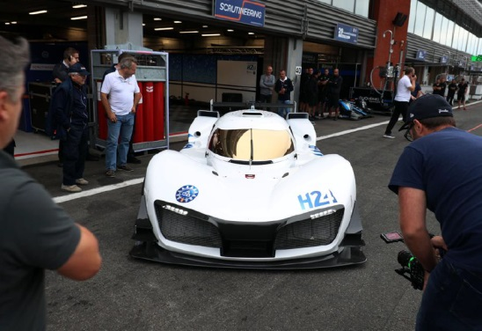
Niche product, racing: Mission H24 by ACO
Some technical characteristics of the LMPH2G Hydrogen
LMP chassis in carbon & steel
FC assembly of 4 stacks
FC total power of 250 kW
4 electric motors of 120 kW each
Electric motor max rpm: 13000
Transmission ratio to the wheels: 1:6.3
Hydrogen tank in composite materials
Storage: 8.6kg H2 @ 700 bars
HV battery Li-ion of 2.4 kWh @ 700 V
Max speed: 300 kph
0 to 100 kph in 3.4 seconds
Breaking energy recovery (max 250 kW)
Length: 4710 mm
Width: 1970 mm
Height: 1070 mm
Weight: 1420 kg
Regular driving range
Source: press conference greengt @ spa francorchamps

Slide 19
Electric vehicles improved by a hydrogen FC range extender
The hydrogen fuel cell is basically a simple way to produce electricity. It works as a power generator and can be connected to a big battery in order to charge it permanently
The fuel cell plays therefore the role of a range extender
It reduces the discharge of the battery when driving
It charges the battery when the powertrain is not used
The range of the electric car is easily doubled
In this case it is not necessary to use a big fuel cell, a small stack of 5 to 10 kW is enough for sufficient power, as the main energy comes from the battery
This solution is ideally suited to captive fleets when the driving cycle is known and well defined beforehand

Slide 20
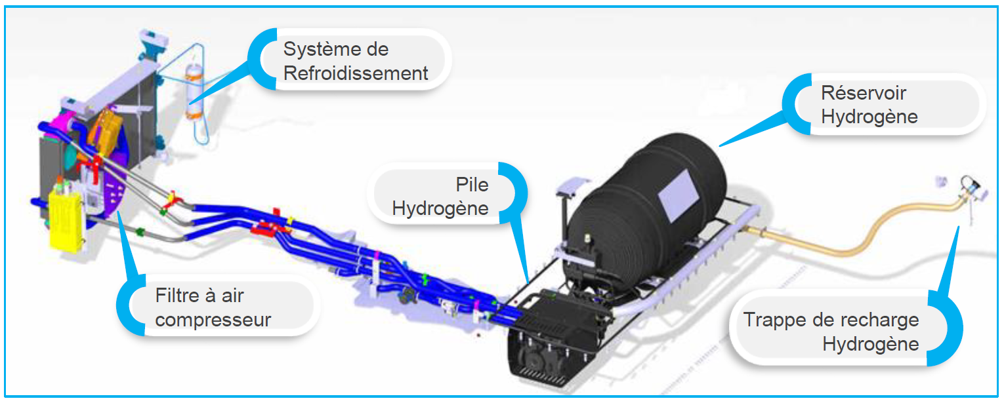
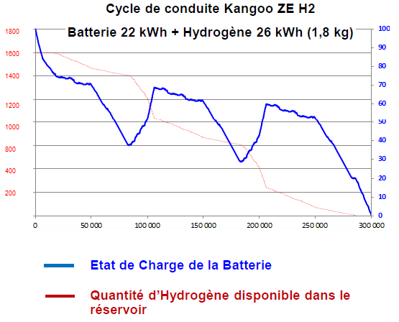
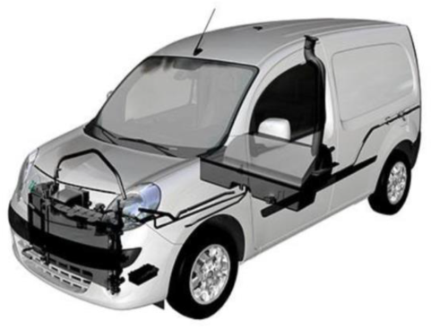
Electric vehicles improved by a hydrogen FC range extender
Example of the Renault Kangoo ZE Fuel Cell by Symbio FC (France)
Cooling system
H₂ Tank
Fuel cell
Air filter & compressor
Filling plug
Kit « range extender » from Symbio to add to the electric Renault Kangoo ZE
Plug-in hybrid H₂
Battery of 22 kWh
H₂ tank, storage of 1,78 kg or 26 kWh
Bonus: heat delivered by the fuel cell
Fuel cell of 5 kW
FC start at a battery SOC of 80%
Ideal design for a known driving cycle
Source : https://www.symbio.one/

Slide 21
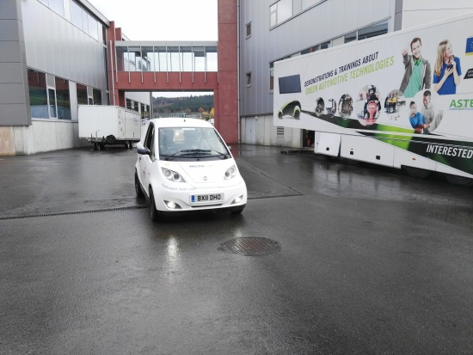
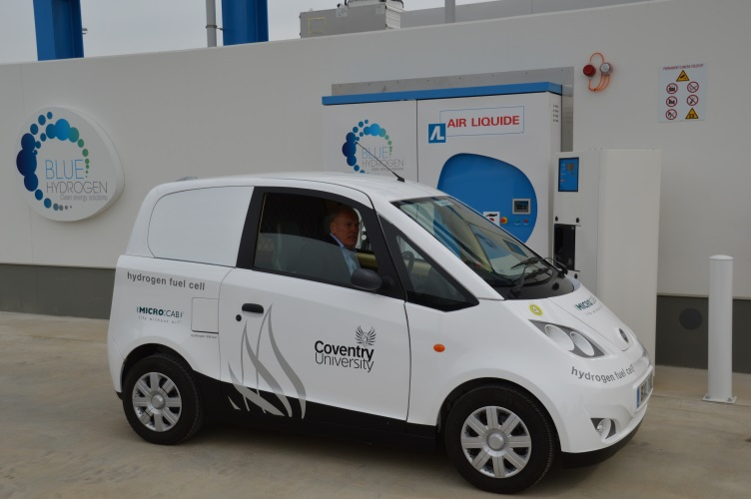
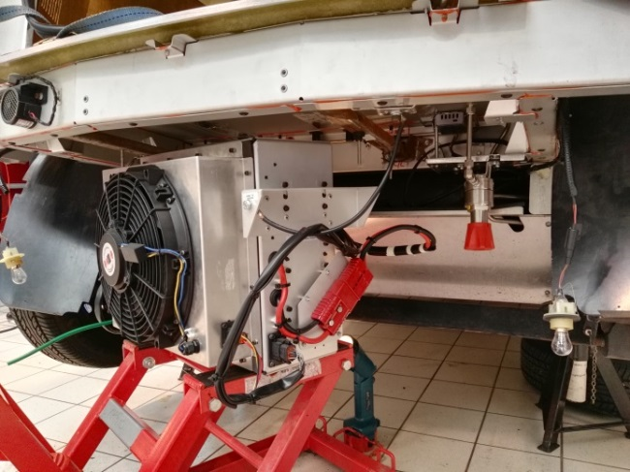
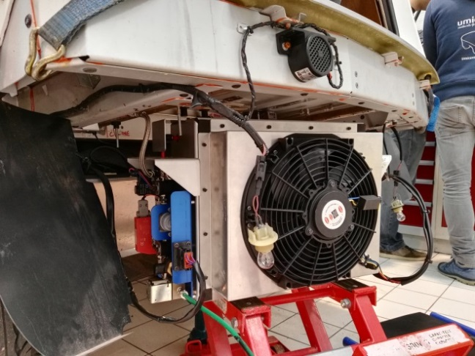
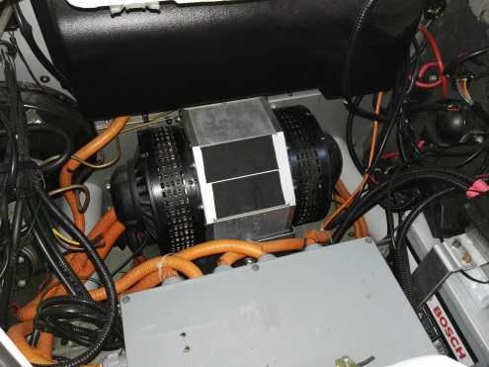
Electric vehicles improved by a hydrogen FC range extender
Example of the Microcab (England)
This kind of niche product is dedicated to short travels in cities. It is designed to keep a maximum internal volume for goods. The fuel cell and pressure tanks are located at the rear of the vehicle, under the chassis and for safety reasons outside the car volume. There is no connection between the hydrogen tank and the passenger compartment.
http://www.microcab.co.uk/
The fuel cell of 5 - 10 kW
E-Motor

Slide 22
Electric vehicles improved by a hydrogen FC range extender
The hydrogen fuel cell is basically a simple way to produce electricity. It works as a power generator and can be connected to supercapacitors in order to keep them charged
The fuel cell plays therefore the role of a permanent charger delivering a constant nominal current to the supercapacitors, except when they are charged
The maximum power will be delivered to the e-motor by discharging the supercapacitors which can deliver high currents during a short time
The range of the car depends only on the tank size
In this case it is not necessary to use a big fuel cell, a small stack of 10 kW is enough to provide significant energy, instant power being delivered by supercapacitors
This solution is well suited for light vehicles

Slide 23
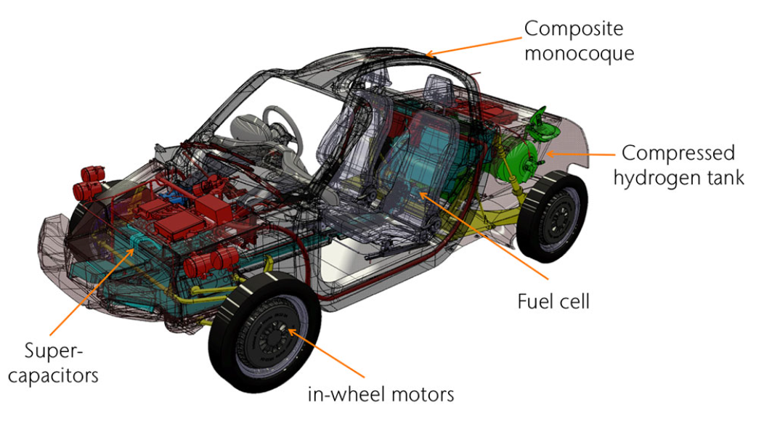
Electric vehicle using a small power fuel cell
Example of the RASA from Riversimple, a light electric vehicle (England)
Eco-friendly, light vehicle designed around a fuel cell powertrain associated to supercapacitors for braking energy recovery. In this case, the FC keeps the supercapacitors constantly at a maximum state of charge.
Source: https://www.riversimple.com/

Slide 24
Electric vehicle using a fuel cell, Example of the forklift
Many companies are using forklifts for handling material
For the food industry or solely indoor use it is mandatory to use electric forklifts
Battery electric forklifts are often used in this case
The range of a battery forklift is limited when the company works in 2 or 3 shifts, half of the forklifts are then permanently blocked for charging the battery
Hydrogen forklifts are more profitable in this particular case
The hydrogen forklift is based on a fuel cell included in a powerpack
The powerpack occupies the same volume as the classical lead acid battery pack
The powerpack is lighter than the classical lead acid battery pack
Performances of the hydrogen forklift are similar to the electric battery model

Slide 25
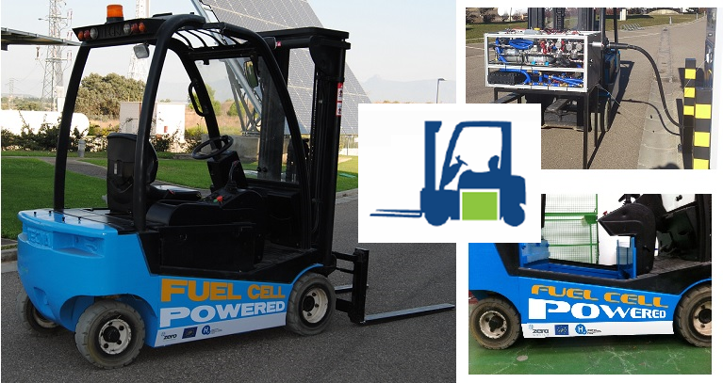
Electric vehicle using a fuel cell
Example of the fork lift
Forklift & hydrogen powerpack
Source: FHA fundacion

Slide 26
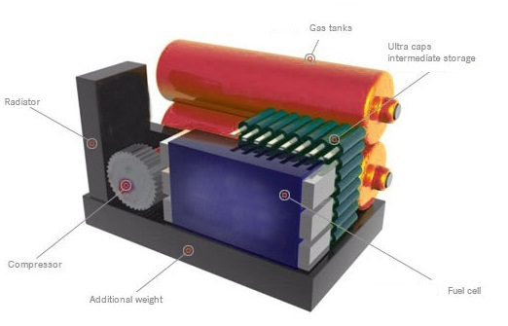
Electric vehicle using a fuel cell
Example of the fork lift
Schematic 3D view of the hydrogen powerpack of the fork lift
Source: FHA fundacion

Slide 27
Electric vehicle using a fuel cell, Example of the bus
A bus is a good example of the application of hydrogen fuel cells
A bus usually runs in towns and city centres where pollution must be avoided
There is a lot of space for the location of hydrogen components
Hydrogen tanks can be easily located on the roof, this place is well ventilated and there is no connection with the passenger compartment
The fuel cell module is also located on the roof and is made of a differing number of fuel cell stacks depending on the power needed. A stack being able to deliver around 100 kW.
The rest of the powertrain: batteries, power electronics and electric motors are located as low as possible to lower the vehicle’s centre of gravity The filling of the tanks is performed in only a few minutes

Slide 28
Electric vehicle using a fuel cell
Example of the bus
First prototypes: 2005

Slide 29
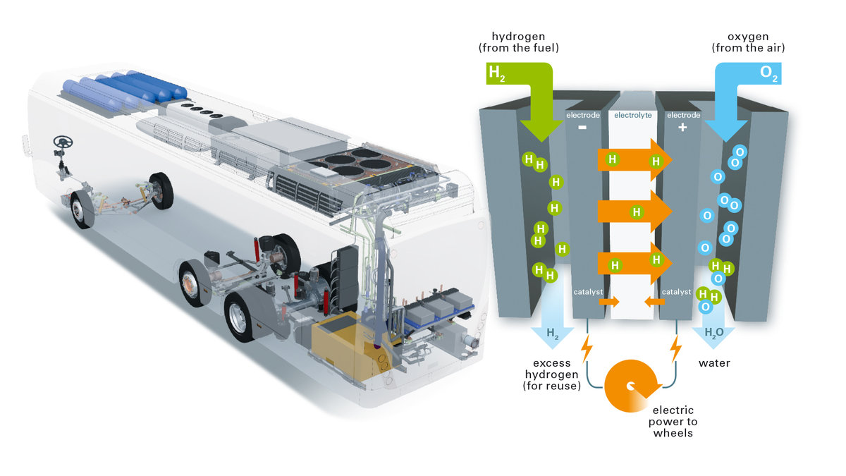
Electric vehicle using a fuel cell
Example of the bus
Modern version of a hydrogen bus: 2019
Hydrogen tanks
Fuel cell module
Battery pack
Source: https://www.vanhool.be/fr/transport-public/agamma/hybrid-fuel-cell

Slide 30
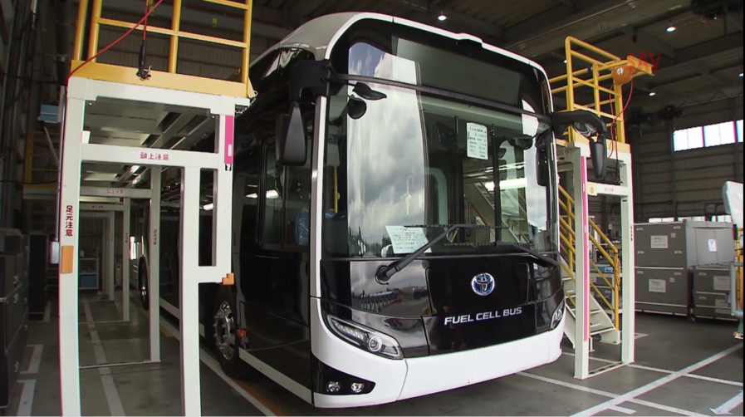
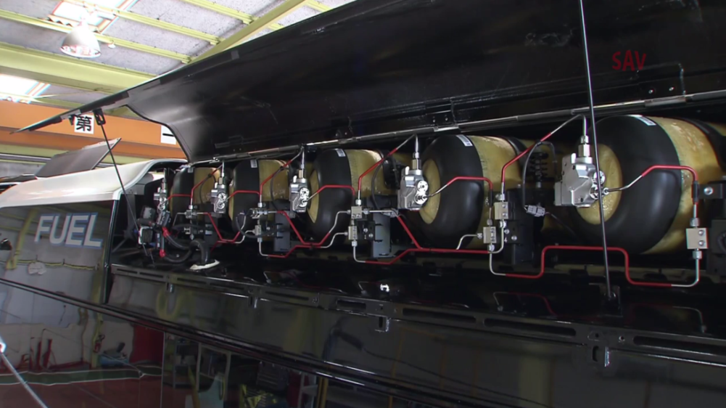
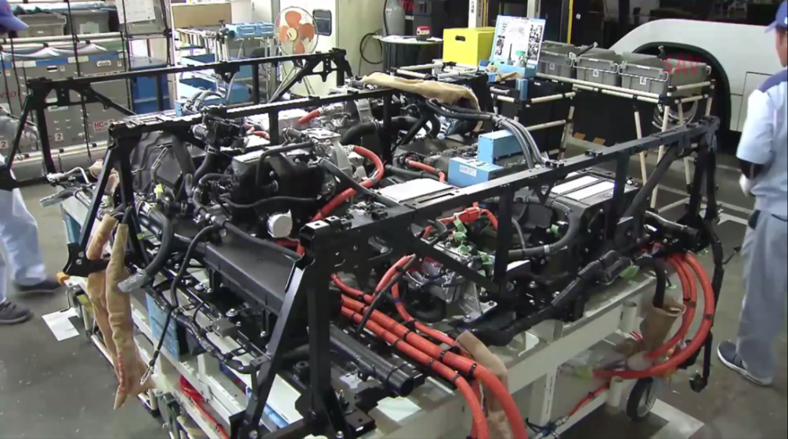
Electric vehicle using a fuel cell
Example of the bus
Modern version of a hydrogen bus: 2019
There is a lot of space in a bus or coach to locate the components of the hydrogen system like the fuel cells and the pressure tanks. The components of this bus are identical to the ones used in the Toyota Mirai.
The best location for hydrogen components is on the roof of the vehicle, there is enough space, air intake, good ventilation and it is outside the passenger area.
Hydrogen bus SORA by Toyota
The 10 full composite pressure tanks
The 4 fuel cells

Slide 31
Electric vehicle using a fuel cell, Example of the hydrogen train
Hydrogen fuel cells can also be used to power an electric train
There is an interest in using them when it is difficult to install an electrical infrastructure
No infrastructure is more safe for people and animals
The architecture of a train is similar to the one of a bus
Hydrogen tanks are located on the roof, this place is well ventilated and there is no connection with the passenger compartment
The fuel cell module is also located on the roof. The number of fuel cell stacks depends upon the power needed.
The rest of the powertrain: batteries, power electronics and electric motors are located as low as possible to lower the vehicle’s centre of gravity.
A filling station must be built on the railway route, generally at the terminus station

Slide 32
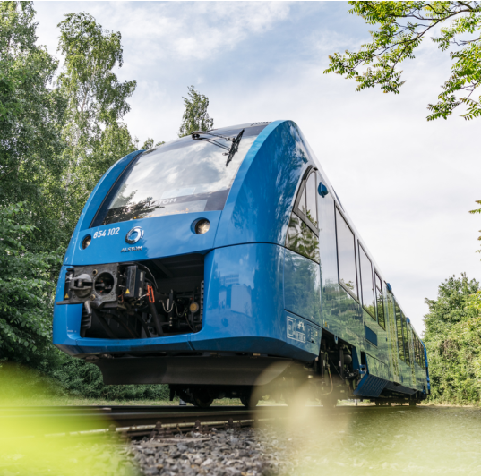
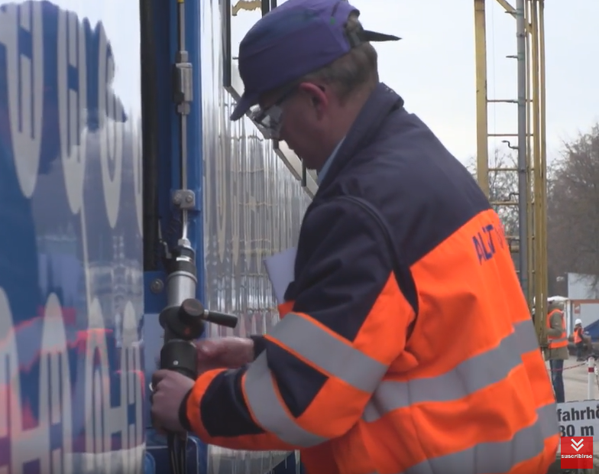
Electric vehicle using a fuel cell
Example of the hydrogen train
CORADIA iLINT hydrogen train
Source: https://www.alstom.com/coradia-ilint-worlds-1st-hydrogen-powered-train

Slide 33
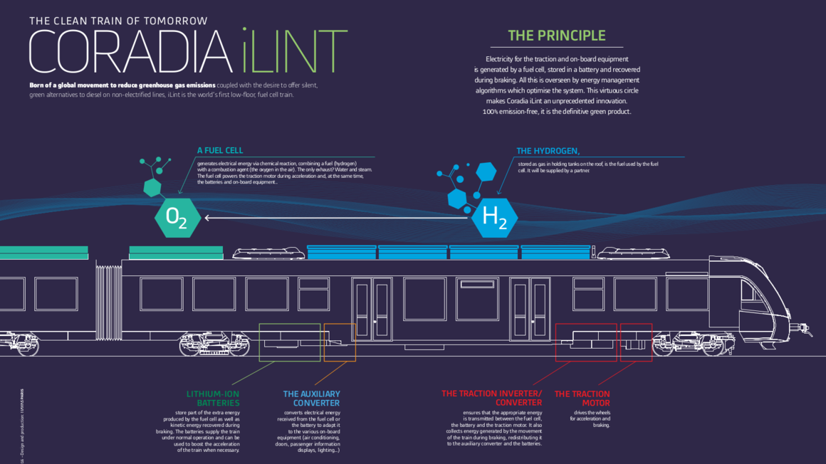
Electric vehicle using a fuel cell
Example of the hydrogen train
CORADIA iLINT hydrogen train
Source: https://www.alstom.com/coradia-ilint-worlds-1st-hydrogen-powered-train

Slide 34
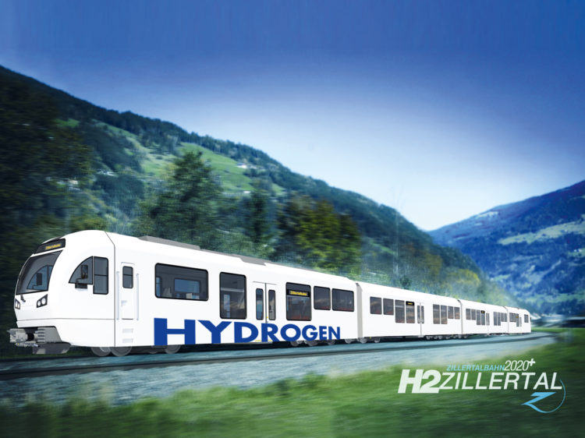
Electric vehicle using a fuel cell
Example of the hydrogen train
Hydrogen train project in Austria
Source: https://www.molinari-rail.com/it/projects/zillertalbahn-hydrogen-train/

Slide 35
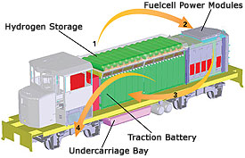
Electric vehicle using a fuel cell
Example of the hydrogen locomotive
Hydrogen locomotive from BNSF
Source: https://www.bnsf.com/communities/environmental/fuel.html

Slide 36
Applications in space
First developments and use of hydrogen fuel cells have been made for space applications
In this case hydrogen and oxygen are used directly to produce electricity and water as there is no air in space
This solution is lighter than using batteries
A fuel cell can deliver more energy for a given volume, so tanks need sizing correctly
For some spaceships like the Arianne, hydrogen and oxygen are also used for the propulsion of the second stage

Slide 37
Applications in space
1962 – 1966: Space program GEMINI

Slide 38
Applications in space
1981 : The space shuttle

Slide 39
Combined Heat Power (CHP) for the energy sector and for houses
CHP means that we valorise electricity and heat in the same place
The fuel cell efficiency is about 60%
The fuel cell therefore produces 40% of heat
If we valorise both, the theoretical efficiency is 100% !
For stationary applications the fuel is generally natural gas (methane CH₄)
Natural gas CH₄ is reformed into hydrogen H₂ and carbon dioxide CO₂
Hydrogen is then used in the fuel cell to produce electricity and heat
This principle may be used on different scales; for the energy sector in an energy production plant or for personal houses
Different technologies like SOFC (solid oxide fuel cells) or MCFC (molten carbonate fuel cells) all work at high temperatures

Slide 40
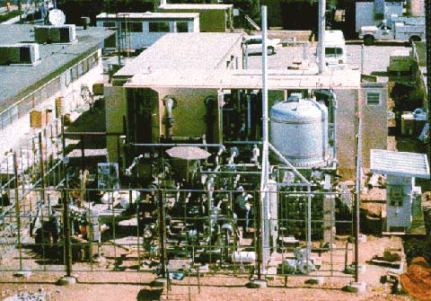
Combined Heat Power (CHP) for the energy sector
Example of a power plant
Molten Carbonate Fuel Cell History
M-C Power's molten carbonate fuel cell power plant in San Diego, California, 1997.
Image from the National Energy Technology Laboratory
Source: http://americanhistory.si.edu/fuelcells/mc/mcfc3.htm

Slide 41
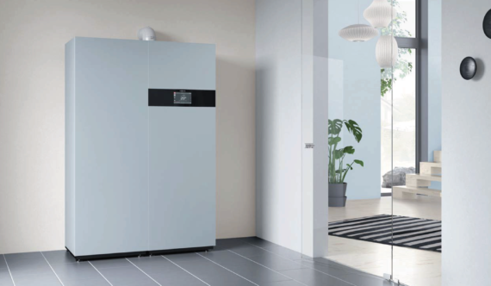
Combined Heat Power (CHP) for the energy sector
Small CHP for houses
Example of a private fuel cell scaled for heating a regular house
Source: Viessmann
Source: https://cleantechnica.com/2018/04/30/viessmanns-new-vitovalor-pt2-fuel-cell-reduces-energy-costs-emissions/

Slide 42
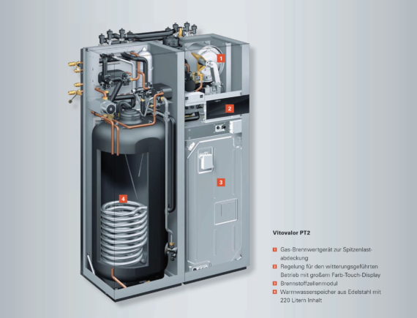
Combined Heat Power (CHP) for the energy sector
Small CHP for houses
Example of a private fuel cell scaled for heating a regular house
Source: Viessmann

Slide 43
Light electric vehicles like bicycles, scooters, karts
Soft mobility is a daily solution for some people living in city centres close to their work place
In this case, these people could go to work with a light electric vehicle like a bicycle, scooter or three-wheeler.
This kind of vehicle can easily be powered by a fuel cell
In this case, hydrogen components are small
The fuel cell power is between 250 W and 3 kW
The hydrogen tank occupies a volume of few litres under a pressure of a maximum 200 bars
The driving capability of the vehicle is improved by the use of an additional Li-ion battery

Slide 44
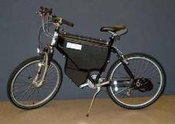
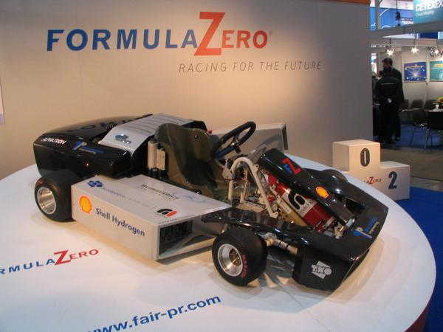
Light electric vehicles like bicycles, scooters, karts
A great variety of examples and possibilities
1980 – 2000 : Laboratory prototypes test the hydrogen technology with all kinds of electric applications. Does it make sense in all cases ?

Slide 45
Light electric vehicles like bicycles, scooters, karts
An example of a 3-wheeler niche product for eco-mobility
A 3 wheeler for cities
FC & tanks located in front
Hydrogen 3 wheeler manufactured by a small team
Source: https://www.youtube.com/watch?v=8rO3h5LrctM

Slide 46
Light electric vehicles like bicycles, scooters, karts
The first commercialised hydrogen bicycle
Hydrogen bicycle manufactured by the company Pragma (France)
Source: https://www.pragma-industries.com/fr/products/light-mobility/

Slide 47
Light electric vehicles like bicycles, scooters, karts
The first commercialised hydrogen bicycle
Hydrogen bicycle manufactured by the company Pragma (France) and associated filling station by Atawey (France).
Source: https://www.pragma-industries.com/fr/products/light-mobility/

Slide 48
Some examples of didactic equipment available
Do not hesitate to use demonstrations to increase the interest of students
Didactic equipment is now available on the market
If you do not have provision to purchase equipment you can collaborate with universities (visit) or training centres (partnership) depending on your regional policy

Slide 49
Some examples of didactic equipment available
https://www.horizoneducational.com/
http://heliocentrisacademia.com/
https://www.pragma-industries.com/fr/products/education/

