Slide 1
Hydrogen Applications
Student Powerpoint
Content created by
<Partner logo>
Last updated 18th October 2019

Slide 2
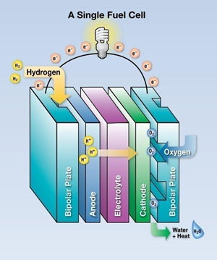
Hydrogen Applications
Industry has safely used hydrogen for decades in the following applications:
Petroleum refining
Glass purification
Semiconductor manufacturing
Aerospace applications
Fertilizer production
Welding, annealing and heat-treating metals
Pharmaceuticals
As a coolant in power plant generators
For hydrogenation of unsaturated fatty acids in vegetable oil
How can hydrogen fuel cells be applied to solve modern energy needs?

Slide 3
Fuel cells can be used in a variety of applications, which can be categorized into three groups:
1 – Portable power generation
2 – Stationary power generation
3 – Power for transportation
Can you think of an example of each?

Slide 4
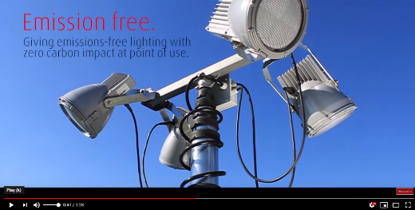
1 - Portable power generation
Compact, portable fuel cell systems can be used to recharge batteries or directly power consumer electronics (such as laptops and smartphones). Portable fuel cells can also supply off-the-grid backup power (in remote locations, for instance) or on-the-go power.
Can you think of any other places where a portable fuel cell could be used?

Slide 5
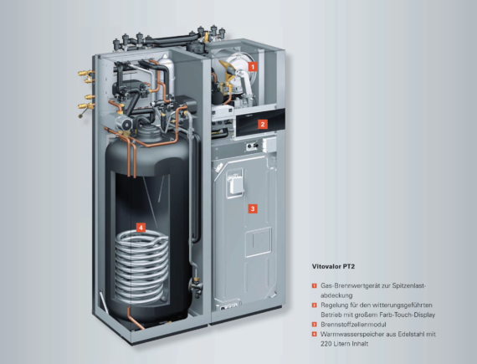
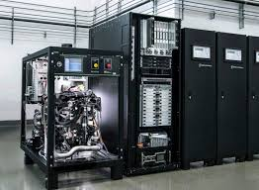
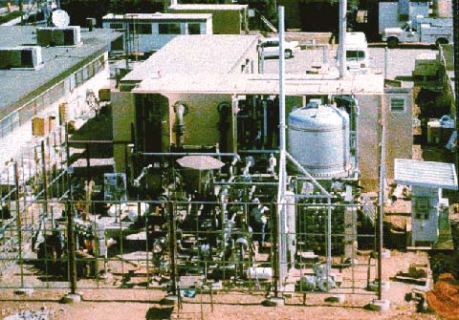
2 - Stationary power generation.
Stationary fuel cells can be an important part of distributed generation, and are often used as primary or backup power for large energy infrastructures. They are highly efficient: 50 percent for electricity generation, and more than 90 percent with heat recovery (plus there is no need for long transmission lines, with their associated power loss).
There are three main uses for stationary fuel cells:
Combined Heat and Power
(CHP)
Uninterruptible Power Supplies
(UPS)
Primary Power Units
These use both the heat and electricity generated by the fuel cell to maximize fuel efficiency (the heat, which is lost in other systems, can be used to heat water and/or provide space heating for a building, for instance).
Sources of uninterrupted power that are primarily used as backup power during grid outages. They can replace diesel-powered emergency generators in critical facilities like hospitals and server farms.
Large stationary units that can be used to generate power for facilities or for the grid.

Slide 6
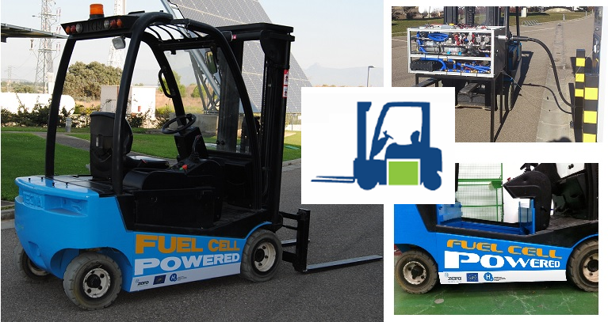
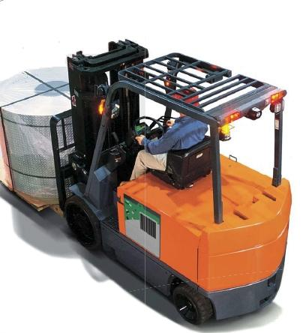
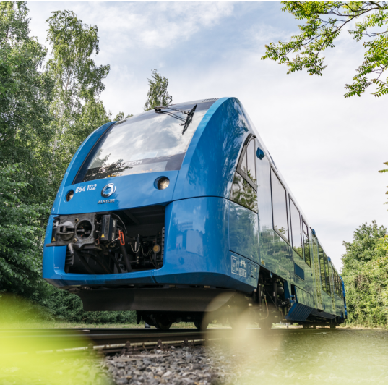
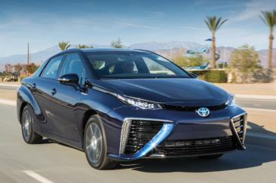
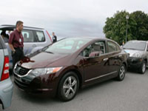
3 - Power for transportation.
Fuel cells can be used to power scooters, forklift trucks, buses, trains, boats, aircraft and cars.
New markets are emerging for industrial trucks (e.g., forklifts) and passenger cars powered by hydrogen fuel cells. Indoor and outdoor hydrogen fueling stations are being built in support of these vehicles. A fuel cell is a device that combines hydrogen with oxygen from the air in an electrochemical reaction to create electricity, which can power an electric motor and propel a vehicle. Fuel cells are twice as energy-efficient as combustion engines, and the hydrogen used to power them can come from a variety of sources, including renewable energy resources. A hydrogen fuel cell emits only heat and water, without producing any air pollutants or greenhouse gases.

Slide 7
Hydrogen fuel cells are cleaner and more efficient than traditional combustion-based engines and power plants. Hydrogen and fuel cells can also be used in mobile applications to power vehicles and mobile power packs.
Can you think of 3 main advantages or disadvantages of an immediate transition to hydrogen fuel cells?
Split into opposing groups and debate

Slide 8
Possible advantages
Reduced greenhouse gas emissions
High Reliability
Flexibility in installation and operation
Reduced demand for foreign oil
Possible disadvantages
Most of it is currently produced from fossil fuels
Limited availability
The cost
Storage issues

