Slide 1










Linde case Study for Distribution, Production and Storage
Production
Compression
Storage
Distribution
Content created by
<Partner logo>
Last updated 18th October 2019

Slide 2
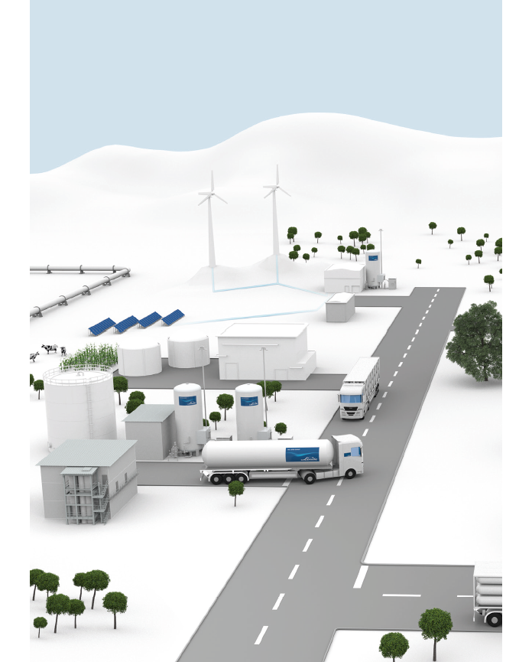
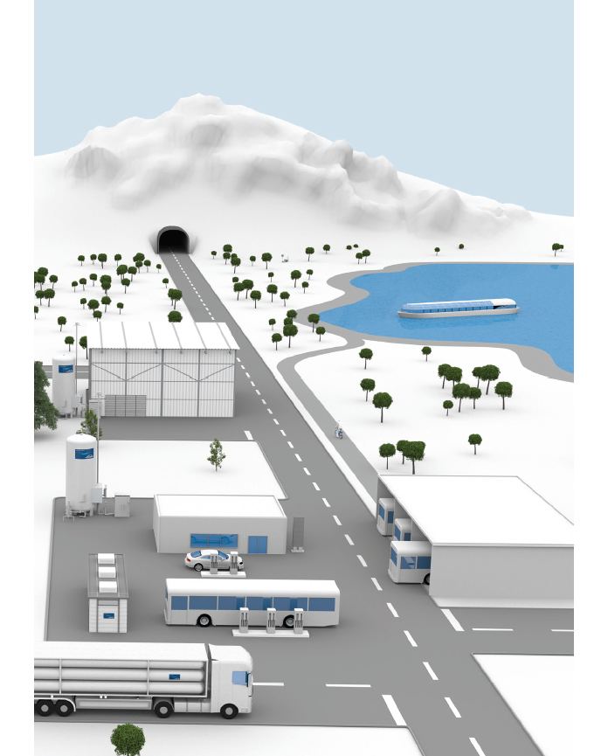
Autarkic power supply
H₂ Pipeline
H₂ ship
Electrolysis for H₂ production
H₂ material handling vehicles
Biogenic processes for H₂ production
H₂ e-bike
Storage
LH₂ Trailer
H₂ liquefaction plant
H₂ car
Steam reforming for H₂ production
Cryo-pump or ionic compressor
H₂ bus
CGH₂ trailer

Slide 3
Production, (compression,) storage and distribution
The Linde Group is a globally active industry gases and engineering company with a history of more than 135 years of success. As a storage medium for electric power, hydrogen is an ideal energy carrier within a sustainable energy cycle. With this in mind, and knowing that fossil energy sources will only become scarcer and scarcer, we have been intensely engaged in the use of hydrogen as an emission-free fuel for over 25 years.
Our cutting edge in this area is based on the development of innovative technologies, e.g. for the efficient compression and safe fuelling of hydrogen. This is what makes us an ideal partner for all who want to advance the use of hydrogen as a fuel – especially where the creation of a comprehensive H2 fuelling station infrastructure for cars and buses is concerned.
With support from Linde, hydrogen infrastructure projects can be implemented in a highly efficient, sustainable and professional manner: We are the one-stop shop for hydrogen solutions – offering everything you need, from reliable H2 supply and cutting-edge fuelling station systems to customised services. Together, we plan, design and build high-performance plants, help you with commissioning, supply gaseous (CGH2) or liquid hydrogen (LH2) or produce it on site. And thanks to expert maintenance, we also ensure the highest levels of safety and reliability.

Slide 4
LINDE BOC
They can supply customers with 100% ‘green’ hydrogen by producing hydrogen from biogenic raw materials. They also use Steam Methane Reforming but their aim is to create an emission free hydrogen energy cycle.
Thanks to long experience and proven technologies, Linde has also been leading the way in the subsequent compression, storage and distribution of hydrogen for many years. Hydrogen is stored either as compressed gaseous hydrogen (CHG2) at different pressures or as liquid hydrogen (LH2) in its cryogenic state (i.e. at -253 °C) and transported by means of correspondingly equipped trailers or via pipelines.
In addition to the development of applications, the equipment of hydrogen fuelling stations with the corresponding H2 components is one of the key areas of our company’s H2 expertise. With our developments – e.g. with the ionic compressor and the cryo pump –, we have set new bench-marks in terms of safety, efficiency and reliability, and thus not only significantly increased the technical feasibility, but also society’s general acceptance of hydrogen as a fuel for vehicles. Moreover, our portfolio includes H2-fuel-cell-based technologies for self-contained power supply – such as the fuel-cell power generator Hymera.
Production, (compression,) storage and distribution
The Linde Group is a globally active industry gases and engineering company with a history of more than 135 years of success. They know that as a storage medium for electric power, hydrogen is an ideal energy carrier within a sustainable energy cycle. With this in mind, and knowing that fossil energy sources will only become scarcer and scarcer, they have been intensely engaged in the use of hydrogen as an emission-free fuel for over 25 years.
Their cutting edge in this area is based on the development of innovative technologies, e.g. for the efficient compression and safe fuelling of hydrogen. This is what makes us an ideal partner for all who want to advance the use of hydrogen as a fuel – especially where the creation of a comprehensive H2 fuelling station infrastructure for cars and buses is concerned.
As key players in along the hydrogen chain, from production, compression, storage to distribution, hydrogen infrastructure projects can be implemented in a highly efficient, sustainable and professional manner. They are also able to plan, design and build high-performance plants, help you with commissioning, supply gaseous (CGH2) or liquid hydrogen (LH2) or produce it on site. And thanks to expert maintenance, we also ensure the highest levels of safety and reliability.

Slide 5
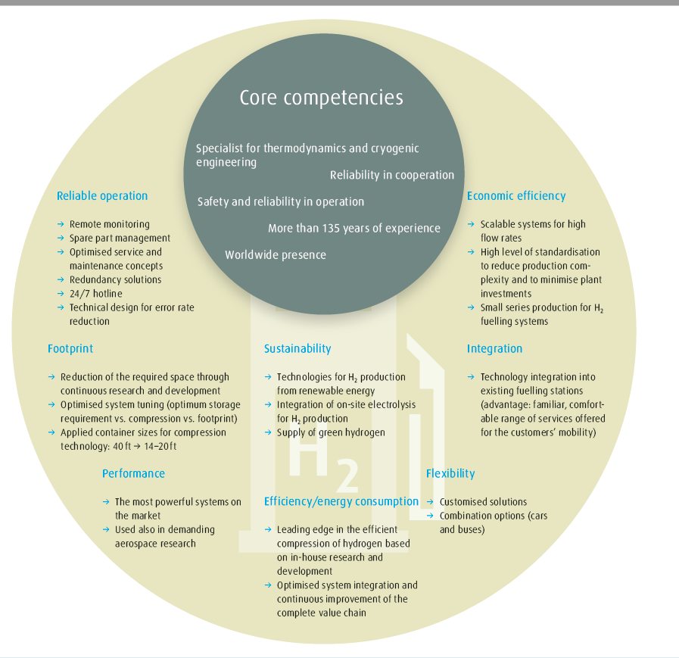

Slide 6
Decarbonisation of the planet requires action from every country.
Hydrogen Technology by Linde – All around the world
BMW manufacture, Greer (SC), USA
→ 14 H2 dispensers for hydrogen-fuelled material handling vehicles
→ Fuelling of more than 380 material handling vehicles
→ Fuelling in only 3 minutes
→ More than 3,000 m of pipeline from the compressor to the dispensers
→ 2.5 MPa (IC with additional capacity)
Energiepark Mainz, Germany
→ Power to gas
→ Production of green H2 for mobility applications by electrolysis with renewable energies
→ Storage capacity: 1,000 kg
→ Ionic compressor
Aberdeen, Scotland
→ Largest hydrogen fuelling station in the UK
→ Fuelling of Europe’s largest H2 bus fleet → More than 80 t H2/year
→ Alkaline water electrolysers, hydrogen generation based on green electricity → 35 MPa (2 x IC 90)

Slide 7
Decarbonisation of the planet requires action from every country.
Hydrogen Technology by Linde – All around the world
Ramos Oil Company,
Sacramento (CA), USA
→ Linde’s first H2 fuelling station in the US
→ 11,000-litre LH2 tank
→ Ionic compressor IC 90
→ 35/70 MPa
ATM, Milan, Italy
→ Italy’s first H2 fuelling station for buses
→ Fuelling of H2 buses in daily operation
→ H2 production with on-site electrolyser
→ 35 MPa
Arlanda Airport, Stockholm, Sweden
→ Sweden’s first public H2 fuelling station
→ Capacities for up to 180 fuellings per day
→ 70 MPa

Slide 8
Decarbonisation of the planet requires action from every country.
Hydrogen Technology by Linde – All around the world
CEP/Vattenfall, Hamburg, Germany
→ Capacities for a large fleet of up to 20
H2 buses
→ Integration of two electrolysers for on-site H2 production
→ 35/70 MPa (2 x ionic compressor)
CEP/Total, Munich, Germany
→ Public fuelling station
→ Cryo pump with a capacity of 100 kg/h
→ 70 MPa (30 MPa for cryo-compressed fuelling (CCH2))
CEP/Shell at Sachsendamm, Berlin, Germany
→ One of the world’s most powerful H2 fuelling stations with a capacity of up to 200 kg/h
→ Below-ground installation of the storage tank and the compressor system (two cryo pumps)
→ 50 % green H2 from Linde
→ 35/70 MPa

Slide 9
Decarbonisation of the planet requires action from every country.
Hydrogen Technology by Linde – All around the world
Watani, Amagasaki City, Japan
→ Japan’s first commercial H2 fuelling station
→ LH2 tank
→ Ionic compressor IC 90
→ 35/70 MPa
OMV, Vienna, Austria
→ Built in record time of less than 6 months
→ Small footprint
→ Austria’s first public H2 fuelling station
→ 70 MPa (piston compressor MF 90)
Tongji, Shanghai Anting, China
→ Shanghai’s first H2 fuelling station
→ Hydrogen supply from Linde’s SMR plant in Shanghai
→ 35 MPa for cars and buses (diaphragm compression)

Slide 10
Hydrogen Technologies
H2 cars
→ Commercial market launch of fuel-cell vehicles from leading car manufacturers
→ Usability like conventional diesel or gasoline-powered vehicles
→ No local emissions (zero emissions along the complete value chain can be achieved with green hydrogen)
→ Quick fuelling in 3 minutes
→ Long travel distances (up to 800 km, according to manufacturers’ information)
Over 80 fuelling stations worldwide are equipped with H2 technology from Linde

Slide 11
H2 buses
→ First H2 bus fleets are in daily operation worldwide
→ Usability like conventional diesel buses
→ No local emissions (zero emissions along the complete value chain can be achieved) → Long travel distances and high flexibility (shift operation without fuelling possible) → Quick fuelling in under 10 minutes
→ Reduced noise emissions
Over 10 fuelling stations worldwide are equipped with H2 technology from Linde

Slide 12
H2 material handling vehicles
→ Commercial market launch of entire fleets at production companies and distribution centres in the US (piloting in the EU)
→ No loading times as with battery operation, no battery replacements, no space required for storage of replacement batteries
→ Constant power level of the H2 material handling vehicles
→ No emissions in the storage/plant area, indoor and outdoor usability
→ H2 dispenser with very small footprint, for indoor or outdoor installation
→ Quick fuelling in under 3 minutes

Slide 13
Over 700 material handling vehicles are already being fuelled with
H2 technology from Linde
Customised special-purpose H2 solutions
→ H2 system solutions for industrial or research purposes
→ Tailor-made solutions
→ One-stop shop for plant design, engineering and project planning.

Slide 14
We offer you the optimal fuelling concept for your application.
Our innovative solutions cover the entire range of H2 fuelling technology
– from the manufacturing of dispensers for H2 material handling vehicles to complete fuelling stations for H2 bus fleets or H2 cars. Complemented by our wide range of services along the entire H2 value chain, we are the one-stop shop for all hydrogen-related products and processes.

Slide 15
Production and distribution
On-site production or flexible delivery; Linde ensures your worldwide supply with H2 – according to your preferences
→ Over 200 production centres and a tight hydrogen distribution network
→ Efficient distribution: Liquid or high-pressure hydrogen (up to 50 MPa) and a network of several hundred km of pipelines
→ On-site electrolysis/steam reforming for independent production

Slide 16
Storage at the fuelling station
Appropriate, space-saving on-site storage options
→ Gaseous:
• 45-MPa upright tank (small footprint)
• 20-MPa tubes (below-ground tank installation possible)
• Storage tank sizes from 200–350 kg
→ Liquid at -253 °C:
• Storage tank sizes from 400–5,000 kg

Slide 17
Compression
The cryo pump and ionic compressor technologies are the core of the fuelling system
→ Design of the optimal technology concept according to your requirements
→ Powerful and energy saving
(10–120 kg/h possible)
→ H2 compression up to 90 MPa

Slide 18
Cutting-edge compression technology. The core of the hydrogen fuelling station.
The compressor unit is the key component of a hydrogen fuelling station because the fuelling is carried out using compressed gaseous H2 at pressures from 35 to 70 MPa. Apart from the initial state – gaseous or liquid – the technology used for fuelling also depends on a range of other factors, as for example the throughput and the type of vehicle to be fuelled.
With the ionic compressor and the cryo pump, Linde has two cutting-edge, self-developed and patented technologies in its portfolio which impress with their outstanding reliability, their low amount of maintenance and their high energy efficiency. Both systems can be optimally tailored to meet your individual requirements. Furthermore, we have advanced our fuelling technology to a point where we are now the first company world-wide that can produce small series of H2 fuelling technologies.
ionic compressor
cryo pump

Slide 19
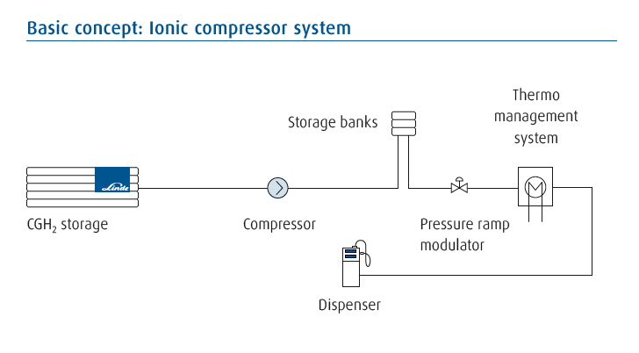
The ionic compressor. In five steps, the ionic compressor compresses gaseous hydrogen up to 90 MPa. On its piston is the eponymous ionic liquid which, however, does not bond with the gas. This liquid acts both as a lubricant and coolant and thus significantly reduces wear, because the ionic compressor has a lot less moving parts than a classic piston compressor. On top of that, it increases the compressor’s energy efficiency due to better cooling and the avoidance of dead spots during the compression process.
Because the ionic compressor helps to avoid the use of lubricants, there is also no contamination of the hydrogen’s level of purity, which is required, for example, for fuel-cell applications. – diagram

Slide 20
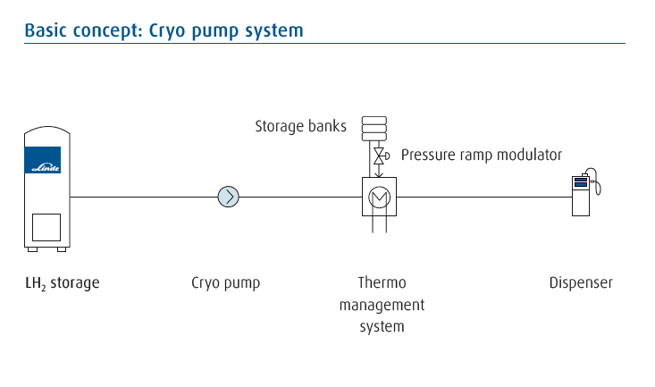
The cryo pump – image
The cryo pump operates with liquid hydrogen (LH2) at -253 °C. At this temperature, however, hydrogen cannot simply be suctioned in, which is why the pump uses a two-chamber system which is completely immersed in the cryogenic liquid. In the first chamber, LH2 from the storage tank is compressed to 0.6 MPa. The compression to 90 MPa takes place in the second chamber. Subsequently, the temperature of the cryogenic gas is increased up to the fuelling temperature of -40 °C. During all of these pro-cess steps, the high purity level of the hydrogen remains unchanged.
In addition to its small footprint and very high capacity, the cryo pump system also minimises the energy consumption of the H2 fuelling station. Due to the application of cryogenic LH2, only 10–20 % of a gas compressor’s energy are needed for compression and the cooling system within the thermo management is omitted. Furthermore, the low amount of maintenance ensures additional cost savings. – diagram

Slide 21
→ Fuelling for your H2 application Over 1,000,000 fuellings at stations with Linde technologies
→ Gaseous fuelling for applications with 35-MPa or 70-MPa high-pressure tanks (cars: 70 MPa, buses and material handling vehicles: 35 MPa)
→ Dispensers with familiar “touch and feel”
→ Quick car fuelling in 3 minutes

Slide 22
H2 initiatives
Creating a sustainable hydrogen infrastructure is essential for the commercial use of this emission-free fuel. Within various initiatives, Linde, in cooperation with other companies and government organisations, is one of the main driving forces behind the advancement of the H2 infrastructure. The common objective is to ensure that the vision of comprehensive hydrogen mobility is accomplished. Thanks to over 135 years of experience in the world of gases, including numerous patents and engineering solutions for the application of hydrogen, our company is optimally positioned to achieve this goal. On top of that, Linde is also involved in the development of industry standards for hydrogen technology such as, for example, SAE J 2601.
CaFCP – California Fuel Cell Partnership
The objective of the CaFCP, a consortium of vehicle manufacturers, electric energy providers, technology companies and government agencies, is the close coordination between the roll-out of fuel-cell vehicles, the build-up of an H2 fuelling station infrastructure as well as government regulations in the State of California – the leading American state for sustainable mobility: www.fuelcellpartnership.org
CEP – Clean Energy Partnership
The CEP initiative has taken up the task of testing the suitability of H2 as a fuel for daily use in Germany. Since 2002, the CEP partners have been working on the roll-out of H2 vehicles in Germany:
www.cleanenergypartnership.de
H2 Mobility
The companies Air Liquide, Daimler, Linde, OMV, Shell and Total have joined hands to form the “H2 Mobility” initiative. Their plan: 400 H2 fuel-ling stations in Germany until 2023: www.h2-mobility.de
Our experience for your project
With Linde at your side, you choose a partner who has been consistently committed to the application of hydrogen as an energy carrier for over 25 years. Our expertise covers the entire H2 value chain, from the production of the gas to tailored services, making us an optimally positioned solution provider for all customers who want to implement an H2 project or who have already taken first steps in that direction. Based on our own research and development as well as numerous cutting-edge H2 technologies, we can always offer you an optimal solution – even for special subdomains of your project.
We’re ready. Now it’s up to you: Let’s do H2.

