Slide 1









Distribution
Extra Information For Teachers
Content created by
<Partner logo>
Last updated 18th October 2019

Slide 2
What is the matter?
Depending on the application, the constraints on the hydrogen handling are disparate:
→ How to transport and deliver for such different applications?
 | Distribution rate (kg/h) | Comment
Automotive | 60 | Mobile application → constraints on weight and volume
Electrolyser 10 MW | 300 | Largest electrolysers available in 2019
Electrolyser 100 MW | 3.000 | In 2019, only on paper
Refineries | 30.000 | Presently produced by hydrocarbons reforming in large chemical plants

Slide 3
Physical properties of hydrogen
At STP, compared with other fuels, hydrogen has a high energy density per weight but low energy density per volume
→ How to deal with such low energy density per volume?
 | energy density per weight (kWh/kg) | energy density per volume (kWh/m3)
Hydrogen (H₂) @STP | 33.3 | 2.99
Methane (CH₄) @STP | 15.4 | 10.5
Gasohol E85 | 9.19 | 7125

Slide 4
Hydrogen transportation and delivery
Presently hydrogen is mostly produced by hydrocarbon reforming in large chemical plants
Due to this concentrated process, the hydrogen is either:
  Consumed on site (55 Mt/y for an overall consumption of 60 Mt)
  Transported by pipeline
  Transported by road (in gas or liquid form)

Slide 5
Hydrogen pipelines
“ Transporting gaseous hydrogen via existing pipelines is a low-cost option for delivering large volumes of hydrogen. The high initial capital costs of new pipeline construction constitute a major barrier to expanding hydrogen pipeline delivery infrastructure. Research today therefore focuses on overcoming technical concerns related to pipeline transmission, including:
The potential for hydrogen to embrittle the steel and welds used to fabricate the pipelines
The need to control hydrogen permeation and leaks
The need for lower cost, more reliable, and more durable hydrogen compression technology.
Potential solutions include using fibre reinforced polymer (FRP) pipelines for hydrogen distribution. The installation costs for FRP pipelines are about 20% less than that of steel pipelines because the FRP can be obtained in sections that are much longer than steel, minimizing welding requirements.”
Source: US Dept. of Energy - https://www.energy.gov/eere/fuelcells/hydrogen-pipelines
“Larger volumes” : >10.000 m³/h under 100 bar (typically 40 or 70 bar)

Slide 6
Hydrogen pipelines
Example of hydrogen network owned and operated by Air Liquide
240 km, annual capacity of 250 Millions of Nm³
3000 km of hydrogen pipelines exist in Europe, North America, China, Japan and Singapore
Source : IMPACT OF HIGH CAPACITY CGH2-TRAILERS, Project DeliverHy

Slide 7
Hydrogen transport by road
“Truck fleets are currently used by industrial gas companies to transport seamless steel vessels of
compressed gaseous hydrogen for short distances (200-300 km) and small users (1 to 50 m3/h) from
centralized production. Single cylinder bottles, multi-cylinder bundles or long cylindrical tubes are
installed on trailers (Figure 5).”
Source : IMPACT OF HIGH CAPACITY CGH2-TRAILERS, Project DeliverHy

Slide 8
Hydrogen transport by road
“Storage pressures range from 200 to 300 bar and a trailer can carry from 2000 to 6200 Nm3 of H₂ for trucks subject to a weight limitation of 40 tons. The amount of hydrogen carried out is thus relatively small (from 180 to 540 kg, depending on the number of tubes or bundles), which represents ~ 1 to 2 % of the total mass of the truck.
Current trailers utilize Type I storage cylinders (all-metal).”
Source : IMPACT OF HIGH CAPACITY CGH2-TRAILERS, Project DeliverHy
180 to 540 kg H2 → 5.9 to 17.8 MWh

Slide 9
Hydrogen transport by road
“In North America, a large part of the hydrogen produced is delivered in liquefied form to customers. This is justified by large distances between sources and customers (300 – 500 km depending on consumption and local customer density), and the fact that large liquefaction units built in the 70’s for the need of spatial projects of the NASA programs are now fully depreciated.
In Europe, four liquefiers are in operation in Germany, the Netherlands and France for a capacity between 5 and 10 tons per day and per unit”
Source : IMPACT OF HIGH CAPACITY CGH2-TRAILERS, Project DeliverHy

Slide 10
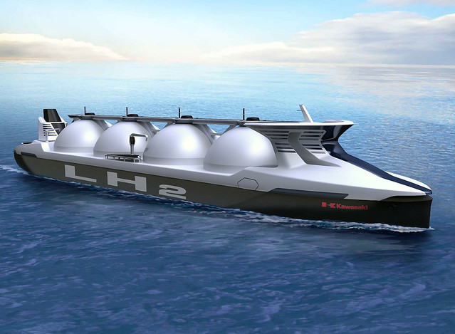
Hydrogen tankers
Based on LNG carrier technology, hydrogen tankers could transport large amount of hydrogen across the sea in the coming years.
https://www.flickr.com/photos/141766965@N06/27092075444/in/album-72157667139345124/

Slide 11
Hydrogen tankers
“The cargo containment system […] can accumulate boil-off gas for up to 21 days at sea. As the temperature of liquefied hydrogen is even lower – minus 253°C – than that of LNG and it is easier to vaporise, we adopted vacuum insulation to minimise heat transfer into the cargo.
The carrier is about 116m long and can accommodate two cargo containment systems of 1,250m³. Hydrogen is not to be used for propulsion. The main propulsion system features electric motors. These receive power from generators driven by diesel engines.”
Source : https://www.lngworldshipping.com/news/view,kawasaki-ship-designs-support-japans-hydrogensociety-plans_46421.htm
1.250 m³ of liquid hydrogen at 70,85 kg/m³ → 88.6 t H2 → 2.9 GWh

Slide 12
What’s next?
All these technologies fit the present usages of hydrogen:
  Production centralised in large plants
  Huge consumption in refineries and in chemical industries
  Less than 10% is transported
  → Highly centralised
Hydrogen-energy for the energy transition
  Hydrogen will be produced more and more from renewable energies (mainly electricity but also heat, biomass, light…) by smaller equipment
  “Emerging” usages like mobility/transport require the distribution of hydrogen all around territories in refuelling stations
  → Highly de-centralised or a-centralised

Slide 13
Refuelling Stations
Presently in passenger cars the hydrogen is stored in gas form at 350 or 700 bar in tanks.
Filling the tank requires:
  Producing the hydrogen
  Filtering and drying it
  Storing it in a buffer at “low” pressure
  Compressing and cooling it down
  Why cool it?
 | energy density per weight (kWh/kg) | energy density per volume (kWh/m3)
H₂ @ STP | 33.3 | 2.99
H2 @ 350 bar | 33.3 | 750
H2 @ 700 bar | 33.3 | 1300

Slide 14
Refuelling Stations
Why cool the hydrogen?
“ When gas is compressed, it heats up. When it relaxes, it cools down. The result of which is that the gas in the vehicle tank is significantly warmer than when it was delivered from the filling station. Without active measures, these temperatures would be above 100°C when fuelling in the desired time of a few minutes.
The current maximum permitted tank temperature is 85°C. The result of which is that active measures must be taken to prevent exceeding the permissible temperature. This is done by actively pre-cooling the gas down to -40 °C. “
Source: SAE J2601 – The Worldwide Standard for Hydrogen Fuelling Stations, David Wenger

Slide 15
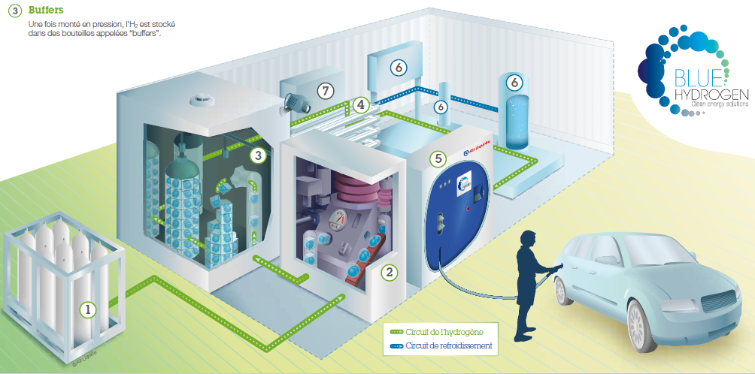
Refuelling Stations
How does it work?
Hydrogen filling station
Sources: Air Liquide
1. Hydrogen source
H₂ is stored in gas cylinders at 200 bars
2. Compression phase
H₂ is compressed at 350 or 700 bars
3. Buffers
Storage of H₂ at high pressure
4. Heat exchanger
H₂ is cooled to -40°C before delivery
5. Dispenser
H₂ is transferred to the vehicle tank
6. Cooling equipment
Supplies the heat exchanger with coolant
7. General management unit

Slide 16
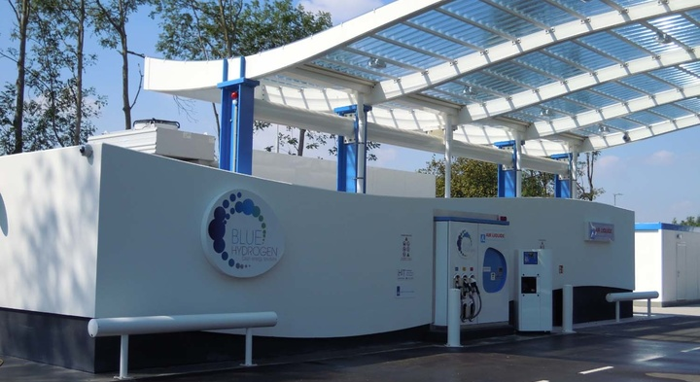
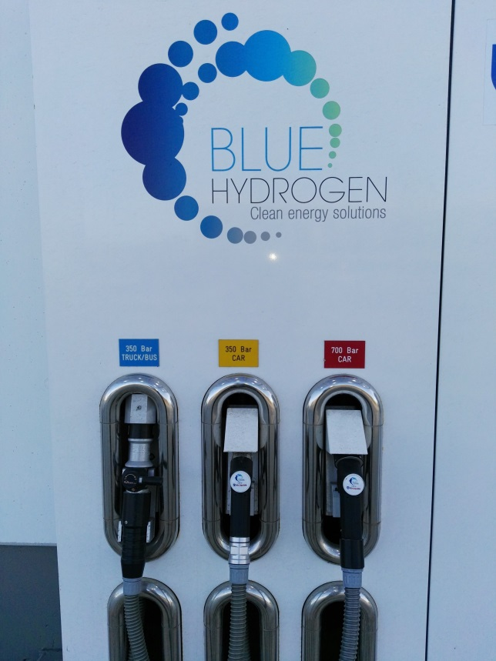
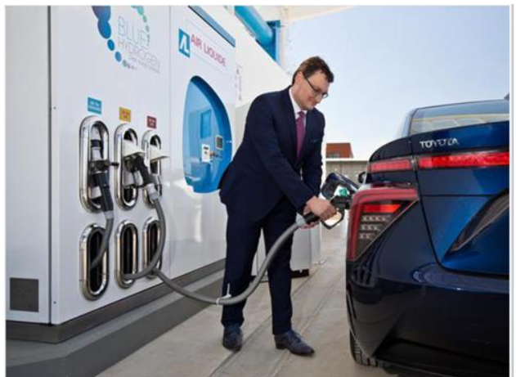
Refuelling Stations
Site of Toyota, Zaventem, Belgium
Filling station with 3 pistol grips:
trucks/buses 350 bars ; cars 350 and 700 bars
Source: https://fr.toyota.be/world-of-toyota/articles-news-events/2016/station-hydrogene.json

Slide 17
Refuelling Stations
On Youtube :
  Toyota Mirai: Hydrogen Refueling Explained https://www.youtube.com/watch?v=-vgIIs0CGqw
  ITM Power Hydrogen Refuelling Guide https://www.youtube.com/watch?v=HjqRifqUav0
  WEH hydrogen fuelling components https://www.youtube.com/watch?time_continue=40&v=dWZCJntPYUk

