Slide 1
Distribution
Student Task
Give a set of 9 labels to each pair/group of students
Content created by
<Partner logo>
Last updated 18th October 2019

Slide 2
Source of hydrogen
Boosters
Buffers
Exchanger
Dispenser
Air compressor
Buffer tank
Refrigeration
General control cabinet
Print and cut out these labels

Slide 3
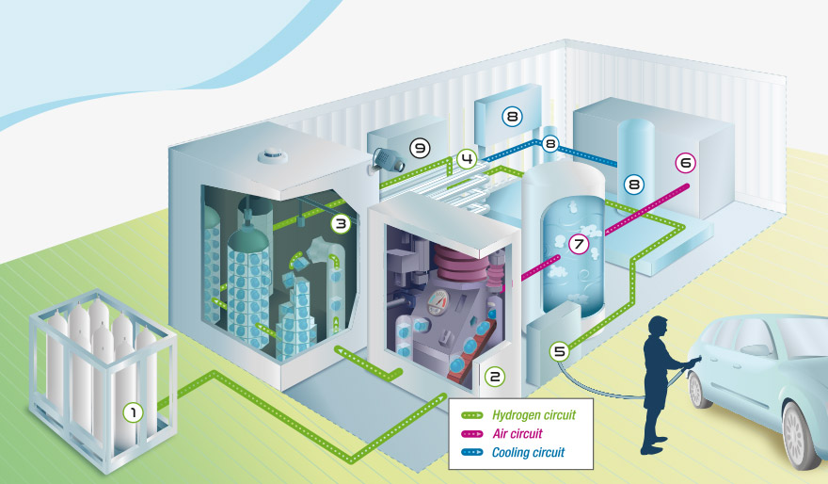
Below is a hydrogen refuelling station similar to one you have seen. Try to match the labels with their description.*
* One description has two labels as it is the same process but in a different area.

Slide 4
Copy this down and match your description label.
H₂ is compressed using boosters.

Slide 5
Copy this down and match your description label.
Before it is distributed, H₂ is cooled using the exchanger and the refrigeration unit.

Slide 6
Copy this down and match your description label.
The station’s electrical control cabinet.

Slide 7
Copy this down and match your description label.
It regulates and supplies the air needed to make the boosters function.

Slide 8
Copy this down and match your description label.
H₂ is compressed using boosters.

Slide 9
Copy this down and match your description label.
Low pressure hydrogen H₂, is stored in bottles (cylinder racks), tanks or tube trailers.

Slide 10
Copy this down and match your description label.
It enables distribution of H₂ to the vehicles tank, filling it in a few minutes.

Slide 11
Copy this down and match your description label.
Once the pressure has been increased (700 bars), H₂ is stored in bottles known as buffers.

Slide 12
Copy this down and match your description label.
Unit supplies cooling fluid to the exchanger and is made up of a buffer tank that stores and regulates the flow of the liquid, the pumps and the electrical control cabinet.

Slide 13
Take one minute to check your ideas…

Slide 14
Answers
1 – Low pressure hydrogen H₂, is stored in bottles (cylinder racks), tanks or tube trailers.
1 – Source of hydrogen
2 – Boosters
3 – Buffers
4 – Exchanger
5 – Dispenser
6 – Air compressor
7 – Buffer tank
8 – Refrigeration
9 – General control cabinet

Slide 15
Answers
1 – Low pressure hydrogen H₂, is stored in bottles (cylinder racks), tanks or tube trailers.
2 – H₂ is compressed using boosters.
1 – Source of hydrogen
2 – Boosters
3 – Buffers
4 – Exchanger
5 – Dispenser
6 – Air compressor
7 – Buffer tank
8 – Refrigeration
9 – General control cabinet

Slide 16
Answers
1 – Low pressure hydrogen H₂, is stored in bottles (cylinder racks), tanks or tube trailers.
2 – H₂ is compressed using boosters.
3 – Once the pressure has been increased (700 bars), H₂ is stored in bottles known as buffers.
1 – Source of hydrogen
2 – Boosters
3 – Buffers
4 – Exchanger
5 – Dispenser
6 – Air compressor
7 – Buffer tank
8 – Refrigeration
9 – General control cabinet

Slide 17
Answers
1 – Low pressure hydrogen H₂, is stored in bottles (cylinder racks), tanks or tube trailers.
2 – H₂ is compressed using boosters.
3 – Once the pressure has been increased (700 bars), H₂ is stored in bottles known as buffers.
4 – Before it is distributed, H₂ is cooled using the exchanger and the refrigeration unit.
1 – Source of hydrogen
2 – Boosters
3 – Buffers
4 – Exchanger
5 – Dispenser
6 – Air compressor
7 – Buffer tank
8 – Refrigeration
9 – General control cabinet

Slide 18
Answers
1 – Low pressure hydrogen H₂, is stored in bottles (cylinder racks), tanks or tube trailers.
2 – H₂ is compressed using boosters.
3 – Once the pressure has been increased (700 bars), H₂ is stored in bottles known as buffers.
4 – Before it is distributed, H₂ is cooled using the exchanger and the refrigeration unit.
5 – It enables distribution of H₂ to the vehicles tank, filling it in a few minutes.
1 – Source of hydrogen
2 – Boosters
3 – Buffers
4 – Exchanger
5 – Dispenser
6 – Air compressor
7 – Buffer tank
8 – Refrigeration
9 – General control cabinet

Slide 19
Answers
1 – Low pressure hydrogen H₂, is stored in bottles (cylinder racks), tanks or tube trailers.
2 – H₂ is compressed using boosters.
3 – Once the pressure has been increased (700 bars), H₂ is stored in bottles known as buffers.
4 – Before it is distributed, H₂ is cooled using the exchanger and the refrigeration unit.
5 – It enables distribution of H₂ to the vehicles tank, filling it in a few minutes.
6 – H₂ is compressed using boosters
1 – Source of hydrogen
2 – Boosters
3 – Buffers
4 – Exchanger
5 – Dispenser
6 – Air compressor
7 – Buffer tank
8 – Refrigeration
9 – General control cabinet

Slide 20
Answers
1 – Low pressure hydrogen H₂, is stored in bottles (cylinder racks), tanks or tube trailers.
2 – H₂ is compressed using boosters.
3 – Once the pressure has been increased (700 bars), H₂ is stored in bottles known as buffers.
4 – Before it is distributed, H₂ is cooled using the exchanger and the refrigeration unit.
5 – It enables distribution of H₂ to the vehicles tank, filling it in a few minutes.
6 – H₂ is compressed using boosters
7 – It regulates and supplies the air needed to make the boosters function.
1 – Source of hydrogen
2 – Boosters
3 – Buffers
4 – Exchanger
5 – Dispenser
6 – Air compressor
7 – Buffer tank
8 – Refrigeration
9 – General control cabinet

Slide 21
Answers
1 – Low pressure hydrogen H₂, is stored in bottles (cylinder racks), tanks or tube trailers.
2 – H₂ is compressed using boosters.
3 – Once the pressure has been increased (700 bars), H₂ is stored in bottles known as buffers.
4 – Before it is distributed, H₂ is cooled using the exchanger and the refrigeration unit.
5 – It enables distribution of H₂ to the vehicles tank, filling it in a few minutes.
6 – H₂ is compressed using boosters
7 – It regulates and supplies the air needed to make the boosters function.
8 – Unit supplies cooling fluid to the exchanger and is made up of a buffer tank that stores and regulates the flow of the liquid, the pumps and the electrical control cabinet.
1 – Source of hydrogen
2 – Boosters
3 – Buffers
4 – Exchanger
5 – Dispenser
6 – Air compressor
7 – Buffer tank
8 – Refrigeration
9 – General control cabinet

Slide 22
Answers
1 – Low pressure hydrogen H₂, is stored in bottles (cylinder racks), tanks or tube trailers.
2 – H₂ is compressed using boosters.
3 – Once the pressure has been increased (700 bars), H₂ is stored in bottles known as buffers.
4 – Before it is distributed, H₂ is cooled using the exchanger and the refrigeration unit.
5 – It enables distribution of H₂ to the vehicles tank, filling it in a few minutes.
6 – H₂ is compressed using boosters
7 – It regulates and supplies the air needed to make the boosters function.
8 – Unit supplies cooling fluid to the exchanger and is made up of a buffer tank that stores and regulates the flow of the liquid, the pumps and the electrical control cabinet.
9 – The station’s electrical control cabinet.
1 – Source of hydrogen
2 – Boosters
3 – Buffers
4 – Exchanger
5 – Dispenser
6 – Air compressor
7 – Buffer tank
8 – Refrigeration
9 – General control cabinet

