Slide 1
Distribution
Student Powerpoint
Getting it from where it’s made to where it’s needed and the case for distributed power.
Content created by
<Partner logo>
Last updated 18th October 2019

Slide 2
Case Study – Cadent’s HyNet Project
HyNet North West is a significant clean growth opportunity for the UK.
It is a low cost, deliverable project which meets the major challenges of reducing carbon emissions from industry, domestic heat and transport.
HyNet is based on the production of hydrogen from natural gas. It includes the development of a new hydrogen pipeline; and the creation of the UK’s first CCUS infrastructure. CCUS is a vital technology to achieve the widespread emissions savings needed to meet the 2050 carbon reduction targets.
Accelerating the development and deployment of hydrogen technologies and CCUS through HyNet, positions the UK strongly for skills export in a global, low carbon economy.
The North West of England is ideally placed to lead HyNet. The region has a history of bold innovation, and today, clean energy initiatives are thriving. On a practical level, the concentration of industry, existing technical skill base and unique geology means the region offers an unparalleled opportunity for a project of this kind.
The new infrastructure built by HyNet is readily extendable beyond the initial project, and provides a replicable model for similar programmes across the UK.

Slide 3
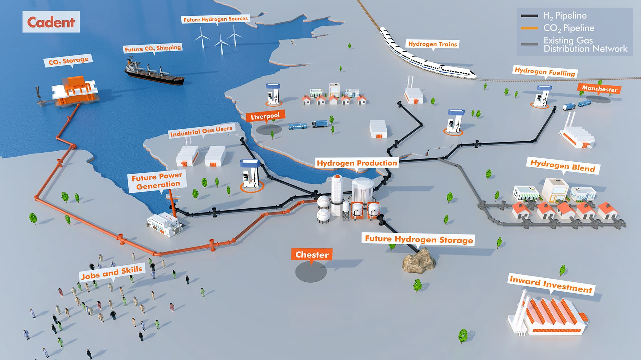
HyNet is based on the production of hydrogen from natural gas. It includes the development of a new hydrogen pipeline; and the creation of the UK’s first CCUS infrastructure.
Click on the stars for more information!

Slide 4
As hydrogen infrastructure is developed, there will be more hydrogen filling stations leading to more people using hydrogen fuel cell vehicles. These will differ from current refuelling stations as different safety standards must be met. The remaining slides show the differences.
Private filling station, no H₂ production onsite
A filling station is basically composed of two elements: a storage of hydrogen gas and a dispenser.
The storage of hydrogen gas is generally using classical steel pressure gas cylinders associated in a rack. All the cylinders are connected to each other so that there is only one delivery pipe for each rack.
The rack of gas cylinders is connected to a dispenser.
The dispenser is made of pipes, one being connected to a pistol grip nozzle.
There are two main functions fulfilled by the dispenser:
Connect/close the pressure to the delivery pistol grip nozzle
Release pressure and degassing pipes after the filling operation

Slide 5
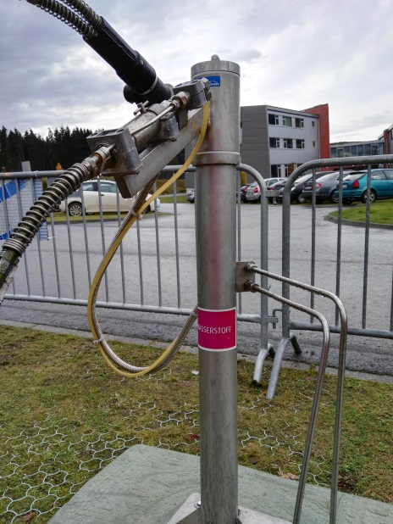
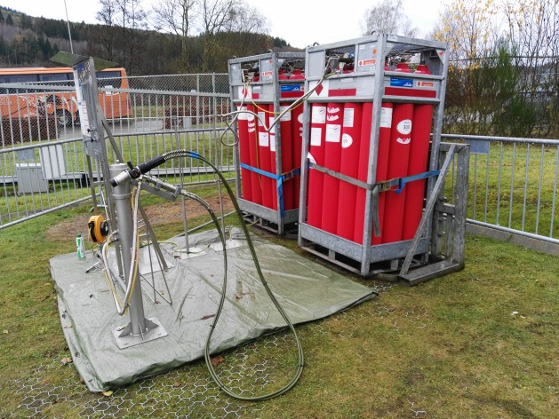
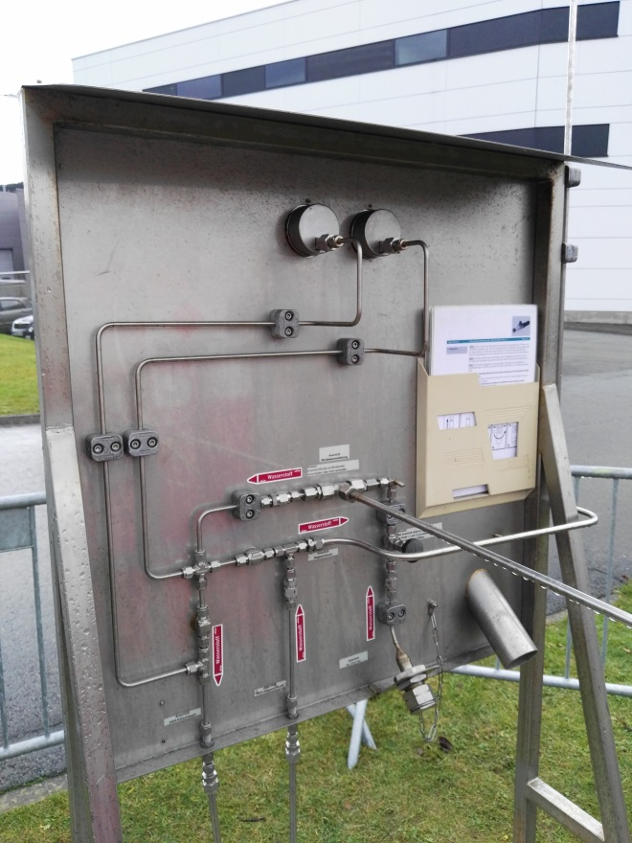
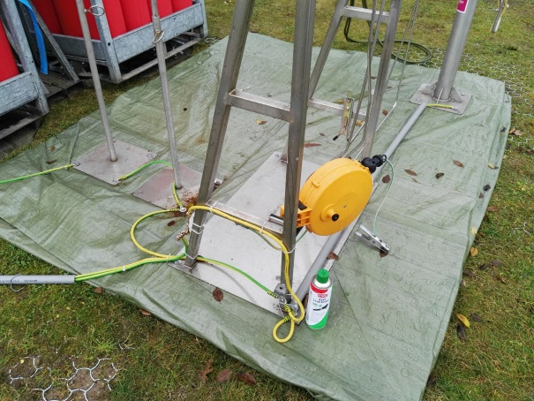
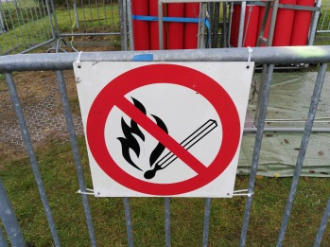
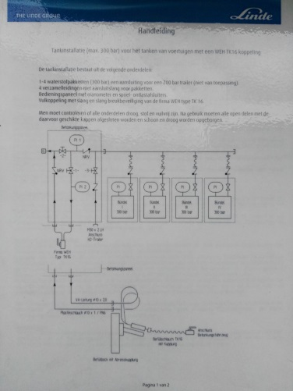
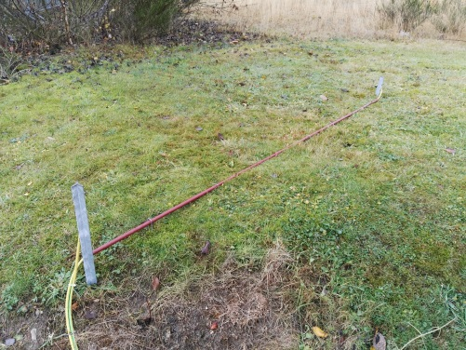
Hydrogen filling stations : simple station technology

Slide 6
Private filling station, with H₂ production onsite
A filling station is basically composed of two elements: a storage of hydrogen gas and a dispenser.
Renewable hydrogen is produced with an electrolyser supplied with green energy coming from solar panels and from wind turbines
We can find containers which host:
An electrolyser
Filter, dryer
A compressor
A storage zone
Source: Knowhy

Slide 7
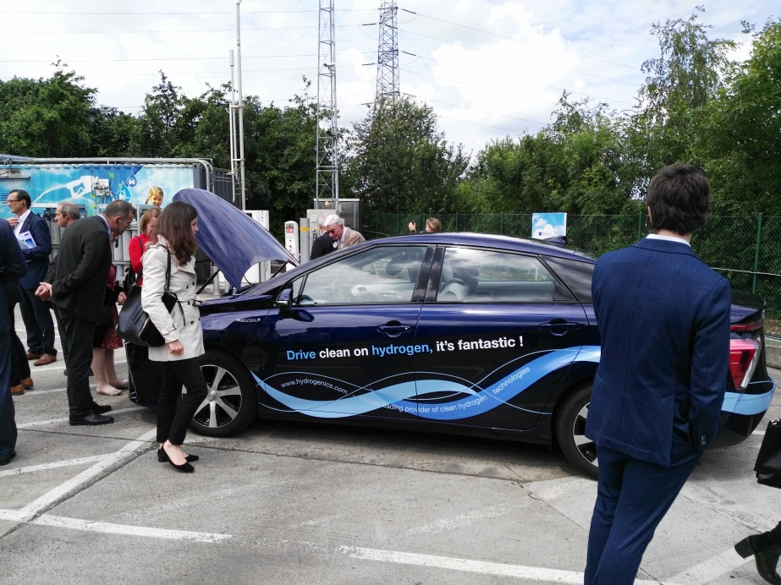
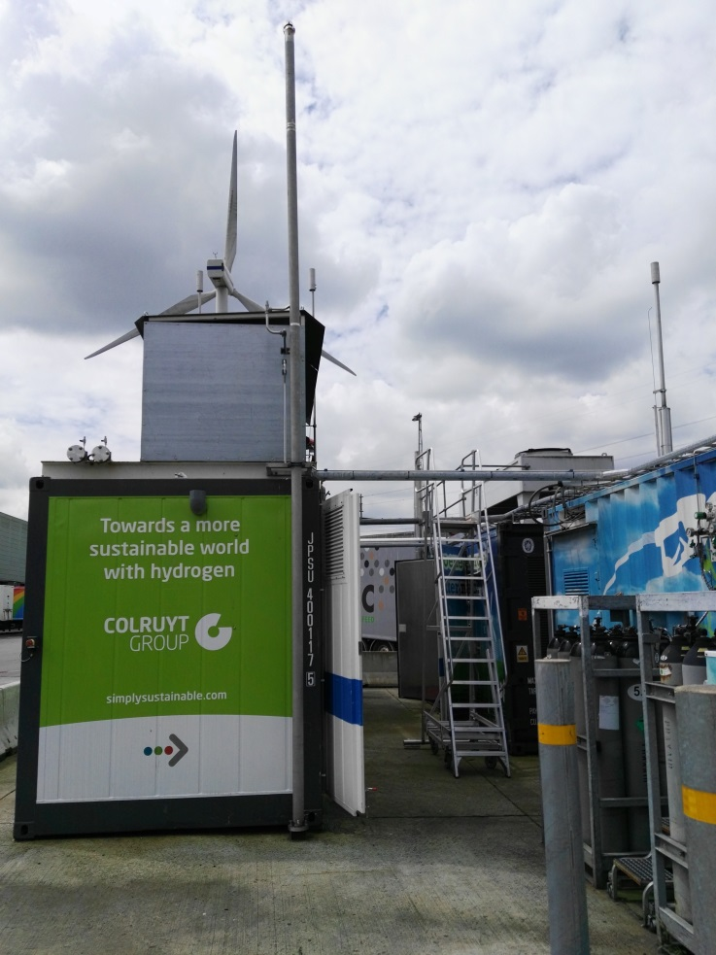
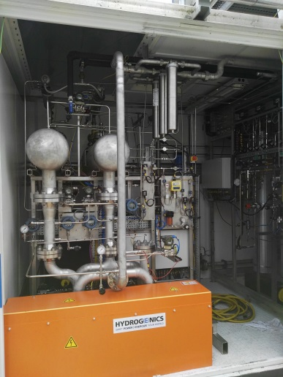
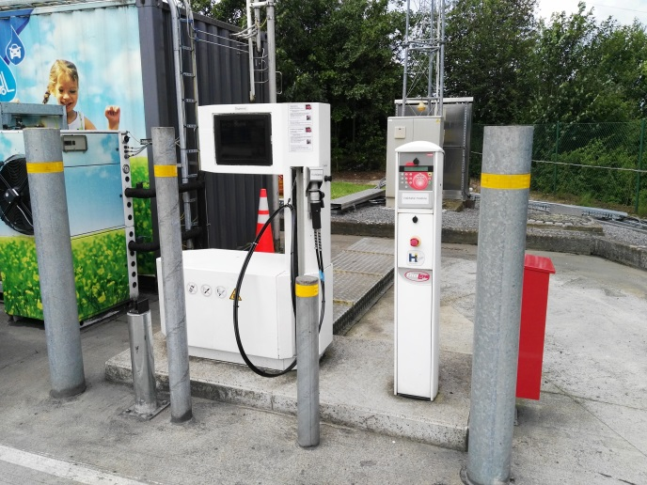
Hydrogen filling stations
Site of Colruyt in Halle, Belgium
EU Project Don Quichotte

Slide 8
Hydrogen filling stations
Public filling station, with or without on-site H₂ production
A public filling station may be associated to hydrogen production but both must be physically separated. No public access to the production site.
A public filling station limits the use to owners of RFID access cards.
A public filling station must satisfy all safety criteria and meet higher ISO standards.
Hydrogen is compressed and stored in large buffers at 350 or 700 bars.
Hydrogen is cooled at -40°C before the delivery to mitigate the negative Joule-Thompson coefficient. Hydrogen will increase its temperature during expansion which is not typical!
A communication between the vehicle and the station must occur during the filling process. The filling process will be stopped if the temperature in the vehicle gas cylinder reaches 85°C. Infrared communication is often used for this purpose.
Source: Knowhy

Slide 9
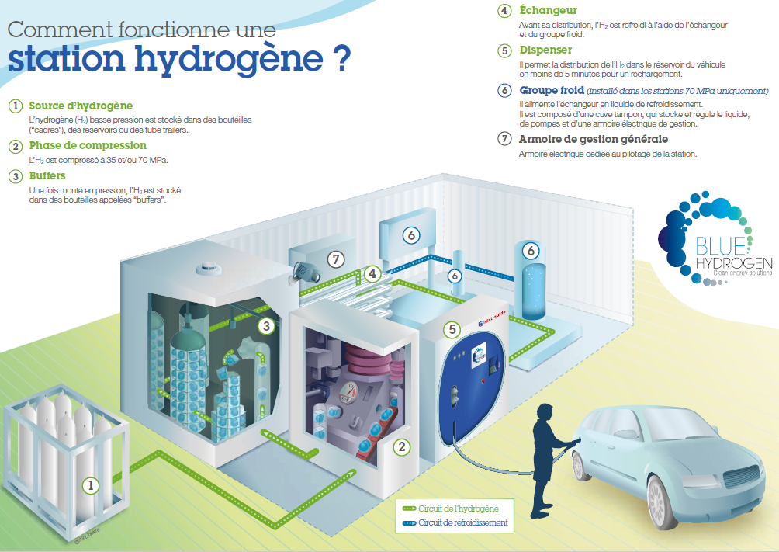
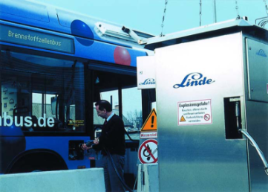
Filling station that meets ISO standards
How does it work?
Hydrogen filling station
4. Heat exchanger
H2 is cooled at -40°C before delivery
5. Dispenser
H2 is transferred to the vehicle tank
6. Cooling equipment
Supplies the heat exchanger with coolant
7. General management unit
1. Hydrogen source
H2 is stored in gas cylinders at 200 bars
2. Compression phase
H2 is compressed at 350 or 700 bars
3. Buffers
Storage of H2 at high pressure
Sources: Linde, Air Liquide, WEH

Slide 10
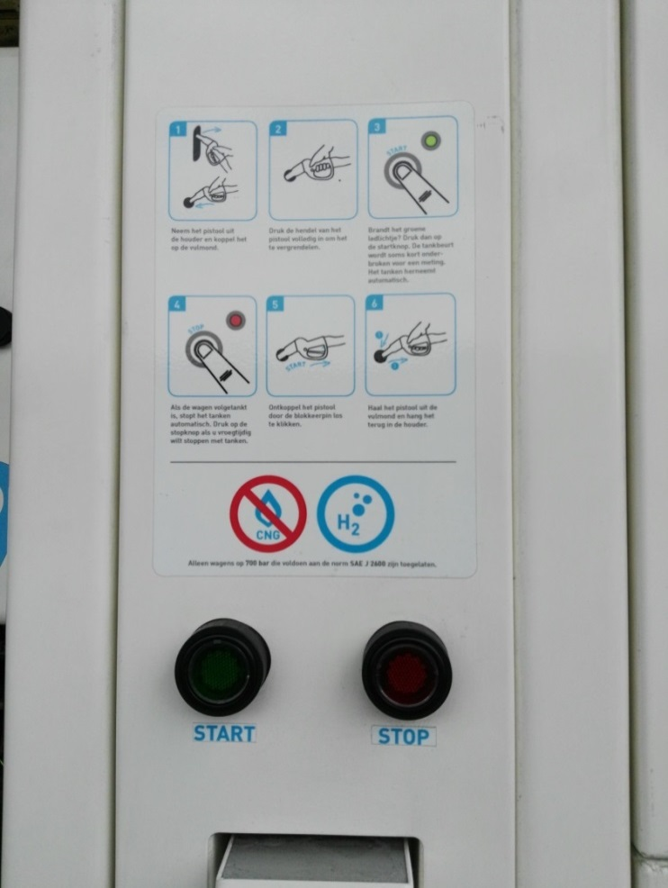
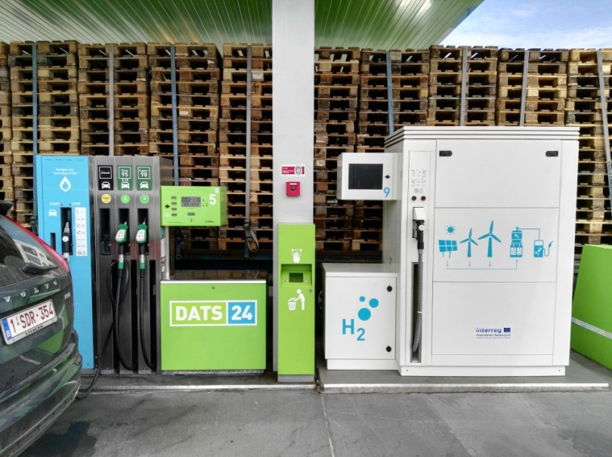
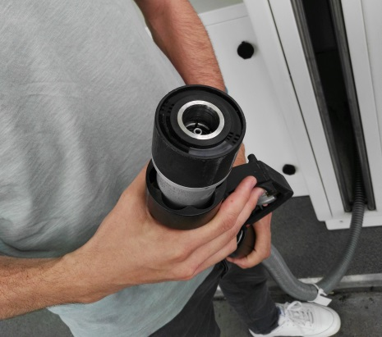
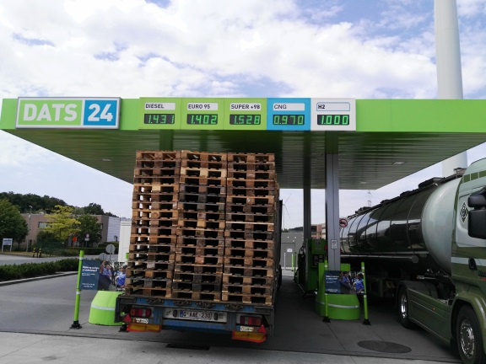
Filling station that meets ISO standards
Site of Colruyt in Halle, Belgium
Public dispenser
Friendly user’s guide of the dispenser, as easy as other gas delivery systems
IR communication on the pistol grip

Slide 11
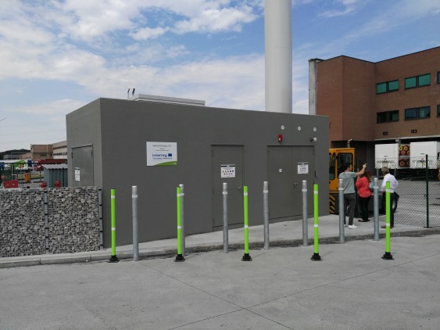
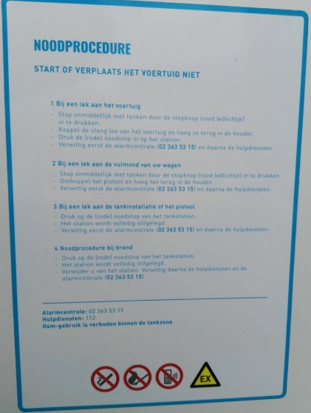
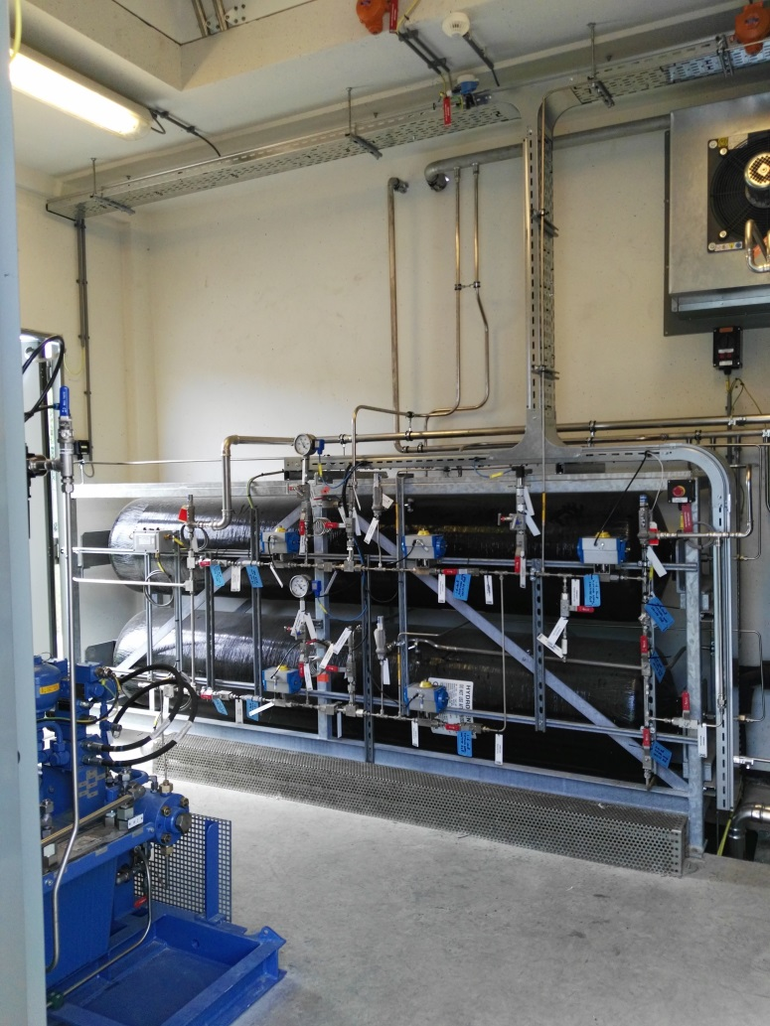
Filling station that meets ISO standards
Site of Colruyt in Halle, Belgium
Technical building near the dispenser
What to do in case of emergency, written in the local language.
Safety pictograms
Big buffers at 700 bars in the technical building of the station, ready to deliver

Slide 12
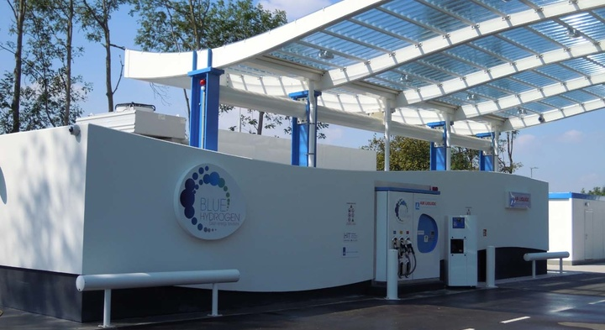
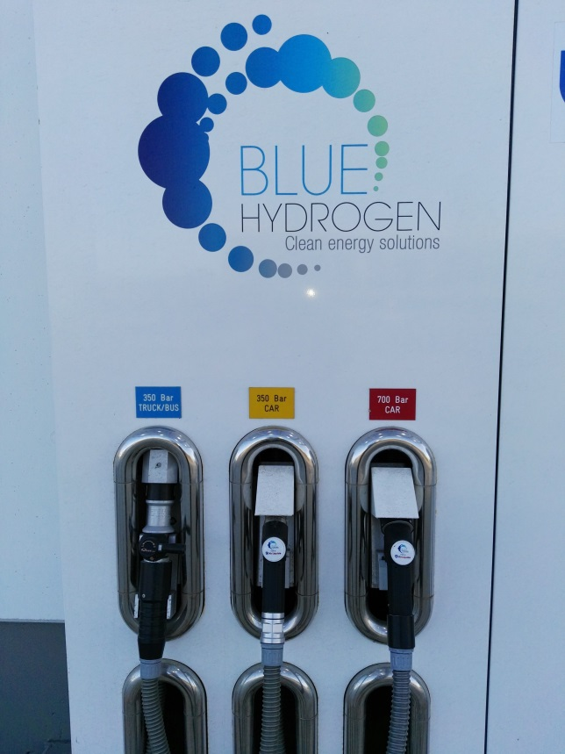
Filling station that meets ISO standards
Site of Toyota, Zaventem, Belgium
Filling station with 3 pistol grips:
trucks/bus 350 bars ; cars 350 and 700 bars
Source: https://fr.toyota.be/world-of-toyota/articles-news-events/2016/station-hydrogene.json

Slide 13
CO₂ Storage
Reduced cost CCUS infrastructure opportunity through the reuse of the Liverpool oil and gas fields. Estimated CO₂ storage capacity of 130 million tonnes. Greater CO₂ storage also available in the wider area.
Back to map

Slide 14
Future CO₂ Shipping
Shipping could offer a flexible solution to enable larger amounts of CO₂ to be transported from other industrial clusters, for example, South Wales.
Back to map

Slide 15
Future Hydrogen Sources
Renewable energy sources in the region offer potential for future hydrogen production to move towards 100% renewable energy. The potential for connection to hydrogen infrastructure could also encourage investment in regional renewable energy projects (e.g. wind, solar, tidal and biomass). This could help absorb excess off-peak renewable energy generation.
Back to map

Slide 16
Hydrogen Trains
Separate projects in the North West are exploring the possibility of running hydrogen trains in the future. Building accessible hydrogen infrastructure through HyNet could help to bring hydrogen to the UK rail network for the first time.
Back to map

Slide 17
Hydrogen Fuelling
Hydrogen pipeline infrastructure can facilitate transport fuelling hubs throughout the North West. This would help to lower harmful emissions from transport including trains and buses, contributing towards cleaner air for Liverpool, Manchester and the surrounding areas.
Back to map

Slide 18
Future Power Generation
Renewable energy sources in the region offer potential for future hydrogen production to move towards 100% renewable energy. The potential for connection to hydrogen infrastructure could also encourage investment in regional renewable energy projects (e.g. wind, solar, tidal and biomass). This could help absorb excess off-peak renewable energy generation.
Back to map

Slide 19
Industrial Gas Users
HyNet will supply hydrogen to 10-15 major industrial gas users with up to 100% hydrogen via a dedicated pipeline. This will achieve a material reduction in carbon dioxide emissions. Reducing industrial CO₂ emissions helps to protect jobs by reducing exposure to carbon related costs from gas use.
Back to map

Slide 20
Hydrogen Production
HyNet is based on the production of hydrogen from natural gas. Hydrogen would be produced in bulk at a central plant using established, proven technology. There are already existing sources of hydrogen in the region meaning that there is an established skills base for hydrogen production and handling; as well as potential sources for an initial demonstration project.
Back to map

Slide 21
Hydrogen Blend
A blend of hydrogen (up to 20% by volume) and natural gas could be delivered to customers and businesses on the existing, surrounding gas network. This would help towards reducing carbon emissions from heat without the need to change domestic appliances.
Back to map

Slide 22
Jobs and Skills
Reducing carbon emissions from energy intensive industry helps to secure the long-term future of industry and jobs. Building on the existing technical skills present in the North West could form a pioneering research, development and skills base for hydrogen; offering opportunities for export.
Back to map

Slide 23
Future Hydrogen Storage
To meet fluctuations in energy demand from households, hydrogen storage would be needed in the long-term. Salt caverns in the Cheshire ‘Basin’ offer potential for future storage and may reduce the cost of developing new assets. Five existing salt caverns amount to a total current storage capacity of 455 million m³ (mcm) of natural gas.
Back to map

Slide 24
Inward Investment
The new hydrogen infrastructure created for HyNet is readily extendable into the wider area. This encourages inward investment from other companies looking to utilise the infrastructure. The opportunity for hydrogen connections could also boost investment in other regional renewable energy projects.
Back to map

