Slide 1
Hydrogen Economy and Employment
Extra Information for Teachers
Content created by
<Partner logo>
Last updated 18th October 2019

Slide 2
Road Map
Energy & Economy: how are they related?
What about the hydrogen (H2) sector?
How are hydrogen technologies progressing with time?
Why and how is the energy transition in electricity market supporting the development of hydrogen?
Why is it important to tax carbon emissions? How?
How can government support hydrogen technologies?
Does the future look bright for the hydrogen economy?

Slide 3
Energy & Economy: how are they related?

Slide 4
Energy and Economy: a recent story…
Before the Industrial Revolution, society was essentially agrarian:
The whole global energy consumption was “renewable” : wind (ships, mill), biomass (wood), animals and human force
Coal exploitation in England (18th century, due to the lack of wood resources) and then oil in the US (19th) boosted both economic and social development:
Growth, slavery abolition, social rights, etc.
"What slavery really demonstrated was that we don’t really know how to use energy wisely and that we can be incredibly abusive and barbaric."
- Andrew Nikiforuk, The Energy of Slaves (2014)

Slide 5
… that turns out to be an addiction!
Nowadays, our economy is strictly dependent on fossil fuels (coal, oil and gas) and standards of living are rising with energy consumption (e.g. Nasa satellite picture of Earth by night)
The recent awareness of anthropogenic climate change and the realisation of various possible consequences should (in the best case scenario) put an end to our fossil energy addiction : this is known as the energy transition

Slide 6
Even E.T. can see how addicted we are…
NASA (2016):
https://earthobservatory.nasa.gov/features/NightLights

Slide 7
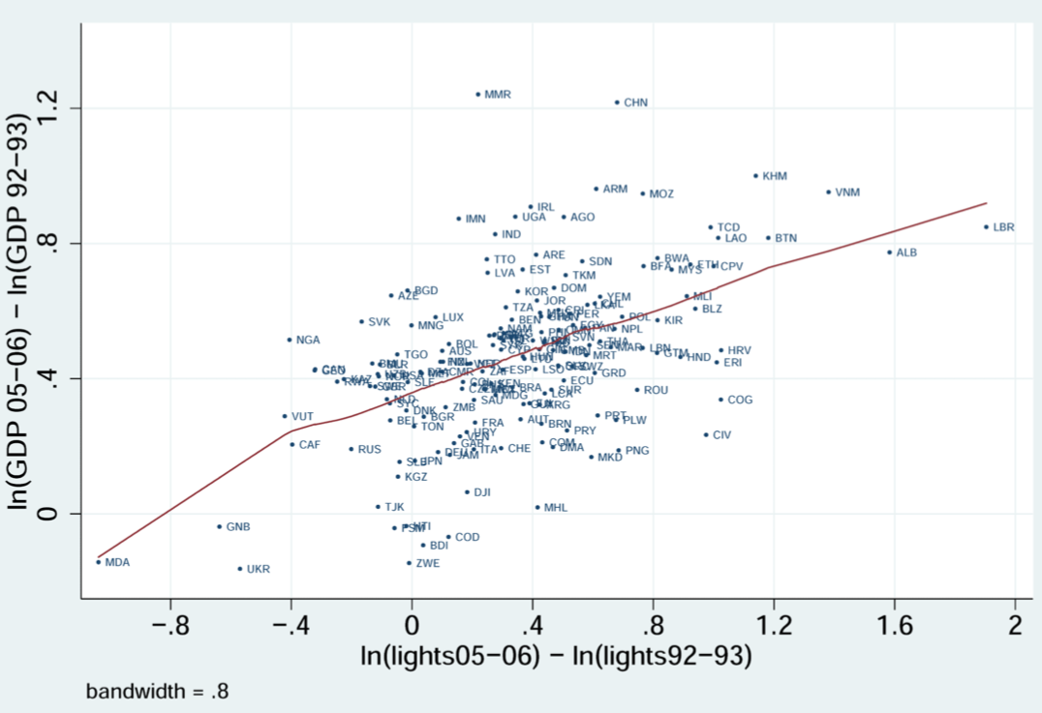
… guess what? Science says he’s right!
Hendersen et al, Measuring economic growth from outer space, AER (2012)
Y axis : Economic growth between 1992 and 2006
X axis : Light intensity growth from 1992 to 2006
Each dot is a country : look for yours !

Slide 8
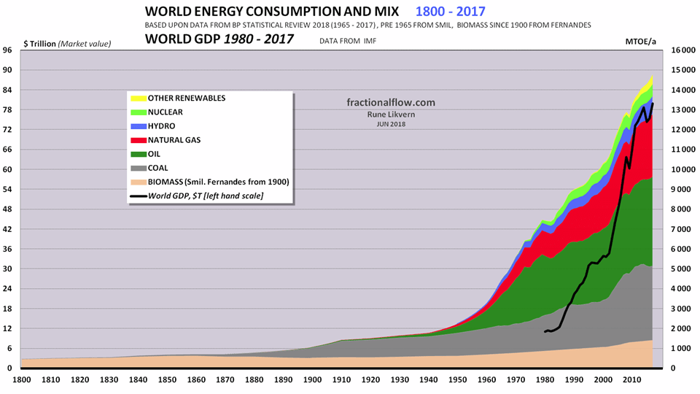
Has the energy transition already started?
World energy consumption from solar and wind was about 2.4% of world total in 2017
Rune Likvern (2018):
https://runelikvern.online/tag/world-energy-consumption-2/

Slide 9
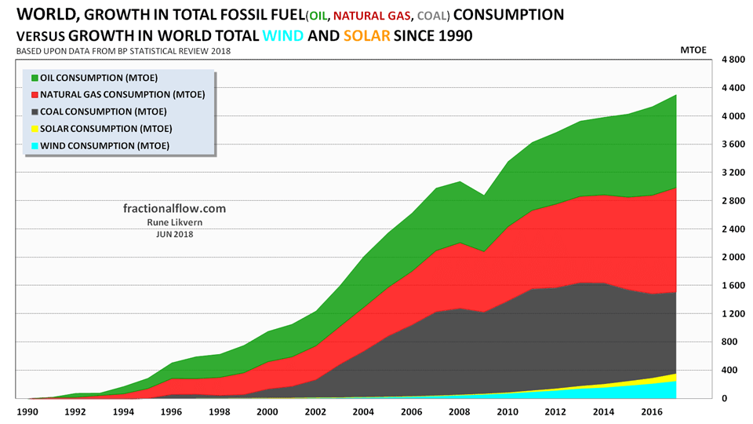
Short answer: No.
1990-2018 World Energy “Cup” :
Fossil fuels: 18
Solar & Wind: 0
Rune Likvern (2018):
https://runelikvern.online/tag/world-energy-consumption-2/

Slide 10
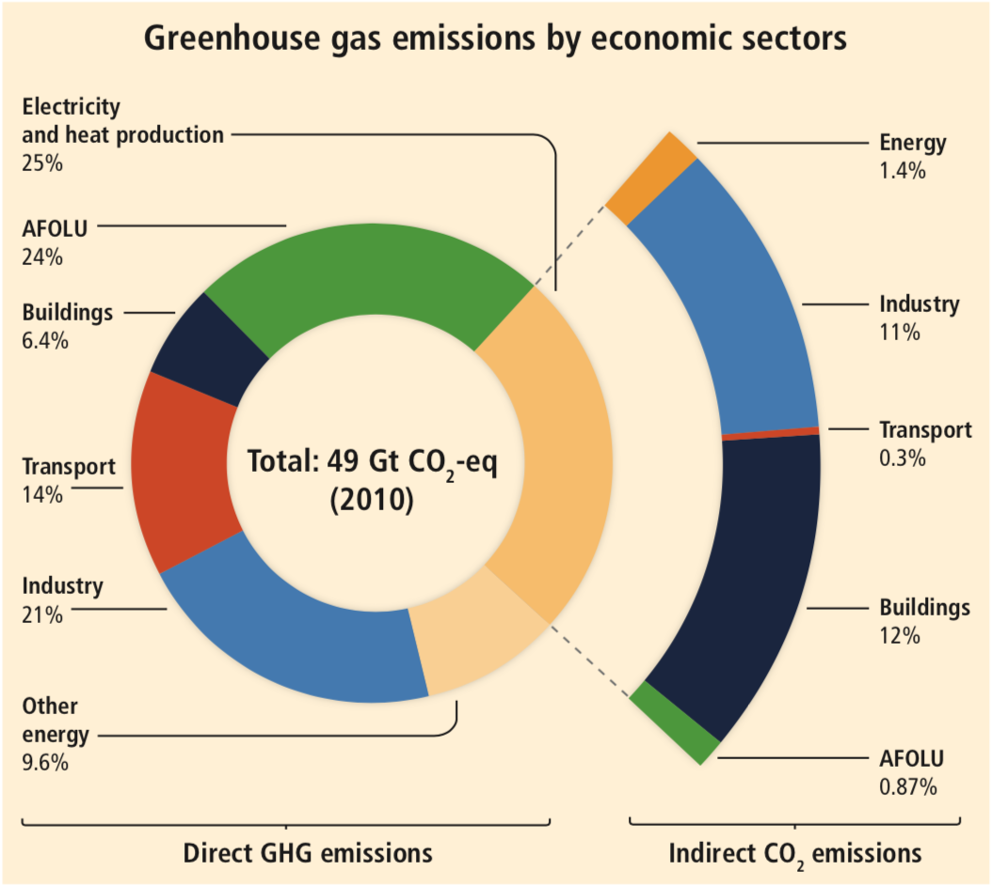
CO2 emissions and energy sector
IPCC 2014 (AR5)
"CO2 emissions from fossil
fuel combustion and industrial processes contributed about 78% to the total GHG emission increase between 1970 and 2010, with a contribution of similar percentage over the 2000-2010 period.“
Fossil fuels = Dark side of the force

Slide 11
Is the energy sector as big in term of GDP?
According to the World Bank data, the energy sector in its whole (production, transport, distribution, etc.) accounts for only 3-4% of the global GDP (approximately 3000 bn$)
But : Every sector of the economy has a production function depending on four essential factors as follow, including energy :
$$Y=f(K,L,E,M)$$
Where K is capital (engine, plant), L is labour (humans), E is energy and M stands for materials
A shock in the energy sector can impact the whole economy (e.g. oil crisis 1973, 1979)

Slide 12
What about the hydrogen (H2) sector?

Slide 13
What about the hydrogen sector?
The current annual world production of Hydrogen is estimated at ~75 Mt
mainly by fossil fuel reforming (Steam methane reforming + water gas shift). 10 t_{CO2}/t_{H2} → 750 Mt CO2 emitted to produce hydrogen (1.8% of the global CO2 emissions and 1.8% of the global energy demand)
The annual market of commercial hydrogen is estimated at 100 billion dollars (3.3% of the global GDP’s energy share)
The annual hydrogen demand is almost entirely due to industry:
Oil refinery: to remove the sulphur of fuel and avoid SOx emission (50%)
Ammonia production (NH3): to produce fertilizers (40%)
Steel and glass making, pharmaceutical industry, …
Source: The future of Hydrogen, IEA, 2019

Slide 14
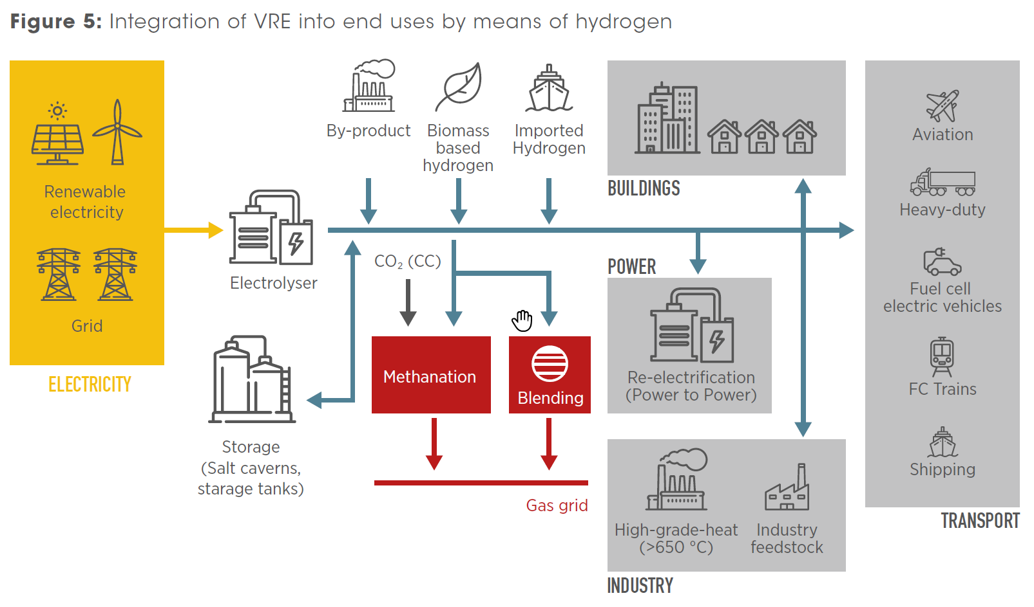
Hydrogen: a future versatile energy carrier
IRENA (2018):
https://www.irena.org/-/media/Files/IRENA/Agency/Publication/2018/Sep/IRENA_Hydrogen_from_renewable_power_2018.pdf

Slide 15
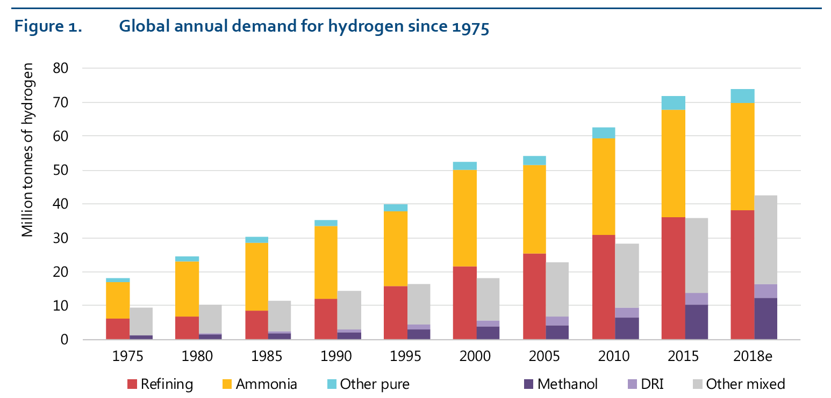
Hydrogen demand rising since 1975
IEA (2019):
https://www.iea.org/hydrogen2019/

Slide 16
What’s behind the H2 light side of the force?
Since 1975, the rise of H2 demand is mainly due to the rise of polluting industrial uses (e.g. chemistry, refinery in the oil industry)
What could be the drivers to push hydrogen towards a truly green energy carrier?
Technological progress (e.g. cost reduction)?
The rise of variable renewable energies (wind, solar)?
The evolution of electricity prices?
Carbon pricing (e.g. tax, emission quotas)?
Regulation? Governmental objectives for energy transition?

Slide 17
How are hydrogen technologies evolving with time?

Slide 18
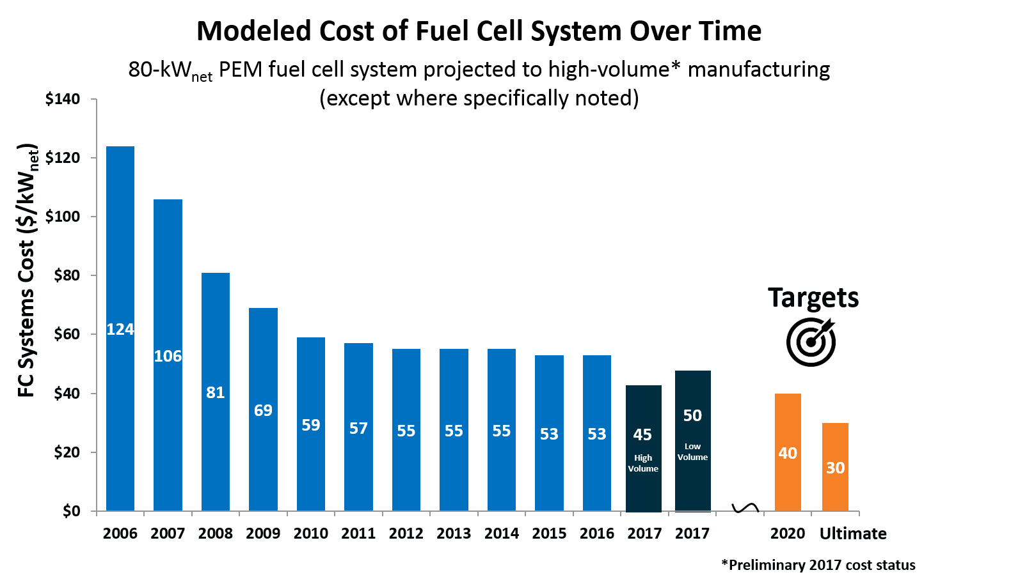
Technological progress on the right track
During the last ten years, electrolysis and fuel cells’ costs have decreased sharply
Source: DOE Hydrogen and Fuel cells Program Record

Slide 19
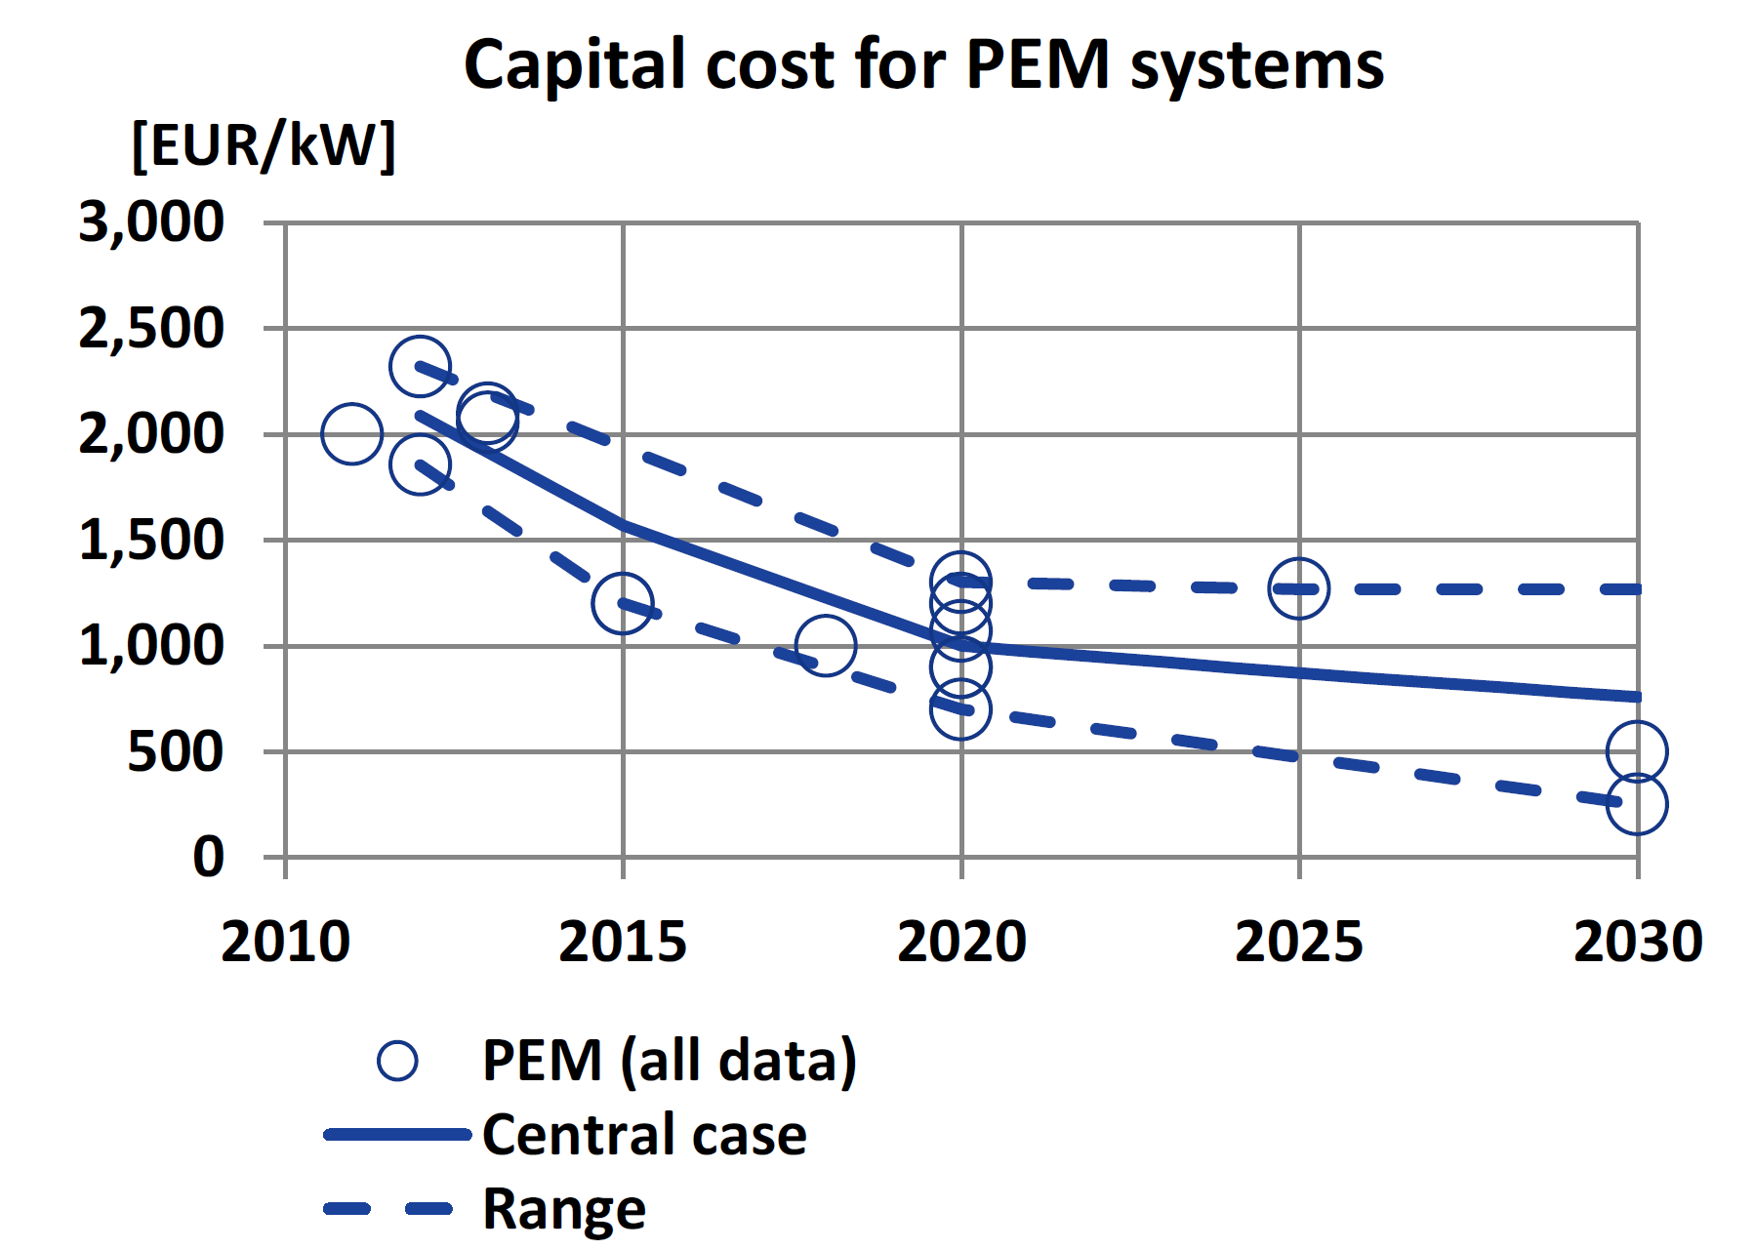
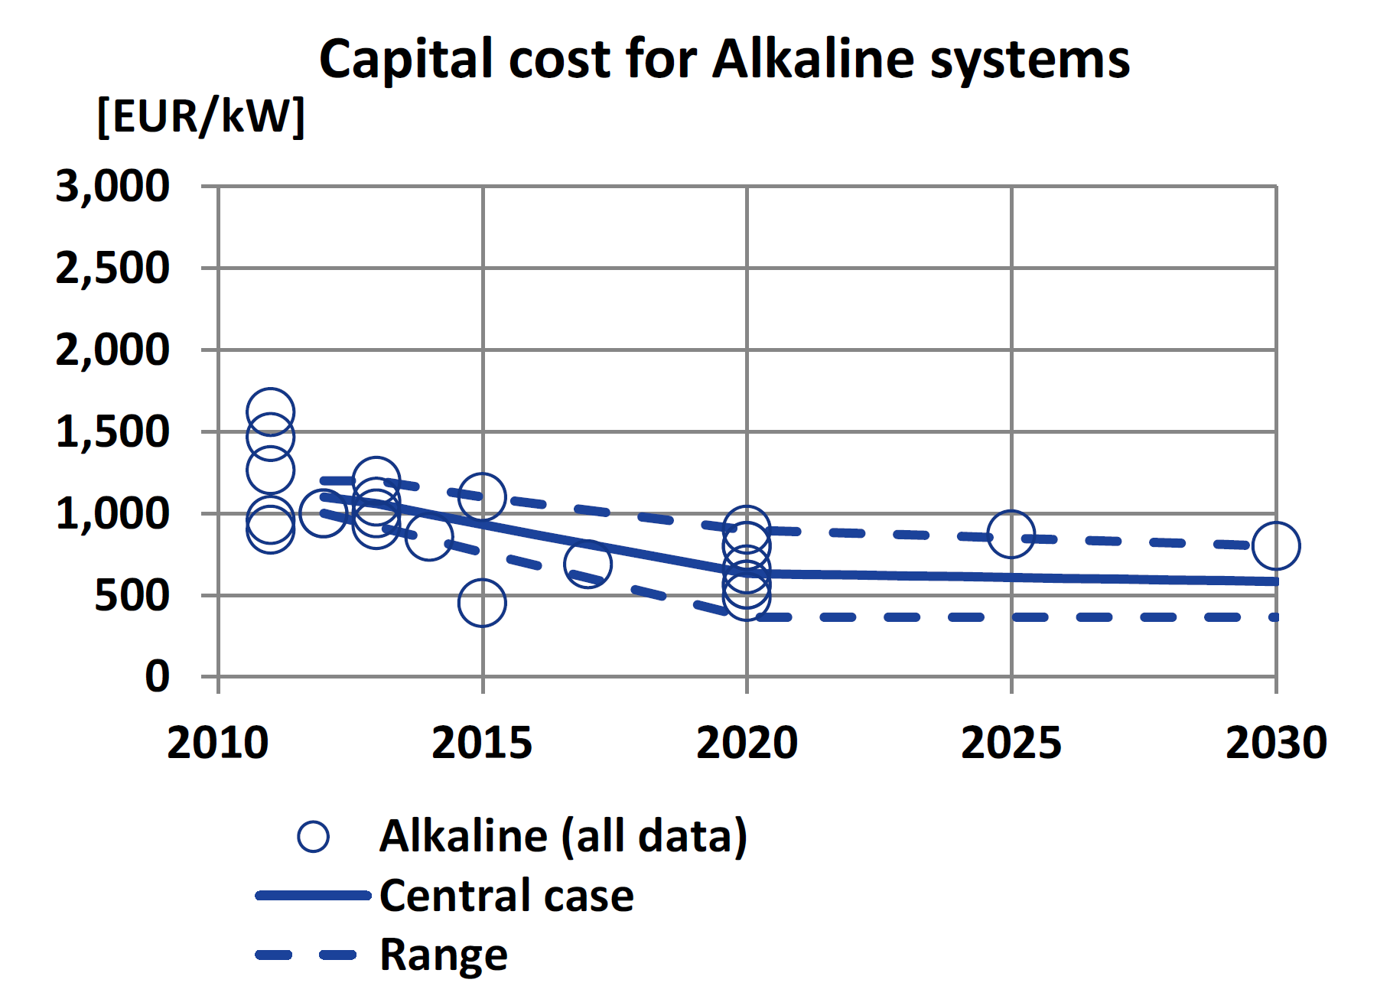
Technological progress on the right track
Source: E4Tech

Slide 20
How is the energy transition in power market supporting the development of hydrogen?

Slide 21
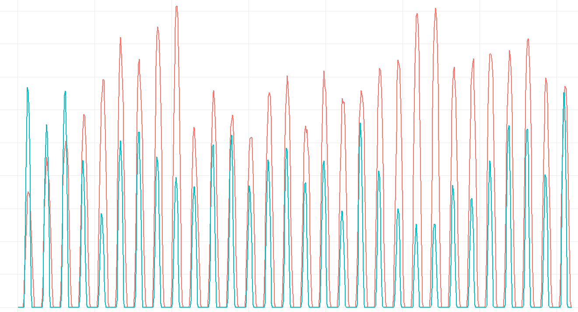
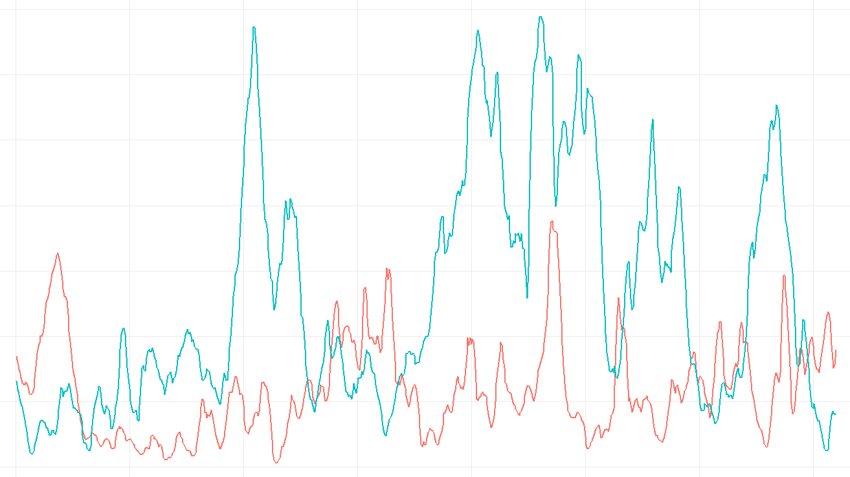
Renewable energy can be very uncertain…
Variable renewables (VRE)
Also called intermittent energy sources, they are non-controllable: there is no switch for wind nor for the sun…
Solar energy
+
Wind
Energy

Slide 22
… and this is an issue for the electricity market
The electricity market is very unique: supply must always meet the demand. Any difference between the two can lead the network to a blackout !
Same as for hotel room or plane tickets: if the room (resp. seat) is empty, it is lost forever !
Increasing the share of VRE into the market increases the uncertainty on the supply side and requires more flexibility
VRE integration in the electricity market has a non negligible impact on the market price : this is the merit-order effect

Slide 23
Firstly, what is the logic of the electricity market?
The electricity market has two sides (as a usual market):
The supply: the electricity is produced using several technologies (nuclear, coal, gas, etc.). The cheapest ones in term of marginal cost c (cost to produce one more MWh, directly related to the cost of the fuel used) are used in priority: this is the merit-order
Note: The fuel for wind and solar is free, thus they have the priority to sell electricity on the market
The demand (Q): vary across time (e.g. day, night, cold weather, etc.). P(Q,t) is the inverse demand curve (which describes the price P as a function of the demand Q

Slide 24
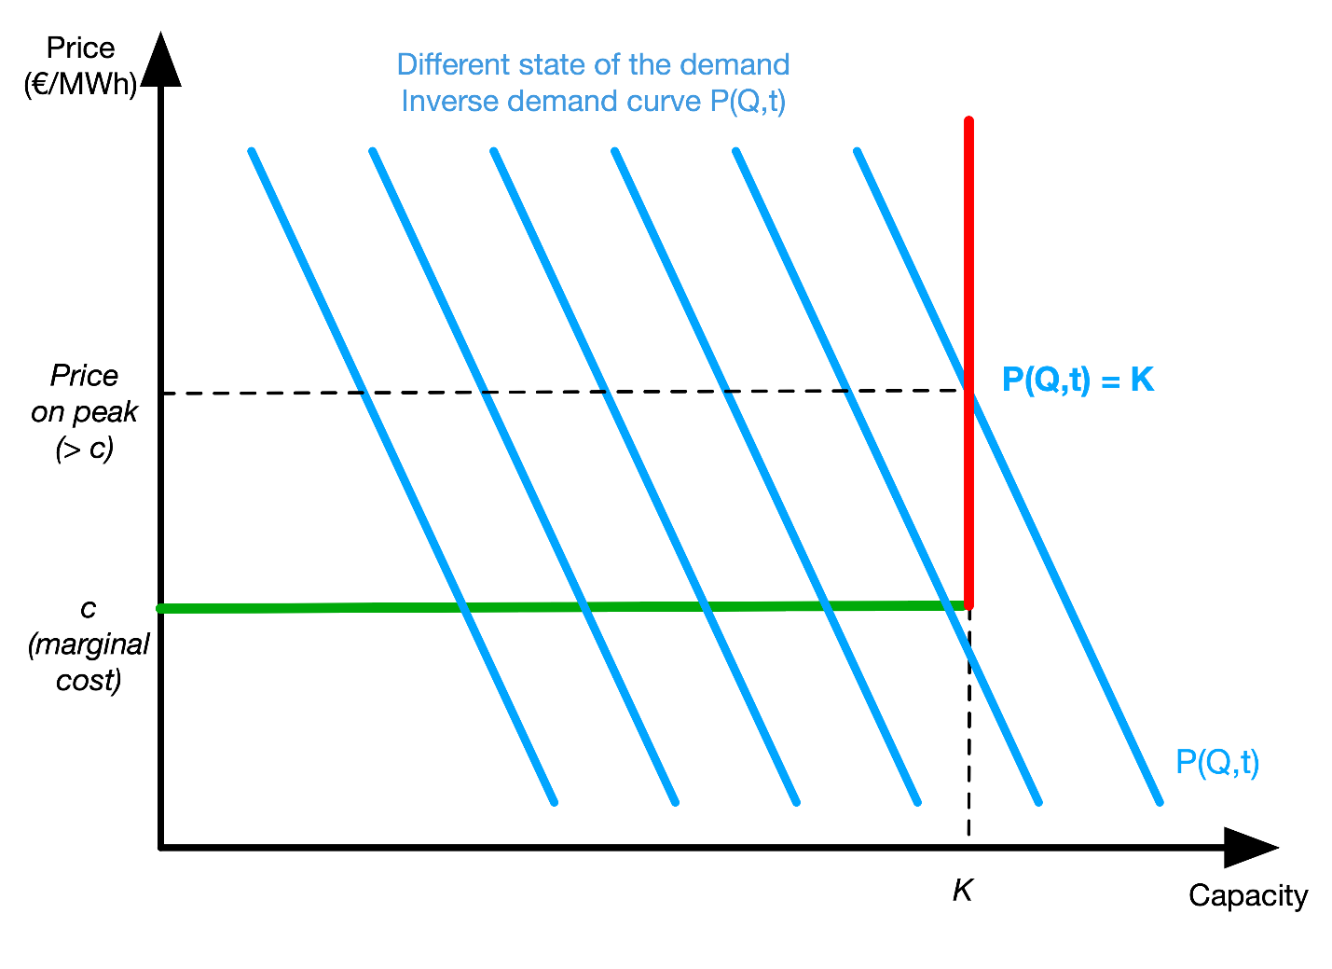
Illustration: Power market with 1 technology
Fictive market with only one technology of production of marginal cost c and capacity K
The curves in blue represent the different states of the demand (the more to the right, the higher)
The market price P is always equal to c, except when the demand reaches the maximum capacity of production K (this is a specific case for very few hours during the year, often during the coldest days of winter)

Slide 25
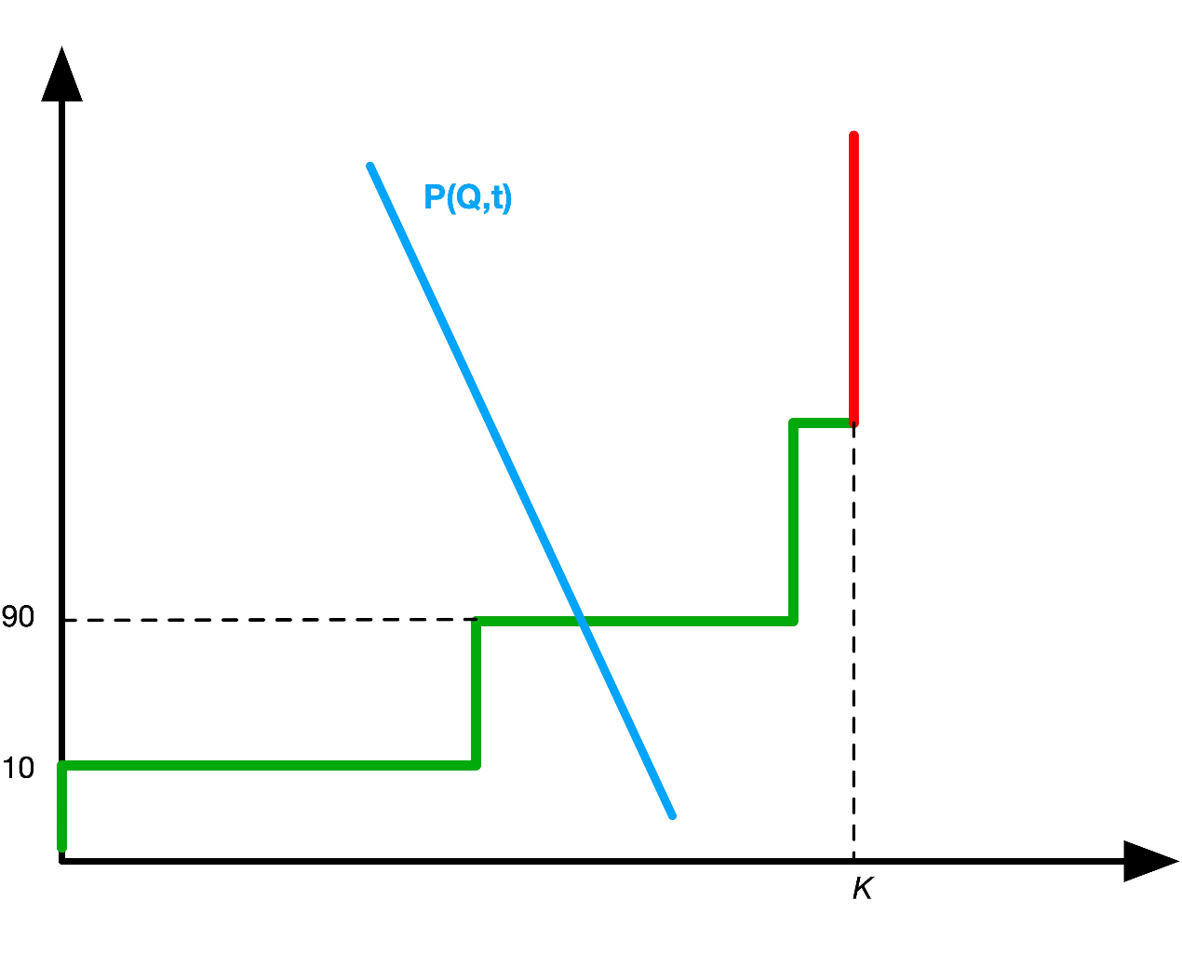
Power market with 3 technologies
3 technologies on the supply side:
- Nuclear (10€/MWh)
- Gas (90€/MWh)
- Oil (120€/MWh)
(numbers only for the example)
Price on the market without renewable energy : 90€/MWh
Oil
Gas
Nuclear

Slide 26
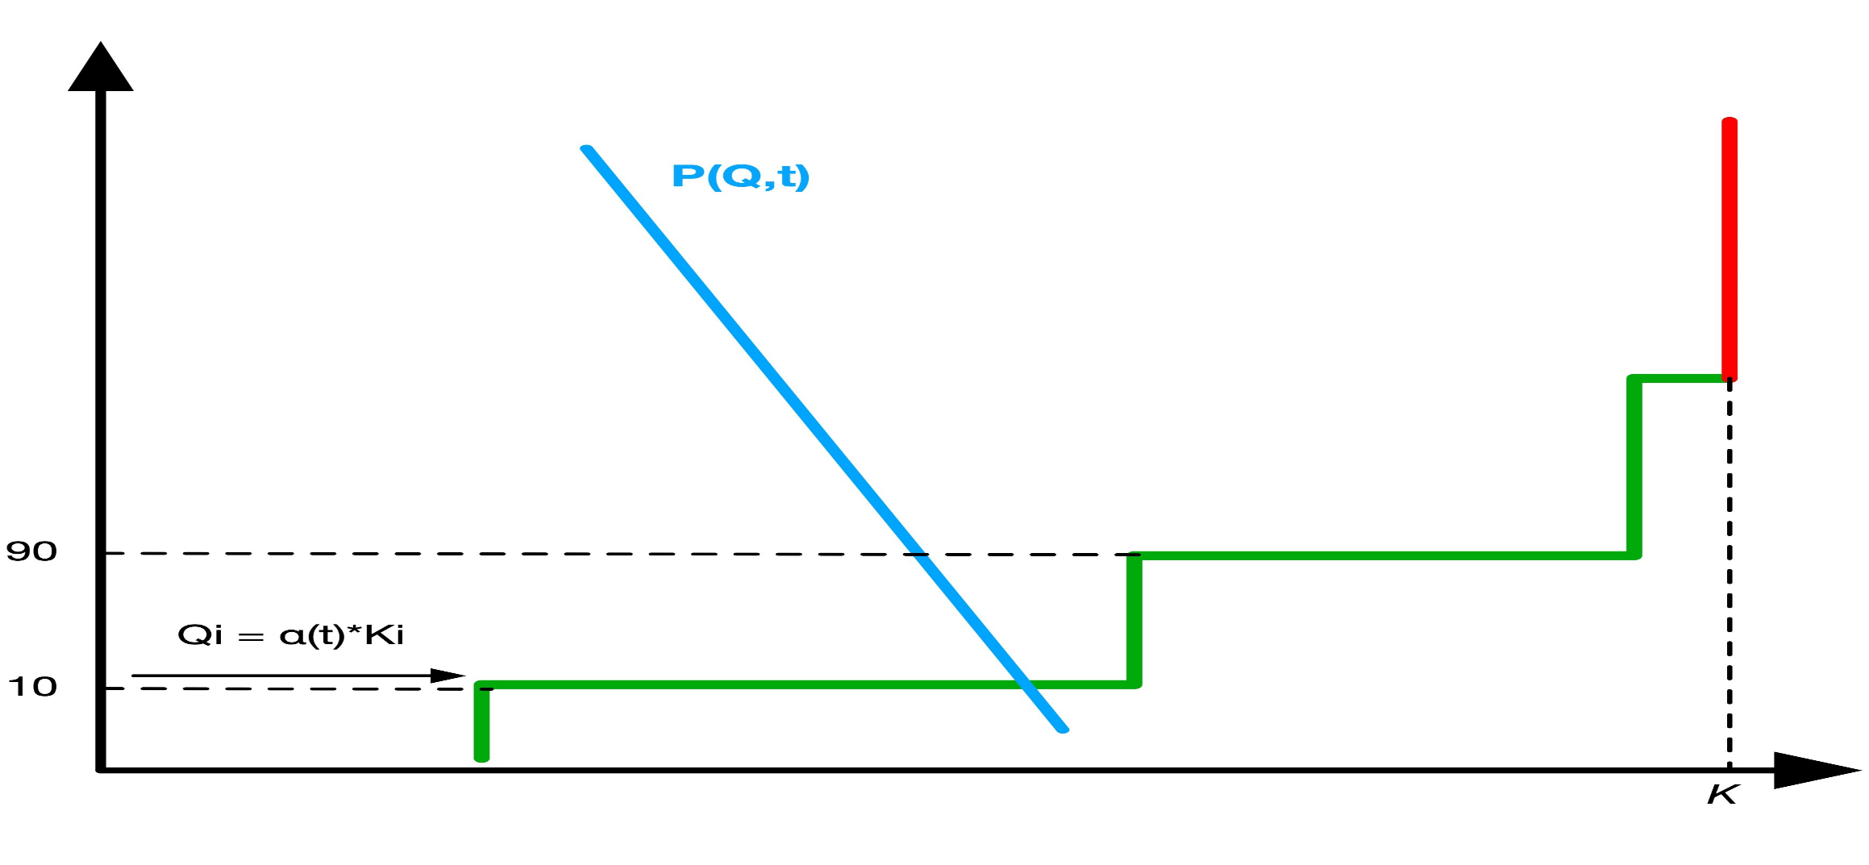
Power market with 3 technologies + VRE
New market price with renewable energy : 10€/MWh
Merit-order effect
A capacity Ki of VRE enter the market, α(t) measures the variability
The supply curve shifts to the right
Oil
Gas
Nuclear

Slide 27
The merit-order effect: enabler of H2 ?
The merit order effect describes the impact of VRE on the electricity market prices:
Decrease prices (as seen previously)
Increase price volatility (the more VRE, the more the the electricity price will vary)
Positive consequences for H2 development :
Electrolysis is less expensive (electricity price is lower)
More arbitrage opportunities (store electricity when prices are low, sell when prices go up)

Slide 28
The merit-order effect: enabler of H2 ?
… in other words, using a Causal loop diagram
B
Balancing loop
Average
Electricity Price
Reinforcing loop
-
+
R
B
R
+
+
Renewable
Energies
Storage capacity
incl. H₂
-
+
B
B
-
Volatility of
Electricity Price
+

Slide 29
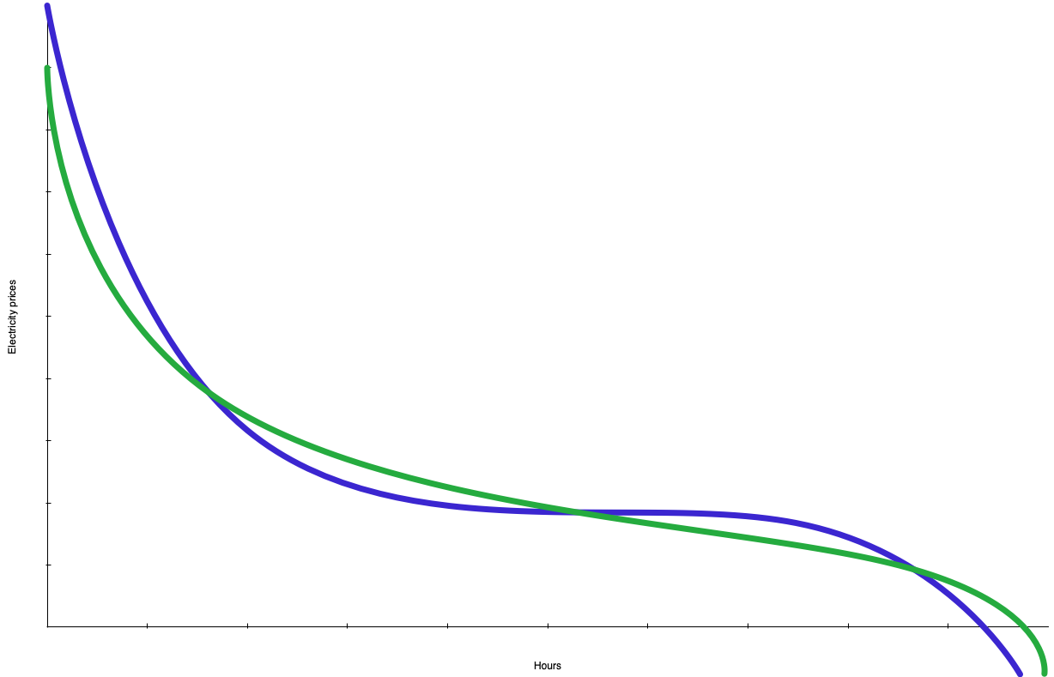
Hydrogen storage & arbitrage opportunities
The merit-order effect would change the decreasing price curve shape from the green to the blue one (steeper)
The arrows show how storage and de-storage periods are extended with the merit order effect
Electricity prices
De-storage price cap
Storage price cap
Hours
More periods to sell (high prices)
More period to store (low prices)

Slide 30
Case study : Nuclear power and market price
To better understand the concept of electricity network flexibility, why does it matter in a context of energy transition and finally how hydrogen could increase it, you can check the following case study about nuclear and power market.

Slide 31
Why is it important to tax carbon emissions?

Slide 32
Carbon pricing: the elegant solution?
From an economic perspective, the most efficient way to mitigate climate change and promote renewable energy technologies is to put a price on carbon and green house gases (GHG) emissions
Different tools: Carbon tax, carbon market, emissions quotas, etc.
Global market? 1 ton of CO2 emitted in France has the same impact on climate as 1 ton of CO2 emitted in China:
The price should be global and determined on a global market
But, this is impossible to implement mainly due to institutional and political reasons

Slide 33
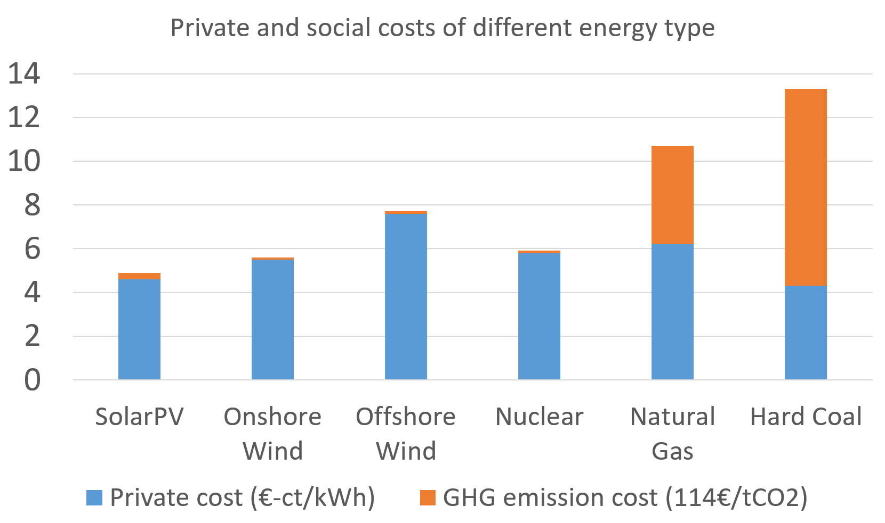
Carbon pricing: reveal the true energy cost
Fossil fuels are really cheap for making electricity, but expensive if you account for carbon cost
Source: Data from Samadi (2017), The Social Cost of Electricity Generation

Slide 34
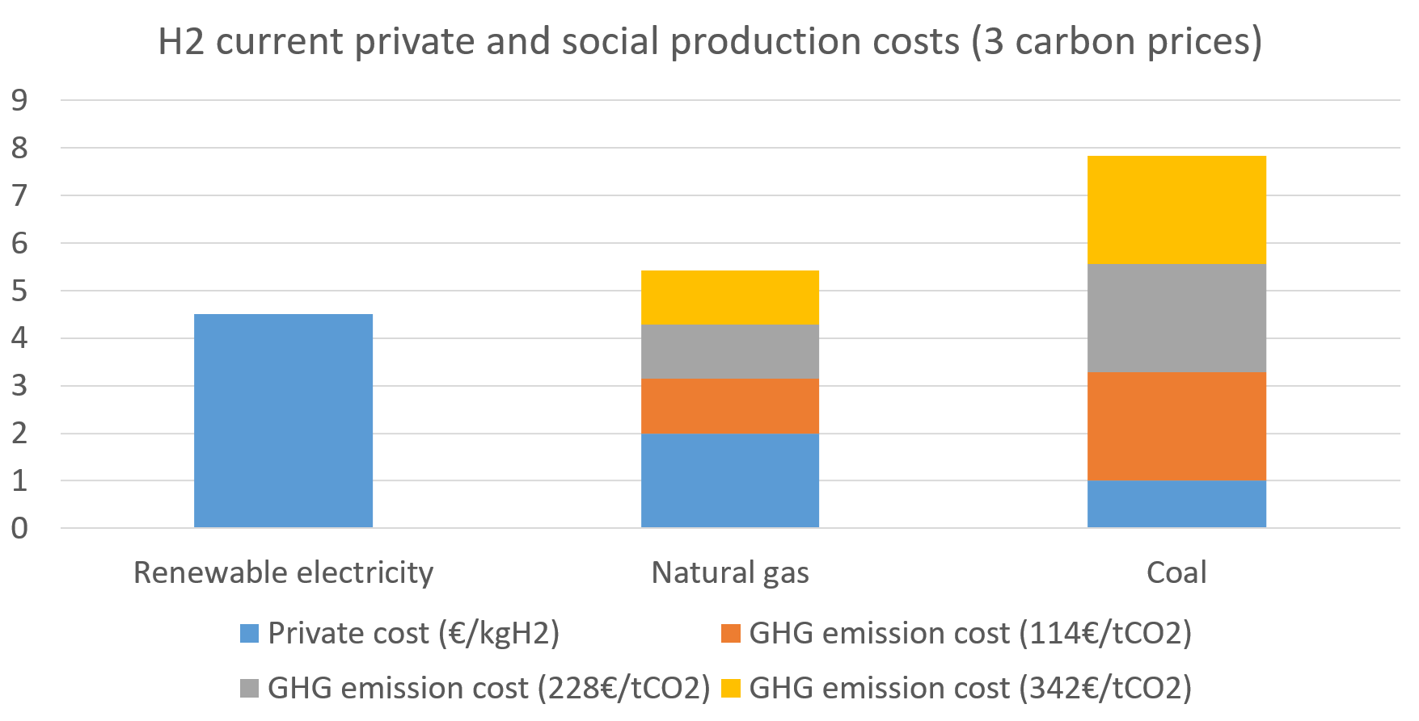
H2 electrolysis and carbon pricing

Slide 35
How can government support hydrogen technologies?

Slide 36
Governmental support: needed or not?
As for renewable energy (which benefits public support mechanisms), the development of H2 technologies could benefit from different support:
Direct support: subsidies, lump sum, favourable regulation, etc.
Indirect support: carbon tax, renewables support (merit-order), etc.
From a territorial perspective, deploying H2 transport requires a certain number of refueling stations: regional support?
What has been done already at the European scale?

Slide 37
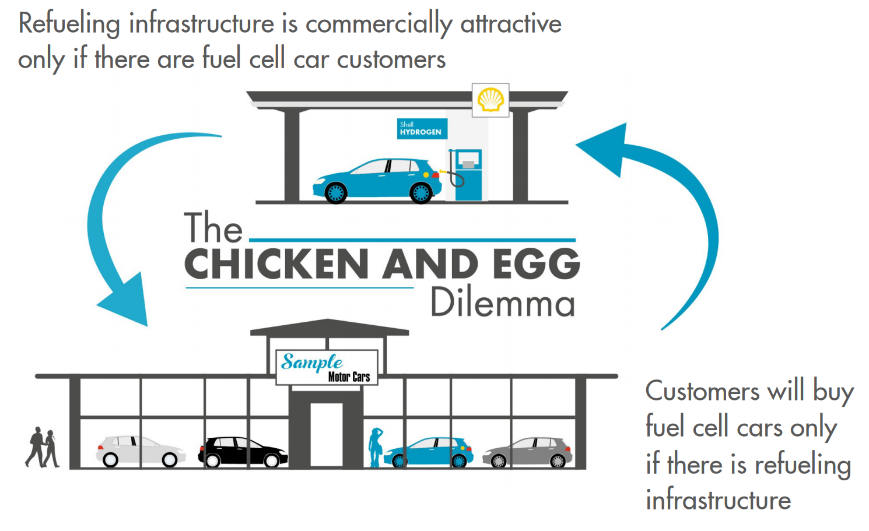
The “Chicken or the egg” dilemma…
Source: http://www.h2mobility-kongress.de/programm/vortraege/H2-Infrastructure--Presentation-Oliver-Bishop-at-BMVI.pdf

Slide 38
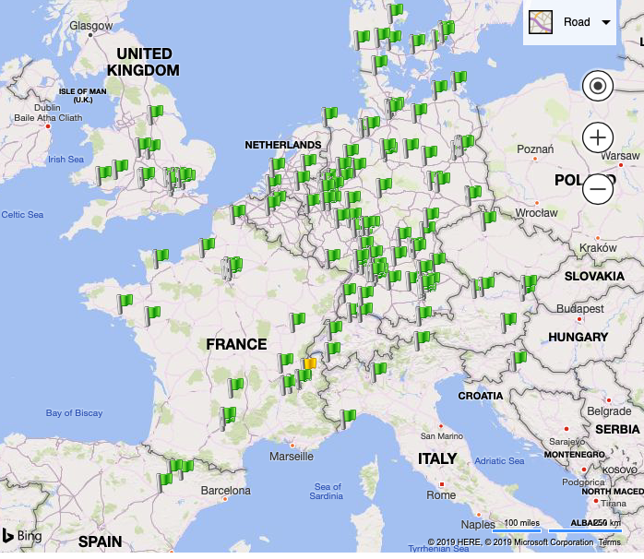
… that can be solved with public investment
H2 refuelling stations currently in Europe (from h2stations.org)
European countries have directly supported the installation of H2 stations through captive fleets for local communities (garbage collect, public transport, etc.)
Example: FaHyence project (read more)

Slide 39
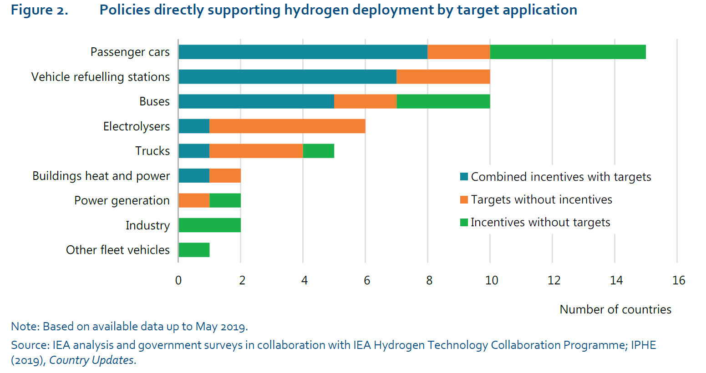
Governmental support to H2 technologies
IEA (2019):
https://www.iea.org/hydrogen2019/

Slide 40
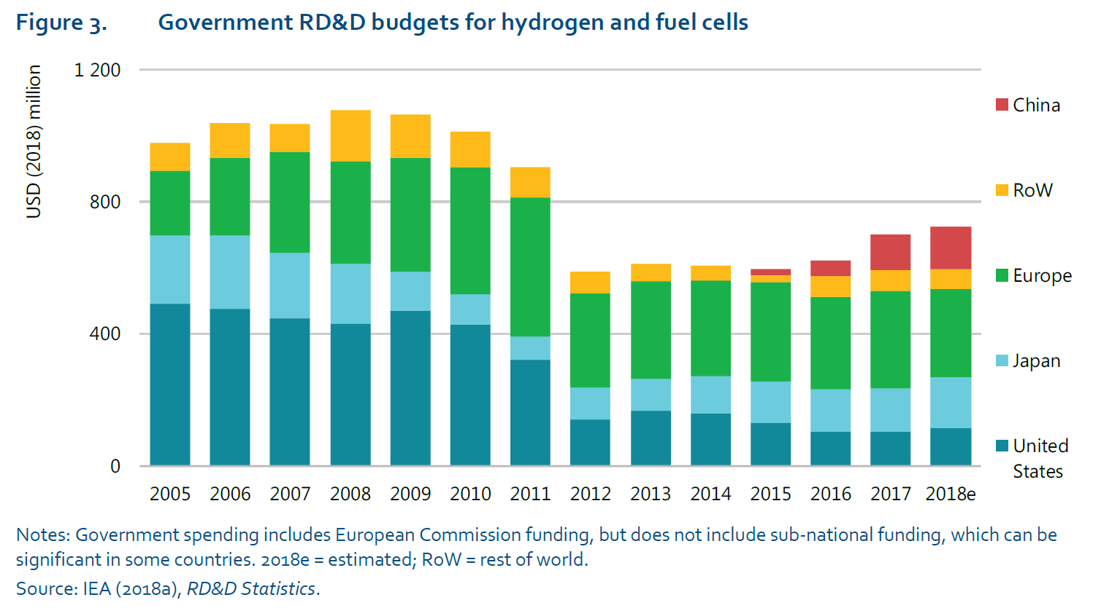
Government R&D budget for H2 by region
IEA (2019):
https://www.iea.org/hydrogen2019/

Slide 41
Does the future look bright for hydrogen energy?

Slide 42
Simulating vs. forecasting the future of H2
Caution:
Some results are based on models used to make simulations of possible futures for the H2 sector: these are not accurate forecasts!
Indeed, models rely on several assumptions, which if one was not entirely verified in the reality, even by a small error, it could lead to very different results as illustrated by the butterfly effect

Slide 43
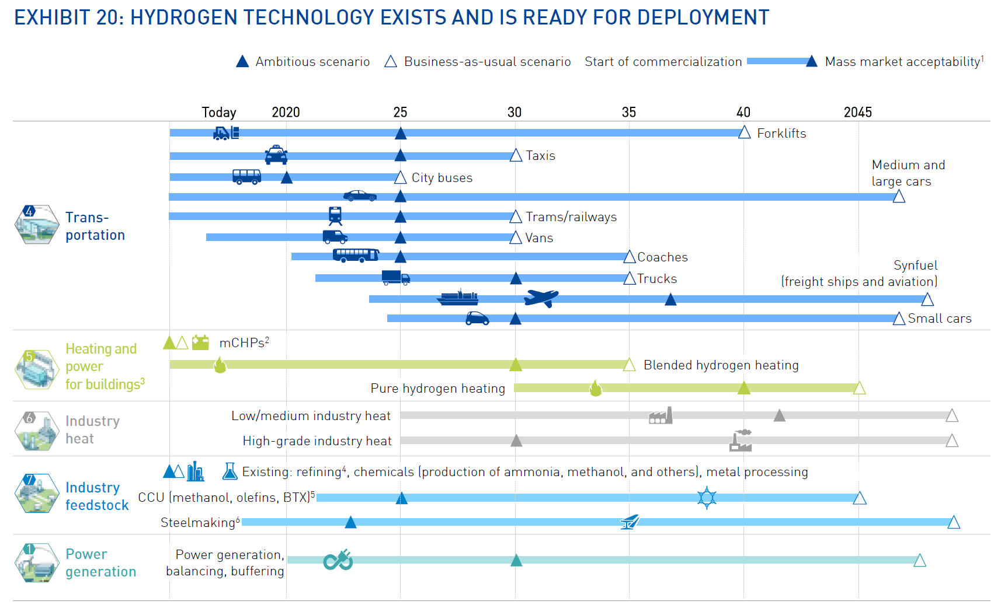
H2 technologies: Which? When?
Source: Hydrogen Europe (2019)

Slide 44
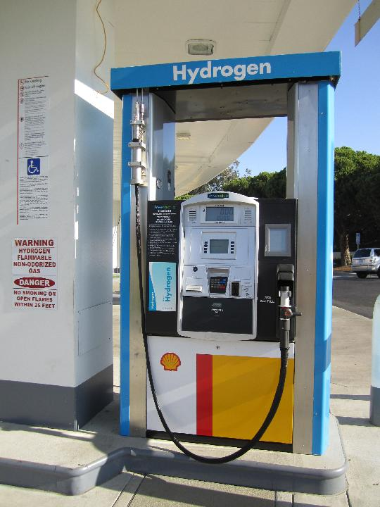
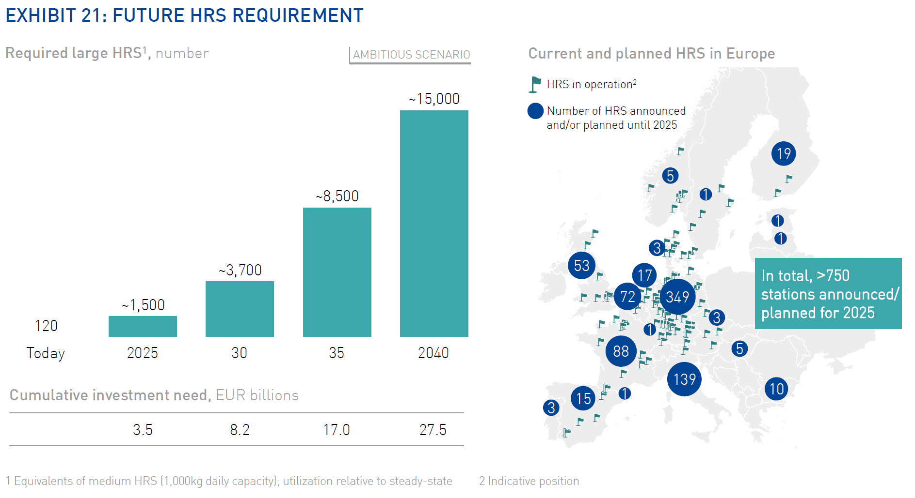
H2 stations: More than 750 in Europe by 2025
Source: Hydrogen Europe (2019)

Slide 45
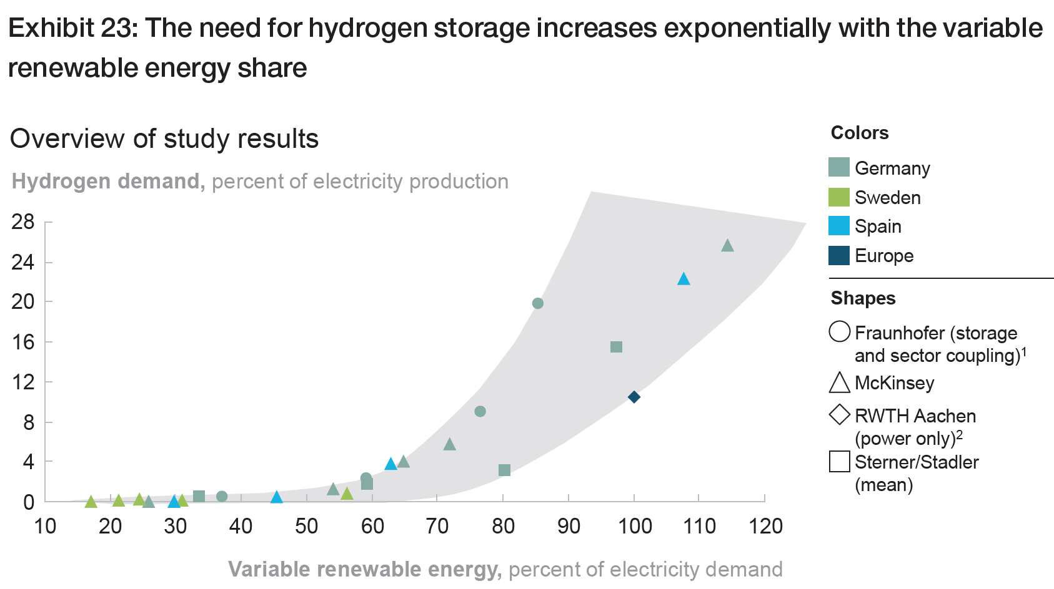
The more renewable energy, the more H2?
Studies says that the need for H2 storage increases exponentially with the VRE share…
#Merit-order #effect
Source: Hydrogen council (2017)

Slide 46
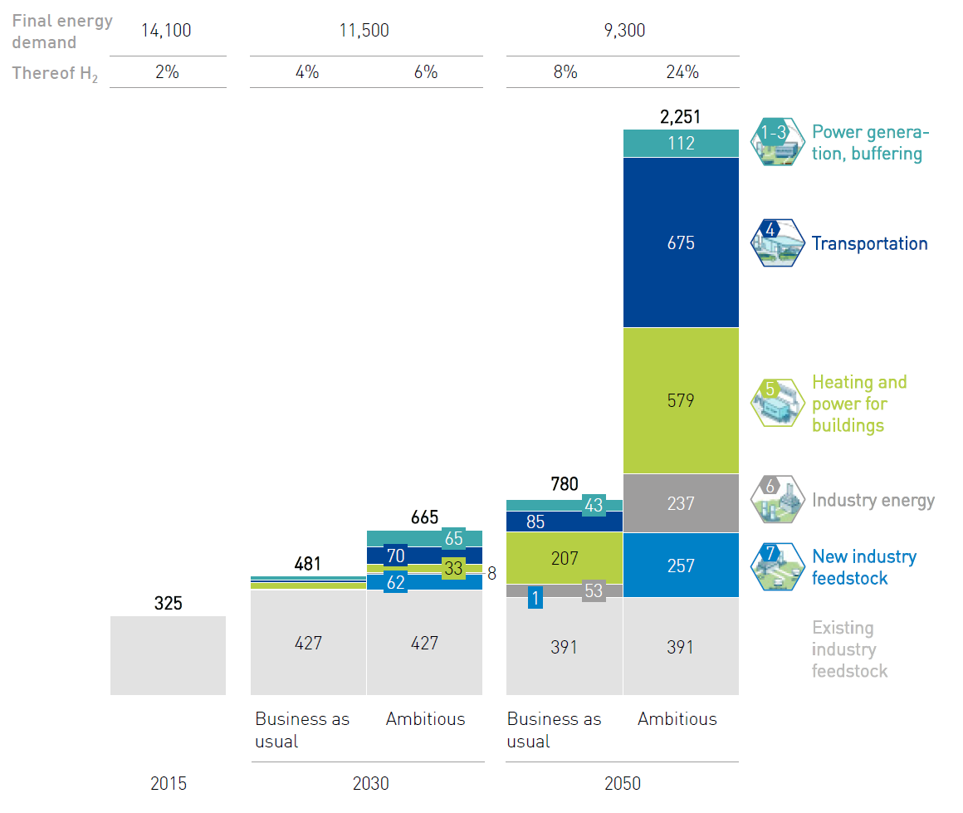
H2 share in the future final energy demand
2030: 4-6%
2050: 8-24%
The more we move forward, the less accurate the predictions…
#Butterfly #effect
Source: Hydrogen Europe (2019)

Slide 47
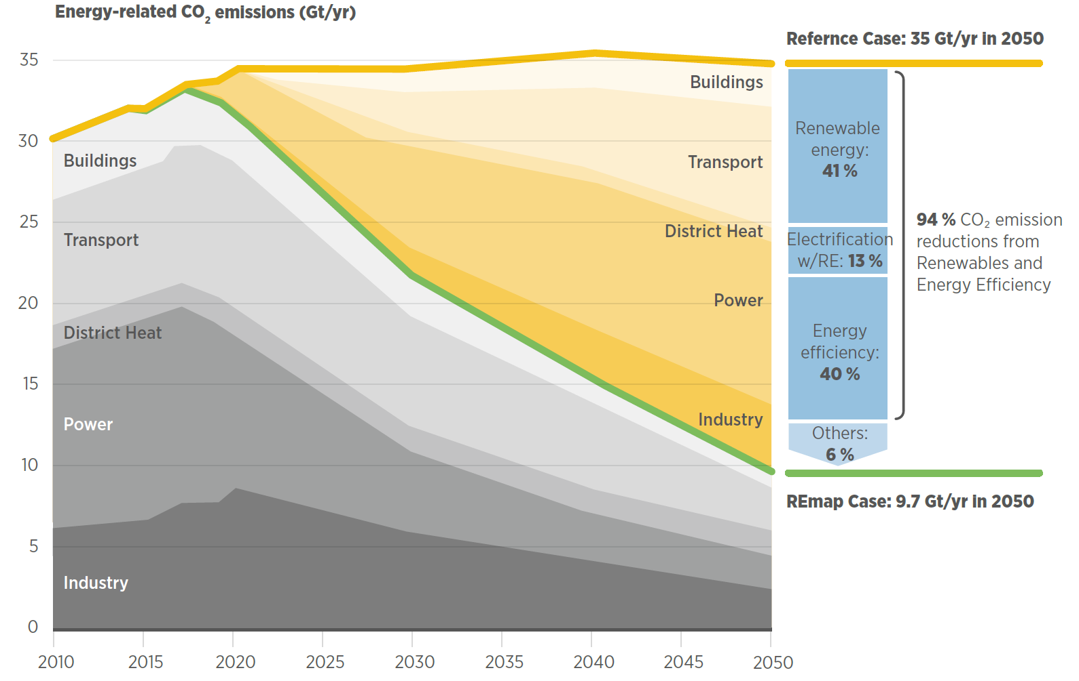
H2 deployment will push back fossil fuels…
… and reduce global CO2 emissions !
Source: IRENA (2018)

Slide 48
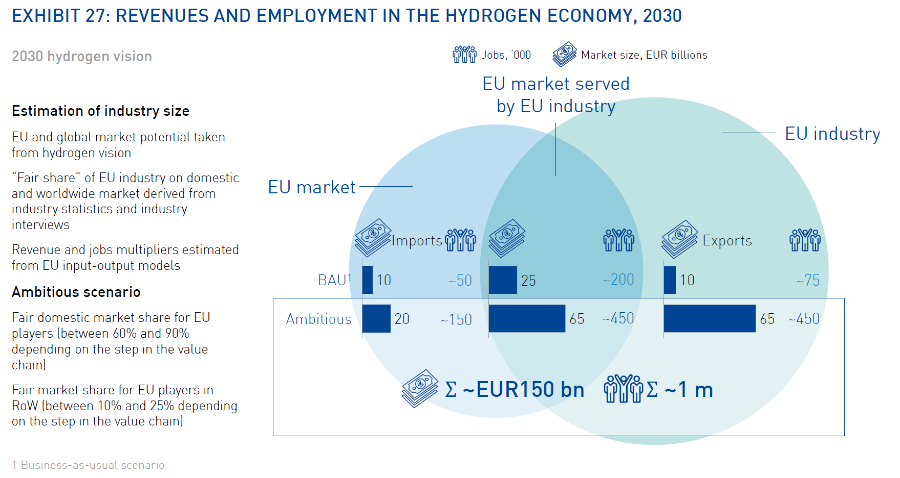
The future of the European H2 economy
2030 “best” scenario in Europe:
1 m jobs
Market size of 150bn €
Source: Hydrogen Europe (2019)

