Slide 1
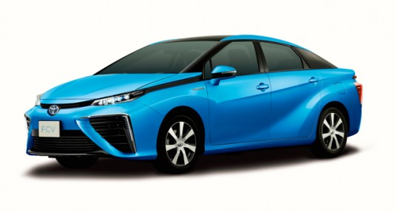
Economy and Employment
Student Powerpoint
What are the expected or anticipated economy-wide impacts of introducing more hydrogen fuelling stations and using more hydrogen fuel cell powered vehicles?
Content created by
<Partner logo>
Last updated 18th October 2019

Slide 2
The economic impact of introducing more hydrogen fuelling stations and using more hydrogen fuel cell powered vehicles will depend upon where countries currently obtain their fossil fuels from.
Consider the following countries…

Slide 3
Country 1
Country 1 imports all its fossil fuels and therefore its supply chain is import intensive.

Slide 4
Country 1
Country 1 imports all its fossil fuels and therefore its supply chain is import intensive.
Country 2
Country 2 manufactures and uses its own fossil fuels therefore it has a strong domestic supply chain.

Slide 5
Country 1
Country 1 imports all its fossil fuels and therefore its supply chain is import intensive.
Country 2
Country 2 manufactures and uses its own fossil fuels therefore it has a strong domestic supply chain.
Country 3
Country 3 manufactures, uses and exports its own fossil fuels therefore it has both a strong domestic supply chain and benefits from exports.

Slide 6
Country 1
Country 1 imports all its fossil fuels and therefore its supply chain is import intensive.
Country 2
Country 2 manufactures and uses its own fossil fuels therefore it has a strong domestic supply chain.
Country 3
Country 3 manufactures, uses and exports its own fossil fuels therefore it has both a strong domestic supply chain and benefits from exports.
How might these countries’ economies differ?

Slide 7
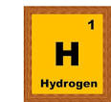
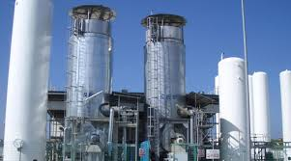
What if these countries were now able to generate their own hydrogen?
Country 1
Country 2
Country 3

Slide 8
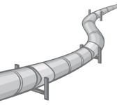
What if they could export it too?
Country 1
Country 2
Country 3

Slide 9
What if these countries were now able to generate their own hydrogen?
What if they could export it too?
Discuss with a partner…
Country 1
Country 2
Country 3

Slide 10
How is this impacted when we factor in that hydrogen is intended to replace the use (and therefore supply) of fossil fuels?

Slide 11
How is this impacted when we factor in that hydrogen is intended to replace the use (and therefore supply) of fossil fuels?
Task - What are the implications of retaining a fossil fuel base in the fuel supply chain and what if it is imported rather than domestic?

Slide 12
Notes for teachers –
* Hydrogen in transport has been chosen to consider as it is the area which has had the most rapid uptake for hydrogen and fuel cell technology.
* A significant move away from the current use of refined fuels in private transport towards hydrogen can potentially yield a valuable increase in GDP and employment.
* The likely gains will come not only from the production and distribution of hydrogen but also from the range of service sector activities, including finance, involved in a potentially strong domestic supply chain.
* Policy makers and other stakeholders need a clear/clearer picture of the potential wider costs and benefits, the differences and trade-offs from the deployment of hydrogen as a new and replacement fuel source.
Further extension questions:
1 - Can we expect that hydrogen supply will share strong domestic supply chain properties of proxy sectors (electricity and/or gas supply)?
2 - What might the substitution between fuel cells look like and how long could it take to happen?
3 - What are the implications of retaining a fossil fuel base in the fuel supply chain and what if it is imported rather than domestic?

