Slide 1
A Brief History of Fuel Cells
Extra Information For Teachers
Content created by
<Partner logo>
Last updated 18th October 2019

Slide 2
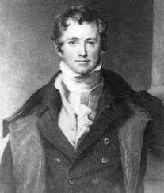
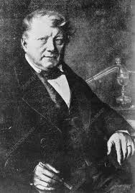
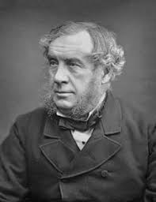
Origins
Humphry Davy effectively demonstrated the concept of a fuel cell in the early 19th century.
In 1838, Christian Friedrich Schönbein followed with pioneering work on what were to become fuel cells.
William Grove, a chemist, physicist and lawyer is credited with inventing the first fuel cell in 1839.

Slide 3
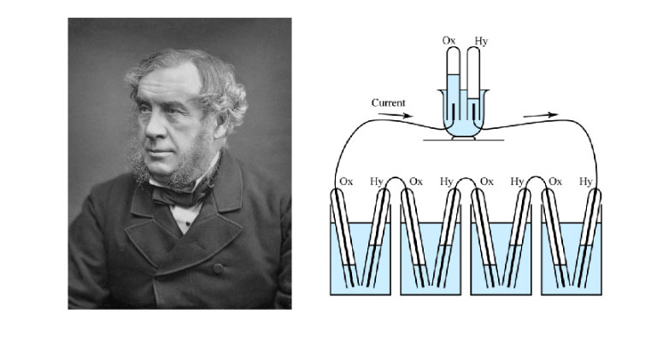
Origins
Grove conducted a series of experiments with what he termed a gas voltaic battery, which ultimately proved that electric current could be produced from an electrochemical reaction between hydrogen and oxygen over a platinum catalyst.

Slide 4
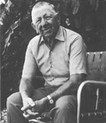
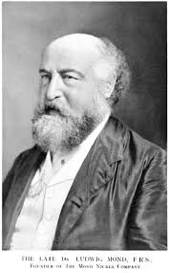
Origins
The term fuel cell was first used in 1889 by Charles Langer and Ludwig Mond, who used coal gas as a fuel. Further attempts to convert coal directly into electricity were made in the early twentieth century but the technology generally remained obscure.

Slide 5
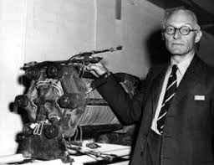
Origins
In 1932, Cambridge engineering professor Francis Bacon modified Mond's and Langer's equipment to develop the first AFC but it was not until 1959 that Bacon demonstrated a practical 5 kW fuel cell system.
At around the same time, Harry Karl Ihrig fitted a modified 15 kW Bacon cell to an Allis-Chalmers agricultural tractor. Allis-Chalmers, in partnership with the US Air Force, subsequently developed a number of fuel cell powered vehicles including a forklift truck, a golf cart and a submersible vessel.

Slide 6
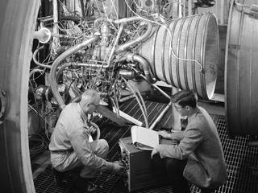
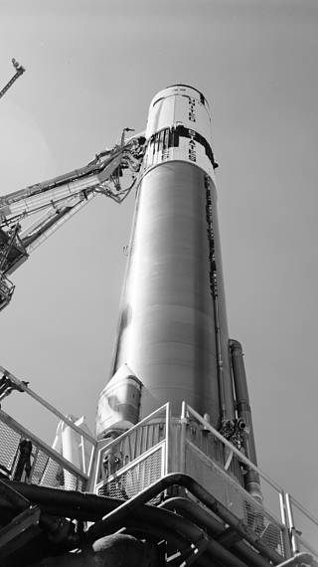
The Space Programme
In 1957, almost one year before Congress created NASA, the Air Force studied an exhaustive proposal from General Dynamics/Astronautics Corp. to develop a new space booster that could give the U.S., in the shortest possible time, a means of orbiting heavy payloads. That vehicle was to become Centaur, a high-energy second stage with a new propulsion system using liquid hydrogen. Mixed with liquid oxygen, this new fuel afforded the promise of boosting payloads as great as 8,500 pounds.
In the late 1950s and early 1960s NASA, in collaboration with industrial partners, began developing fuel cell generators for manned space missions. The first PEMFC unit was one result of this, with Willard Thomas Grubb at General Electric (GE) credited with the invention. Another GE researcher, Leonard Niedrach, refined Grubb's PEMFC by using platinum as a catalyst on the membranes.
In this image, engineers test the RL-10 engine in NASA Lewis (now Glenn) Research Centre's Propulsion Systems Laboratory. Developed by Pratt & Whitney, the engine was designed to power the Centaur second-stage rocket. Centaur was responsible for sending the Surveyor spacecraft on its mission to land on the moon and to explore the surface in the early stages of the Apollo Program.

Slide 7
The Space Programme
The Grubb-Niedrach fuel cell was further developed in cooperation with NASA, and was used in the Gemini space programme of the mid-1960s.
International Fuel Cells (IFC, later UTC Power) developed a 1.5 kW AFC for use in the Apollo space missions. The fuel cell provided electrical power as well as drinking water for the astronauts for the duration of their mission. IFC subsequently developed a 12 kW AFC, used to provide onboard power on all space shuttle flights.

Slide 8
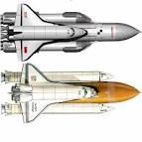
* Dissolved in 1991
The Space Programme
While research was continuing on fuel cells in the West, in the Soviet Union* fuel cells were being developed for military applications. Although much of this early work is still secret, it did result in fuel cells being used to provide onboard power to a submarine and later to the Soviet manned space programme.

Slide 9
The 1970s was also the era of the OPEC oil embargoes, which led governments, businesses and consumers to embrace the concept of energy efficiency. Clean air and energy efficiency were to become two of the principal drivers for fuel cell adoption in subsequent decades, in addition to the more recent concerns about climate change and energy security.
1970s
The 1970s saw the emergence of increasing environmental awareness amongst governments, businesses and individuals. Prompted by concerns over air pollution, clean air legislation was passed in the United States and Europe. This ultimately mandated the reduction of harmful vehicle exhaust gases and was eventually adopted in many countries around the world.

Slide 10
Funding from the US military and electrical utilities enabled developments in MCFC technology, such as the internal reforming of natural gas to hydrogen.
Several German, Japanese and US vehicle manufacturers and their partners began to experiment with FCEV in the 1970s, increasing the power density of PEMFC stacks and developing hydrogen fuel storage systems.
1970s
There were significant field demonstrations of large stationary PAFC units for prime, off-grid power in the 1970s, including a 1 MW unit developed by IFC.
Prompted by concerns over energy shortages and higher oil prices, many national governments and large companies initiated research projects to develop more efficient forms of energy generation in the 1970s. One result of this was important advances in PAFC technology, in particular in stability and performance.
Concerns over oil availability in the 1970s led to the development of a number of one-off demonstration fuel cell vehicles, including models powered by hydrogen or ammonia, as well as of hydrogen-fuelled internal combustion engines.
The use of an established natural gas infrastructure was a key advantage in developing fuel cells for large stationary prime power applications.

Slide 11
1980s
In the 1980s, research, development and demonstration (RD&D) work continued into the use of fuel cells for transport applications.
Substantial technical and commercial development continued in the 1980s, notably in the area of PAFC. A bright future for the technology was widely predicted around this time for stationary applications and buses.
The US Navy commissioned studies into the use of fuel cells in submarines where highly efficient, zero-emission, near-silent running offered considerable operational advantages.
In 1983 the Canadian company Ballard began research into fuel cells, and was to become a major player in the manufacture of stacks and systems for stationary and transport applications in later years.
Successes
Ambitious conceptual designs were published for municipal utility power plant applications of up to 100 MW output. Predictions of tens of thousands of units in operation by the end of the century were made, but only hundreds were to actually appear by that date.
Less successful endeavours
Several experimental large stationary PAFC plants were built, but saw little commercial traction in the 1980s.*
*With subsequent advancements in membrane durability and system performance, PAFC were rolled out in greater numbers almost two decades later for large-scale combined heat and power applications.

Slide 12
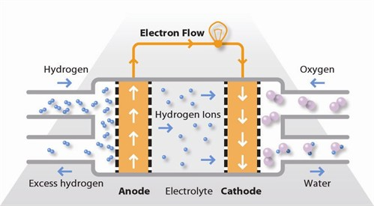
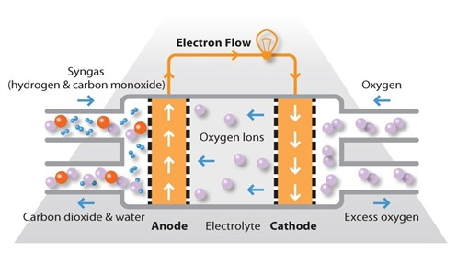
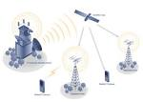
1990s
Interest turned to Proton Exchange Membrane and Solid Oxide fuel cells as they were ideal for small, stationary applications.
PEMFC
SOFC
These fuel cells were seen to offer a more imminent commercial possibility due to…
The lower cost per unit.
A greater number of potential markets eg.
In Germany, Japan and the UK, there began to be significant government funding devoted to developing PEMFC and SOFC technology for residential micro-CHP applications.
Back-up power for telecoms sites.
Residential micro-CHP.

Slide 13
Government policies to promote clean transport also helped drive the development of PEMFC for automotive applications.
1990s
In 1990, the California Air Resources Board (CARB) introduced the Zero Emission Vehicle (ZEV) Mandate.
The first vehicles emissions standard in the world based on the use of alternative powertrains.
Carmakers such as the then-DaimlerChrysler, General Motors and Toyota responded to this by investing in PEMFC research.
Companies other than automakers, such as Ballard, continued PEMFC research for automotive and stationary clean power.
The programmes initiated in the 1990s still continue, albeit with some changes to the strategic focus of some key players.

Slide 14
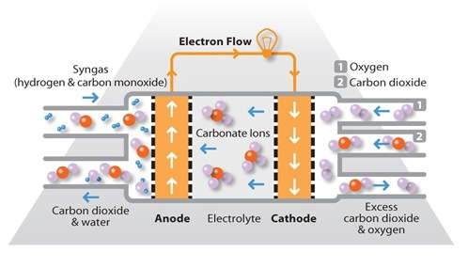
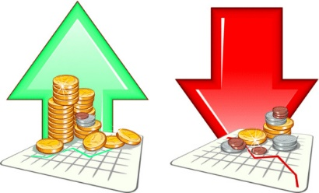
1990s
Significant advances in technology occurred around this time.
PEMFC
technology was adapted for direct methanol portable devices. Early applications included power for laptops and mobile phones.
MCFC
technology made substantial commercial advances, in particular for large stationary applications.
SOFC
technology also underwent substantial developments in terms of power density and durability for stationary applications.
Boosted by general optimism in high-technology industries, many fuel cell companies listed on stock exchanges in the late 1990s, only for prices to fall victim to the crash in technology stocks shortly after.

Slide 15
This decade was characterised by increasing concerns on the part of governments, business and consumers over energy security, energy efficiency, and carbon dioxide (CO2) emissions.
2000s
Attention has turned once again to fuel cells as one of several potential technologies capable of delivering energy efficiency and CO2 savings while reducing dependence on fossil fuels.
Government and private funding for fuel cell research increased markedly. There was been a renewed focus on fundamental research to achieve breakthroughs in cost reduction and operational performance to make fuel cells competitive with conventional technology. A good deal of government funding worldwide has also been targeted at fuel cell demonstration and deployment projects – See case studies in other units.

Slide 16
PEMFC and DMFC dominated the total market share in the portable, stationary and transport sectors.
Micro fuel cell units were sold in toys and educational kits.
PEMFC and DMFC auxiliary power units (APU) were commercialised in boats and campervans.
PEMFC and DMFC portable power units were put into service for infantry soldiers.
The greatest commercial activity occurred in the materials handling segment. Funding for demonstration fleets of fuel cell materials handling vehicles saw increasing numbers deployed in warehouses.
Fuel cell cars were available but only for lease.
Hydrogen and natural gas fuelled PEMFC units were sold in parts of India and east Africa to provide primary or backup power to mobile phone masts.
In 2009, stationary PEMFC units were installed in homes as part of a large-scale residential Combined Heat and Power (CHP) programme in Japan.
Fuel cell buses have been commercially available for several years and their usefulness has been well demonstrated. However their cost, at around five times that of a diesel bus, plus the cost of hydrogen infrastructure means that they are only used where a city deems the environmental benefit to be worth the extra investment.
Hurricane Katrina highlighted the need for reliable stationary power that exceeded the capabilities of diesel generators.

Slide 17
* Research, development and demonstration
2008 Recession…
A number of firms go out of business
Restrictions in government funding
Other companies become more commercially orientated and pursue opportunities for revenue generation that could support further RD&D* in their core competencies.
Limited credit availability
Lack of profitability for organisations that were mainly RD&D* focused
The fuel cell industry has faced and continues to face challenges as it comes through a period of recession and completes the transition from R&D to commercialisation. On the whole, it has survived extremely difficult circumstances. Although many fuel cell companies are still far from being profitable, the opportunities for growth in the future are very promising.

Slide 18
Looking to the future…
* Since the recession, governments around the world have come to see fuel cells as a promising area of future economic growth and job creation and have invested further resources in their development, something fuel cell companies have not been slow to capitalise on.
* As many Western countries seek to rebalance their economies towards high-value manufacturing and environmental technologies, fuel cells seem poised to enter a period of sustained growth.
* The success of certain application segments in recent years means that there has been a move to consolidate particular technologies into a standard reference design for a particular type of fuel cell.
* This has led to fuel cells increasingly being developed as scalable energy solutions capable of serving several different market segments, be they auxiliary power units (APU) or to power devices such as unmanned aerial vehicles (UAV).

Slide 19
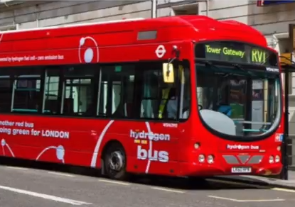
Future plans
Many countries are now engaged in high-profile demonstration projects, primarily of stationary and transport fuel cells and their associated fuelling infrastructure.
Buses are seen as a promising early market application of fuel cells due to their combination of high efficiency, zero-emissions and ease of refuelling, and due to the vehicles running on set routes and being regularly refuelled with hydrogen at their bases.
The genuine benefits that fuel cell technology offers over conventional technologies has played a part in promoting adoption. For example, the value proposition that fuel cell materials handling vehicles offer in terms of extended run-time, greater efficiency and simplified refuelling infrastructure compared with their battery counterparts makes them attractive to warehouse operators.

