Slide 1
History
Student Powerpoint
Content created by
<Partner logo>
Last updated 18th October 2019

Slide 2
Hydrogen: The story so far.
This presentation aims to dispel the myths regarding hydrogen allowing you to leave them in the past where they belong, ready to move into the future and enjoy the benefits of a hydrogen economy. Unlike a normal history session, there will be no dates to remember from the past. We will discuss the situation as it is today and look how it is changing. The only dates you need to keep in mind are the dates set out for reducing carbon emissions.

Slide 3
The energy we use daily is so reliable and constant that we don’t really give it much thought.

Slide 4
When is the last time that you really thought about where your gas or electricity was coming from?

Slide 5
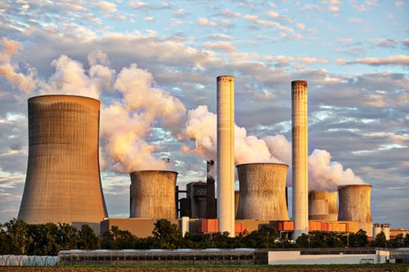
Where it was produced…

Slide 6
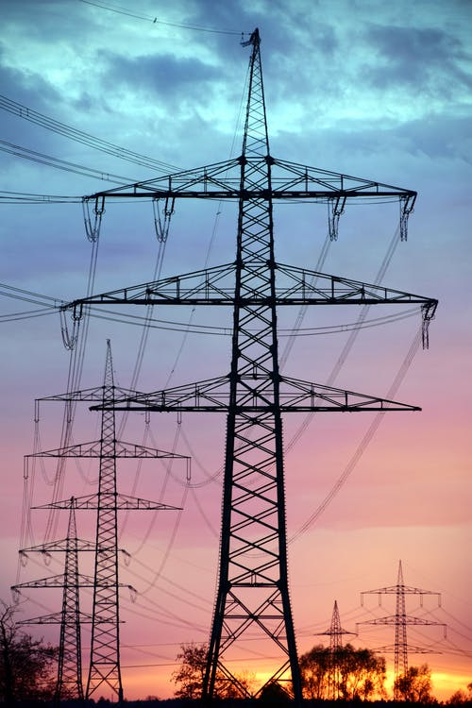
…or how it got to your home?

Slide 7
If it’s dark…

Slide 8
We turn on a light.

Slide 9
If it’s cold…

Slide 10
…we turn the heating up or add fuel to the fire.

Slide 11
If we want to travel…

Slide 12
We drive a car…

Slide 13
…catch a bus

Slide 14
Train…

Slide 15
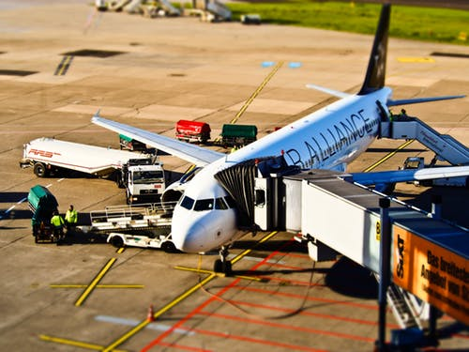
Or plane

Slide 16
Our gadgets and mobile phones are probably the only things that remind us of the need to store energy.
Imagine never needing to charge your phone!

Slide 17
All the energy we use does have to be produced, stored and distributed and the methods vary depending on the fuel type.
Fossil fuels have been the primary producer of our energy for many years and the idea of changing to a ‘new’ fuel has caused some concern over its reliability, availability, safety and storage.
As with many ‘new’ technologies, any reluctance in adopting them is usually based on a lack of understanding or believing common misconceptions.

Slide 18
Myth 1
Hydrogen is more dangerous than gasoline.

Slide 20
*Petrol is more likely to cause a fire, or an explosion when confined in a tight space due to its vapours being heavier than air.

Slide 21
*Petrol is more likely to cause a fire, or an explosion when confined in a tight space due to its vapours being heavier than air.
*Burning petrol remains as a liquid, spreading over nearby surfaces, leading to widespread fire damage.

Slide 22
*Petrol is more likely to cause a fire, or an explosion when confined in a tight space due to its vapours being heavier than air.
*Burning petrol remains as a liquid, spreading over nearby surfaces, leading to widespread fire damage.
* Hydrogen is 14 times lighter than air and when burning, vents straight up, like the flame from a lighter.

Slide 23
Check out this video…
it shows the torching of a hydrogen fuel leak and then a petrol leak in the same car.

Slide 24
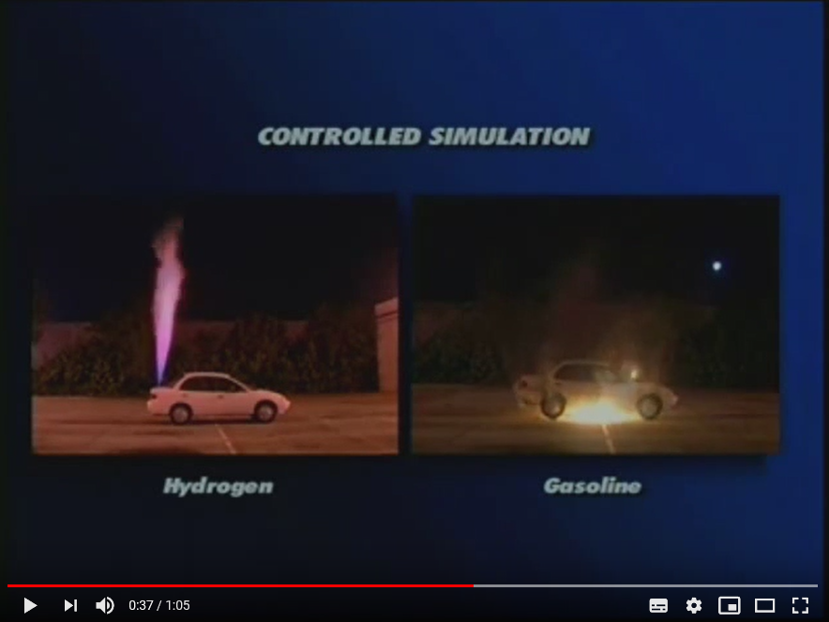
The burning hydrogen, which vented up and away, didn't damage the vehicle, whereas the petrol fire destroyed the car.

Slide 25
Myth 2
Hydrogen gas is dangerous to store and use.

Slide 27
* Hydrogen is no more dangerous than other flammable fuels or the batteries used in electric cars.

Slide 28
* Hydrogen is no more dangerous than other flammable fuels or the batteries used in electric cars.
* There exists a global multi-billion industry which has been transporting and making hydrogen for many decades.

Slide 29
* Hydrogen is no more dangerous than other flammable fuels or the batteries used in electric cars.
* There exists a global multi-billion industry which has been transporting and making hydrogen for many decades.
* Hydrogen can be used, stored and transported safely.

Slide 30
Check out this video…
It shows a bullet being fired at a carbon-fibre fuel tank containing hydrogen.

Slide 31
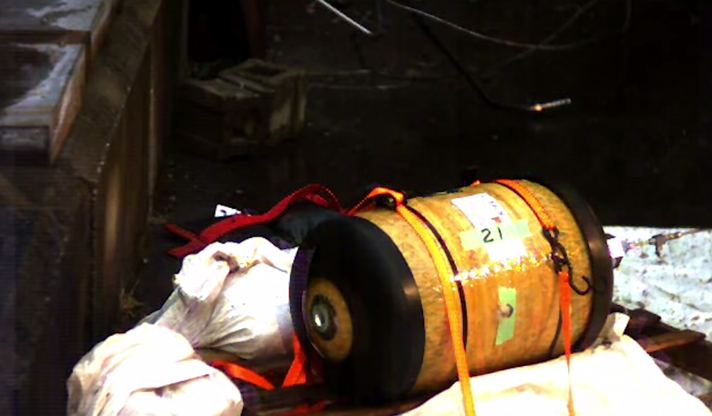
The gas escaped, harmlessly into the air.

Slide 32
Myth 3
The Hindenburg exploded because of hydrogen.

Slide 34
* The Hindenburg didn't explode.

Slide 35
* The Hindenburg didn't explode.
* Its millions of cubic feet of hydrogen burned away in less than 60 seconds.

Slide 36
* The Hindenburg didn't explode.
* Its millions of cubic feet of hydrogen burned away in less than 60 seconds.
* Most of the smoke and flames seen in the images, came from burning diesel fuel and the dirigible's painted canvas "gas bag" covering.

Slide 37
The truth is that all fuels can be dangerous if they're not properly handled. As a transportation fuel, hydrogen is less dangerous than existing fuels.

Slide 38
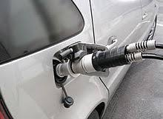
The truth is that all fuels can be dangerous if they're not properly handled. As a transportation fuel, hydrogen is less dangerous than existing fuels.
During the hydrogen fuelling process a controlled and monitored seal is created and fuelling is shut off if the seal is broken. In petrol fuelling there are no controls preventing discharge of fuel.

Slide 39
Currently, there are few hydrogen refuelling stations in Europe.
QUESTION
Can you think of any reasons why this might be?
(pause for discussion)

Slide 40
You may have said that there aren’t many hydrogen powered vehicles on the roads.
This is true.
Increasingly though, industry is deploying more hydrogen fuelled vehicles and over time, their refuelling stations will be made more accessible to the public and uptake of hydrogen powered vehicles will be able to increase.

Slide 41
Taking the UK as an example, Hydrogen refuelling centres are being built which will eventually lead to a connected network over time, similar to the initial rollout of electric vehicle charging points.

Slide 42
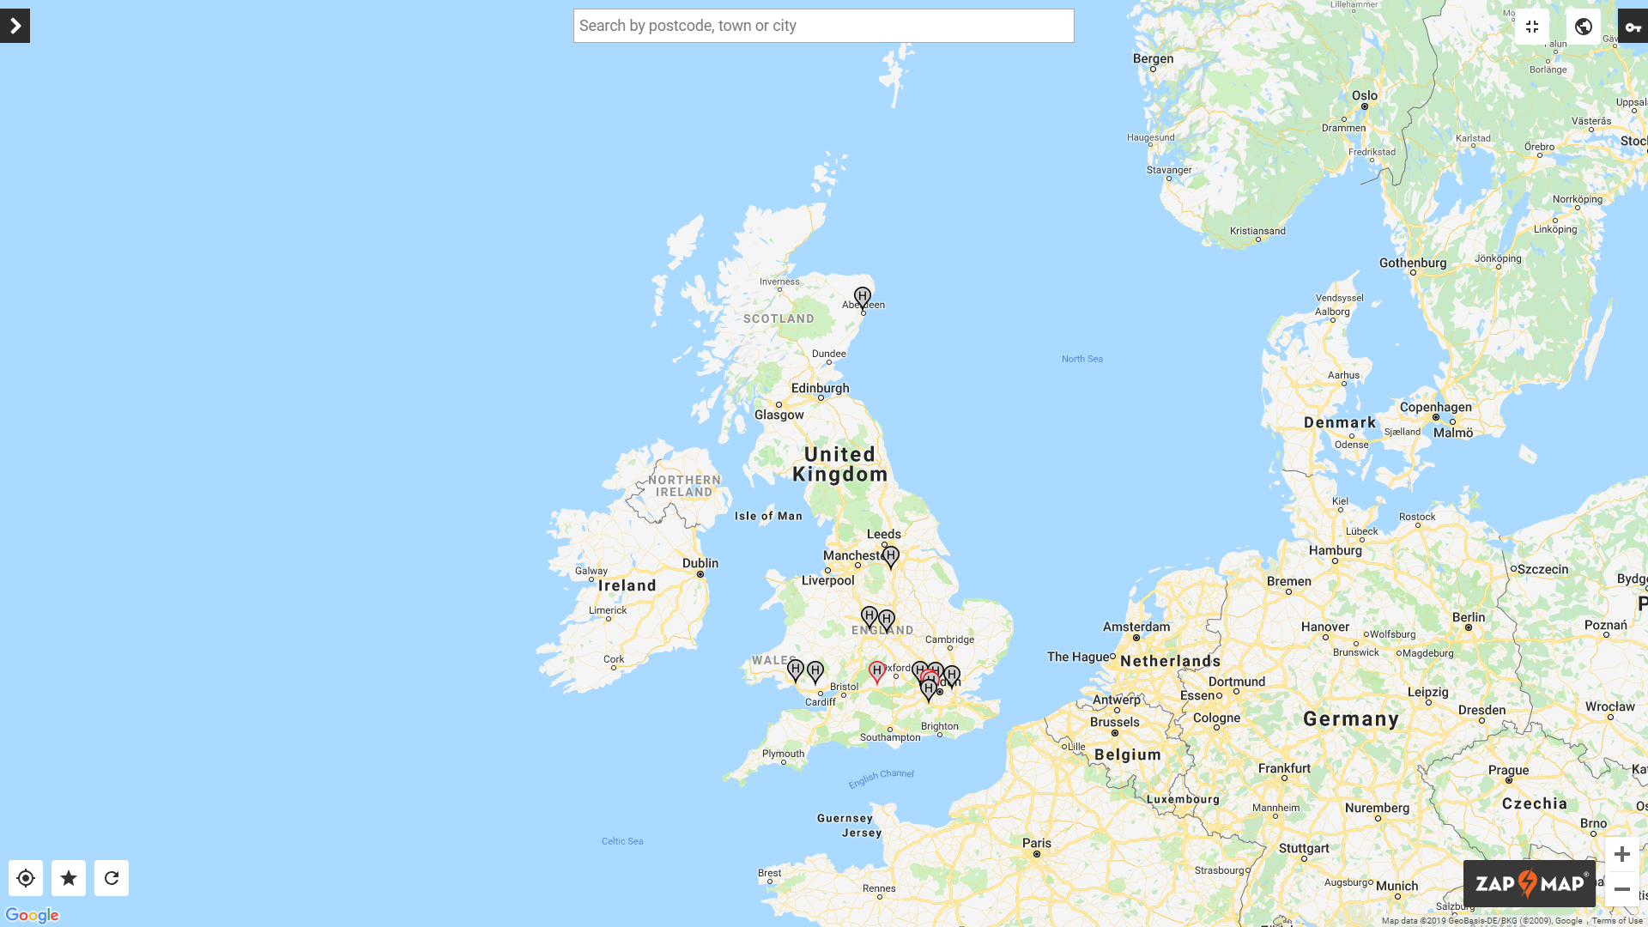

Slide 43
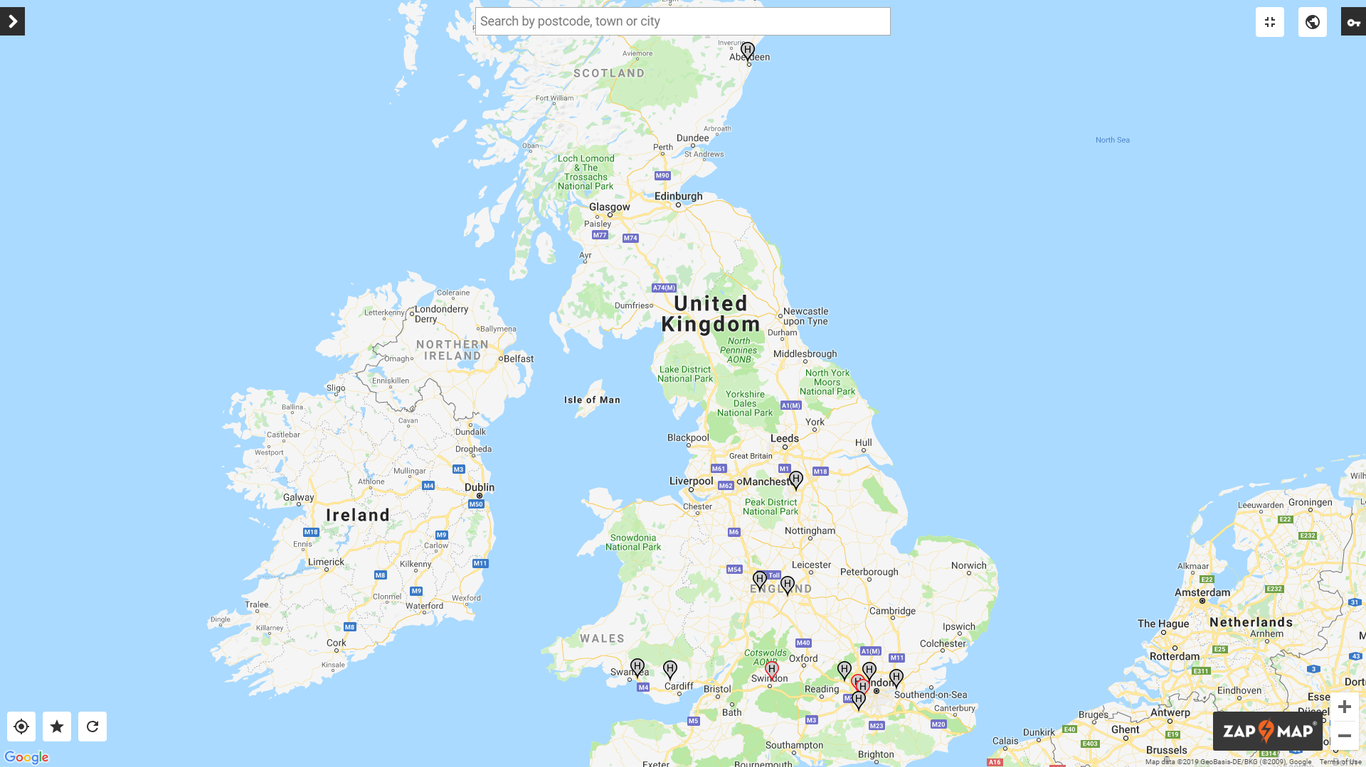
Built as part of the Aberdeen Hydrogen Bus Project in 2015

Slide 44
Built as part of the Aberdeen Hydrogen Bus Project in 2015
Arval, in Swindon lease hydrogen fuel cell vehicles to the public.

Slide 45
There are projects taking place in these areas that will inevitably lead to stations being built here too.

Slide 46
One day, in the not too distant future, the availability of hydrogen refuelling stations will be comparable with those for electric vehicles.

Slide 47
2019 ?
Of course, the UK has a relatively small surface area so ensuring the availability of hydrogen for domestic vehicles will be easier.
The development of these hydrogen ‘hubs’ however, set a precedent and prove what can be done.
This, in time will give investors and the government the security to know that their investment will be financially wise.

Slide 48
Facts and figures

Slide 49
Facts and figures
In 2017, 23 countries operated hydrogen fuelling stations with over 250 worldwide.
Asia lead the way, closely followed by Europe, each with over 40% of the total.
The Americas had 16%.
In 2018, Japan opened its 100th station, Germany its 60th and California its 39th.
The worldwide total number had grown to 337.

Slide 50
Facts and figures
In 2017, 23 countries operated hydrogen fuelling stations with over 250 worldwide.
Asia lead the way, closely followed by Europe, each with over 40% of the total.
The Americas had 16%.
In 2018, Japan opened its 100th station, Germany its 60th and California its 39th.
The worldwide total number had grown to 337.
100

Slide 51
Facts and figures
In 2017, 23 countries operated hydrogen fuelling stations with over 250 worldwide.
Asia lead the way, closely followed by Europe, each with over 40% of the total.
The Americas had 16%.
In 2018, Japan opened its 100th station, Germany its 60th and California its 39th.
The worldwide total number had grown to 337.
100
60

Slide 52
Facts and figures
In 2017, 23 countries operated hydrogen fuelling stations with over 250 worldwide.
Asia lead the way, closely followed by Europe, each with over 40% of the total.
The Americas had 16%.
In 2018, Japan opened its 100th station, Germany its 60th and California its 39th.
The worldwide total number had grown to 337.
100
60
39

Slide 53
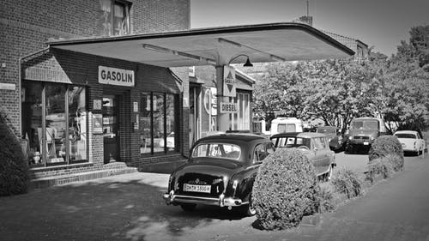
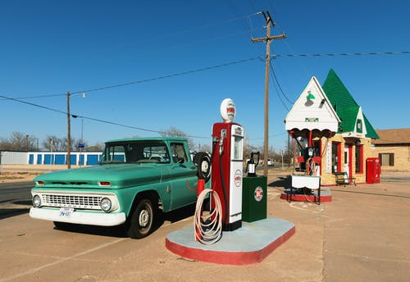
With the rapid developments occurring all over the world, a lack of hydrogen refuelling stations will soon be a historical barrier to customers investing in hydrogen powered vehicles.

Slide 54
Watch the following videos, filmed in 2008 and 2015.
Note how rapidly the technology is changing.
2008
2015
Work with a partner or in a small group to create a role play based on myths and/or changing attitudes towards hydrogen.

