Slide 1









Principles
Extra Information For Teachers
Content created by
<Partner logo>
Last updated 18th October 2019

Slide 2
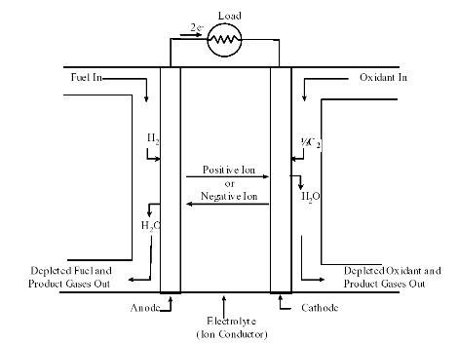
A fuel cell is a device that converts the chemical energy from a fuel into electricity through a chemical reaction of positively charged hydrogen ions with oxygen or another oxidizing agent.

Slide 3
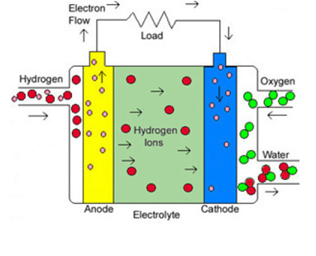
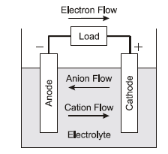
Fuel Cells Vs Batteries
Basic operating principles of both are very similar, but there are several intrinsic differences.
Hydrogen fuel cell
Chemical energy storage device
(e.g. lithium ion battery)
Open system
The anode and cathode are typically Pt on Carbon based materials. The reaction occurs at the triple phase boundary where the catalyst, electrolyte and gas meet.
Reactants are externally supplied, no recharging required.
Closed system
Anode and cathode are typically metals.
Reactants are internally consumed, need periodic recharging.

Slide 4
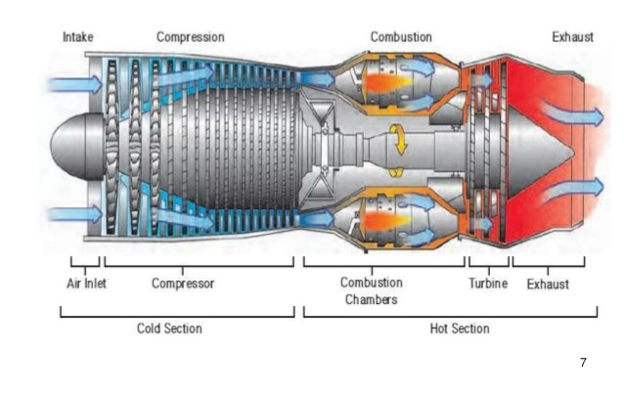
Fuel Cells Vs Thermodynamic system
Both are open system where fuel (hydrogen) reacts with the oxidant (Air)
Hydrogen fuel cell*
Thermodynamic (combustion) system
Chemical energy is directly transformed into electricity via electrochemical reaction
Efficiency is NOT limited by the Carnot limit;
Electrical energy is directly produced
Chemical energy is transformed into heat via chemical reaction
Efficiency is limited by the Carnot limit;
Mechanical energy has to be transformed into electricity
* Note that there are many types of fuel cells, which require different fuels, electrode materials and operate under varying conditions (temperature etc). The example of the Hydrogen PEM fuel cell is given as it is considered the most viable alternative to fossil fuel based combustion engines within the automotive industry.

Slide 5
The chemical reaction of a fuel cell is the following:
H₂ + ½ O₂ → H₂O + Energy
Anodic reaction: Hydrogen oxidation reaction (HOR):
H₂ → 2H⁺ + 2e⁻
Cathodic reaction: Oxygen reduction reaction (ORR) (is limiting step reaction within a fuel cell due to its sluggish kinetics):
acidic media
O₂ + 4H⁺ + 4e⁻ → 2H₂O direct (4 electron pathway) ,
O₂ + 2H⁺ + 2e⁻ → H₂O₂ indirect (2 electron pathway) H₂O₂ + 2H⁺ + 2e⁻ → 2H₂O
Alkaline media
O₂ + 2H₂O + 4e− → 4OH− direct (4 electron pathway)
O₂ + H₂O + 2e− → HO₂− + OH− indirect (2 electron pathway)
HO₂− + H₂O + 2e− → 3OH−
The 4 electron is desired as the hydrogen peroxide produced in the 2 electron pathway can cause cell degradation and loss of efficiency. An efficient catalyst is therefore required for the 4 electron pathway to occur. This is typically Pt based.

Slide 6
Thermodynamic main properties are:
ΔH_{r} : Standard Enthalpy (= total energy) of reaction
ΔG_{r} : Free Gibbs energy(= available electrical energy) of reaction
ΔS_{r} : Entropy (= heat disorder.. ) of reaction
T : Reaction temperature
Related by the following:
ΔH_{r} = ΔG_{r} + T ΔS_{r}

Slide 7
H₂ + ½ O₂ → H₂O + Energy
Thermodynamic properties depend on:
Reacting species
Temperature
Pressure
For hydrogen reaction in fuel cells:
ΔH_{r} at 25°C and 1 bar: 241.61 kJ/mol
ΔS_{r} at 25°C and 1 bar: 43.58 J/mol K
ΔG_{r} at 25°C and 1 bar: 254.61 kJ/mol

Slide 8
H₂ + ½ O₂ → H₂O + Energy
ΔH_{r} = ΔG_{r} + T ΔS_{r}
Note that ΔG_{r} and ΔS_{r} are functions of temperature

Slide 9
H₂ + ½ O₂ → H₂O + Energy
Fuel cells convert chemical energy directly into electrical energy. In the ideal case of an electrochemical converter, such as a fuel cell, the change in Gibbs free energy, ΔG, of the reaction is available as useful electric energy at the temperature of the conversion.
ΔG_{r} = WORK
with work equivalent to charge moved in the electric field (potential) it follows:
ΔG_{r} = n F E_{r}
n = mole of electrons involved in the reactions. For hydrogen n=2
F = Farday constant 96485.3329 C/mol
E_{r} = ideal reaction potential

Slide 10
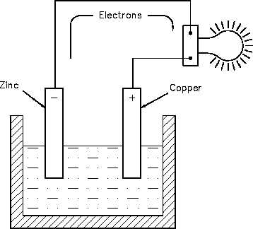
Ideal reaction potential in a battery
Cu²⁺ + 2e⁻ → Cu
Zn → Zn²⁺ + 2e⁻
Cu²⁺ + Zn → Cu + Zn²⁺
Redox reactions

Slide 11
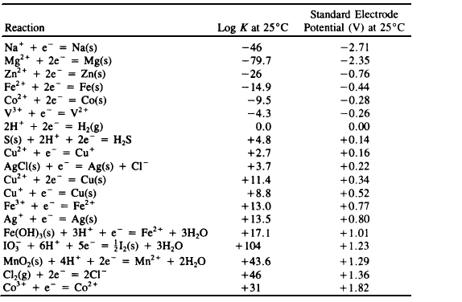
Ideal reaction potential in a battery
E₀
Cu²⁺ + 2e⁻ → Cu (E = +0.34 V)
Zn → Zn²⁺ + 2e⁻ (E = −0.76 V)
Cu²⁺ + Zn → Cu + Zn²⁺
E₀ =0.34 V −(−0.76 V) = 1.10 V

Slide 12
Ideal reaction potential in a fuel cell
E_{r} = ΔG_{r} / ( n F )
H₂ + ½ O₂ → H₂O + Energy
In standard conditions: E₀ = 1.185 V

Slide 13
Standard reaction potential in a fuel cell
Reaction potential (E_{r}) is function of thermodynamic conditions, like ΔG_{r}
E_{r} decreases when temperature increases

Slide 14
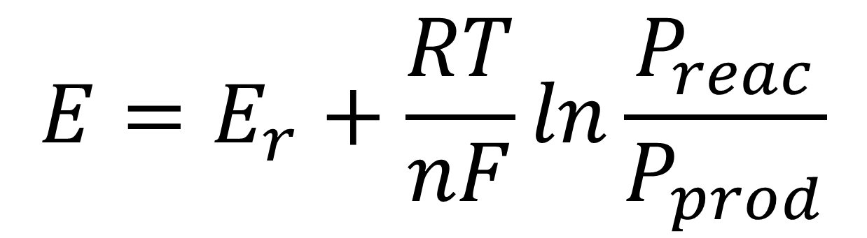
Nernst low
Reaction potential → Equilibrium potential
$$E=E_{r}+\frac{RT}{nF}ln\frac{P_{reac}}{P_{prod}}$$
The Nernst equation provides a relationship between the ideal standard potential (E_{r}) for the cell reaction and the ideal equilibrium potential (E) at other temperatures and partial pressures of reactants (P_{reac}) and partial pressures of products (P_{prod})

Slide 15
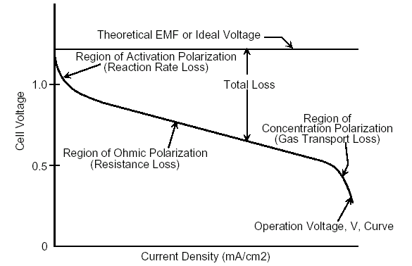
Useful amounts of work (electrical energy) are obtained from a fuel cell only when a reasonably current is drawn, but the actual potential is decreased from its equilibrium potential because of irreversible losses
The losses are called:
Activation Polarization
Ohmic Polarization
Concentration Polarization

Slide 16

Cell Voltage
The cell voltage includes the contribution of the anode and cathode potentials and ohmic polarization:
V_{cell} = V_{cathode} – V_{anode} – iR
Is possible to define voltage efficiency: as the ratio between cell real voltage (V) and ideal voltage (E_{r}).
$$η_{v}=\frac{V}{E_{r}}$$

Slide 17
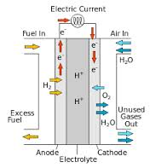
Reactant utilization
It is apparent from the Nernst equation that fuel and oxidant gases containing higher partial pressures of electrochemical reactants produce a higher cell voltage.
To keep high operative voltage not all the hydrogen reacts in the cell and a part of the fuel is vented in the outlet.

Slide 18


Is possible to calculate the utilization of hydrogen and of oxygen as the ratio between reacted species and inlet one.
Fuel Utilization factor
Reacted species are directly calculated from the current (I).
Since current is defined as the product of electron mole flow and Faraday constant:
$$I={F∗mol e}^{−}$$
And electron mole flow is twice hydrogen involved in the reaction:
H₂ → 2e⁻ + 2H⁺
$${mol e}^{−}=2∗H_{2reac}$$
Anodic semi-reaction

Slide 19
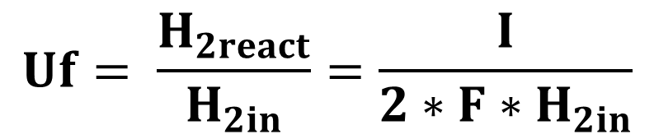
Is possible to calculate the utilization of hydrogen and of oxygen as the ratio between reacted species and inlet one.
Fuel Utilization factor
$$Uf= \frac{H_{2react}}{H_{2in}}=\frac{I}{2∗F∗H_{2in}}$$

Slide 20
In general is possible to define cell efficiency as the ratio between outlet power P_{out} (electrical) and inlet power P_{in} (fuel energy)

Slide 21
Is possible to elaborate the equation so to obtain..
.. that fuel cell efficiency depends on reversible efficiency, utilisation of fuel and voltage efficiency.

Slide 22
In general:
η_{rev} depends on the type of fuel (in general hydrogen) and on the thermodynamic conditions;
u_{f} is related to the design of the cell;
η_{v} depends on the performance of the materials and on the quality of contacts;

Slide 23
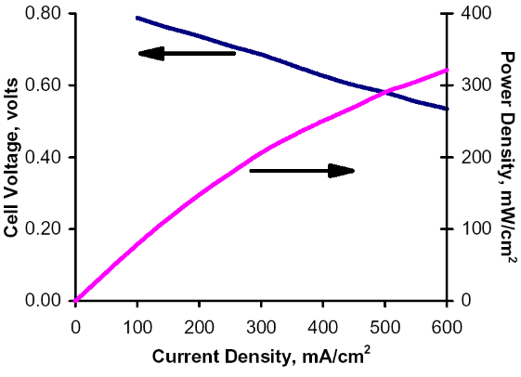
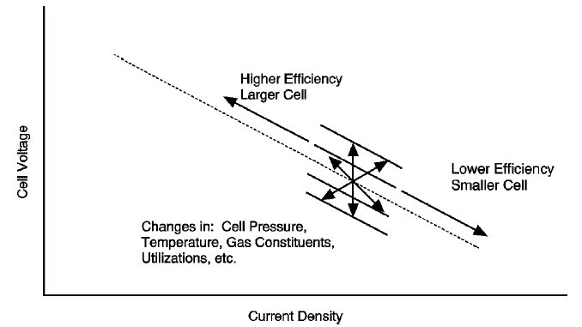
Parameter with impact on fuel cell efficiency
  Temperature
  Pressure
  Utilisation of reactants
  Current density
  Impurities/contaminant
  time
Operating conditions are a trade off between operative cost and capital cost.

