Slide 1
Principles
Student Powerpoint – Hydrogen Technologies
Content created by
<Partner logo>
Last updated 18th October 2019

Slide 2
What is a fuel cell?
A fuel cell is an energy conversion device
It converts the chemical energy of a fuel directly into electricity.
Photo by Utahraptor ostrommaysi / CC BY
Photo By LPS.1 - Own work, CC0

Slide 3
What is a fuel cell?
What does directly mean?
Directly means that instead of burning the fuel and using the heat in a classic engine the electricity is generated straight away!
The efficiency of the process is higher, a great part of the chemical energy possessed by the fuel is turned into electricity (up to ~70%).
Photo by Utahraptor ostrommaysi / CC BY
Photo By LPS.1 - Own work, CC0

Slide 4
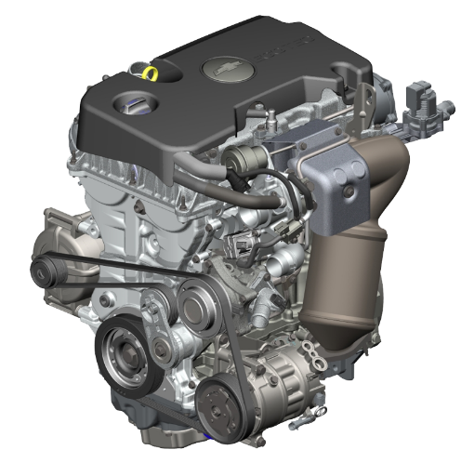
What is a fuel cell?
Fuel cells have common features with traditional thermal engines and batteries
Like internal combustion engines, fuel cells needs a continuous fuel stream
The working principle of a fuel cell is based on a redox reaction, exactly like a battery

Slide 5
What is a fuel cell?
They are also different from engines and batteries:
Batteries have a limited amount of energy stored inside them and the recharge time is slow, fuel cells are only limited by the size of the fuel tank.
With a continuous fuel stream they can produce energy continuously
Internal combustion engines burn the fuel and use the heat in a thermodynamic cycle. Their efficiency is lower.

Slide 6
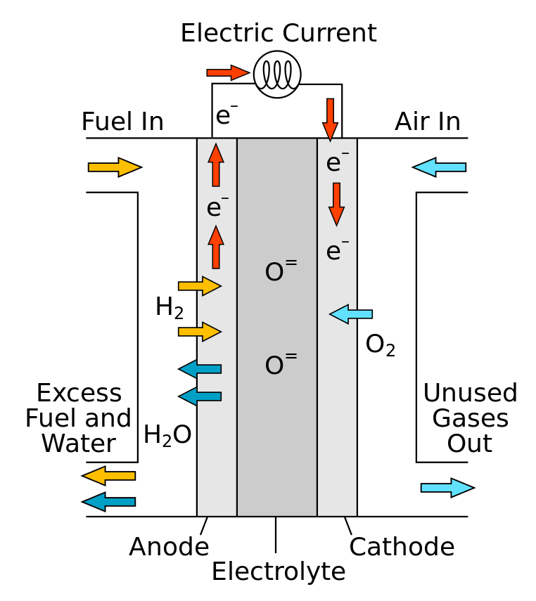
Fuel cell components
A Fuel Cell is made of two porous electrodes sandwiched around the electrolyte
Photo by Sakurambo / CC BY

Slide 7
Fuel cell components
A Fuel Cell is made of two porous electrodes sandwiched around the electrolyte
Electrolyte
a physical barrier to avoid direct mixing of fuel gas and oxidant (cross-over)
allows transport of ionic charge between the two electrodes, closing the electric circuit.

Slide 8
Fuel cell components
A Fuel Cell is made of two porous electrodes sandwiched around the electrolyte
Electrodes
- Porous material, provide the diffusion of active species
- The active surface where redox reactions occurs
- Allow conduction of ions and electrons produced in the redox reactions

Slide 9
Fuel cell components
A Fuel Cell is made of two porous electrodes sandwiched around the electrolyte
Electrodes
Anode is also called the “Fuel Electrode” and assumed to have a negative polarity.
Cathode is also called the “Air Electrode” and it is designed as the positive electrode.

Slide 10
Fuel cell operation
Fuel is continuously fed on the anode side of the cell.

Slide 11
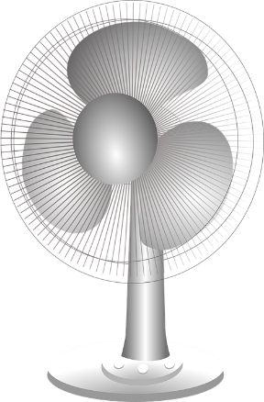
Fuel cell operation
Air or oxygen are continuously fed on the cathode side of the cell

Slide 12
Fuel cell operation
O²⁻ / H⁺
Ions flow through the electrolyte

Slide 13
Fuel cell operation
Electrons flow through the external circuit, powering devices.

Slide 14
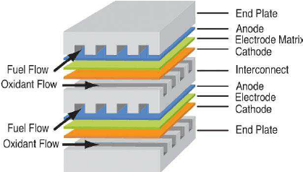
Fuel cell stack
A single fuel cell produces a small voltage (~1V). In order to obtain a voltage suitable for practical applications the single cells are connected in series to form a stack.
A fuel cell stack is composed of several elements that create the correct working conditions for the cell and allow an efficient collection of the energy produced.

Slide 15
Fuel cell stack: interconnect
The interconnect is an electrically conductive element, usually a metal plate, that provides mechanical support to the cell and is machined to obtain the volumes where anodic and cathodic gases can flow. Each gas chamber needs to be isolated from the others. Sealing material is added to avoid gas crossover.

Slide 16
Fuel cell stack: interconnect
Interconnect requirements:
High electrical conductivity
Chemical compatibility with the cell materials and the fuel/oxidant employed
Stable at high temperatures (structurally and chemically)

Slide 17
Fuel cell stack: sealing
To avoid leakage of the gas introduced in the stack and crossover of fuel and air from one gas manifold to the other, a sealant is added in various positions of each layer of the stack.
The materials employed for the seal are essentially of 3 kinds:
Mineral (mica based)
Glass-ceramic
Metal braze

Slide 18
Fuel cell stack: sealing
Sealing material characteristics:
Chemical and mechanical stability in the fuel cell working environment
Electric insulator
(strong dielectric)
Porous-free
Coefficient of thermal expansion (CTE) compatible with the joined materials

Slide 19
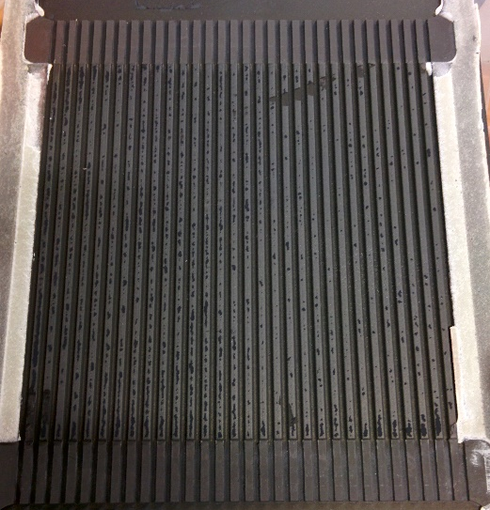
Fuel cell stack: current collector
The electric current generated by the cell must be collected and transferred to the bipolar plate by creating an electric connection on several points of the cell surface.
The current collector fulfills this task and its geometry is optimized to continually harvest the electron flow generated by the cell and allow an unconstrained gas supply to the electrodes.

Slide 20
Fuel cell stack: current collector
Current collector characteristics:
Chemical and mechanical stability in the fuel cell working environment
Excellent electric conductor
Porous/mesh structure to allow gas flow to the cell
Geometry that guarantees a uniform gas distribution on the surface of the cell

Slide 21
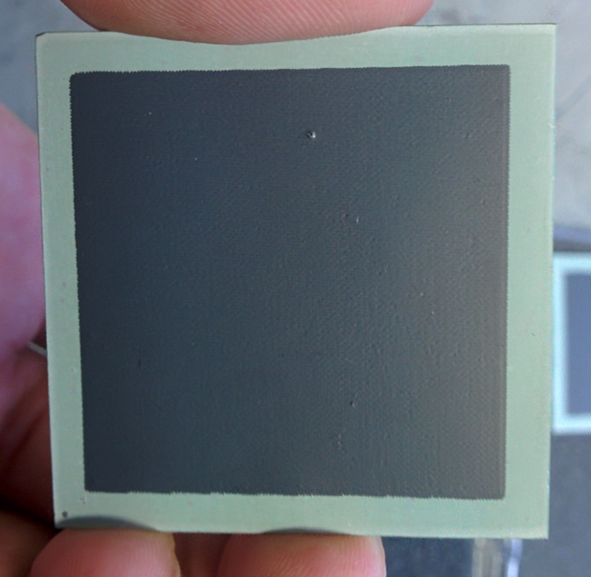
High temperature fuel cells
SOFC
Solid Oxide Fuel Cells
MCFC
Molten Carbonate Fuel Cells
Both technologies operate at high temperature (600-900°C) and this allows the use of several fuels other than pure H₂. The high operative temperature offers the possibility of using the excess heat produced for industrial or domestic purposes (cogeneration) or to produce further electrical energy employing a classic thermodynamic cycle.
The materials employed in SOFCs and MCFC and the electrochemical reactions taking place inside them are different.

Slide 22
High T fuel cells: fuels
Why do high temperature fuel cells allow the use of alternative fuels other than H₂?
Reforming
Reforming is a class of thermochemical reactions where a fuel is converted to another, usually a mixture of fuel gases called syngas (synthetic gas).
Reforming of light hydrocarbons (methane, methanol, ethanol etc.) and other H₂-carrying molecules (such as NH₃) is favoured at high temperature and with common materials as catalysts (Fe, Ni, Cu).
The product of those reactions is a syngas rich in H₂ and CO which is an ideal gas mixture to feed SOFC and MCFC cells.
Here, as an example, is the equation for the reforming of methane with water steam:
Steam methane reforming

Slide 23
High T fuel cells: advantages
High efficiency in converting chemical to electrical energy (up to ~70%).
Possibility to use a wide range of fuels.
Very low emissions: no NO_{x}, sulphur compounds, soot or cyclic hydrocarbons; CO₂ emissions are lower than conventional systems due to higher efficiency and absent in the case of pure H₂ used as fuel.
The excess heat produced by the system can be used for heating purposes.
No moving parts, avoiding noise emissions.
High efficiency independent from system size: ideal candidates for distributed power generation and creation of micro grids.

Slide 24
High T fuel cells: drawbacks
High market cost: due to the fact that it’s a new technology, the prices will decrease once mass production is reached.
Endurance of the systems must be improved: it’s necessary to reach a sufficient amount of working hours while keeping the degradation of system performances under an acceptable level.
System stability in the case of carbon containing fuels must be improved.

Slide 25
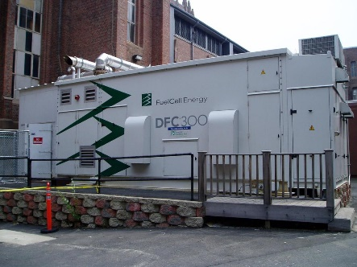
MCFC
Molten Carbonate Fuel Cells

Slide 26
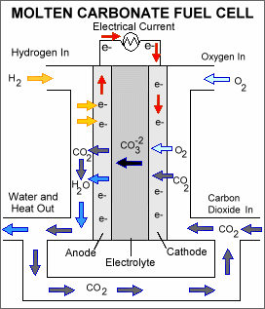
Molten carbonate fuel cells
Anode reaction:
Cathode reaction:

Slide 27
Molten carbonate fuel cells
Electrolyte
The electrolyte is usually a combination of alkali carbonates (Na and K), which is retained in a ceramic matrix of LiAlO₂
The fuel cell operates from 600°C to 700°C, where the alkali carbonates form a highly conductive molten salt, with carbonate ions providing ionic conduction
The ions flowing through the electrolyte are CO₃²⁻, thus a CO₂ flow is required at the cathode

Slide 28
Molten carbonate fuel cells
Anode
Due to high working temperatures noble catalysts are not required
The electrode is composed of porous metal Nickel
The flow of CO₃²⁻ ions towards the anode leads to the generation of water and CO₂ in the anode compartment. The separation and sequestration/reutilization of CO₂ is easily realised by water condensation

Slide 29
Molten carbonate fuel cells
Cathode
The porous electrode is usually realised in nickel oxide (NiO).
A mixture of air and CO₂ is fed to the cathode
The use of CO₂ present in the gas stream makes MCFC ideal candidates for carbon capture from CO₂-rich flue gases

Slide 30
MCFC design concepts
MFCF cell construction is planar.
MCFC cells produce a limited amount of current compared with other types of fuel cells, the power density is low, so big cells are necessary. This makes them suitable for stationary power production.
The matrix is flexible and complies with mechanical stress, allowing the production of cells with a wide area.
Other than H₂, other fuels (CH₄, CO, CH₃OH) can be employed.

Slide 31
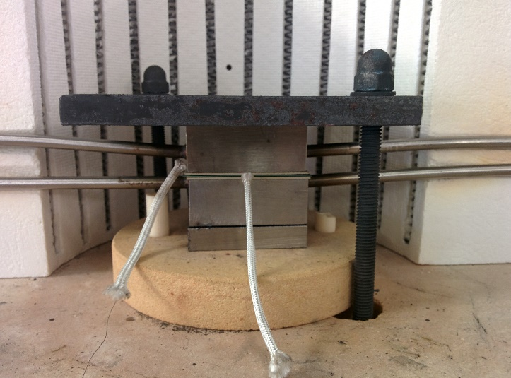
SOFC
Solid Oxide Fuel Cells

Slide 32
Solid oxide fuel cells
Anode reaction:
Cathode reaction:

Slide 33
Solid oxide fuel cells
Electrolyte
The electrolyte is a fully dense ceramic, usually YSZ (Yttria Stabilized Zirconia) or GDC (Gadolinia doped Ceria). The absence of pores avoids crossover problems
The fuel cell operates from 600°C to 900°C, the high temperatures are necessary to have high ionic conductivity and reduce energy loss due to ionic conduction
The ions flowing through the electrolyte are O²⁻, water is generated in the anodic gas compartment

Slide 34
Solid oxide fuel cells
Anode
Due to high working temperatures noble catalysts are not required
The anode is usually a porous cermet (mixture of ceramic and metal), namely Ni+YSZ (nickel + ZrO₂)

Slide 35
Solid oxide fuel cells
Cathode
The material of the cathode is a mixture of oxides with a crystalline structure and composition that makes them good electronic conductors. The two most used materials are LSM (Lantanium Strontium Manganite) and LSCF (Lantanium Strontium Cobalt Ferrite)
No noble metals are required but until now it has been impossible to avoid the use of rare earth elements to catalyse the reaction of oxygen.

Slide 36
SOFC design concepts

Slide 37
SOFC design concepts
In state of the art stacks, SOFC cells are very thin (0.3-1mm) and planar.
The preferred configuration is ASC (anode supported cells). Using a thick anode as mechanical support allows the use of a thin electrolyte, minimizing energy losses.
SOFC cells produce an amount of current of an order of magnitude higher than MCFC, the power density is high so it’s possible to have compact stacks.
The mechanical properties of the cells and the necessity to produce very thin layers makes it hard to manufacture wide dimension SOFCs.
Other than H₂, other fuels (CH₄, CO, CH₃OH, NH₃) can be employed.

