Slide 1









Production
Student Powerpoint – Hydrogen Production Methods
Content created by
<Partner logo>
Last updated 18th October 2019

Slide 2
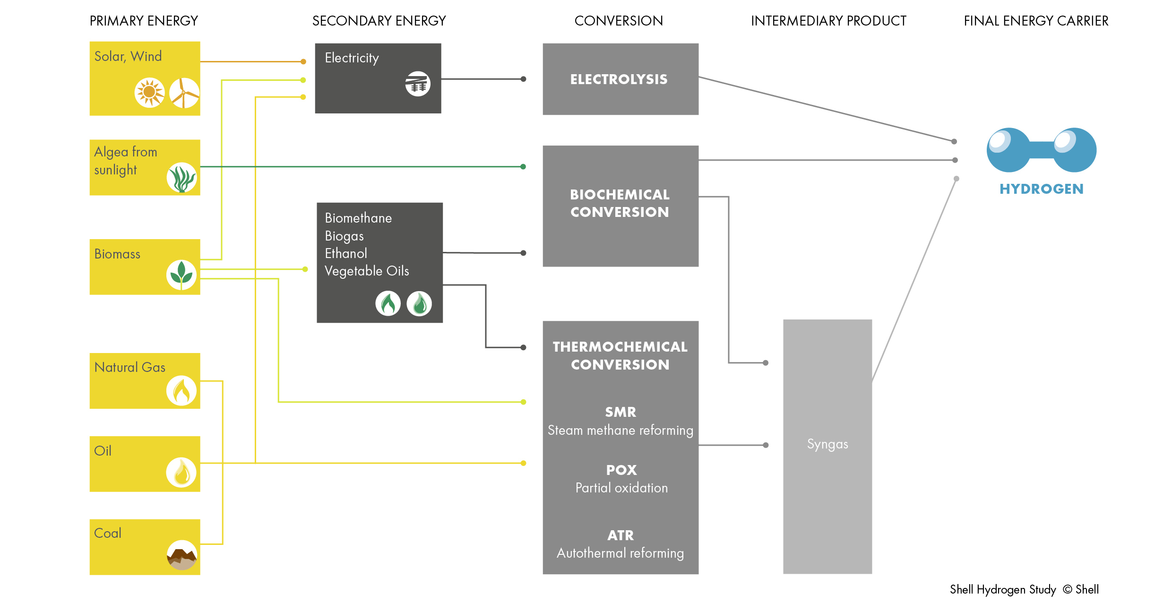

Slide 3
Hydrogen is not a primary fuel unlike oil, coal and natural gas. However, like electricity it is an energy carrier. Hydrogen is a secondary form of energy that is produced using primary energy sources.
This diagram shows the life cycle of hydrogen when sourced from renewable energies. It also demonstrates that hydrogen is produced from water, which is used in conjunction with oxygen to generate useful energy such as electricity, giving water as a product.

Slide 4
Hydrogen Production Processes
Hydrogen might be the most abundant element on earth but it is rarely found in its pure form. Practically, this fact means that in order to produce hydrogen, it needs to be extracted from its compound.
Of course, this extraction process needs energy but hydrogen can be produced or extracted using virtually any primary source of energy, be it fossil or renewable
This diversity of potential supply sources is THE most important reason why hydrogen is such a promising energy carrier.
Hydrogen can be produced using a number of different processes.
.
Thermochemical processes use heat and chemical reactions to release hydrogen from organic materials such as fossil fuels and biomass.
Water (H₂O) can be split into hydrogen (H₂) and oxygen (O₂) using electrolysis or solar energy.
Microorganisms such as bacteria and algae can produce hydrogen through biological processes.

Slide 5
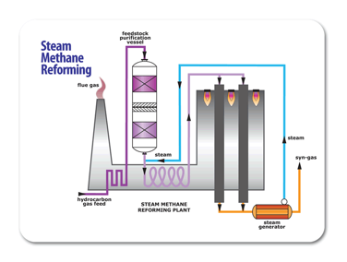
Thermochemical Processes
Some thermal processes use the energy in various resources, such as natural gas, coal, or biomass, to release hydrogen from their molecular structure. In other processes, heat, in combination with closed-chemical cycles, produces hydrogen from feedstocks such as water.
Two examples are outlined in the following slides
Steam Methane Reforming (SMR) Biomass Gasification

Slide 6
Steam Methane Reforming
Approximately 97% of commercially available hydrogen is produced by Steam Methane Reforming (SMR).
SMR involves several processes:
The reaction of methane (CH₄) and steam to form H₂ and CO
Endothermic reaction occurring at approximately 815°C and 3.5 MPa over a nickel based catalyst.
The second reaction is known as the water-gas shift reaction which converts CO and steam to CO₂ and H₂ and is split into two steps, the low temperature shift (LTS) and high temperature shift (HTS).
LTS - Exothermic reaction occurring at 200°C using a CuO catalyst HTS - Exothermic reaction occurring at 350°C in the presence of an Fe₂O₃ catalyst
In a final process called ‘pressure-swing adsorption’, CO₂ and other impurities are removed from the gas stream, leaving essentially pure hydrogen.
*Steam reforming can also be used to produce hydrogen from other fuels, such as ethanol, propane or even gasoline.

Slide 7
Steam Methane Reforming
For chemists:
Steam-methane reforming reaction
CH₄ + H₂O (+ heat) → CO + 3H₂
Water-gas shift reaction
CO + H₂O → CO₂ + H₂ (+ small amount of heat)

Slide 8
Biomass Gasification
A majority of biomass like wood chip and agricultural/municipal waste can contain appreciable amounts of hydrogen. Gasification of such biomass can produce synthesis gas (syngas) which involves heating the organic material to above 700 °C under a controlled atmosphere of oxygen and/or steam as shown below. Gasification of biomass also produces useful by‑products such as ethanol and acetate.
Diagram showing the basic process of biomass gasification for hydrogen production.

Slide 9
Electrolytic Processes
Electrolysis
Electrolysers use electricity to split water into hydrogen and oxygen. This technology is well developed and available commercially, and systems that can efficiently use intermittent renewable power are being developed
Hydrogen can be manufactured without producing greenhouse gases through the electrolysis of water using a renewable energy source such as solar or wind energy.
Direct Solar Water Splitting Processes Direct solar water splitting, or photolytic, processes use light energy to split water into hydrogen and oxygen. These processes are currently in the very early stages of research but offer long-term potential for sustainable hydrogen production with low environmental impact.
Schematic of a typical electrolytic cell for hydrogen production from water.

Slide 10
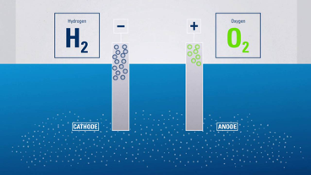
Electrolysis
In this process, the electrolysis breaks down water into hydrogen and oxygen by using electricity. If the electricity used, springs from renewable energy sources like wind or solar and the hydrogen produced is used in a fuel cell, then the entire energy process would create no net emissions. In this case, we would be talking about “green hydrogen”.
The electrolyser consists of a DC source and two noblemetal-coated electrodes, which are separated by an electrolyte.
In an alkaline electrolyser the cathode (negative pole) loses electrons to the aqueous solution.
The water is dissociated, leading to the formation of hydrogen (H₂) and hydroxide ions (OH -)
The charge carriers move in the electrolyte towards the anode. At the anode (positive pole) the electrons are absorbed by the negative OH – anions. The OH – anions are oxidised to form water and oxygen. Oxygen rises at the anode. A membrane prevents the product gases H₂ and O₂ from mixing but allows the passage of OH – ions.
High temperature electrolysis is particularly interesting when there is a source of heat next to the electrolyser as it is often the case in industrial plants. Indeed, some of the energy is supplied as heat, which is either free or cheaper than electricity, and also because the electrolysis reaction is more efficient at higher temperatures.
The choice of a given electrolysis technology depends on the use needs and the local context.

Slide 11
Biological Processes
Production of hydrogen from biomass using biological processes has been an attractive method in recent times since significant amounts of hydrogen can be harvested from agricultural and municipal waste.
Microbes such as bacteria and microalgae can produce hydrogen through biological reactions, using sunlight or organic matter. These technology pathways are at an early stage of research, but in the long term have the potential for sustainable, low-carbon hydrogen production.
Diagram depicting hydrogen production via dark fermentation.

Slide 12

Hydrogen as a by-product
Hydrogen as a by-product is an interesting and cheap source of hydrogen to initiate the deployment of hydrogen applications in the area where it is produced. Not surprisingly regions with high quantities of hydrogen as a byproduct are among the most advanced in their hydrogen deployment strategy.
Some industrial processes produce hydrogen as a by-product. Electrochemical processes, such as the industrial production of caustic soda and chlorine produce hydrogen as a waste product.
These sources can be broken down into three categories:
The “merchant” category supplies hydrogen to other industrial customers
The “captive” category retains hydrogen on site for its own use.
Only “by-product” hydrogen has no further use within the process or on site; only this category can be made available for other applications, such as fuel cell electric vehicles.

Slide 13
Task – Choose one production method and find a company that uses it. Create a profile on the company and make a presentation outlining its processes and how it contributes to the hydrogen economy.

