Slide 1









Risk Management
Extra Information For Teachers
Content created by
<Partner logo>
Last updated 18th October 2019

Slide 2
Risk management when working with H2
Hydrogen properties
  Basics of hydrogen properties
  Properties in a table
Major safety rules when using hydrogen
  List of very important considerations
  Specific skills and knowledge of the workers & employees
  Remove any potential ignition sources
  Choose the right material for hydrogen components
  Piping design & labelling
  Take care when welding & fitting
Specific rules when using liquid hydrogen
Pictograms and warnings for the working environment
Check procedure of a fuel cell installation
How to mitigate risks when working on a FC vehicle
  Environment safety devices: ventilation & H2 detectors
  Vehicle safety devices: H2 detectors & thermal fuse
  Working procedures
Lessons learned after accidents

Slide 3

Basics of hydrogen properties
Gas at room temperature
Liquid under -253°C (cryogenic)
Energy vector
Free of carbon
Clean energy
Lighter than air
No smell
Not visible
No toxicity
Produced from different sources
Can be stored
Can be transported
Density gas 90 g/Nm³
liquid 70,8 kg/m³
gasoline 720 kg/m³
Octane number H2 > 140
Octane number gasoline > 95

Slide 4
Hydrogen properties in a table

Slide 5
Hydrogen properties in a table
Reminders concerning the values in the table
¹ The boiling point at 1 atm pressure
² Heating values are the energy, per gram of fuel, generated by a combustion reaction. The higher heating value (HHV) is obtained when all of the water formed by combustion is liquid. The lower heating value (LHV) is obtained when all of the water formed by combustion is vapour.
³ Experimentally determined flame temperatures are shown in the table.
⁴ In air at 1 atm pressure

Slide 6

Major safety rules when using hydrogen
List of very important considerations
Understanding the properties of hydrogen can help to design a workspace that can mitigate any hazards.
Selection of construction materials must be done carefully taking into account the effects of hydrogen on their mechanical properties under typical operating conditions.
Hazards can be "designed out" in order to reduce risks during construction of the workspace. (anticipation from the beginning)
The piping system for delivering hydrogen should be designed and installed with care in order to reduce leaks and enable their detection with ease.
Implementing interlock systems in the workspace which operate in conjunction with hydrogen and fire detectors can drastically improve safety.

Slide 7

Major safety rules when using hydrogen
Specific skills and knowledge of the workers & employees
Personnel working in the presence of hydrogen should be trained in the following:
The behaviour and properties of hydrogen
Safety requirements for working with or close by to high-pressure hydrogen
Safety requirements for working with or close by to cryogenic liquid hydrogen
The inspection of hydrogen equipment, operation and maintenance
First aid procedures
Emergency and safe evacuation procedures

Slide 8
Major safety rules when using hydrogen
Remove any potential ignition sources
Because the energy needed to ignite a suitable mixture of hydrogen and air is very small, it is very important to avoid any energy source nearby a potential leak. These may be:
Static electricity and electric charge from operating equipment
Impact, friction and metal fracture
Open flame, high-velocity jet heating, hot surfaces and vehicle exhaust
According to the National Fire Protection Association (NFPA 55), compressed hydrogen gas and liquid hydrogen storage vessels should be located at least 50 feet from combustible materials.
Mixtures close to optimal combustion conditions are assumed to be prone to spontaneous ignition, i.e. 29% hydrogen-to-air volume ratio

Slide 9


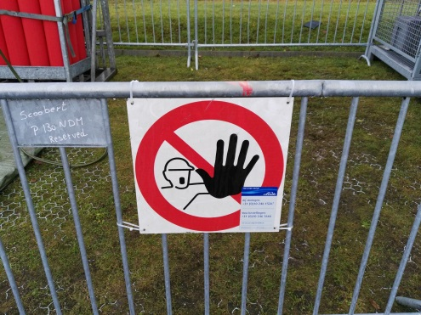
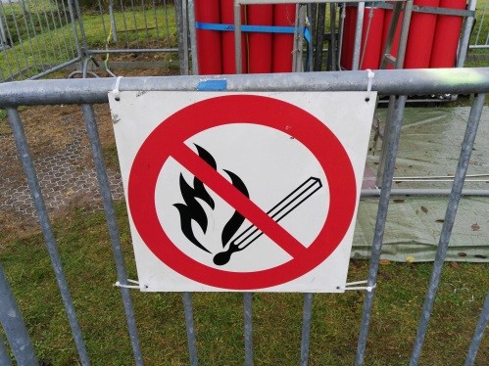
Major safety rules when using hydrogen
Remove any potential ignition sources
Some examples of safety signs

Slide 10
Major safety rules when using hydrogen
Choose the right material for components
Materials in contact with hydrogen :
Suitable storage and piping materials for hydrogen include austenitic stainless steels, aluminium alloys, copper and copper alloys.
Metals which undergo severe hydrogen embrittlement are nickel, nickel alloys and cast irons.
Specific with liquid hydrogen at -253°C
Certain materials can change from being ductile to brittle as temperature decreases.
Large temperature difference between ambient and cryogenic conditions can cause thermal contraction in a majority of materials.

Slide 11
Major safety rules when using hydrogen
Piping design & labelling
Hydrogen piping systems should be designed and installed with care in order to reduce the risk of leaks and enable their easy detection. Therefore, piping systems must be designed in accordance with the applicable codes and standards in order to:
Reduce leaks via the use of welded joints wherever possible.
Ensure joints and fittings are easily accessible for leak checks.
Prevent or minimise the risk of personal injury.
Reduce structural and thermal stresses in piping components and connected equipment.
Ensure gas-tight joints.
Determine appropriate sizes and settings of pressure relief devices.
Appropriately label shutoff valves at safe locations.
Always ensure that piping is labelled indicating content, flow direction and test pressures.

Slide 12
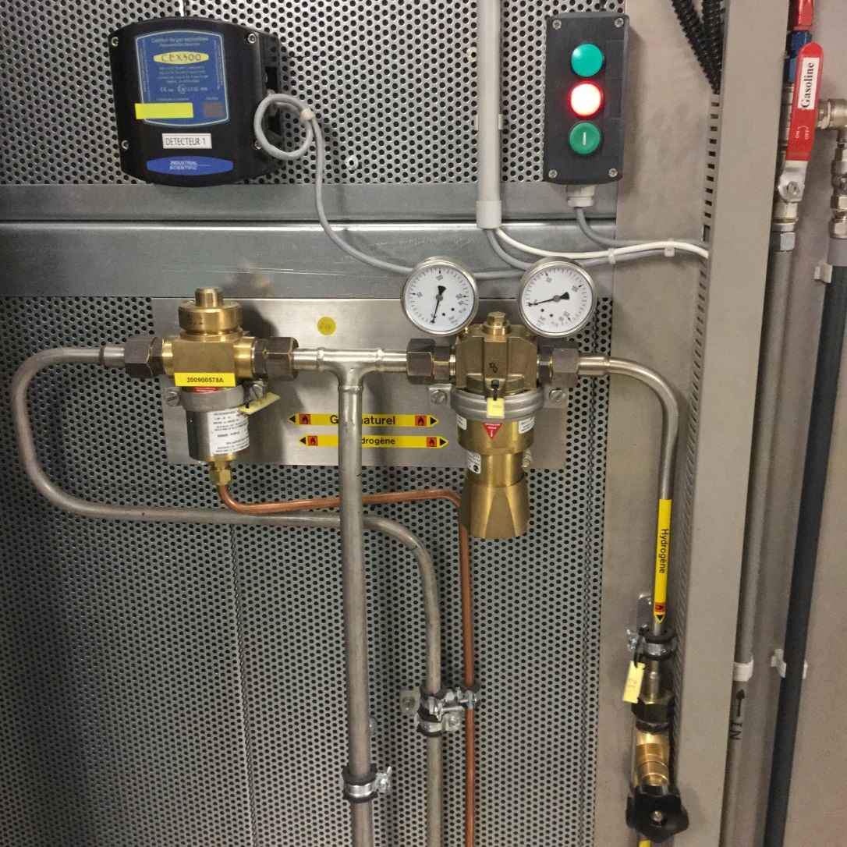
Major safety rules when using hydrogen
Piping design & labelling

Slide 13
Major safety rules when using hydrogen
Take care when welding & fitting
Soft solder is not permitted for use on fittings and joints. This is due to the low melting point of solder and its propensity for brittle fracture under cryogenic conditions.
Brazed joints are permitted providing there is no chance of exposure to an external fire.
List ranking the best types of fittings in a hydrogen system:
Butt welding fittings which meet the requirements of ASME B16.9
Socket welding which meet the requirements of ASME B16.11
Brazing fittings which meet the requirements of ASME B16.18, B16.22 or B16.50 (these fittings should not be used where exposure to fire is expected)
Compression fittings (if no cyclic stresses)
Threaded fittings which meet the requirements of ASME B16.11 (this type of threaded joint is more prone to leaks)

Slide 14
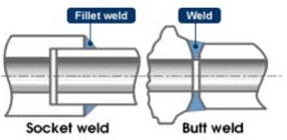
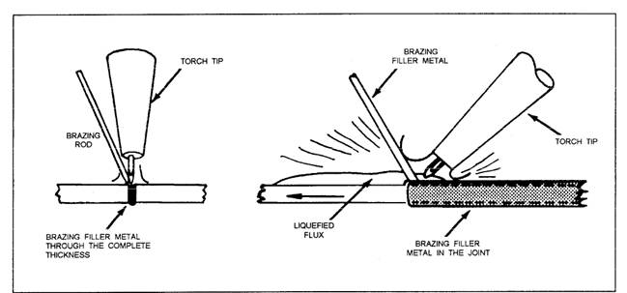
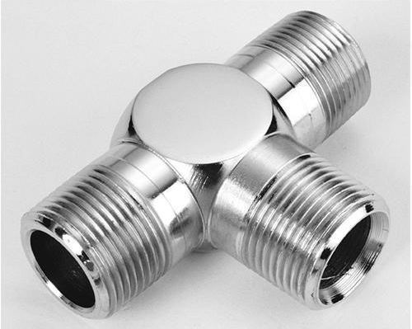
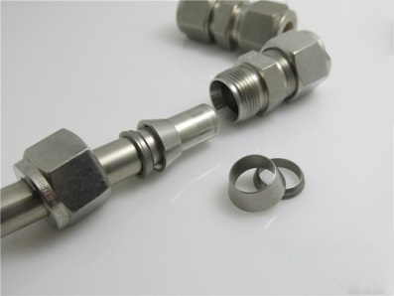
Major safety rules when using hydrogen
Take care of welding & fitting
Brazing fitting
Threaded fittings
Compression fittings

Slide 15
Specific rules when using liquid hydrogen
Hydrogen in liquid form has to be stored under cryogenic conditions and so it is essential to know the associated hazards.
Liquid hydrogen can cause hypothermia and serious frostbite due to its extremely low boiling point in which case medical attention should be sought immediately.
Formation of ice on vents and valves can lead to equipment failure. Moisture in the air freezes upon coming into contact with the cold surfaces of the liquid hydrogen storage tanks and pipes.
Explosive conditions can be created due to condensed air forming on liquid hydrogen storage systems. This happens because nitrogen in the air will boil-off leaving behind an oxygen-rich environment surrounding the storage tank. Adequate system insulation and regular inspection can help to prevent the freezing and condensation of air.
Leaking of air into a liquid hydrogen store can form ice which can block pipes causing system malfunction. This can be prevented by ensuring an air tight system.
Boil-off of liquid hydrogen can build up in pressure over time if not vented properly.

Slide 16
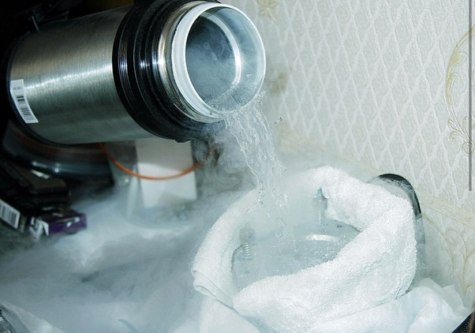
Specific rules when using liquid hydrogen
Hydrogen in liquid form has to be stored under cryogenic conditions and so it is essential to know the associated hazards.
NASA engineer pouring liquid hydrogen sample into container in a sealed environment
By Raphael.concorde - Photo taken during visit at NASA KSC chemical processing facility, CC BY-SA 4.0, https://en.wikipedia.org/w/index.php?curid=59266356

Slide 17
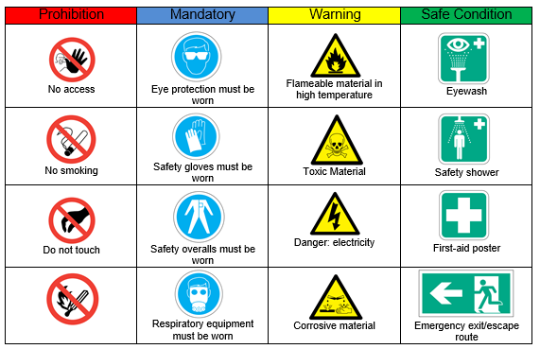
Pictograms and warnings for the working environment
Source: Knowhy

Slide 18
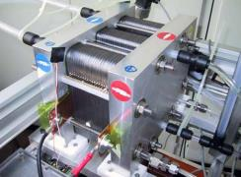

Check procedure of a fuel cell installation
Basic checks of a fuel cell include:
Regular visual inspection of
- Piping, wires and connections
Leak test
- First pressurise the system
- Detection of leakage sources with a special spray
and electronic detector if pressure drops
Verification of electrical insulation
- Tie rods insulated from plates and collectors
- Reagent collector insulated from plates
Plates insulated from the ground
- Checking the axial load
- Torque wrench tightening
Fuel cell stack
Insulation measurement

Slide 19
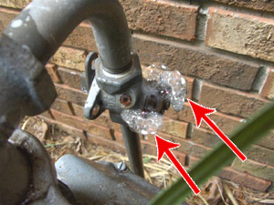
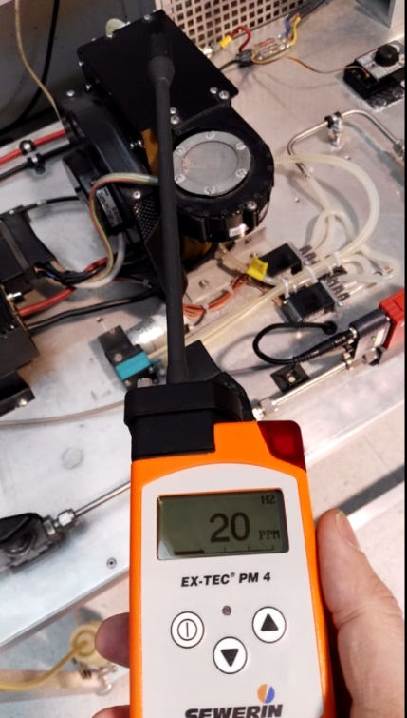
Check procedure of a fuel cell installation
Example of the search for leakages with a special spray and with a detector
The electronic detector will give us directly the concentration of hydrogen near the potential source of leakage.
To spray a special, soap-like, product on a leakage source will rapidly create bubbles. This is an easy way to visualise the leakage.

Slide 20
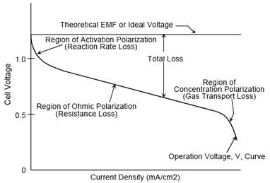
Check procedure of a fuel cell installation
Advance checks of a fuel cell:
To consider before the installation of the hydrogen fuel cell:
- The basement of the supporting chassis
- Aspect of the components on delivery (protection, plugs)
- Cleanliness of the building
- Ventilation of premises, safety equipment
- Verification of the electrical connection to the ground
- Verification of electrical connections
- Ventilation of the electrical panel
Start-up tests
- Polarization curve
- Voltage measurement at the operating point
- Measurement of other parameters (Pressure,
Temperature) at the operating point
Polarization curve

Slide 21
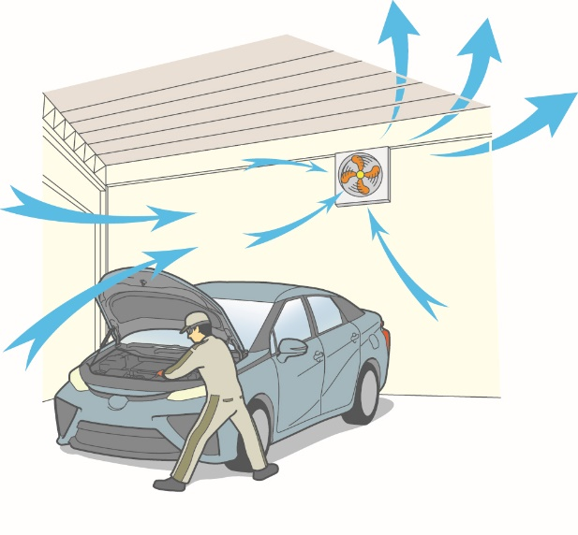

How to mitigate risks when working on a FC vehicle
Safety devices for the working environment
When working with a gas it is very important to ensure good ventilation of the workshop. An active ventilation is always better than a passive one. Ideally, fans that increase in speed in case of leakage detected by gas detectors. The air flow must follow a cross ventilation so that the whole volume will be replaced by fresh air in a short time.
It is also very important to protect the worker. They must wear personal protective equipment such as glasses, gloves, overalls and insulated shoes. In the case of hydrogen fuel cells we have to consider two different kinds of hazards: pressurised gas vessels and high voltage electricity.
Source : Toyota TME

Slide 22
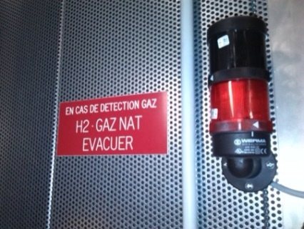
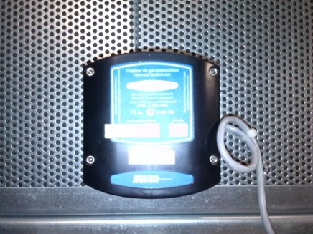
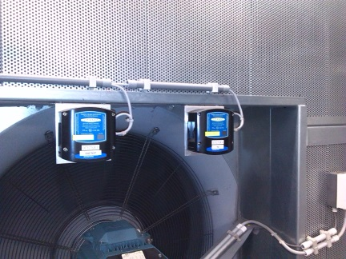


How to mitigate risks when working on a FC vehicle
Safety devices for the working environment
The infrastructure hosting hydrogen equipment is mandatorily equipped with detectors and flashing lights. Increased ventilation and automatic shutdown of gas delivery must occur in case of gas leakage.
As hydrogen is not visible and has no smell, it is very important to keep the worker informed about hydrogen concentration in the air by using portable detectors.
All kind of detectors must be regularly checked. To do this it is necessary to spray a calibrated mix of hydrogen and air on the sensor and check the reaction of safety devices like alarm beep, flash light, increased ventilation and gas shutdown.
Source : Toyota TME

Slide 23
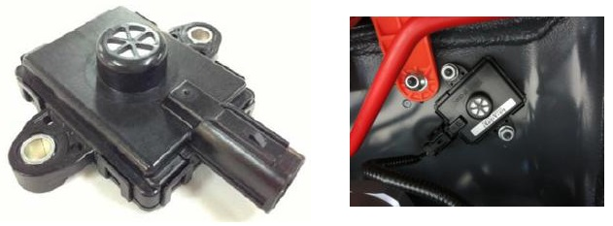
How to mitigate risks when working on a FC vehicle
Vehicle safety devices
Some standalone equipment also include embedded safety devices. For example, cars are equipped with detectors which will close the tank solenoid valves in case of gas leakage.
In addition to hydrogen detectors which close the tank valve in case of leakage, there is also another important safety device, the thermal fuse. This special valve will automatically open and release the contents of the pressured tank when heated over 110°C, typically in case of fire. The gas content is therefore released in the form of a big flame, avoiding any risk of explosion.
A manual valve is used to close the tank before assuming maintenance
A restrictor limits the leak flow in case of pipe loss
A temperature probe is located in the tank in order to monitor temperature during the filling of the pressure tank
Source : Toyota TME

Slide 24
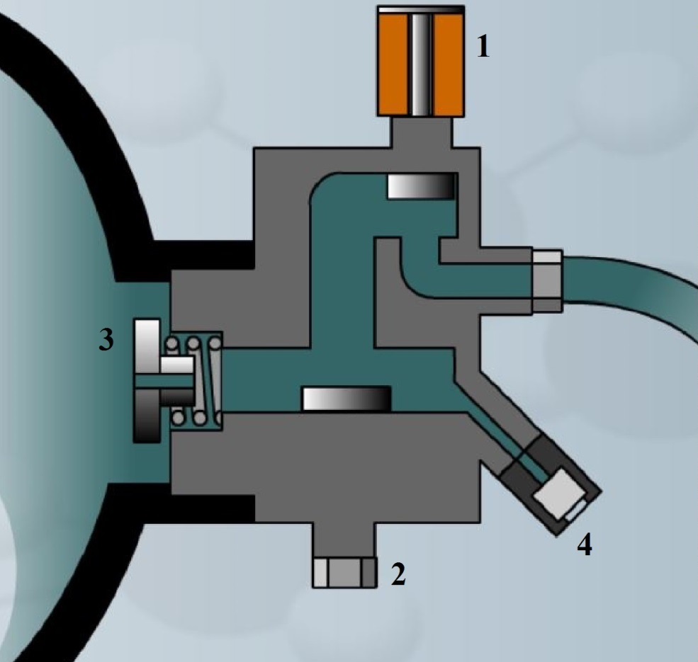
How to mitigate risks when working on a FC vehicle
Vehicle safety devices
Solenoid valve
Leak restrictor
5 Temperature probe
Thermal fuse
Manual valve
Effect of the thermal fuse on: https://www.youtube.com/watch?v=QurQ2uW0oOU
Source : Toyota TME

Slide 25
How to mitigate risks when working on a FC vehicle
Working procedures
Car manufacturers have developed a typical working procedure for assuming the maintenance of a car. This one is built around safety aspects.
Source : Toyota TME

Slide 26
How to mitigate risks when working on a FC vehicle
Working procedures
As there is no standard about hydrogen concentration in a workshop, it is interesting to use general references coming from industry so that we have an idea about the potential effect of a “ppm” number of H2 in the working environment. (ppm=parts per million)
H2 concentration high (ppm) | H2 concentration low (ppm) | Safety topic | Measuring equipment & Safety action related
1 | 0,001 | strict leakage requirements, permeation | bubble counter
1 | 0,01 | manufacturing, assembly | pressure decrease test
1 | 0,1 | manufacturing, assembly | spray test, leak rate sensor
10 | 0,1 | general safety | measuring concentration in air
100 | 1 | process control | gas analysis
1000 | 1 | maintenance work | personal safety devices
10000 | 100 | personal safety | alarms, system failure
10000 | 100 | avoid imminent danger | automatic ventilation increase
10000 | 1000 | built-in safety measures (also check of) | automatic shutdown
100000 | 10000 | combustion, toy kits, explosion | danger, effects on human body
Example of hydrogen concentration in air, associated safety topics and relevant safety actions
Source: KIWA NL

Slide 27



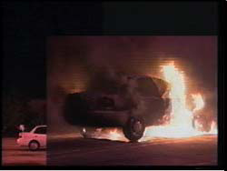
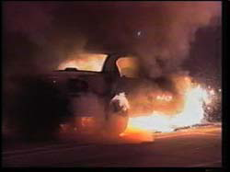
In certain conditions, hydrogen is less dangerous than gasoline thanks to the role of the thermal fuse in this case
Fig. 1. Hydrogen car to the left Gasoline car to the right 0s leak with ignition
Fig. 2. 3s after ignition
Hydrogen leakage: 2100 SCFM Gasoline leakage: 680 cc/min.
Fig.3. 60s after ignition
Fig. 4. 90s after ignition
Fig. 5. gasoline car 140s after ignition
Source: EV World

Slide 28

Lessons learned
Safety is relative, gasoline fuel is also dangerous
Petrol engine vehicle after a small incident with another car
Seen in Francorchamps after a small incident with another car, destruction by fire resulting from a broken gasoline pipe.

Slide 29
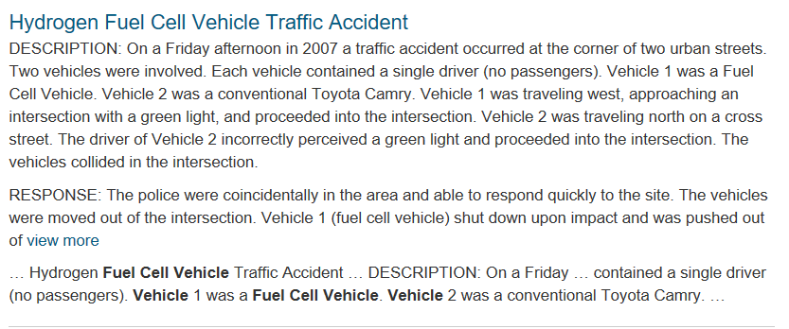
Lessons learned
Please visit H2incidents.org at:
https://h2tools.org/lessons
Example:

