Slide 1









Risk Management
Student Powerpoint
Leaks and Location – A Risk Management Activity
Content created by
<Partner logo>
Last updated 18th October 2019

Slide 2

Task
Using the print out sheet and the materials given, ensure water supply to each area.

Slide 3

Task
What problems did you have?
Were there any leaks?
How could the problems be solved?
Would these problems be harder or easier to solve if you were using gas instead of water?

Slide 4
Task
What problems did you have?
Were there any leaks?
How could the problems be solved?
Would these problems be harder or easier to solve if you were using gas instead of water? Can you see it? Can you smell it?

Slide 5



Issues you may have found:
The straws were too weak after getting wet and did not hold their structure.
There were leaks in the joints.
There was no way of stopping the water once it had started flowing.

Slide 6
Issues you may have found:
The straws were too weak after getting wet and did not hold their structure.
There are regulations involving the materials used.
There were leaks in the joints.
There are devices and techniques for checking for leaks.
There was no way of stopping the water once it had started flowing.
Valves are used for this purpose.

Slide 7
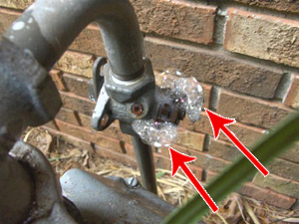
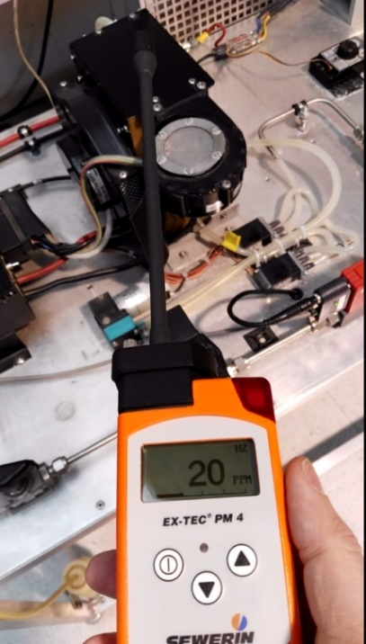
Examples of how to search for leakages with a special spray and with a detector.
The electronic detector will give us directly the concentration of hydrogen near the potential source of leakage.
To spray a special, soap-like, product on a leakage source will rapidly create bubbles. This is an easy way to visualise the leakage.

Slide 8
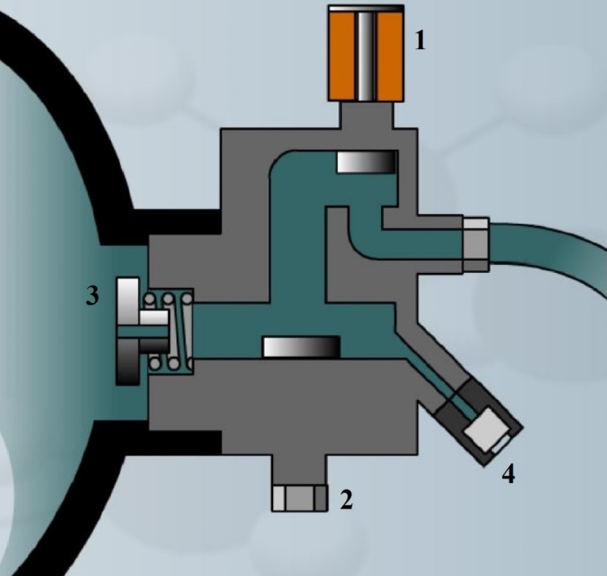
In a Fuel Cell Vehicle (FCV), valves are also used.
Some standalone equipment also include embedded safety devices. For example, cars are equipped with detectors which will close the tank solenoid valves in case of gas leakage.
In addition to hydrogen detectors which close the tank valve in case of leakage, there is also another important safety device, the thermal fuse. This special valve will automatically open and release the contents of the pressured tank when heated over 110°C, typically in case of fire. The gas content is therefore released in the form of a big flame, avoiding any risk of explosion.
A restrictor limits the leak flow in case of pipe loss.
A manual valve is used to close the tank before assuming maintenance.

Slide 9
Hydrogen piping systems should be designed and installed with care in order to reduce the risk of leaks and enable their easy detection. Therefore, piping systems must be designed in accordance with the applicable codes and standards in order to:
Reduce leaks via the use of welded joints wherever possible.
Ensure joints and fittings are easily accessible for leak checks.
Prevent or minimise the risk of personal injury.
Reduce structural and thermal stresses in piping components and connected equipment.
Ensure gas-tight joints.
Determine appropriate sizes and settings of pressure relief devices.
Appropriately label shutoff valves at safe locations.
Always ensure that piping is labelled indicating content, flow direction and test pressures

Slide 10
Hydrogen piping systems should be designed and installed with care in order to reduce the risk of leaks and enable their easy detection. Therefore, piping systems must be designed in accordance with the applicable codes and standards in order to:
Reduce leaks via the use of welded joints wherever possible.
Ensure joints and fittings are easily accessible for leak checks.
Prevent or minimise the risk of personal injury.
Reduce structural and thermal stresses in piping components and connected equipment.
Ensure gas-tight joints.
Determine appropriate sizes and settings of pressure relief devices.
Appropriately label shutoff valves at safe locations.
Always ensure that piping is labelled indicating content, flow direction and test pressures
Task – Using these guidelines, write an honest report on the design of your water pipe system.

Slide 11
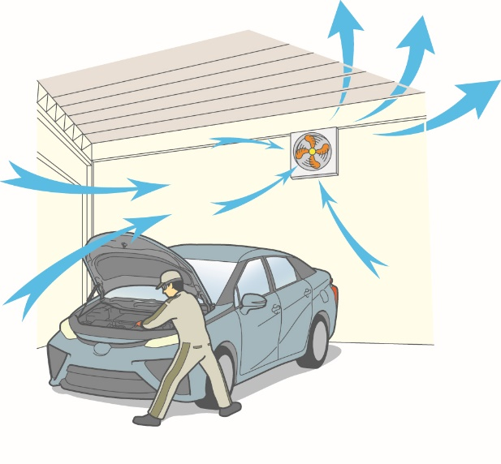
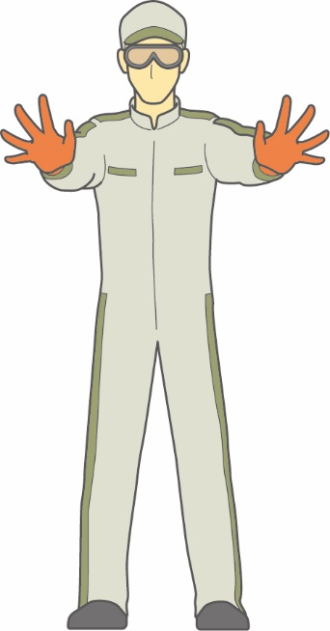
When working with a gas it is very important to ensure good ventilation of the workshop. An active ventilation is always better than a passive one. Ideally, fans that increase in speed in case of leakage detected by gas detectors. The air flow must follow a cross ventilation so that the whole volume will be replaced by fresh air in a short time.
It is also very important to protect the worker. They must wear personal protective equipment such as glasses, gloves, overalls and insulated shoes. In the case of hydrogen fuel cells we have to consider two different kinds of hazards: pressurised gas vessels and high voltage electricity.

Slide 12
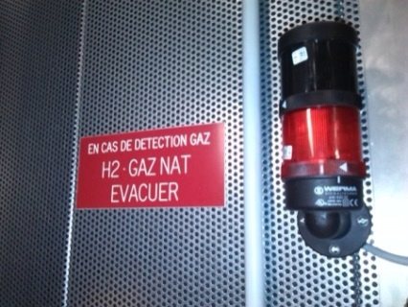
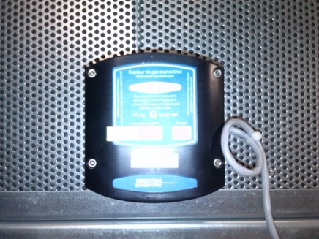
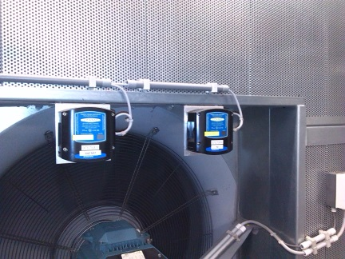
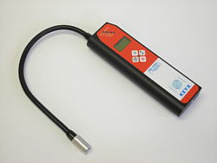
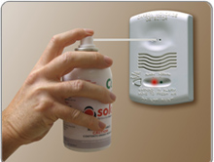
How to mitigate risks when working on a FC vehicle
Safety devices for the working environment
The infrastructure hosting hydrogen equipment is mandatorily equipped with detectors and flashing lights. Increased ventilation and automatic shutdown of gas delivery must occur in case of gas leakage.
As hydrogen is not visible and has no smell, it is very important to keep the worker informed about hydrogen concentration in the air by using portable detectors.
All kind of detectors must be regularly checked. To do this it is necessary to spray a calibrated mix of hydrogen and air on the sensor and check the reaction of safety devices like alarm beep, flash light, increased ventilation and gas shutdown.
Source : Toyota TME

Slide 13
How to mitigate risks when working on a FC vehicle
Working procedures
Car manufacturers have developed a typical working procedure for assuming the maintenance of a car. This one is built around safety aspects.
Source : Toyota TME

Slide 14
Print this off in A3 and give students paper straws, sticky tape, blu-tack and glue.
A
C
Water Source
C

