Slide 1









Storage
Extra Information For Teachers
Content created by
<Partner logo>
Last updated 18th October 2019

Slide 2
Hydrogen storage devices
Hydrogen gas cylinders, pressure vessels
  Hydrogen storage in metallic pressure vessels
  Steel-composite vessels, comparison of weights
  Full composite vessels 350 and 700 bars
  Safety valve connected to mitigate risks
Liquid hydrogen vessels, thermally isolated
  Specialised vessels
  Catalyst device associated to neutralise leakages
Cryo-compressed vessels
  Specialised vessels
  Catalyst device associated to neutralise leakages
Metal Hydride (MH) , hydrogen in a solid form
  Specialised material technology
Hydrogen filling stations
  Simple station technology (temporary)
  Filling station that meets ISO standards with cooling and communication
Hydrogen storage in underground caverns

Slide 3
Hydrogen gas cylinders, pressure vessels.
Hydrogen gas can be stored in steel gas cylinders under a pressure of 200 bars or 300 bars.
Different volumes are available, from 1 litre to 50 litres.
Racks of large gas cylinders are available to deliver large quantities of gas, there are generally 9, 12 or 16 gas cylinders in a rack.
These gas cylinders are delivered by truck and the rack is handled with a mechanical grapple. These heavy racks of gas cylinders are used for static applications only.
The weight of a 50 litre gas cylinder is around 70 kg and the weight of a rack is around 1 ton.

Slide 4
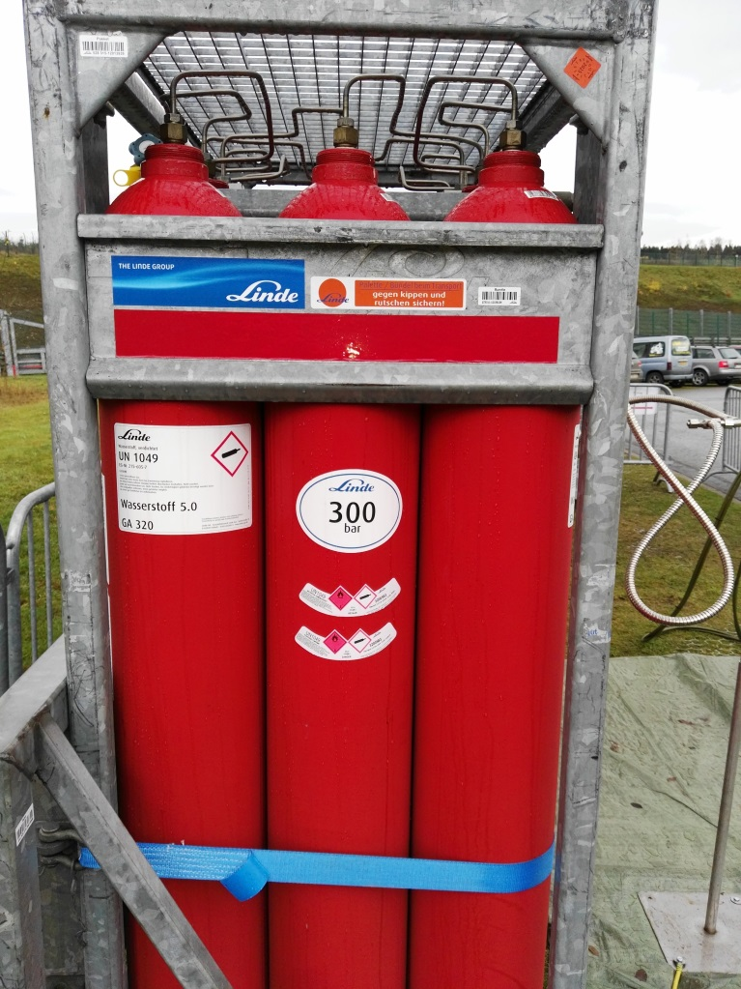
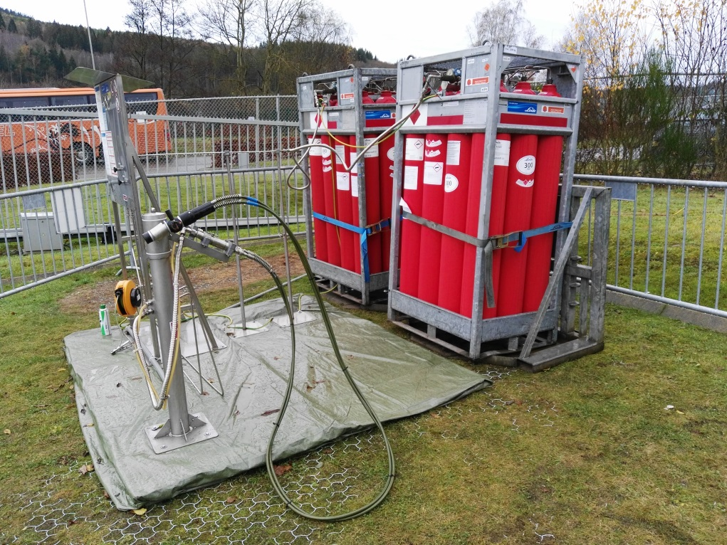
Hydrogen storage in metallic pressure vessels
Hydrogen gas cylinders, pressure vessels.
Hydrogen gas storage in steel gas cylinders under a pressure of 300 bars for supplying a temporary filling station.

Slide 5
Steel-composite vessels.
Comparison of weights
For mobile applications, it is important to increase the mass of hydrogen stored for a given volume.
For mobile applications it is important to reduce the weight of the gas cylinders and simultaneously increase the pressure, up to 700 bars.
In general, composite materials are 3 times lighter and 3 times more resistant than steel.
The use of composite materials for manufacturing gas cylinders is therefore a real improvement in terms of weight reduction and energy stored for a mobile application.

Slide 6
Steel-composite vessels.
Comparison of weights
There are four types of gas cylinders
Type I : vessels are all-metal containers made from either steel or aluminium
Type II : are essentially Type I vessels encased circumferentially in a glass fibre reinforced polymer (GFRP) winding.
Type III vessels are an improvement on the Type II, featuring a full composite material such as carbon fibre reinforced polymer (CFRP) with a metal liner made from either aluminium or steel.
The modern Type IV vessels are constructed mainly from a CFRP with a polyethylene or polyamide liner. This gives a reduction in weight of 4 compared with type I.

Slide 7
Steel-composite vessels.
Comparison of weights
Heaviest
Lightest
The four main types of high pressure vessels used for the storage of hydrogen gas.

Slide 8

Full composite vessels 350 and 700 bars.
How it’s made.
The manufacturing of gas cylinders is completed in 3 steps:
Step 1: The liner in plastic is manufactured by using ‘rotomoulding’ also called rotational moulding of 2 reactive components. The chemical process of polymerisation during the centrifugation results in a plastic bottle which has the shape of the mould.
Step 2: Filament winding is added around the plastic liner. The thickness of the cylinder depends on the final pressure used in the tank. For 700 bars we can observe a thickness of about 25 mm.
Step 3: Glass fibre covering. This third, external, small layer works as a bodywork and a protection against scratches.

Slide 9

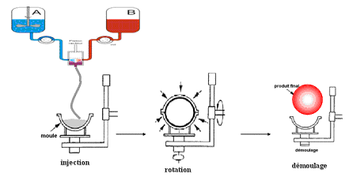
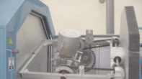

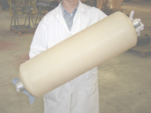
Full composite vessels 350 and 700 bars.
How it’s made
Step 1, interior liner which assumes the sealing
Liquid material is injected, rotated and then removed from the mould.

Slide 10
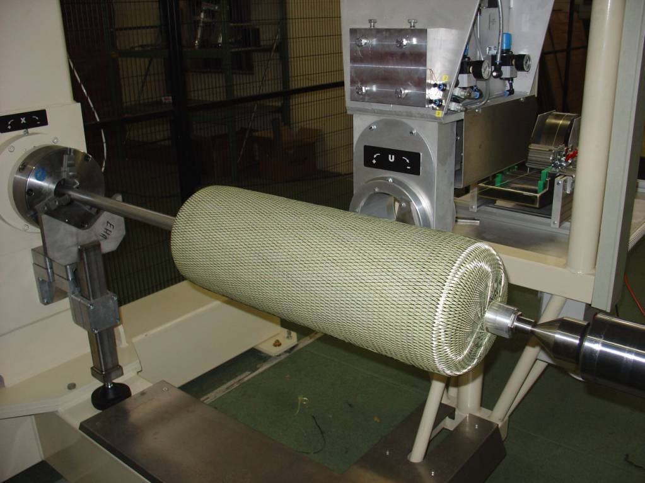
Full composite vessels 350 and 700 bars.
How it’s made
Step 2, the second layer which assumes the resistance
Filament winding around the interior liner. The material of the fibres are generally carbon or a mix of carbon and Kevlar.

Slide 11
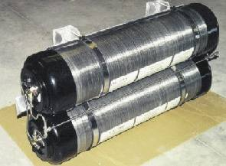

Full composite vessels 350 and 700 bars.
How it’s made
Step 3, the external layer is made of glass fibre, it plays the role of a bodywork to protect the carbon layer against small scratches.
Wall thickness around 25mm for 700 bar vessel
Full composite vessels: final result
The thin, external layer in glass fibres assumes a protection against small scratches and light impact, it plays the role of a bodywork.

Slide 12
Full composite vessels 350 and 700 bars.
Full composite vessels: final result
Two standardized pressures are used with composite material pressure vessels, 350 bars and 700 bars
High pressure hydrogen vessels
35 MPa and 70 MPa

Slide 13
Full composite vessels 350 and 700 bars.
Safety
The safety of gas cylinders is very important and ensured by :
A research and development (R&D) approach including the knowledge of materials and a precise calculation of internal stresses. The finite element analysis or FEA* is generally used.
Validation of the design by regular tests under standard pressures.
Validation of the design by specific tests under higher pressures, until first defaults appear in the material of the vessel.
Crash tests in real conditions in the case of mobile applications.
* Finite element analysis (FEA) is a computerised method for predicting how a product reacts to real-world forces, vibration, heat, fluid flow and other physical effects. Finite element analysis shows whether a product will break, wear out or work the way it was designed to.

Slide 14
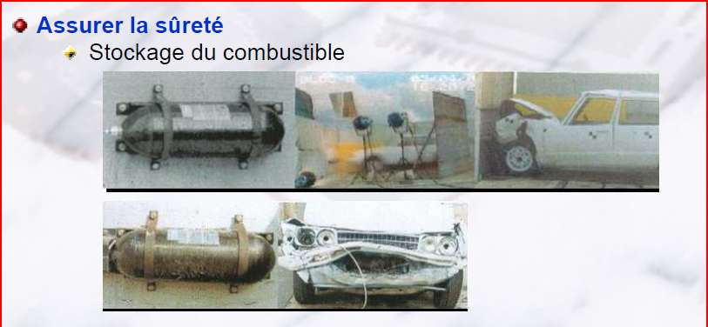
Full composite vessels 350 and 700 bars.
Design, Research and Testing
Crash test in real conditions in the case of mobile applications

Slide 15
Safety devices included in the vessel valve.
Safety valve connected to mitigate risks
A solenoid valve actuated by the control unit. This valve is normally closed, it is held open to allow vehicle operation and for filling the vessel.
A manual valve allows the worker to isolate the contents of the pressurised vessel before servicing the high pressure circuit of the vehicle.
A restrictor valve located within the vessel will “close” the outlet in case the pipe connection is severed.
A thermal fuse must melt at around 100°C and rapidly release the content of the vessel as a big flame if the vehicle is on fire.

Slide 16
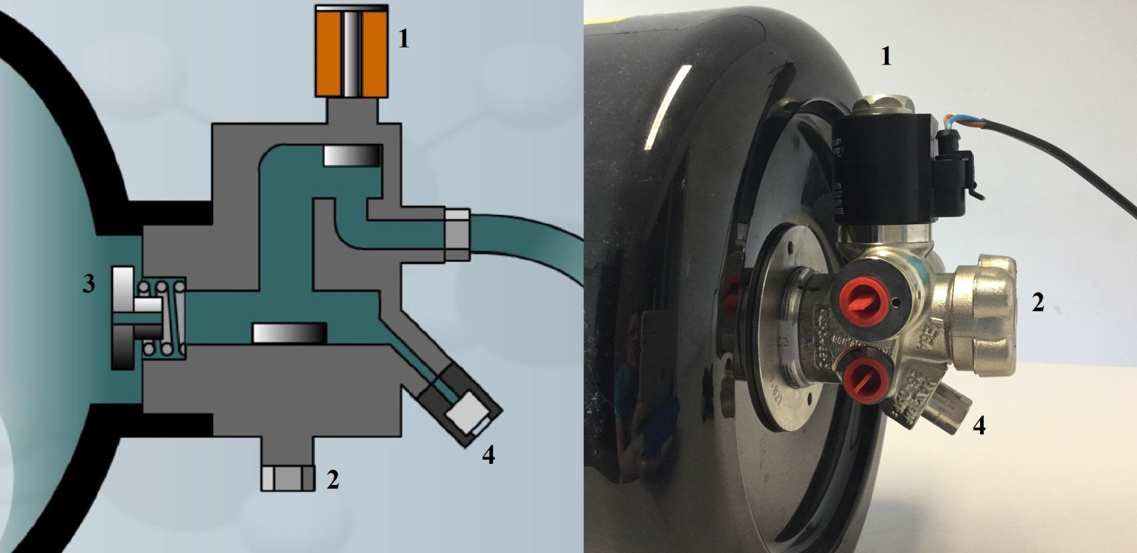
Safety valve connected to mitigate risks
Sketch of the multi-valve including safety devices which act in case of accident or fire

Slide 17
Liquid hydrogen vessels, thermally isolated.
Hydrogen gas becomes liquid at -253°C
Hydrogen gas does not become liquid under high pressure, it is only a question of temperature.
The density of liquid hydrogen is higher than the one of hydrogen gas, around 71 kg/m³ but remains low.
Liquid hydrogen must be stored in a special vessel which is thermally insulated. A vacuum is the best method of insulation known.
When liquid hydrogen evaporates, the pressure in the vessel will increase.
If the vessel is not predicted to sufficiently support pressure, a release valve must be included. The hydrogen gas released must be neutralised for safety aspects. This will be done with a catalytic converter

Slide 18
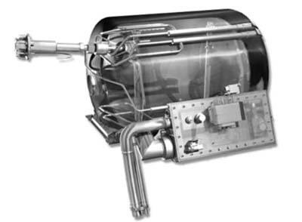
Liquid hydrogen vessels, thermally isolated.
Liquid hydrogen vessel for automotive applications
Source: Magna Steyr

Slide 19
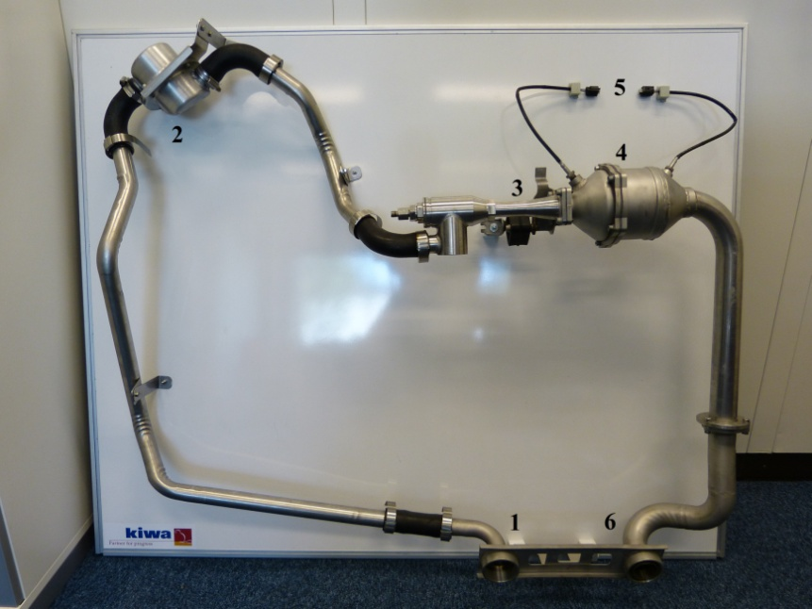
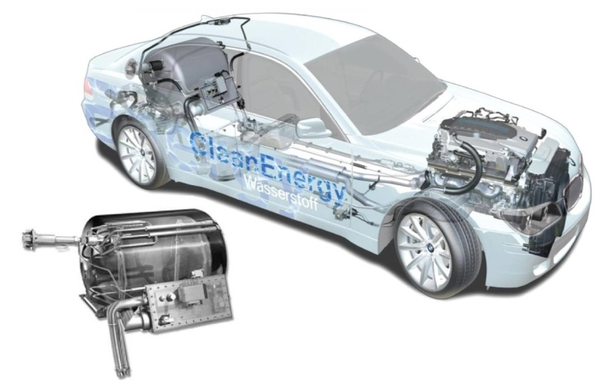
Liquid hydrogen vessels, thermally isolated.
The seal is not assumed, hydrogen will leak in cases of evaporation
Air intake
Air filter
Hydrogen intake
Catalyst
Temperature sensors
Water exit
Safety: a catalytic burner is necessary to neutralise the hydrogen leak into water

Slide 20
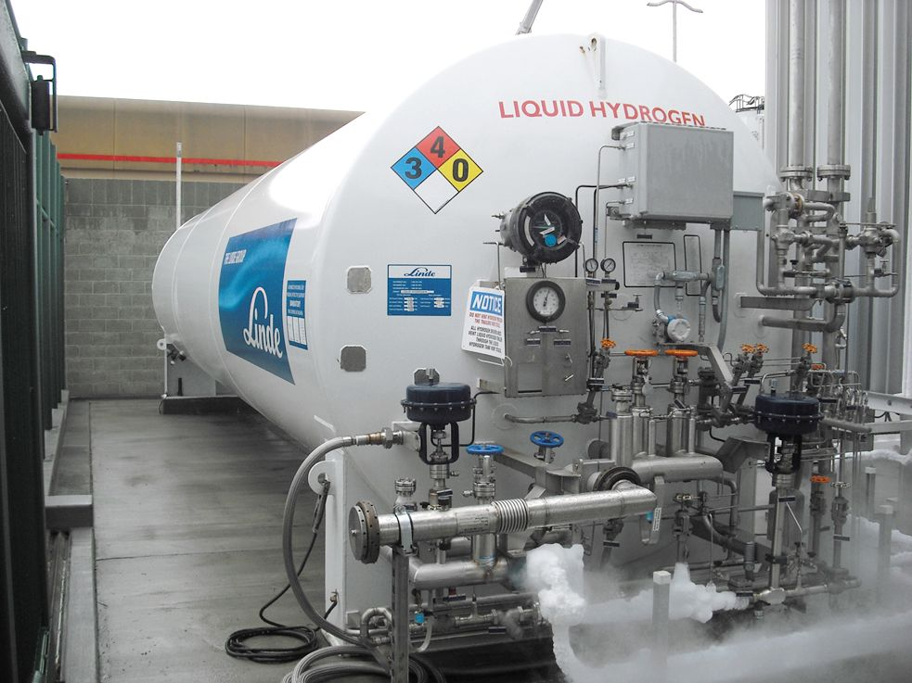
Specialised vessel used to store liquid hydrogen at very low temperatures (< -253°C)
Liquid hydrogen vessels, thermally isolated.
Liquid hydrogen storage at a filling station

Slide 21
Specialised vessels used to store hydrogen at high pressure and very low temperature (300 bar at 30K < T < 50K.
Hydrogen is a gas if the temperature remains above -253°C or 20K, otherwise it becomes liquid.
Hydrogen can be compressed without any phase change from gas to liquid providing the temperature remains above -253°C or 20K .
The density of very cold gas is more important than the one of the same gas at room temperature.
Hydrogen gas can be stored simultaneously at a very low temperature and high pressure in a specialised vessel. This will need to be a pressure gas cylinder encapsulated inside a thermally insulated vessel.
In the following example, the vessel has been designed to store 8kg of hydrogen.

Slide 22
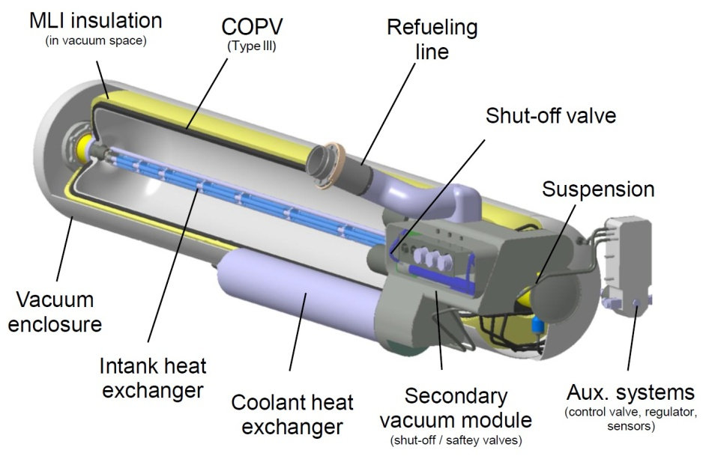
Specialised vessel from BMW designed for a storage of 8 kg cryo-compressed hydrogen at 300 bars and 30 - 50 K. Hydrogen is released at 350 bars.
Maximum hydrogen capacity: 8 kg | Hydrogen loss (burner): ~3g/day
System volume: 235 l | System weight: 145 kg
Refuelling pressure: 300 bars | Release pressure: 350 bars

Slide 23
Specialised vessel used to store hydrogen at high pressure and very low temperature (300 bar at 30K < T < 50K.
A catalytic converter is also necessary in this case

Slide 24
Hydrogen storage in Metal Hydride (MH) materials (solid form).
Some methods involve storing hydrogen either physically or chemically within select materials. Hydrogen can be stored on the surface of a material through adsorption, either in molecular or monatomic form. Hydrogen can also be dissociated into atoms, absorbed into a solid material and stored in the crystal lattice such as in metal hydrides.
Metal hydrides are formed when certain metals react with hydrogen gas. The most useful metal hydrides react at room temperature under 500 kPa of hydrogen. Examples of metal hydrides are palladium hydride (PdH), magnesium hydride (MgH₂) and lanthanum nickel hydride (LaNi₅H_{x}). Absorption of hydrogen into such metals is an exothermic process. Conversely, desorption is endothermic, meaning that heat energy is required to release the hydrogen. The next figure shows a schematic of a metal hydride storage vessel.
For stationary storage in industrial applications, space is not as important as in mobile applications since the system is not limited to the volume constraints of a vehicle.
Source: Knowhy

Slide 25
Hydrogen storage in Metal Hydride (MH) materials (solid form).
Schematic of a metal hydride storage vessel

Slide 26
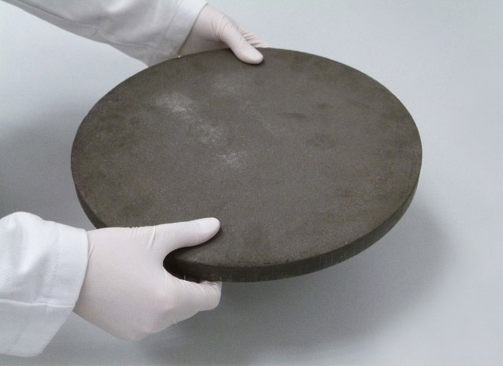
Hydrogen storage in Metal Hydride (MH) materials (solid form).
Hydrogen storage material MH produced by McPhy
Source 1: https://mcphy.com/fr/
Source 2: https://www.ecosources.info/innovations/394-galette-de-stockage-d-hydrogene-solide-mcphy

Slide 27
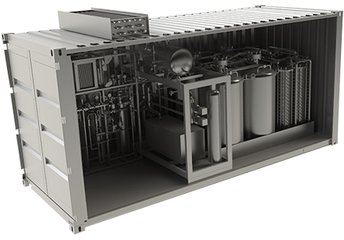
Hydrogen storage in Metal Hydride (MH) materials (solid form).
To facilitate travel and reduce costs, Plug & Play Hydrogen Storage / Destocking systems have been integrated into a container.
HES type storage of 25 kg MgH₂ hydride by McPhy company. Energy storage: 830 kWh.
Source 1: https://mcphy.com/fr/
Source 2: https://www.ecosources.info/innovations/394-galette-de-stockage-d-hydrogene-solide-mcphy

Slide 28
Hydrogen filling stations.
Private filling station (with no H₂ production)
A filling station is basically composed of two elements: a storage of hydrogen gas and a dispenser.
The storage of hydrogen gas generally uses classical steel pressure gas cylinders organised on a rack. All the cylinders are connected to each other so that there is only one delivery pipe for each rack.
The rack of gas cylinders is connected to a dispenser.
The dispenser is made of pipes, one being connected to a pistol grip nozzle.
There are two main functions fulfilled by the dispenser:
  Connect/close the pressure to the delivery pistol grip nozzle
  Releasing pressure and degassing pipes after the filling operation
Source: Knowhy

Slide 29


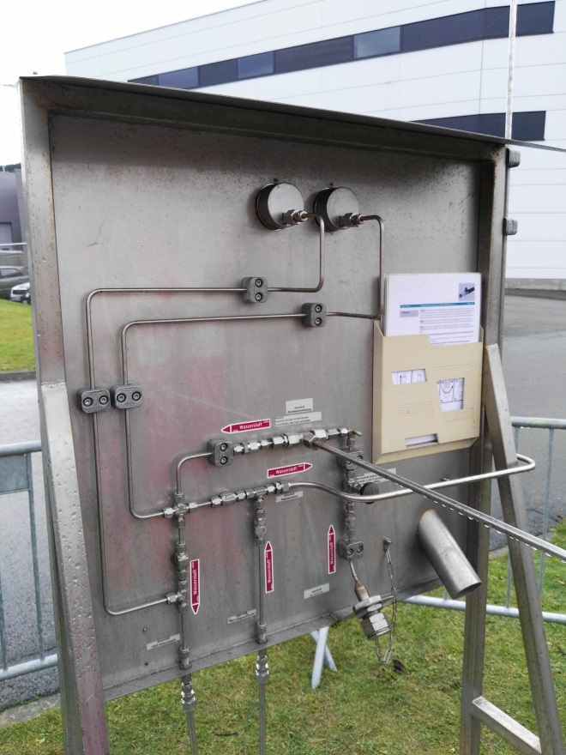
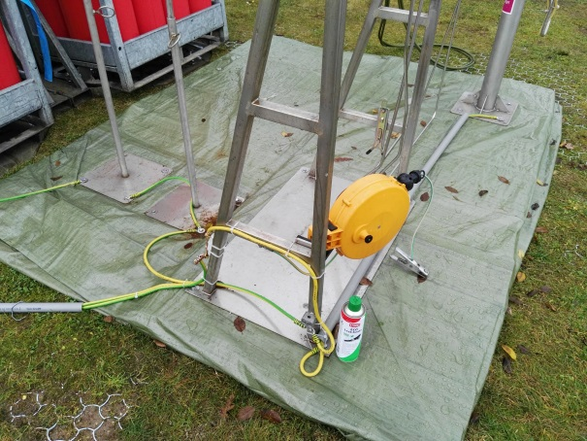

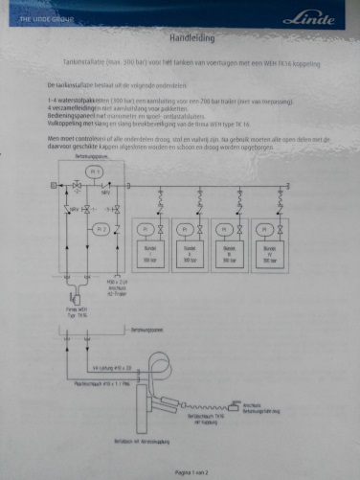


Hydrogen filling stations : simple station technology
Hydrogen filling stations.

Slide 30
Hydrogen filling stations.
Private filling station (with H₂ production)
A filling station is basically composed of two elements: a storage of hydrogen gas and a dispenser.
In some cases the project exists to also produce hydrogen on site
Renewable hydrogen is produced with an electrolyser supplied with green energy coming from solar panels and from wind turbines
We can find containers which host:
    An electrolyser
    Filter, dryer
    A compressor
    A storage zone
Source: Knowhy

Slide 31
Hydrogen filling stations.
Public filling station (with or without H₂ production)
A public filling station may be sited near to hydrogen production sites but both must be physically separated. There should be no public access to the production site.
A public filling station limits the use to owners of Radio Frequency Identification (RFID) access cards.
A public filling station must satisfy all safety criteria and meet higher ISO standards.
Hydrogen is compressed and stored in large buffers at 350 or 700 bars.
Hydrogen is cooled at -40°C before delivery to mitigate the negative Joule-Thompson coefficient. Hydrogen will increase its temperature during expansion which is not classical !
A communication between the vehicle and the station must occur during the filling process. The filling process will be stopped if the temperature in the vehicle gas cylinder reaches 85°C. Infrared communication is often used for this purpose.
Source: Knowhy

Slide 32
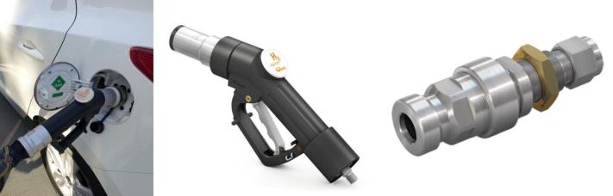

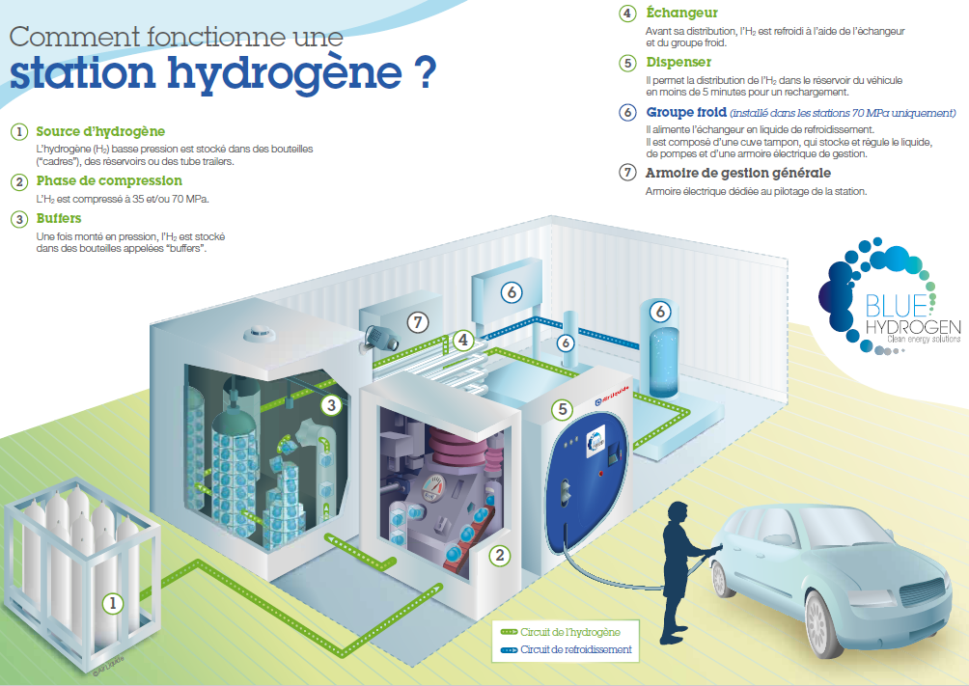

Hydrogen filling stations.
Filling station that meets ISO standards
How does it work?
Hydrogen filling station
4. Heat exchanger
H₂ is cooled at -40°C before delivery
5. Dispenser
H₂ is transferred to the vehicle tank
6. Cooling equipment
Supplies the heat exchanger with coolant
7. General management unit
1. Hydrogen source
H₂ is stored in gas cylinders at 200 bars
2. Compression phase
H₂ is compressed at 350 or 700 bars
3. Buffers
Storage of H₂ at high pressure
Sources: Linde, Air Liquide, WEH

Slide 33
Hydrogen storage in underground caverns.
Hydrogen storage in underground caverns
Hydrogen can also be stored in large quantities in underground caverns, salt domes and depleted oil and gas fields. The next figure demonstrates the potential for the storage of large quantities of hydrogen in salt caverns. There are many storage sites across the globe such as the ICI salt cavern in Teesside, England storing 95% pure hydrogen and 3 – 4% CO₂. Between 1956 and 1974 the French gas company “Gaz” stored syngas in an aquifer in Beynes, France citing no safety issues during this period. Russia has also stored hydrogen underground specifically for their aerospace industry under 9 MPa of pressure.

Slide 34
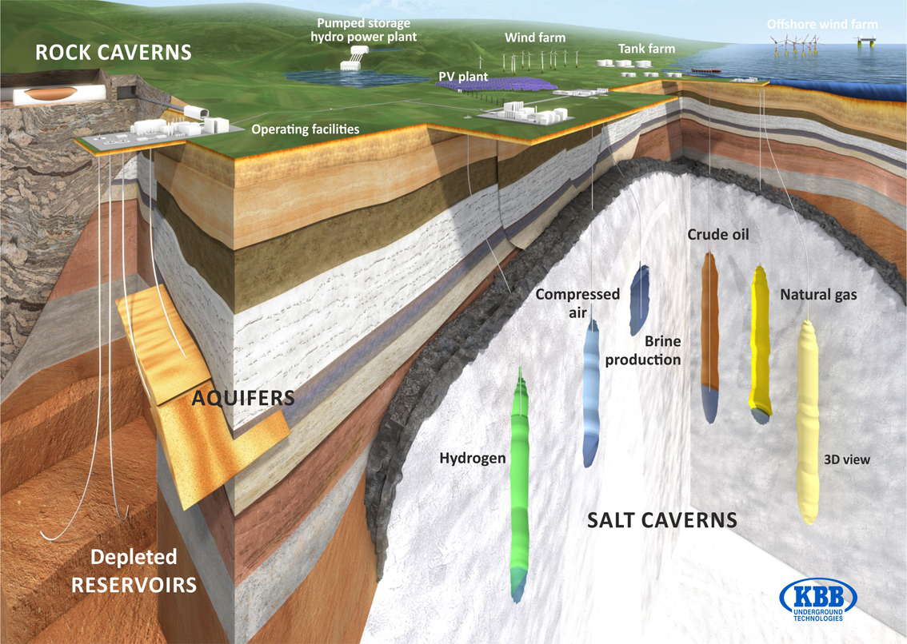
Hydrogen storage in underground caverns.
Figure. Possible underground storage sites in salt caverns for various gases including hydrogen. © KBB Underground Technologies.

Slide 35
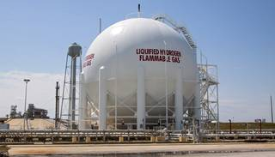
At Launch Pad 39B at NASA’s Kennedy Space Center, the liquid hydrogen vessel that supported space shuttle launches for 30 years has been sandblasted, repaired and repainted. Along with the liquid oxygen storage vessel, the two are designed to store super-cold propellants. They were refurbished to support NASA’s Space Launch System rocket and other launch vehicles

