Slide 1









Storage
Student Powerpoint
Content created by
<Partner logo>
Last updated 18th October 2019

Slide 2
The type of storage used for hydrogen depends upon several factors.
Discuss with a partner what you think these might be.

Slide 3
The type of storage used for hydrogen depends upon several factors.
Volume
Temperature
Time
Usage

Slide 4
The type of storage used for hydrogen depends upon several factors.
Volume – At higher pressure there is more storage capability. This results in a greater weight.
Temperature – Specialist materials are required at certain temperatures.
Time – How long is it going to be stored for?
Usage – Is it going to be transported before use?

Slide 5
Dependent upon the production method, storage requirements will differ. It is therefore helpful to take a quick look at the lifecycle of hydrogen when it is derived from a renewable energy source.
The hydrogen economy is a system for delivering energy sourced from hydrogen through the establishment of a modified infrastructure. Moreover, hydrogen production, distribution, utilisation and storage are fundamental to the realisation of this system.

Slide 6
Below is a typical schematic of an electrolytic cell. Combining a renewable energy source, such as wind or solar, with an electrolyser could produce and store hydrogen which could be later used as a backup supply to help overcome intermittency in the electrical grid.

Slide 7
Hydrogen can be stored onsite at the point of production as compressed gas, liquid or chemically in a solid-state storage medium. Distribution of the hydrogen would be relatively simple since it can be delivered via pipeline to the point of use.
In the last two decades, billions of cubic metres of hydrogen were produced and kept in intermediate storage and transported via pipeline to serve the chemical and aerospace industry.
One of the biggest hurdles facing the establishment of a hydrogen economy is the issue of storing hydrogen in a safe, compact, reliable and cost effective manner. The U.S. DoE published an online article emphasising that in order for hydrogen to be competitive with conventional technologies it must achieve a vehicle range of 300 miles. However, this is a challenge due to the physical properties of hydrogen.

Slide 8
The more established storage techniques are high pressure vessels which are categorised into four groups based on their material and the working pressure.
Type I vessels are all-metal containers made from either steel or aluminium.
Type II are essentially Type I vessels encased in a glass fibre reinforced polymer (GFRP) winding.
The Type III vessels are an improvement on the Type II featuring a composite material such as carbon fibre reinforced polymer (CFRP) with a metal liner made from either aluminium or steel.
The modern Type IV vessels are constructed mainly from a CFRP with a polyethylene or polyamide liner.
The four main types of high pressure vessels used for the storage of hydrogen gas.

Slide 9
A common method of storing hydrogen is in compressed gas form pressurised inside a vessel anywhere between 35 and 70 MPa. Increasing the storage pressure would improve the energy density resulting in a smaller vessel but a much heavier system. Hydrogen is a non-ideal gas meaning large amounts of energy are needed to compress hydrogen into smaller volumes. Compressed hydrogen vessels require 2.1% of the energy content to power the compressor. This energy would be lost at the compression step unless recovered otherwise, making the system less efficient and more costly. Another major drawback for this mode of storage is that the size and weight issue of a compressed vessel makes it an unattractive option for mobile applications.

Slide 10
Hydrogen can also be stored in the liquid state under cryogenic conditions. Typically, these conditions have hydrogen stored under 1 atm at -253 °C. Storing hydrogen in a liquid state will improve its volumetric density, facilitating containment in a smaller vessel. The associated problems with storing hydrogen in this manner include boil-off, energy for hydrogen liquefaction, vessel size and the attributed costs. In this context, boil-off refers to the evaporation of liquid hydrogen resulting in the gradual increase in gas pressure inside the storage vessel. Boil-off can present a significant safety issue in situations where a hydrogen powered vehicle is parked in confined and poorly ventilated spaces since hydrogen is susceptible to auto-ignition. According to the U.S. DoE, approximately 30% of the hydrogen lower heating value is required for liquefaction indicating that this process is energy intensive therefore incurring large costs.

Slide 11
Currently, a hybrid system, named cryo‑compression, is being developed that provides a pressure vessel containing very cold hydrogen gas compressed at 30 MPa and cooled at minus 200°C. This vessel is lighter and more compact than most storage media. BMW have launched a hydrogen powered car in 2015 utilising a cryo-compressed hydrogen storage vessel like the one shown below. Furthermore, the operating temperature is not as low as cryogenic storage, meaning there is less of a penalty for hydrogen liquefaction and reduced boil‑off.
Cross-section of a cryo-compressed hydrogen storage vessel .

Slide 12
Novel methods involve storing hydrogen either physically or chemically within select materials. Hydrogen can be stored on the surface of a material through adsorption, either in molecular or monatomic form. Hydrogen can also be dissociated into atoms, absorbed into a solid material and stored in the crystal lattice such as in metal hydrides. Other methods include the hydrogen atoms forming strong chemical bonds giving rise to chemical compounds such as complex hydrides and chemical hydrides.
Metal hydrides are formed when certain metals react with hydrogen gas, the most useful metal hydrides react at room temperature under 500 kPa of hydrogen. Examples of metal hydrides are palladium hydride (PdH), magnesium hydride (MgH₂) and lanthanum nickel hydride (LaNi₅H_{x}). Absorption of hydrogen into such metals is an exothermic process, conversely desorption is endothermic meaning that heat energy is required to release the hydrogen. The following image shows a schematic of a metal hydride storage vessel.
Diagram of a metal hydride (MH) hydrogen storage vessel.
For stationary storage in industrial applications, space is not as important as in mobile applications since the system is not limited to the volume constraints of a vehicle.

Slide 13
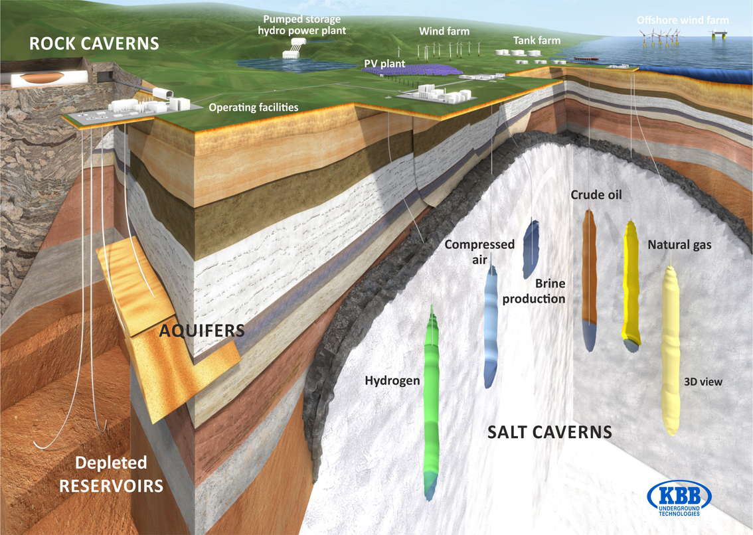
Hydrogen can also be stored in large quantities underground, in caverns, salt domes and depleted oil and gas fields. The image below demonstrates the potential for the storage of large quantities of hydrogen in salt caverns. There are many storage sites across the globe such as the ICI salt cavern in Teesside, England storing 95% pure hydrogen and 3 – 4% CO₂.
Between 1956 and 1974 the French gas company Gaz stored syngas in an aquifer in Beynes, France citing no safety issues during this period.
Russia has also stored hydrogen underground specifically for their aerospace industry under 9 MPa of pressure.

