Slide 1
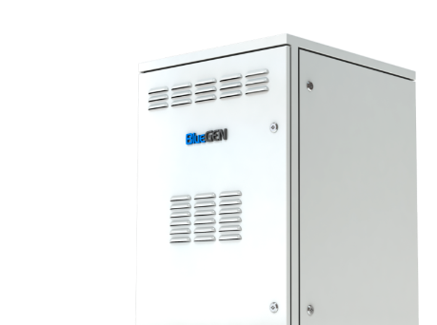
Technology for smarter energy
Highly efficient fuel cells
Last updated 18th October 2019

Slide 2
Company - facts and figures
2018
Plant 3 construction start in Pergine Vals.
2017
1.000th BlueGEN manufactured and installed
2016
Restart commercialization of BlueGEN systems
2015
Acquisition of assets of
Ceramic Fuel Cells GmbH
2014
EnGEN™ roll-out within the European project Ene.field
2011
2.5 kW modular mCHP generator design
2008
Pilot Plant Mezzolombardo (IT) operative
2007
SOFCpower set-up, acquisition HTceramix
2000
EPFL (CH) Spin Off Htceramix s.a.
invention HotBox™ technology

Slide 3

Experts around the world

Slide 4
The energy revolution

Slide 5
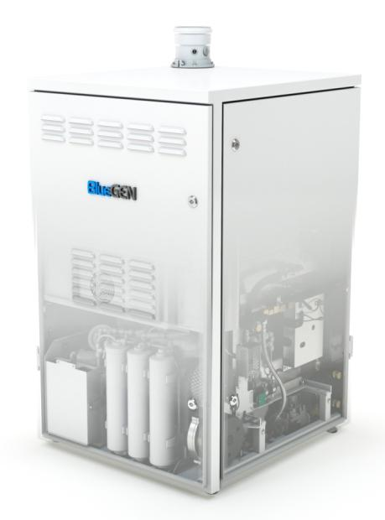
BlueGEN – the most efficient electricity generator
Power
Gas
Heat
  Distributed power production @ 60% efficiency
  Waste heat for hot water production 200 ltr/day

Slide 6
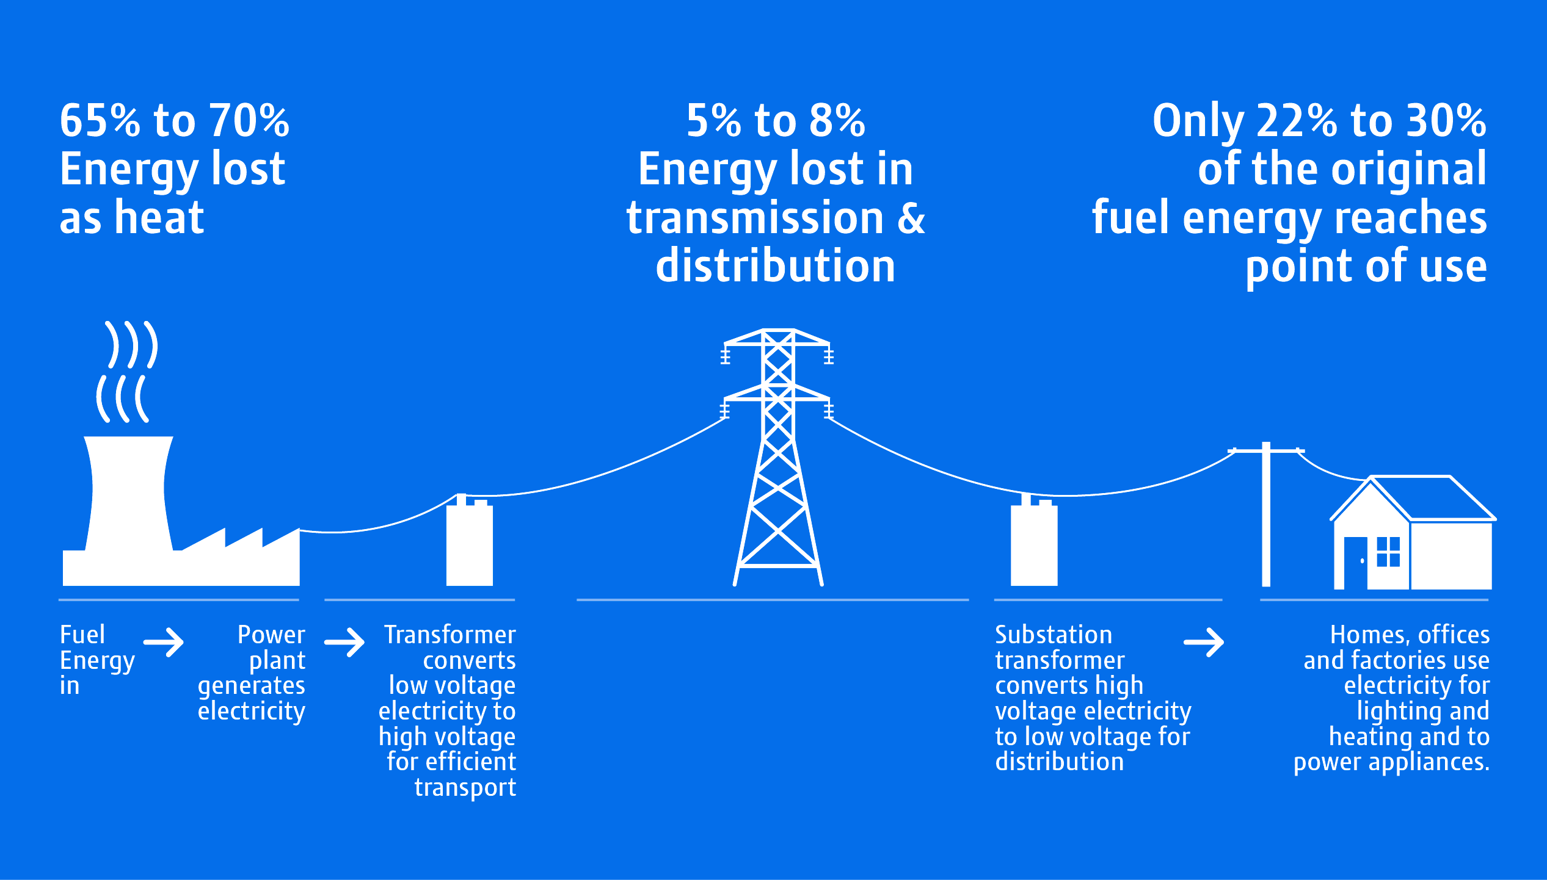
Centralised Generation…

Slide 7
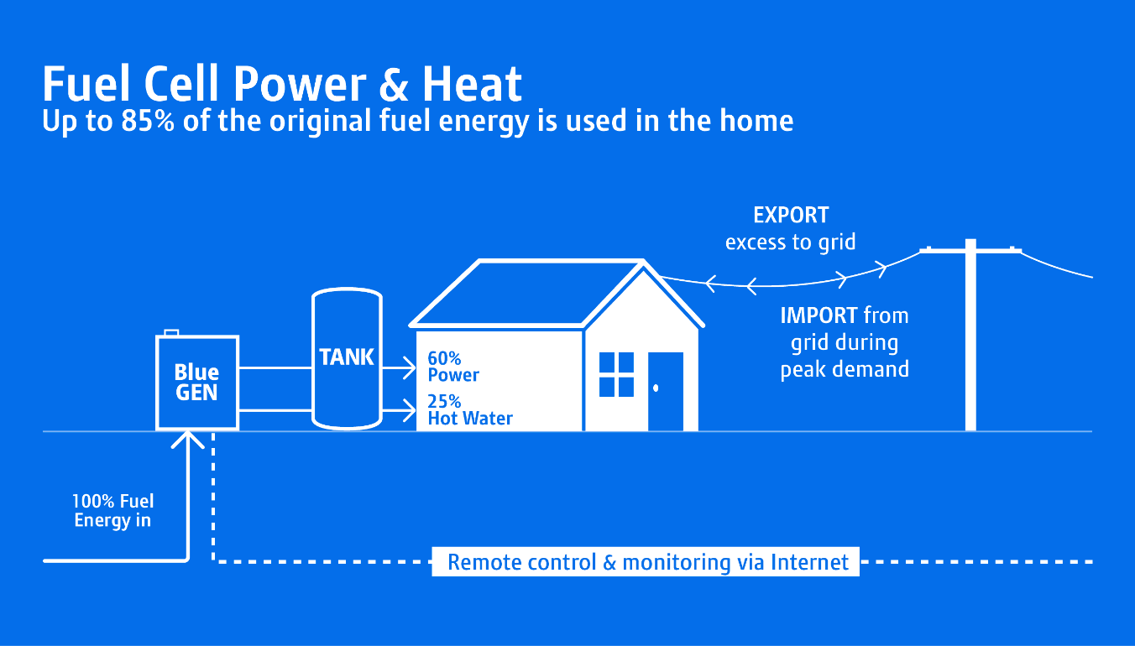
Distributed Generation…

Slide 8

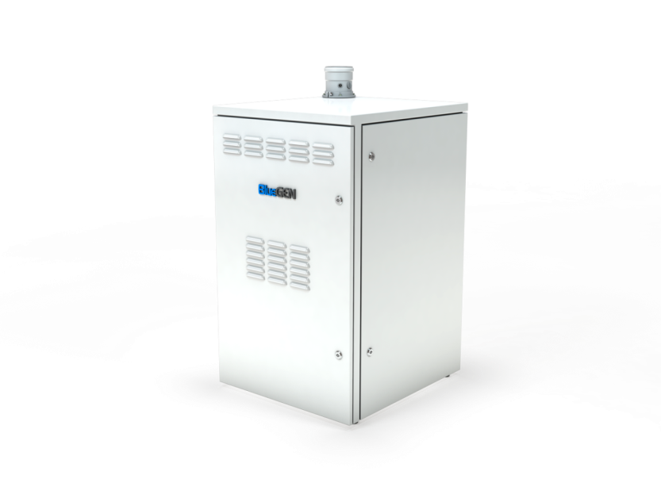




BlueGEN addresses the key challenges of this transition
Highest electrical efficiency (comparable to modern CCGT-plants)
Flexible application, local balancing of fluctuating renewable power sources
Restructuring of fossil power plant portfolio
Expansion of Renewables
  „Virtual
  Power
  Plants“
  Renewable through
  use of bio-methane
  or synthetic gas
Grid stabilization
  Distributed operation reduces losses and stabilises grids
Combined heat and power:
significantly higher efficiencies
Increase in building efficiency
  BlueGEN can perform a fundamental role in the transformation of the energy industry, complementary with renewable energy sources

Slide 9
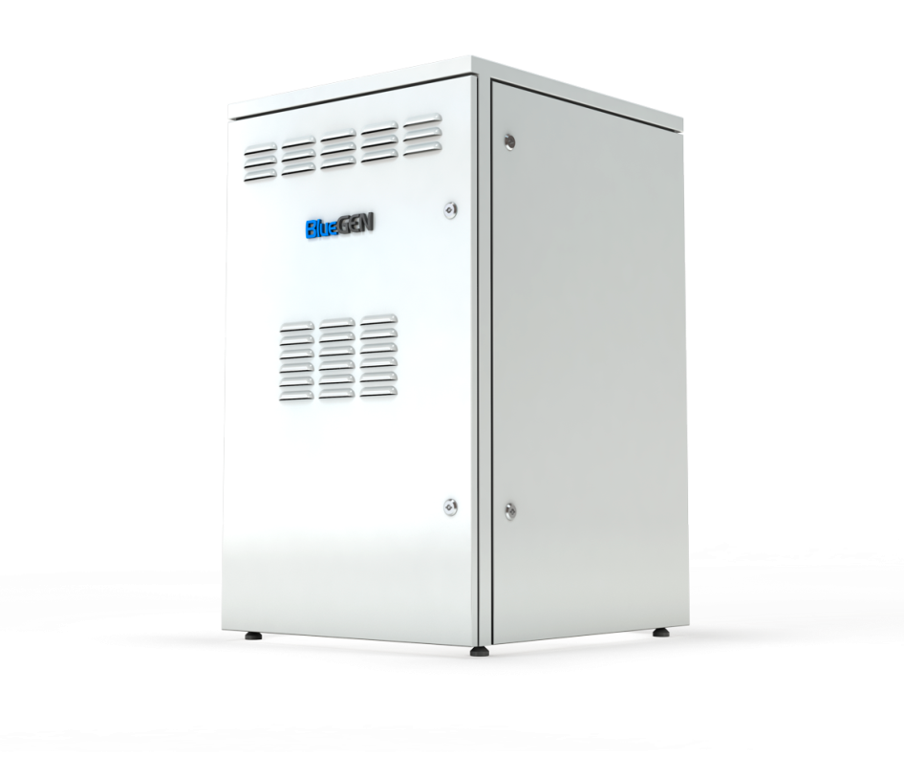

Technology

Slide 10
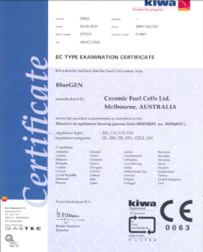

Technical specifications
Power | 1,5 kW
Heat | 0,6 kW
El. efficiency | 60%
Gas input | 2,51 kW
Cog. efficiency | 85%
Voltage/frequency | 230V ± 10%, 50Hz single-phase
Noise level | <47 dB A (1m)
Service interval | 12 months
Weight | Ca. 230 kg

Slide 11
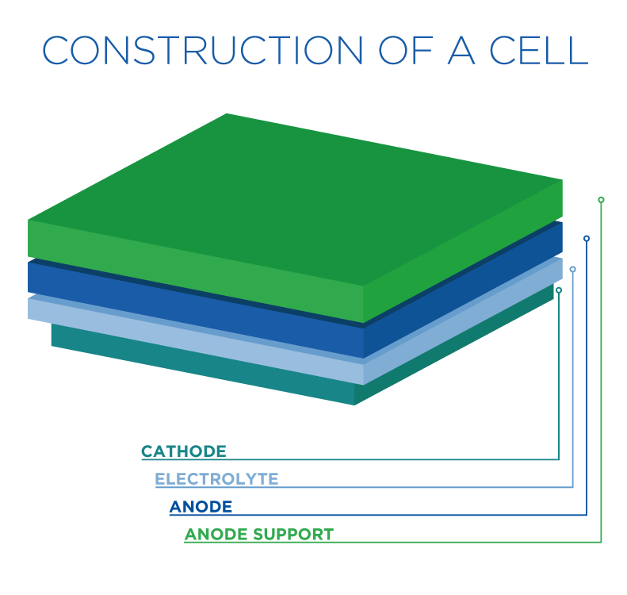
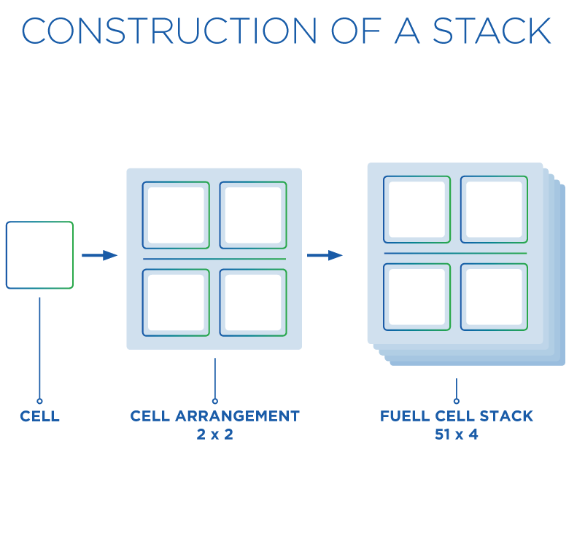
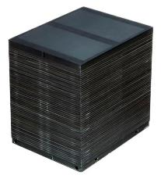

Solid oxide fuel cells - SOFC
Low cost ceramic powders
Easy to produce using existing ceramic processing technologies
Working temperatures ca. 750°
High fuel utilisation ca. 85%
Gross electrical efficiency ca. 68%

Slide 12
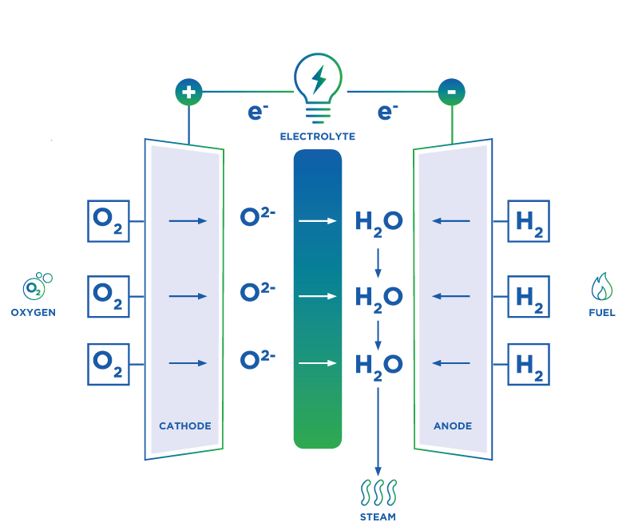
Functioning principle
4. The electrons (e⁻) travel through an external circuit, generating electricity.
1. The fuel cell is charged on the cathode side with oxygen from the air.
2. Natural gas is broken down in an internal steam reforming process into hydrogen and other constituent parts. Hydrogen is fed into the cell on the anode side.
3. Thanks to the special material properties of the fuel cells, the oxygen penetrates the electrolyte’s membrane and interacts with the hydrogen on the other side, where H₂0 is generated.

Slide 13
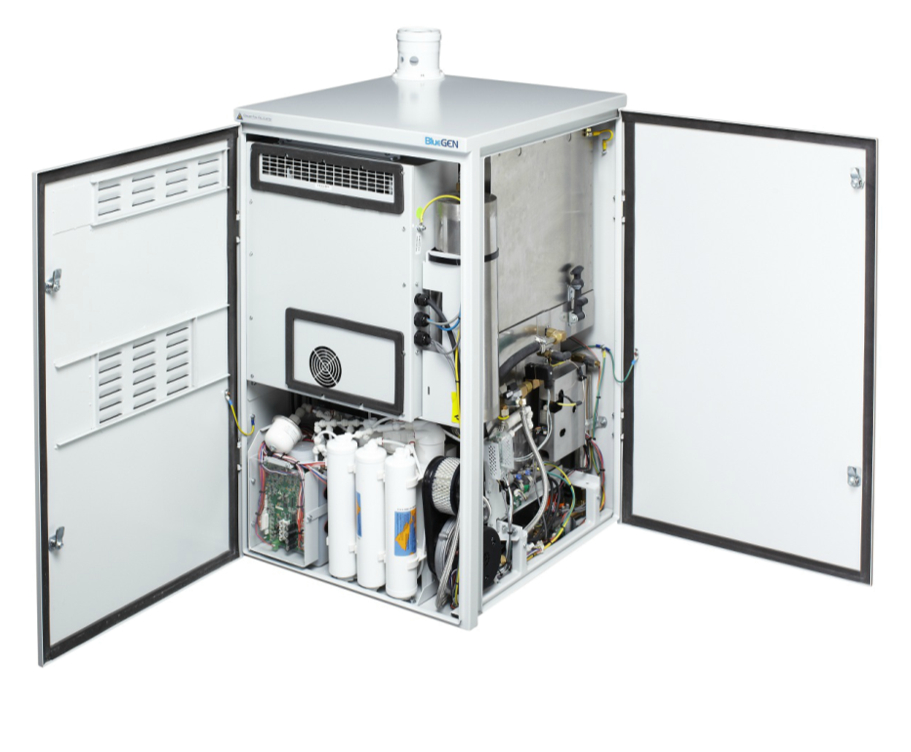
Key components
Air intake/Exhaust
Integrated heat exchanger
Fuel Cell Module
Power Management System
Desulphurisation
Air Blower
Water treatment

Slide 14
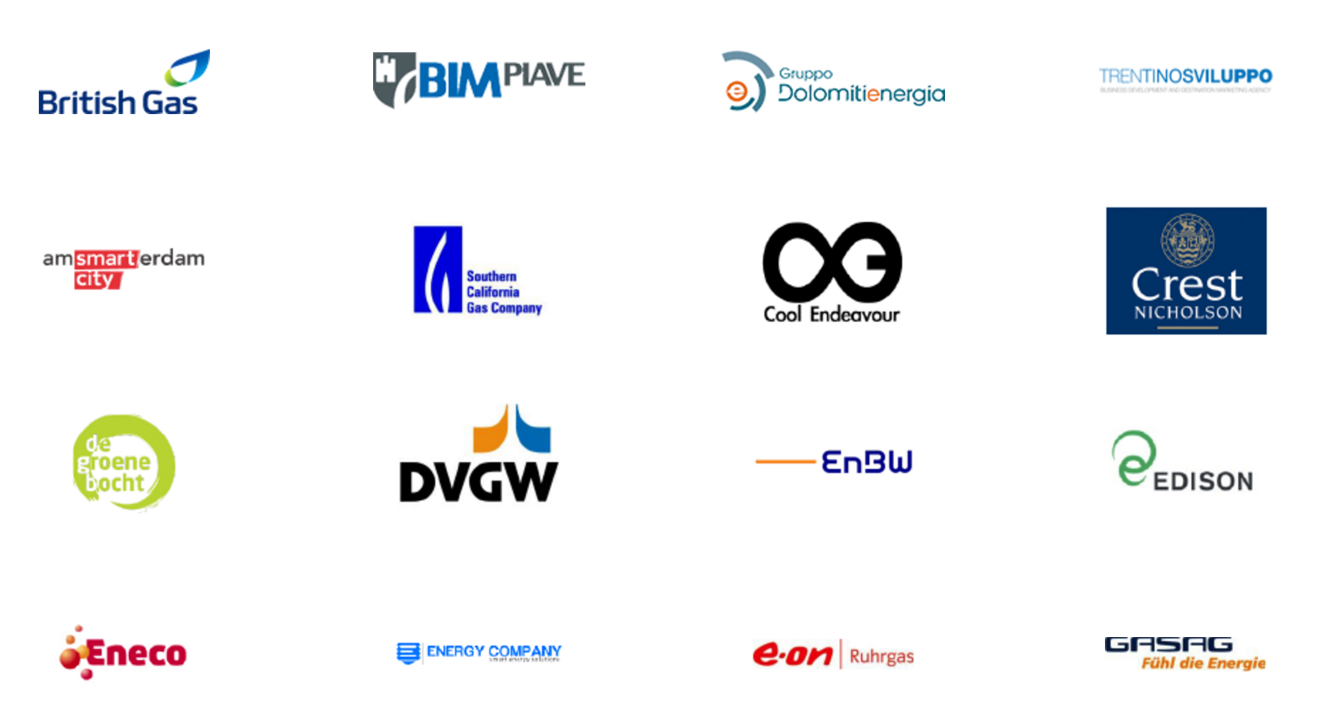
CLIENTI
We have worked with:

Slide 15
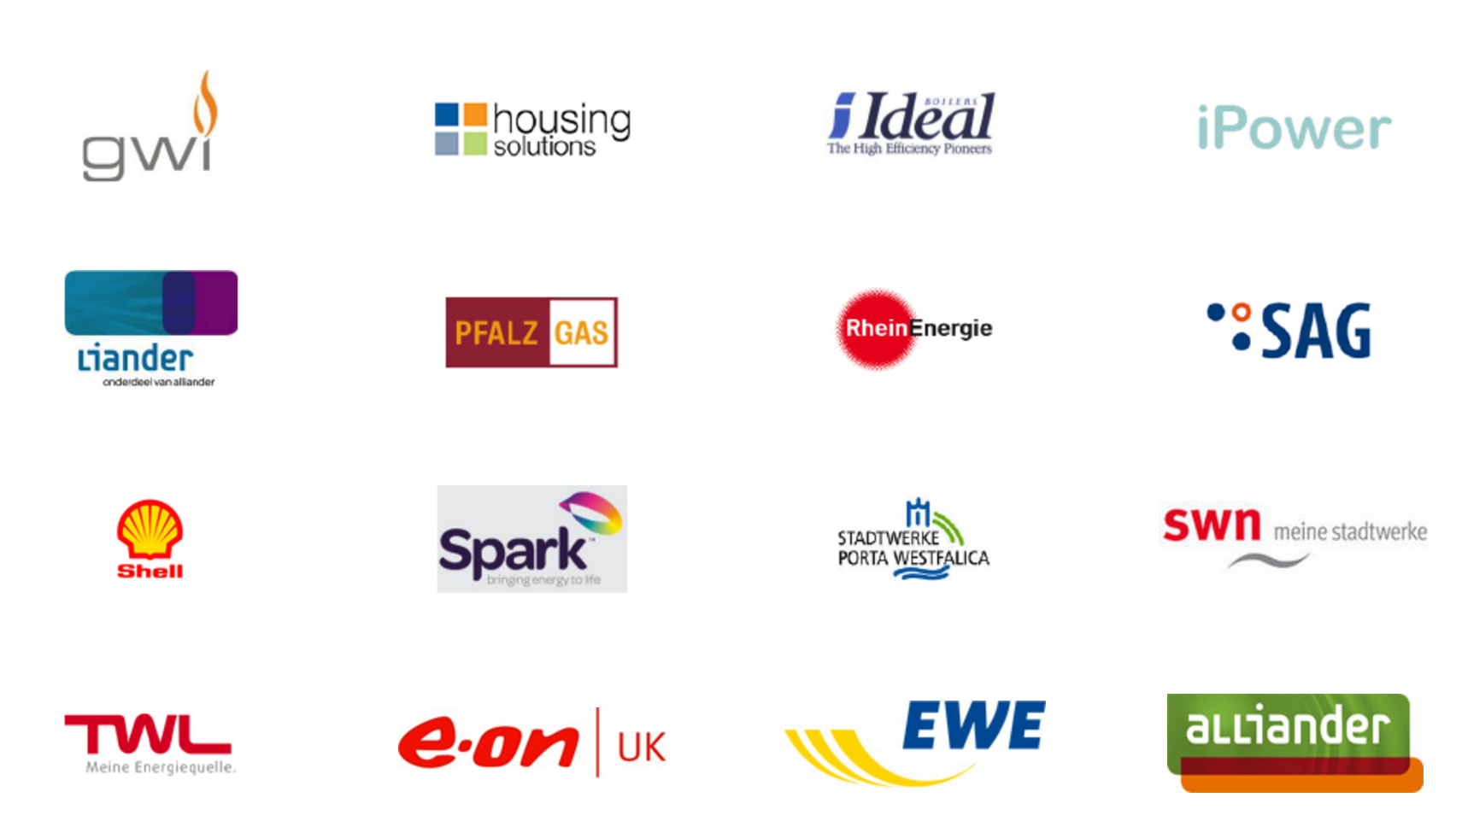
We have worked with:

Slide 16
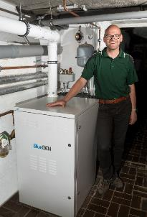
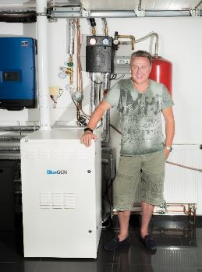
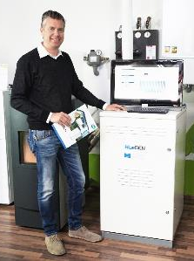
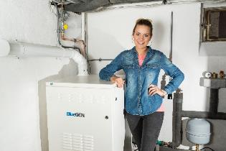

Satisfied customers are our best promoters!

