Slide 1
Technologies
Student Powerpoint 1
Location and connection of components of a fuel cell vehicle powertrain
Content created by
<Partner logo>
Last updated 18th October 2019

Slide 2
Practical exercise:
locating and connecting the components
of a fuel cell vehicle powertrain
Components of a FCV powertrain
Example based on the Toyota Mirai

Slide 3
Practical exercise:
locating and connecting the components
of a hydrogen fuel cell vehicle powertrain
Exercise: Print the pages in the “PRINT SECTION” of this document and cut the components following dot lines. Draw the top view shape of a car or draw a rectangle on the black/whiteboard and then locate the components following the theory explained previously. Label each component role and connect them to each other in order to build a functional powertrain.
Example based on the Toyota Mirai

Slide 4
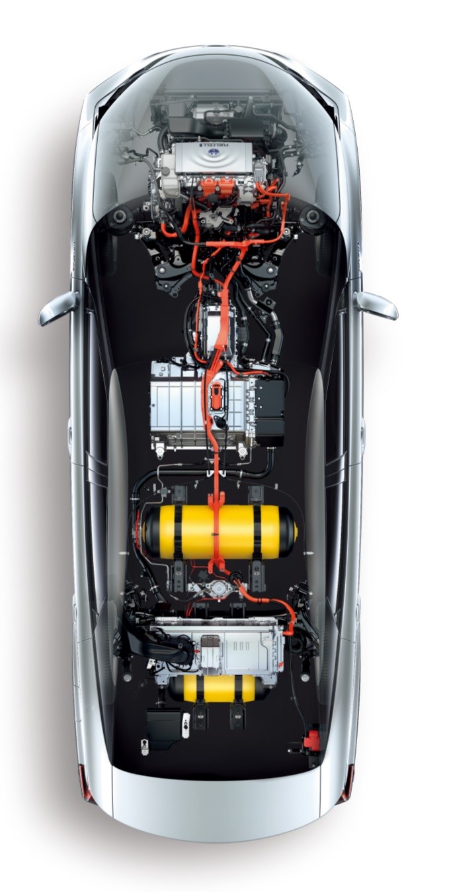
List of the components
Chassis frame
Filling plug
Hydrogen tank(s)
Pressure regulator
Fuel cell
Fuel Cell auxiliaries (sub-exercise)
Radiator & cooling circuit
Hydrogen pump & inverter
Air Filter
Air compressor & intercooler
Humidifier
Exhaust
High Voltage Battery
Traction Inverter
Electric motor
Transmission & wheels
1
6a,c,d
10
8
9
10
5
6b,e
3
4
7
2
6f

Slide 5
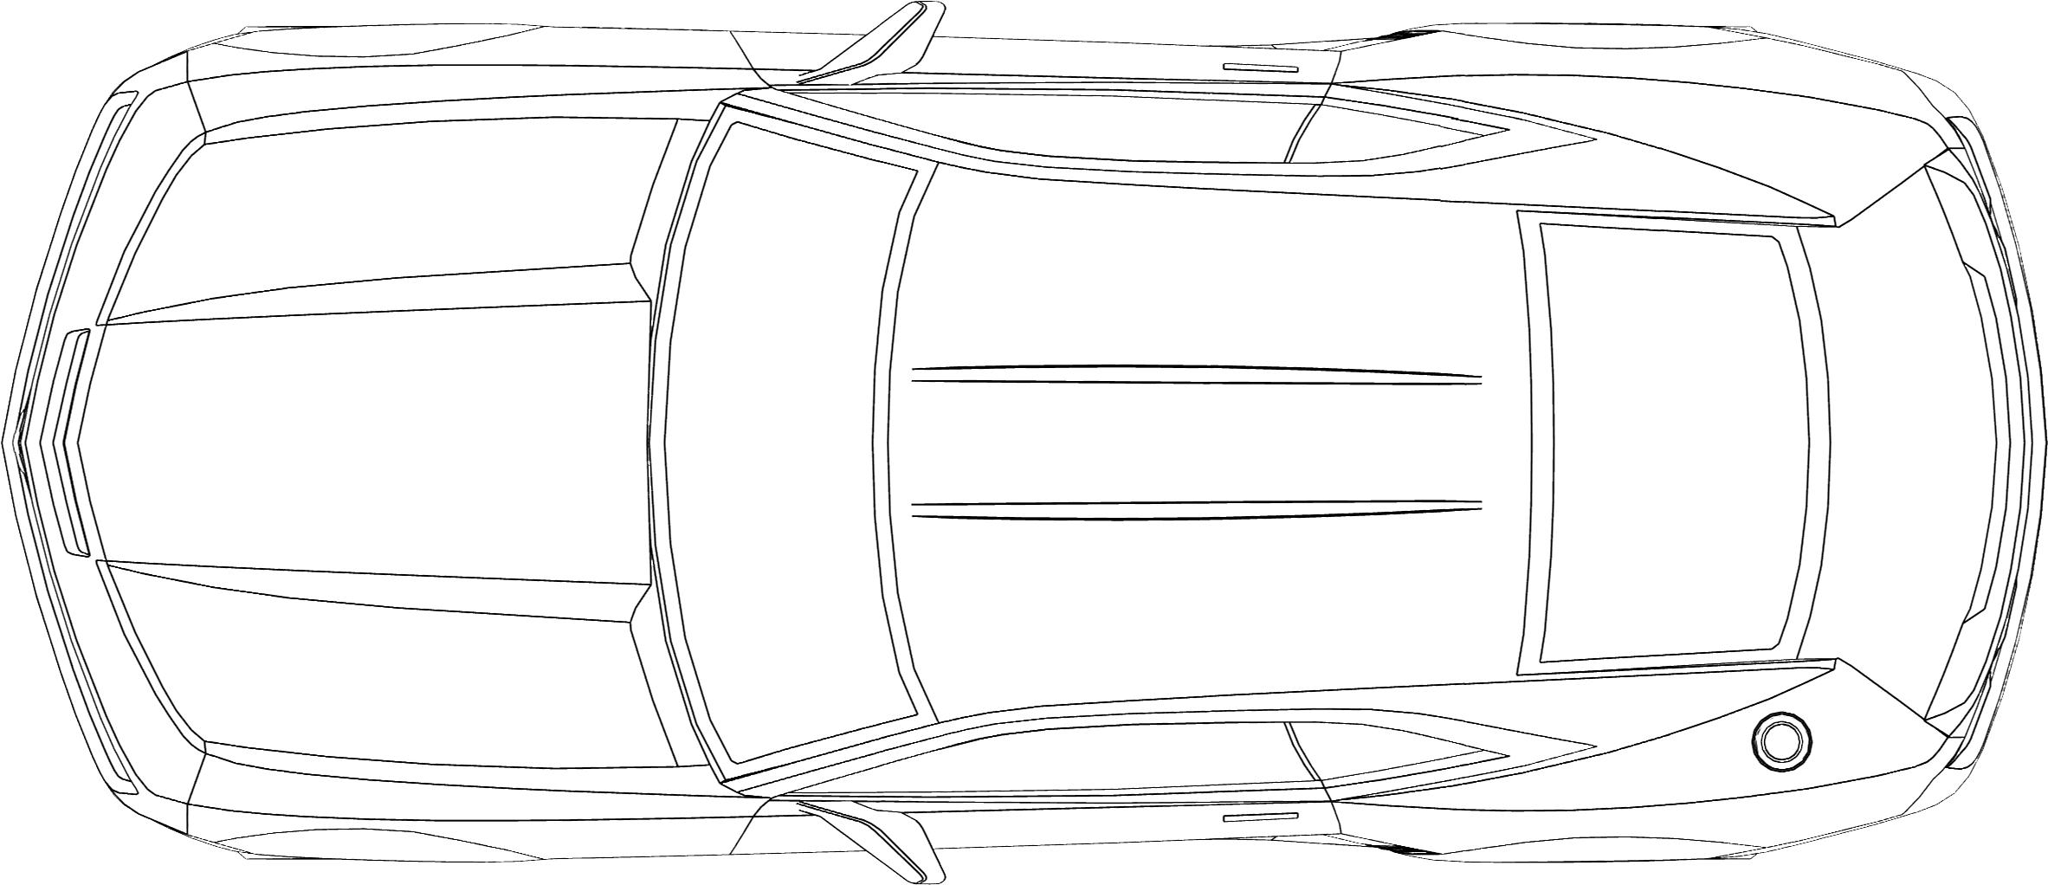
1. Chassis design, we keep the external shape, or we draw a rectangle
This picture shows the general shape of a car

Slide 6
1. Chassis design, we keep the external shape, or we draw a rectangle
This picture shows the general shape of a car and an equivalent rectangle

Slide 7
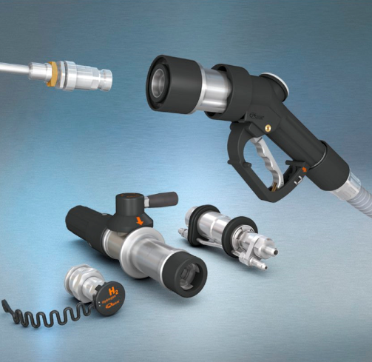
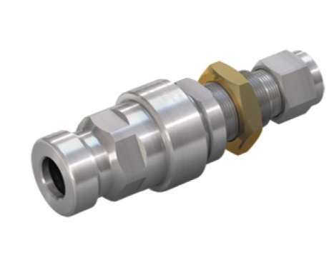
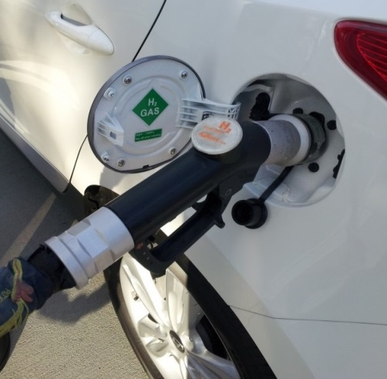
2. Filling plug
Source: WEH
This plug is located on the bodywork, near the trunk and not far from the tanks. It is connected to the pressure tanks and will be connected to the filling station pistol grip each time the driver needs to refill the tank.

Slide 8
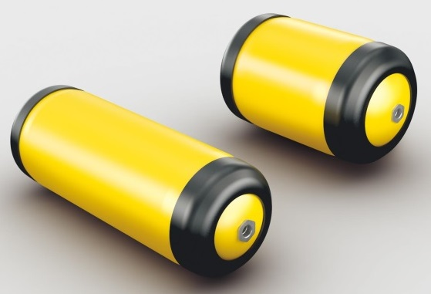
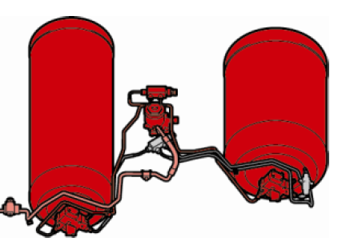
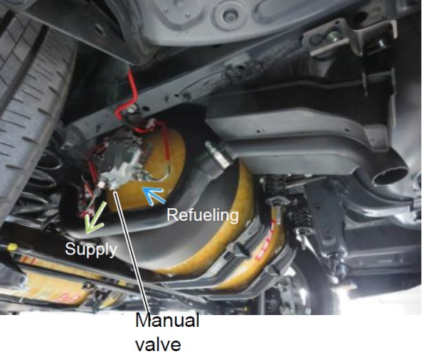
3. Hydrogen pressure tanks
These tanks are used to store 5 kg of hydrogen gas under a pressure of 700 bars. They are manufactured with 3 layers which are made of plastic (liner), carbon fibre composites (intermediate) and glass fibre (exterior)

Slide 9
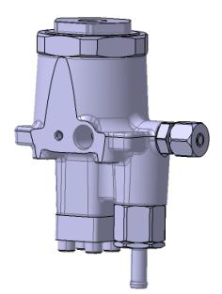
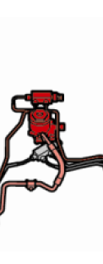
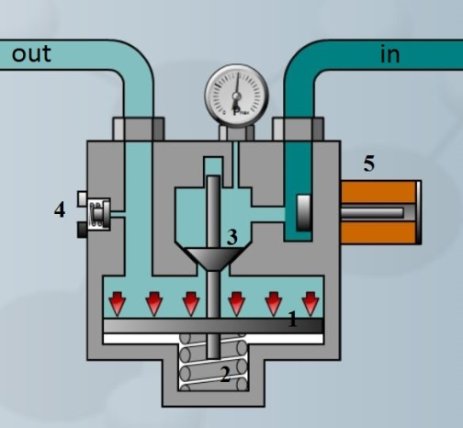
4. Pressure regulator
out
in
in
in
out
This mechanical device is used to reduce the pressure from the tank pressure to an intermediate one, generally 10-15 bars. FC injectors are then reducing the pressure to approximately 1 bar corresponding to the FC H2 intake pressure.

Slide 10
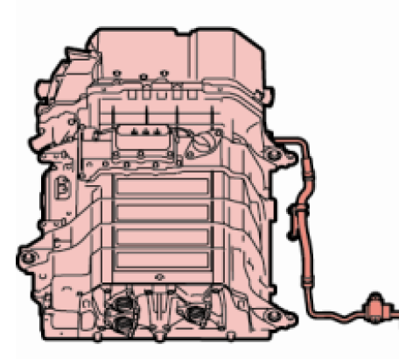
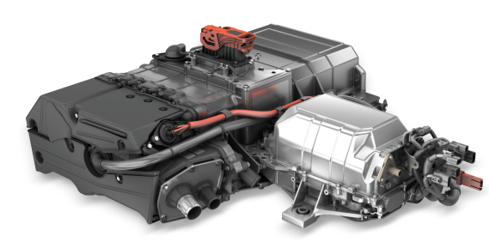
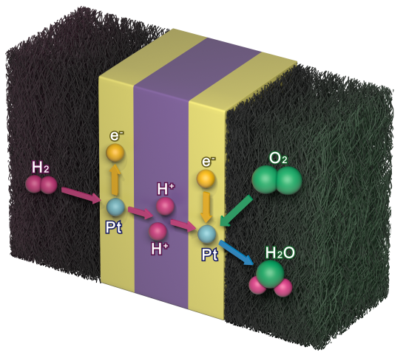
5. Fuel cell stack
This fuel cell is used to produce electricity which will power the vehicle. An average power is around 100 kW. The fuel cell is sometimes associated to a booster circuit for an increase of the voltage.

Slide 11
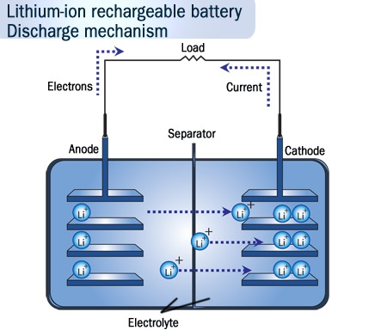
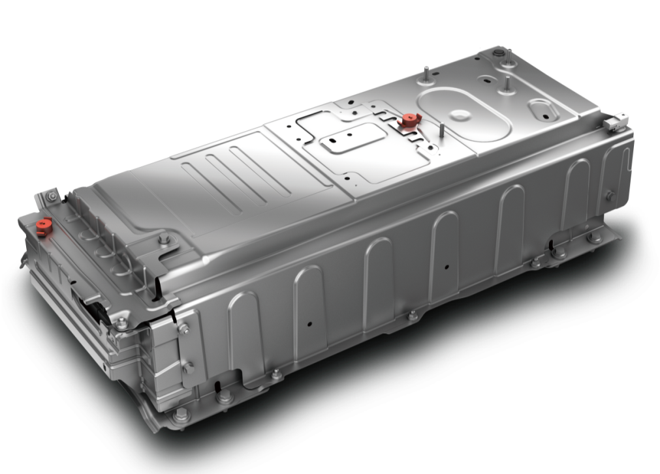
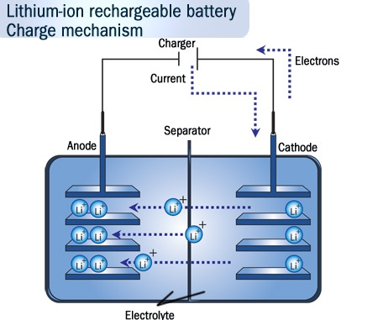
7. High Voltage Battery
This battery is used as a peak power system. Energy can be used immediately during the acceleration of fuel cell auxiliaries. It is also used to store energy recovered during braking

Slide 12
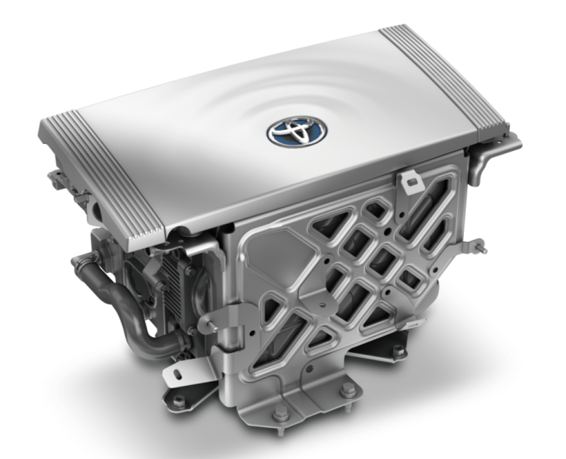
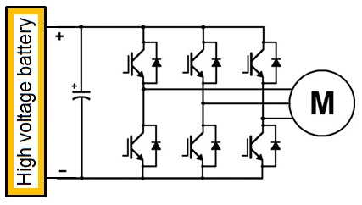
8. Traction Inverter (power electronics)
The traction inverter is a high voltage electronic component. It is used to transform DC from the battery and fuel cell into AC current to power the electric motor. By controlling the frequency and voltage of AC current it also controls the speed of the motor.

Slide 13
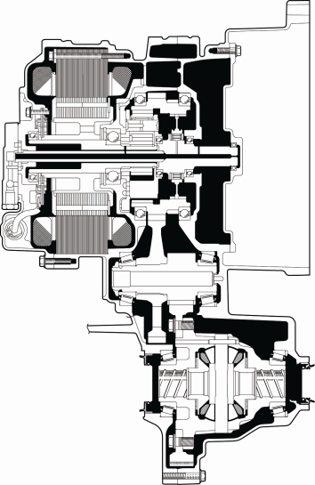
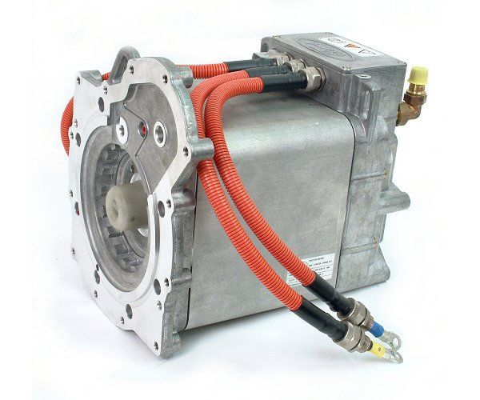
9. AC 3 phases Electric Motor (e-Motor)
The electric motor is used to transform electric energy into mechanical energy. It is a 3 phase reversible machine supplied by AC voltage. The rotational speed depends on the voltage and on the frequency.

Slide 14
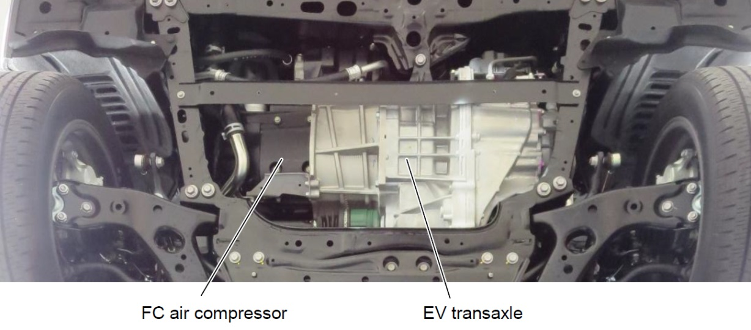
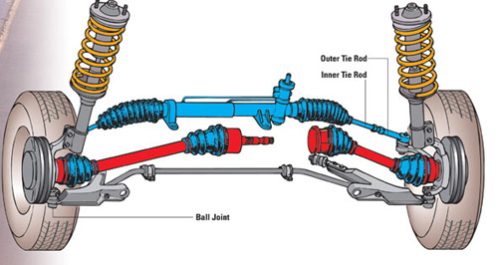
10. e-Motor + Transmission & wheels
The output of the e-motor is connected to a simplified gearbox including one speed and a differential. The gimbals are then connected to the wheels.

Slide 15
Practical exercise:
locating and connecting the components
of a hydrogen fuel cell vehicle powertrain
PRINT SECTION
Example based on the Toyota Mirai

Slide 16
OUT
IN

Slide 17
OUT
IN
IN
OUT

Slide 18
+
OUT
-
IN

Slide 19
+
-
OUT

Slide 20
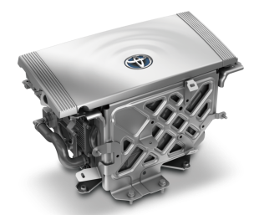
+
IN
-
+
IN
-
OUT
U V W

Slide 21
IN
W V U

Slide 22
