Slide 1
Technologies
Student Powerpoint 2
Interactions between the components of a fuel cell vehicle powertrain
Content created by
<Partner logo>
Last updated 18th October 2019

Slide 2
Practical exercise:
locating and connecting the components
of a fuel cell vehicle powertrain
Components of a FCV powertrain
Example based on the Toyota Mirai

Slide 3
Practical exercise:
locating and connecting the components
of a hydrogen fuel cell vehicle powertrain
Exercise: Print the pages in the “PRINT SECTION” of this document and cut the components following dot lines. Locate the components following the energy flow from the grip nozzle at the filling station to the wheels of the vehicle. Label each component role and connect them to each other in order to build a functional powertrain.
Example based on the Toyota Mirai

Slide 4
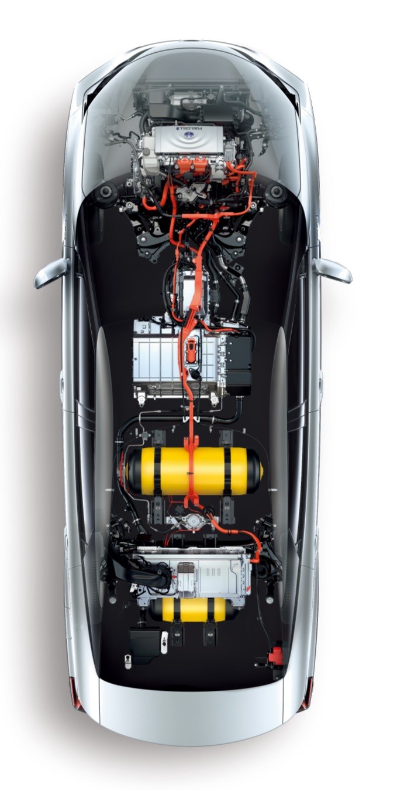
List of the components
Chassis frame
Filling plug
Hydrogen tank(s)
Pressure regulator
Fuel cell
Fuel Cell auxiliaries (sub-exercise)
Radiator & cooling circuit
Hydrogen pump & inverter
Air Filter
Air compressor & intercooler
Humidifier
Exhaust
High Voltage Battery
Traction Inverter
Electric motor
Transmission & wheels
1
6a,c,d
10
8
9
10
5
6b,e
3
4
7
2
6f

Slide 5
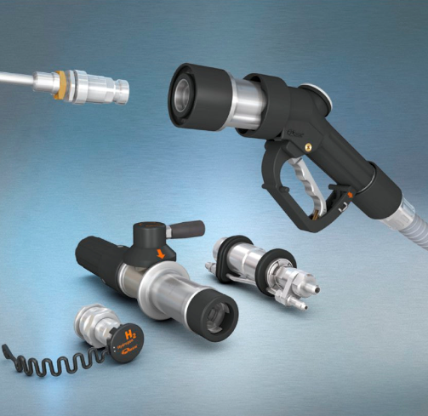
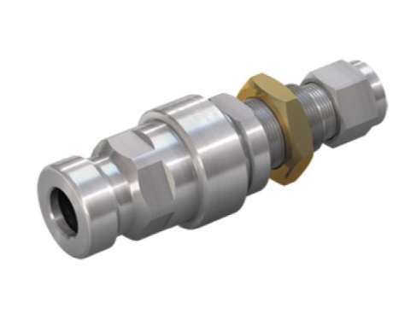
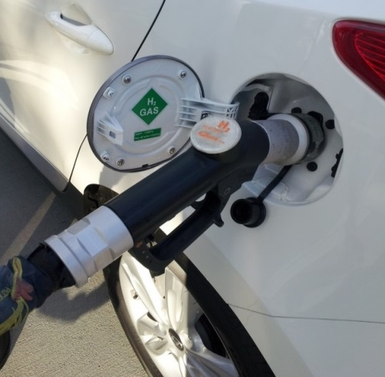
2. Filling plug
Source: WEH
This plug is located on the bodywork, near the trunk and not far from the tanks. It is connected to the pressure tanks and will be connected to the filling station pistol grip each time the driver needs to refill the tank.

Slide 6
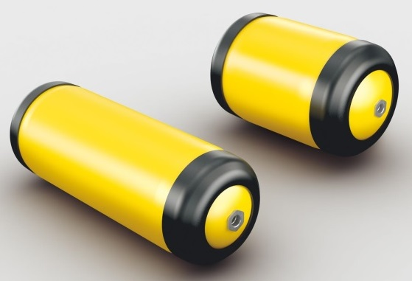
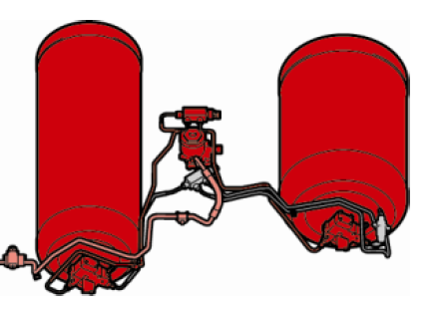
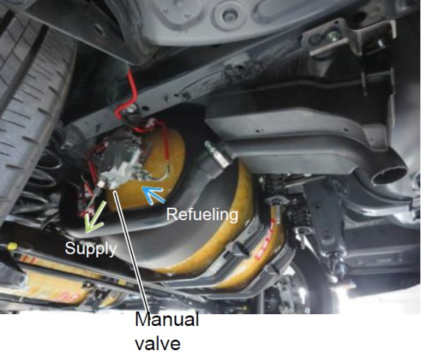
3. Hydrogen pressure tanks
These tanks are used to store 5 kg of hydrogen gas under a pressure of 700 bars. They are manufactured with 3 layers which are made of plastic (liner), carbon fibre composites (intermediate) and glass fibre (exterior)

Slide 7
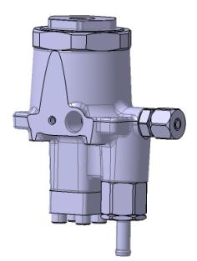
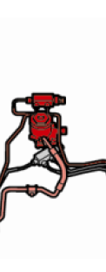
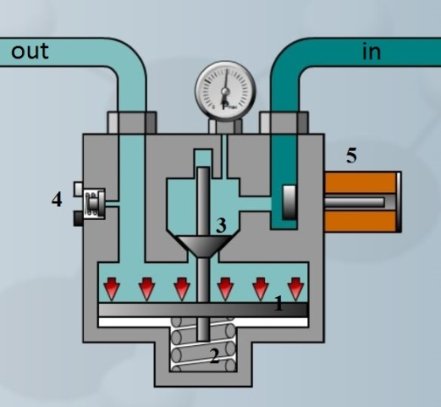
4. Pressure regulator
out
in
in
in
out
This mechanical device is used to reduce the pressure from the tank pressure to an intermediate one, generally 10-15 bars. FC injectors are then reducing the pressure to approximately 1 bar corresponding to the FC H2 intake pressure.

Slide 8
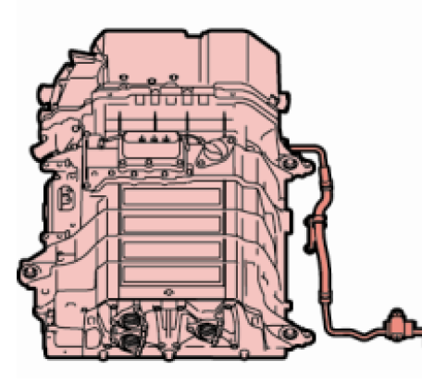
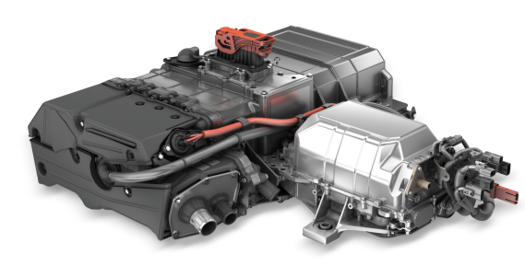
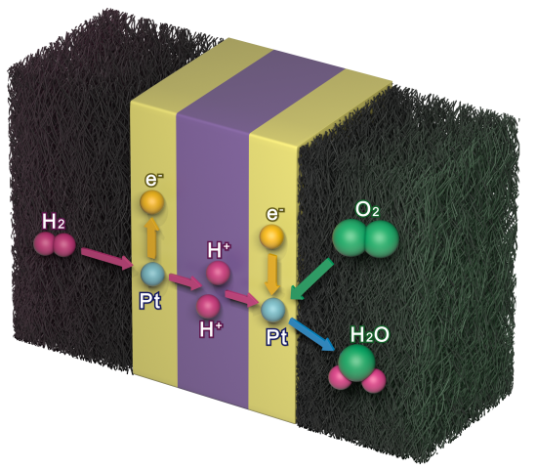
5. Fuel cell stack
This fuel cell is used to produce electricity which will power the vehicle. An average power is around 100 kW. The fuel cell is sometimes associated to a booster circuit for an increase of the voltage.

Slide 9
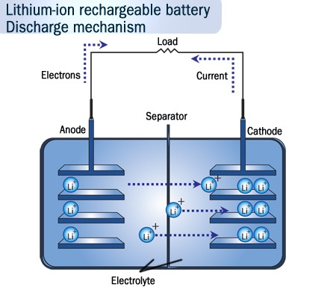
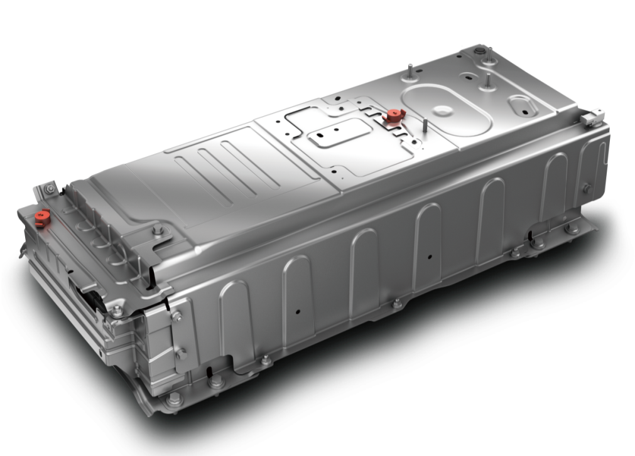
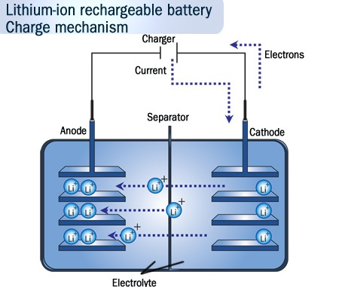
7. High Voltage Battery
This battery is used as a peak power system. Energy can be used immediately during the acceleration of fuel cell auxiliaries. It is also used to store energy recovered during braking

Slide 10
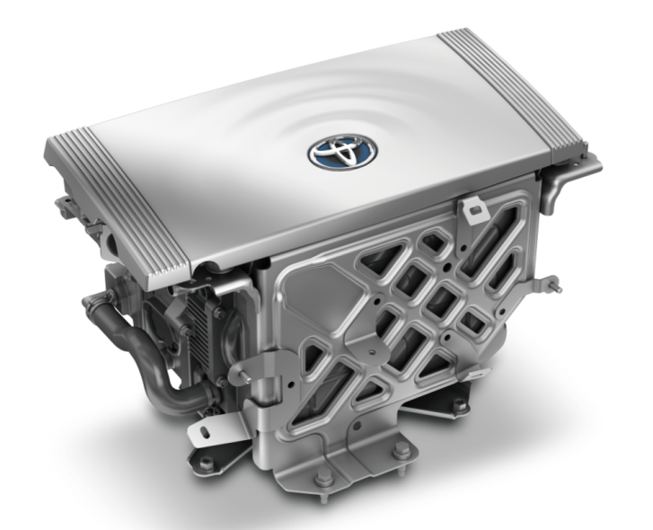
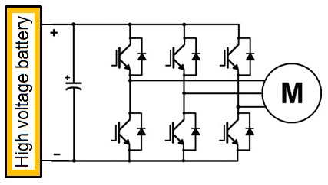
8. Traction Inverter (power electronics)
The traction inverter is a high voltage electronic component. It is used to transform DC from the battery and fuel cell into AC current to power the electric motor. By controlling the frequency and voltage of AC current it also controls the speed of the motor.

Slide 11
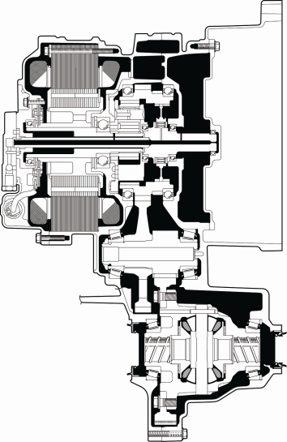
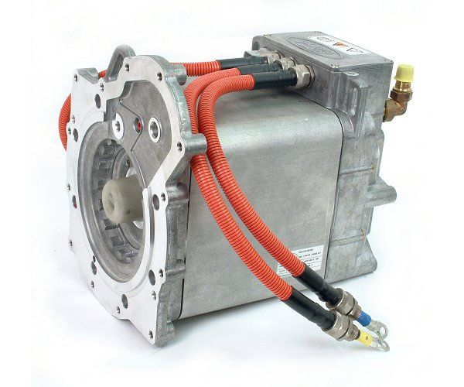
9. AC 3 phases Electric Motor (e-Motor)
The electric motor is used to transform electric energy into mechanical energy. It is a 3 phase reversible machine supplied by AC voltage. The rotational speed depends on the voltage and on the frequency.

Slide 12
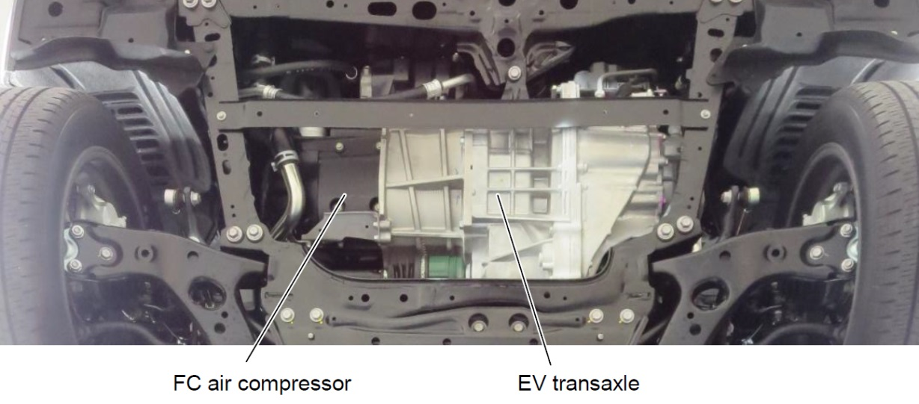
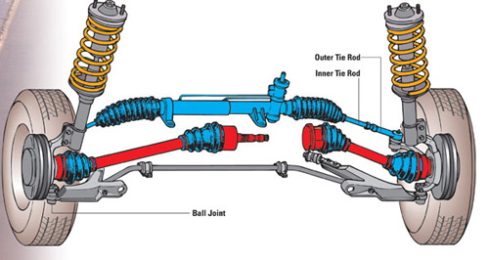
10. e-Motor + Transmission & wheels
The output of the e-motor is connected to a simplified gearbox including one speed and a differential. The gimbals are then connected to the wheels.

Slide 13
Practical exercise:
locating and connecting the components
of a hydrogen fuel cell vehicle powertrain
PRINT SECTION
Example based on the Toyota Mirai

Slide 14
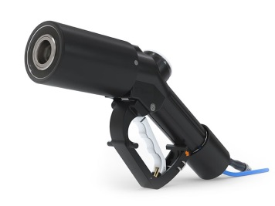
OUT
IN

Slide 15
OUT
IN

Slide 16
H2 IN
H2 OUT

Slide 18
OUT
H2 IN
+ -

Slide 19
OUT
+ -

Slide 20
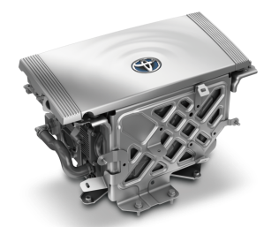
+
IN
-
U V W
+
IN
-
OUT

Slide 21
IN W V U
OUT

Slide 22
