Slide 1
Technologies
Student Powerpoint 3
Locating and connecting the components of a fuel cell vehicle powertrain
Content created by
<Partner logo>
Last updated 18th October 2019

Slide 2
Practical exercise:
locating and connecting the components
of a fuel cell vehicle powertrain
Components of a FCV powertrain
Example based on the Toyota Mirai

Slide 3
Practical sub-exercise:
connecting the auxiliaries
of a PEM fuel cell system for vehicles
Exercise: Print the pictures of the auxiliaries and locate them before and after the fuel cell in order to assume good functioning. Start from the air intake flow until leaving the system by the exhaust. Explain briefly the positioning order of the different elements.
Example based on the Toyota Mirai

Slide 4
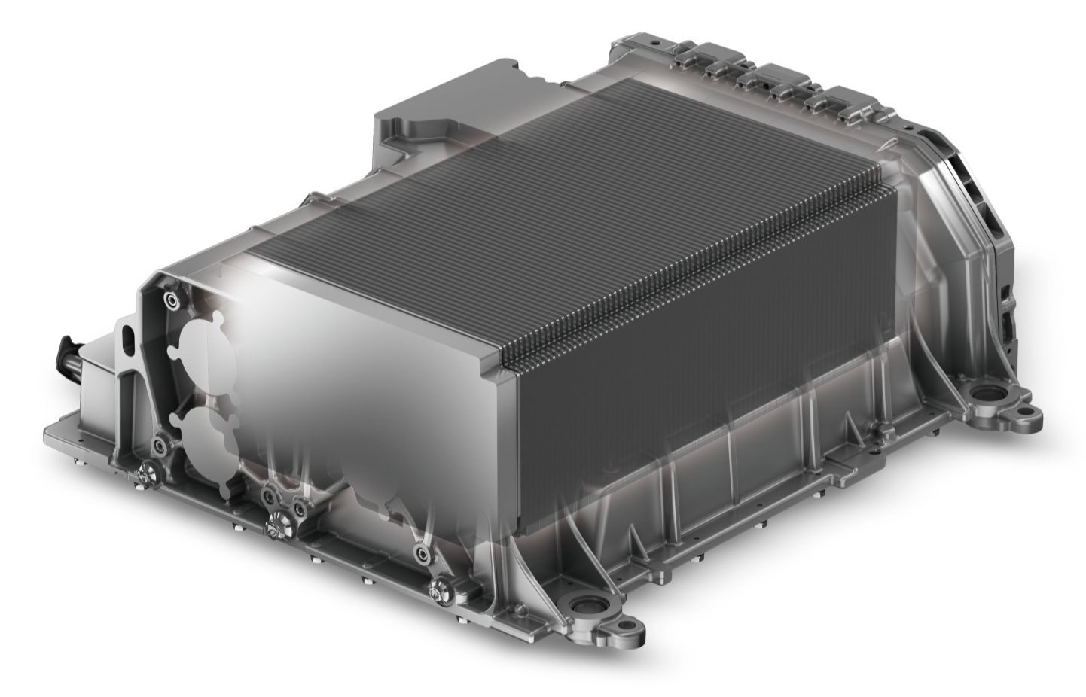
Sub-exercise: the fuel cell auxiliaries
The fuel cell needs auxiliaries to work properly. It must be supplied with hydrogen and with moist filtered air, it must be cooled and the water produced must be eliminated by the exhaust.

Slide 5
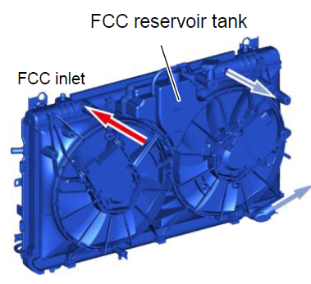
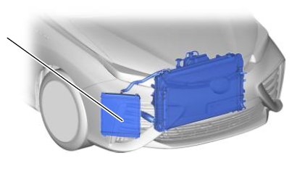
Sub-exercise: the fuel cell auxiliaries
Radiator & sub-radiator
The radiator & cooling circuit is used to cool the fuel cell during operation. A fluid captures the heat produced by the fuel cell and circulates in pipes until exchanging heat with ambient air in the radiator.

Slide 6
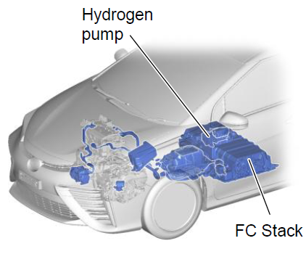
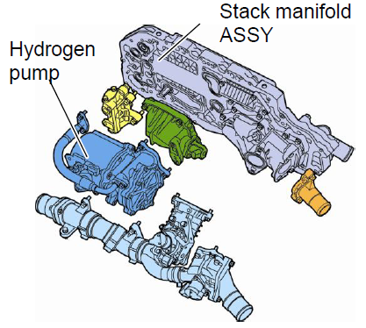
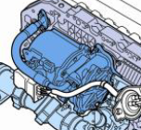
Sub-exercise: the fuel cell auxiliaries
The hydrogen pump is often integrated in the fuel cell casing. It is used to assume a sufficient flow of hydrogen in all cells. It is necessary because intake pressure is low, around 1 bar.

Slide 7
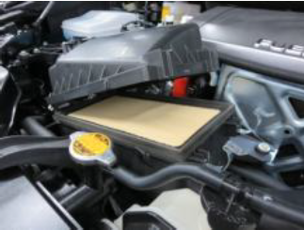
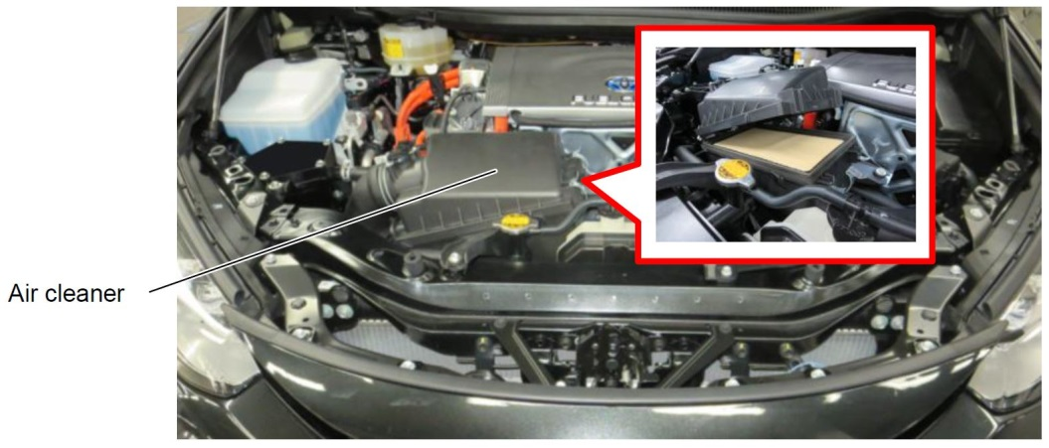
Sub-exercise: the fuel cell auxiliaries
The air filter is used to avoid dust particles entering the fuel cell and contaminating surfaces. We are using a chemical reaction which needs active surfaces. Any kind of contamination will reduce the fuel cell efficiency.

Slide 8
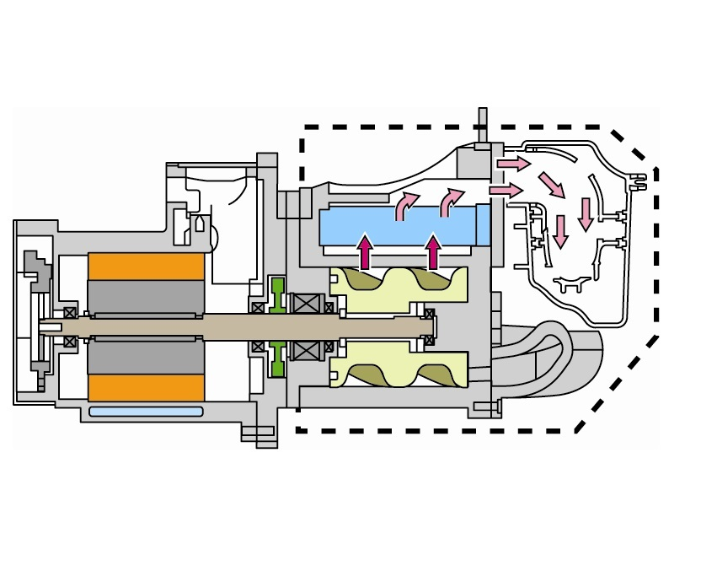
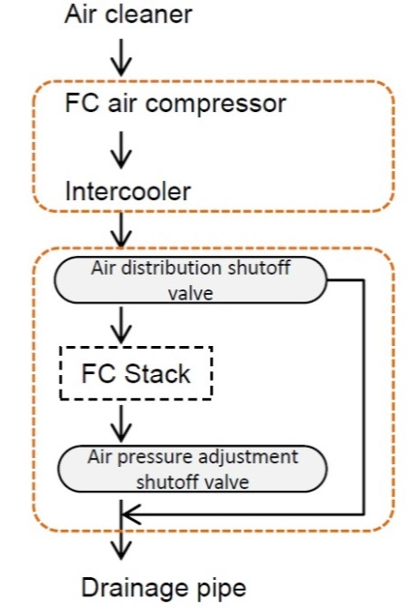
Sub-exercise: the fuel cell auxiliaries
The air compressor is used to assume the flow of air corresponding to the current requested. The more we need current, the more air and hydrogen we must push into the fuel cell.

Slide 9
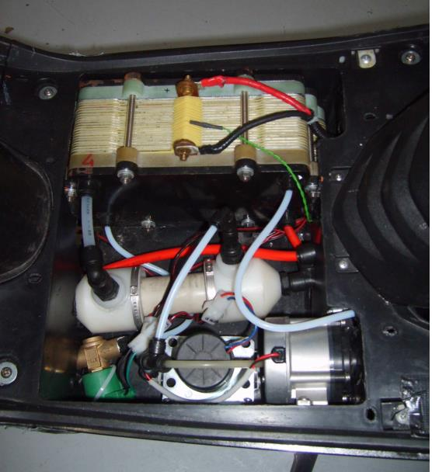
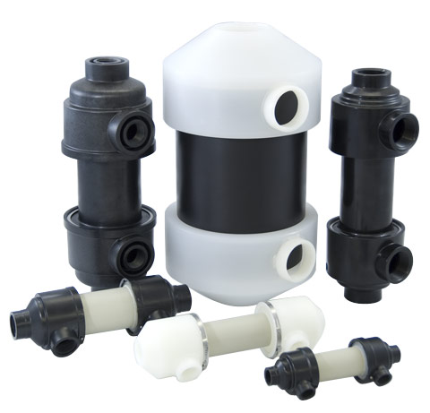
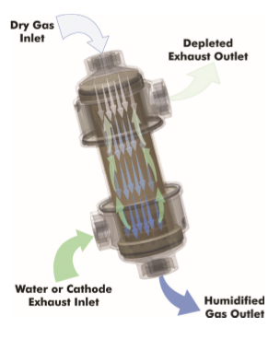
Sub-exercise: the fuel cell auxiliaries
Source: permapure
The air humidifier is necessary because the fuel cell membrane does not work properly when it is dry. The moisture level must nevertheless be kept under a limit (50%) in order to avoid the flooding of the fuel cell.

Slide 10
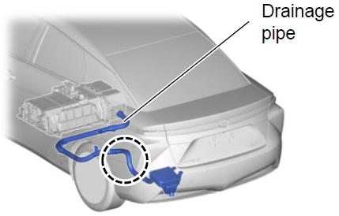
Sub-exercise: the fuel cell auxiliaries
The exhaust of the fuel cell is used to eliminate water produced in the air side of the fuel cell.

Slide 11
Practical exercise:
locating and connecting the components
of a hydrogen fuel cell vehicle powertrain
PRINT SECTION
Example based on the Toyota Mirai

Slide 12
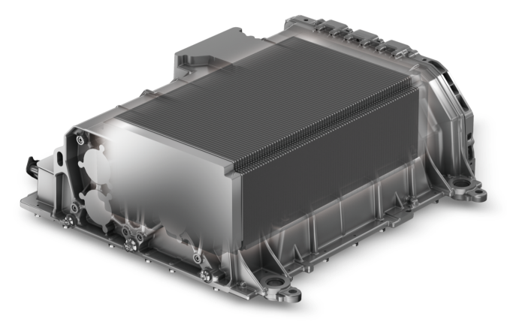
INTAKE
OUT

Slide 13
IN
OUT

Slide 14
OUT
IN

Slide 15
FCC out

Slide 16
IN
OUT

Slide 17
IN
OUT

