Slide 1









Technologies
Student Powerpoint
Content created by
<Partner logo>
Last updated 18th October 2019

Slide 2
Hydrogen Fuel Cell Technology
Different types of fuel cells
Architecture of fuel cells: bipolar - planar - tubular
Working principle of fuel cells
Materials used in a PEFC: Bipolar plates - Diffusion layers - Electrolyte
Auxiliaries associated to the fuel cell
Integration of a fuel cell in a system
Energy management

Slide 3
There are different types of fuel cells using the same working principle
They differ by the electrolyte, catalyst, gaseous reactants and temperature
The chemical reaction takes place in a single cell
A cell is generally composed of 5 elements: 2 bipolar plates, 2 diffusion layers and 1 electrolyte membrane in a central position
There is a fine deposition of a catalyst on the active surfaces of the diffusion layers, on the surfaces in contact with the electrolyte membrane
A cell generates 1.18 Volt when supplied with hydrogen and pure oxygen but only 0.8 Volt if oxygen is replaced with air
The electric output of cells are connected in series in order to increase the working voltage.

Slide 4
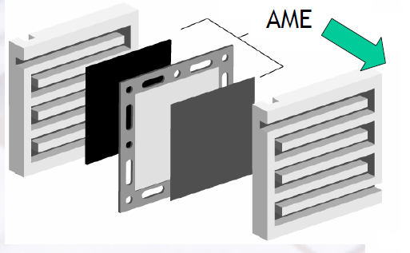
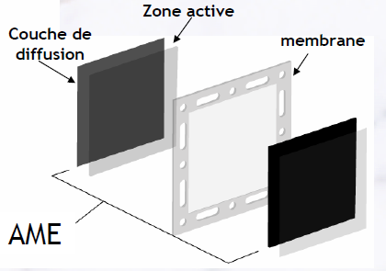
Single cell components
MEA
PEM Cell voltage : 0,8 – 1 V
Membrane Electrode Assembly
Active zone
Diffusion Layer
Membrane
Bipolar plates
MEA

Slide 5
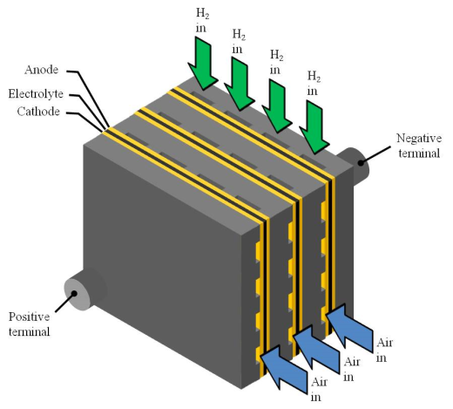
Cells are connected to create a stack
The global voltage is resulting in the addition of cell voltages. If we build a stack of 20 cells, we will measure a working voltage of approximately 20 Volts.
Bipolar architecture of a stack

Slide 6
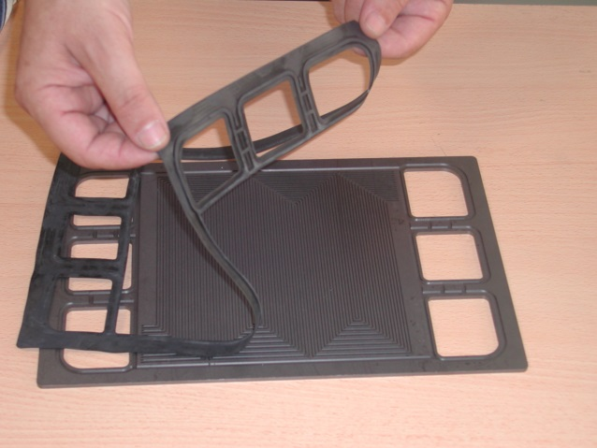
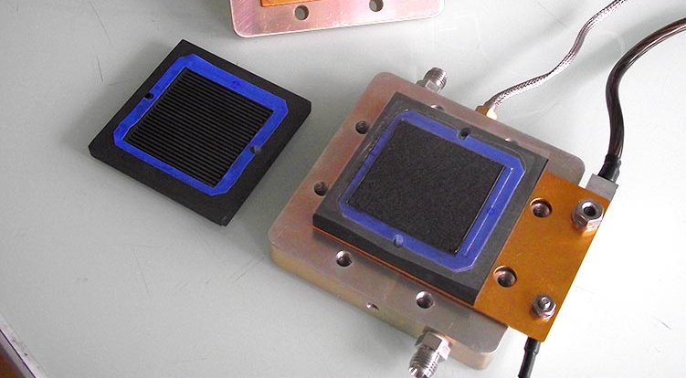
Different types of geometrical arrangements: bipolar, planar or tubular
Bipolar architecture of a stack

Slide 7
Different types of geometrical arrangements: bipolar, planar or tubular
Planar architecture of a stack
Tubular architecture of a stack

Slide 8
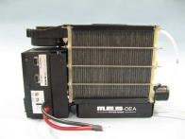
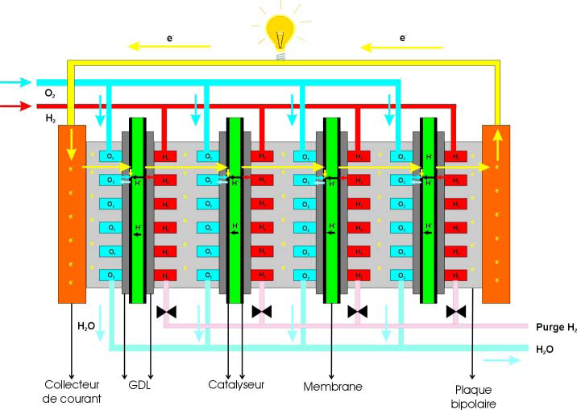
Stack assembly
The cells are connected electrically in series while they are fed with hydrogen and oxygen in parallel.
Electrode
Gas Diffusion Layers
Catalyst
Membrane
Bipolar plates

Slide 9
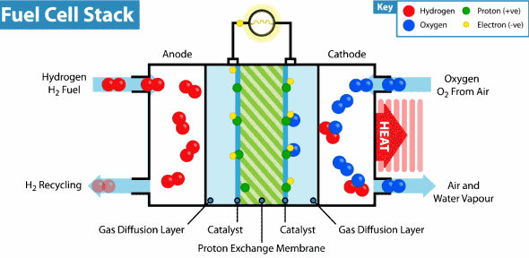
Working principle of a single cell (PEFC)
The operating principle is simple, without moving parts. The protons cross the membrane while the electrons have to go around by the external electric circuit.
Anode: | $${2H}_{2}→4H^{+}+4e^{−}$$ | Eq 1
Cathode: | $$O_{2}+4H^{+}+4e^{−}→{2H}_{2}O$$ | Eq 2
General: | $${2H}_{2}+O_{2}→2H_{2}O$$ | Eq 3

Slide 10
Other types of fuel cells
Alkaline AFC
Direct Methanol DMFC
Solid Oxide SOFC

Slide 11
A fuel cell is like every machine, not perfect. Despite the fact that there are no parts in motion, the materials are real and induce losses. They currently measure a global efficiency of 60%
As a result, we observe a voltage drop when a current is produced. This is represented by the so called polarisation curve.
A fuel cell needs auxiliaries to work properly, these are:
  Intake air management : filter, compressor, air cooling, humidifier, pressure and flow management valves. It is completed by the exhaust of the fuel cell where only water is produced.
  Hydrogen management: tank valves, pressure regulator, injector(s), hydrogen pump and a purge valve
  A cooling circuit is mandatory to dissipate the heat produced by the fuel cell, large radiators are generally necessary as 40% of the total power is heat.

Slide 12
The polarisation curve
The decrease of the voltage as a function of the current is an image of the efficiency of the technology

Slide 13

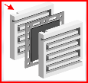
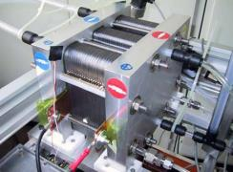
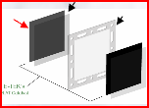
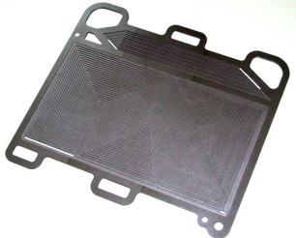
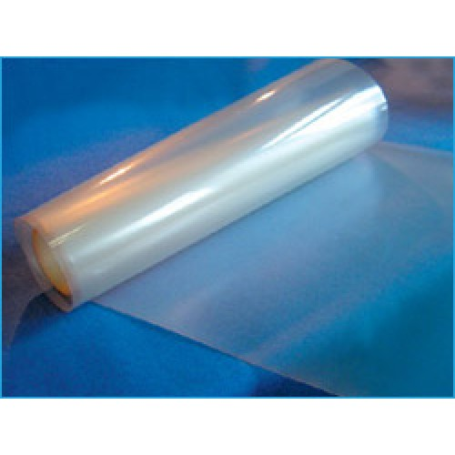
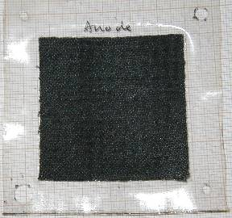
Materials used in a PEFC: bipolar plates, diffusion layers & electrolyte
1
2
3
2
1
3
Bipolar Plate
Electrolyte Membrane
Source: CEA
Gas Diffusion Layer

Slide 14
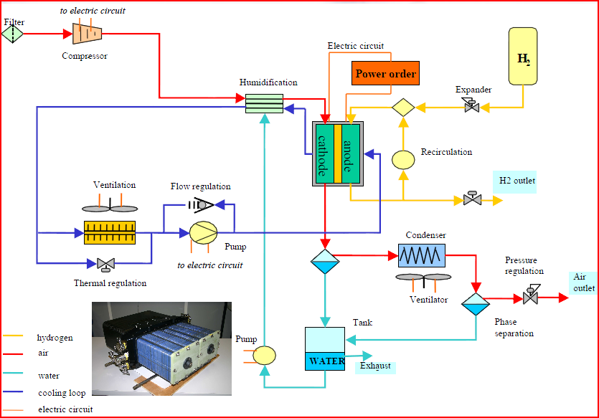
Auxiliaries associated to a fuel cell
The fuel cell stack surrounded by the hydrogen circuit, air circuit, air humidifier, cooling circuit, exhaust pipe and the electrical load.
Source: CEA

Slide 15
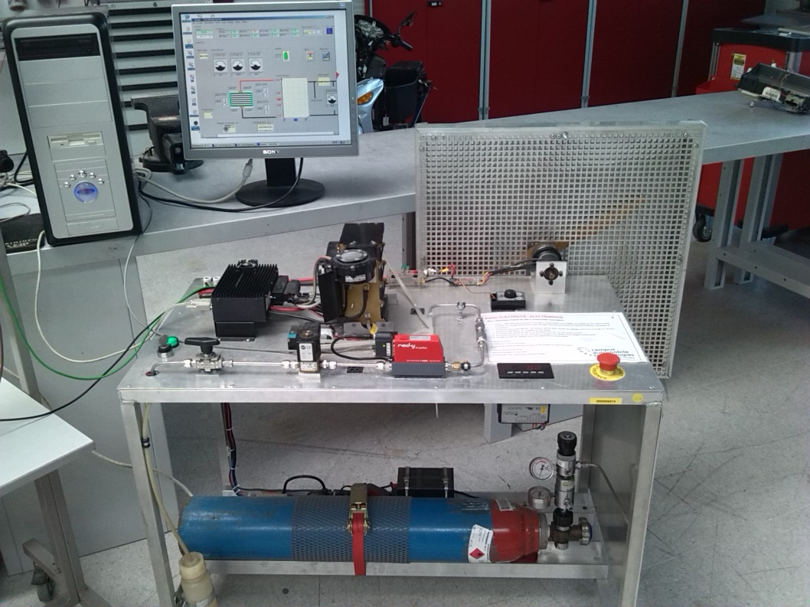
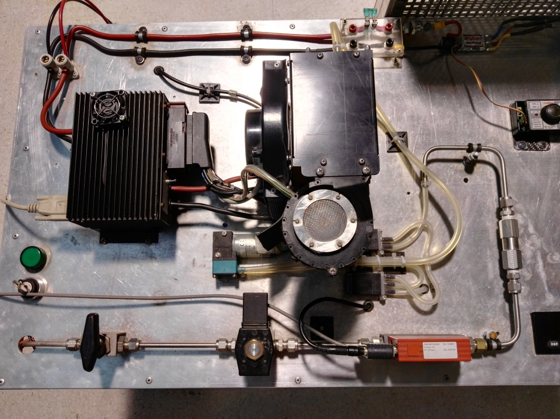
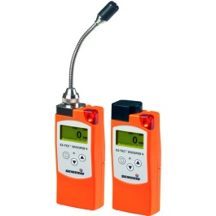
Auxiliaries associated to a fuel cell
ELEC OUT
H2 OUT
FAN
H2 IN
H2 PUMP
H2 IN
Fuel cell test rig supplied by a pressure tank, B10-200 bars
Fuel cell test rig, details
H2 detectors
Source: CEA

Slide 16
Auxiliaries are very important in terms of technology and safety
Hydrogen tanks are generally filled with hydrogen gas under 350 or 700 bars
Hydrogen tanks are engineered to be filled up to 700 bars. They are manufactured in composite materials like carbon and Kevlar fibres.
Hydrogen tanks are equipped with a specific safety multivalve which includes a thermal fuse, manual valve, solenoid valve, pipe torn off restrictor, temperature and pressure sensors and an overpressure disc.
Some specific hydrogen tanks are designed to be filled with liquid hydrogen at minus 253°C or with pressurised cooled gas at very low temperature.
Pipes are designed to support high pressure. They are connected to other components by using screwed connectors.

Slide 17
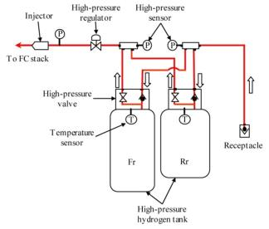
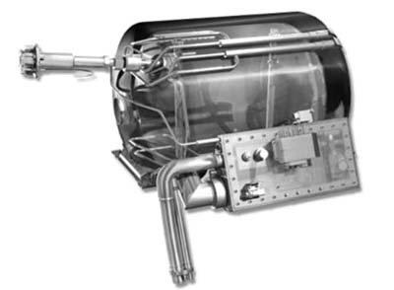
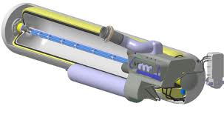
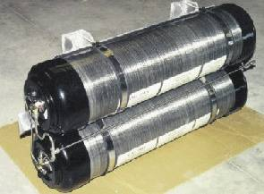
Auxiliaries associated to a fuel cell
1. Hydrogen storage: we consider three types of on board storage for vehicles
Hydrogen gas storage under pressure
Liquid Hydrogen storage at very low temperature
Cold Hydrogen gas storage at very low temperature
Source: BMW, Toyota

Slide 18
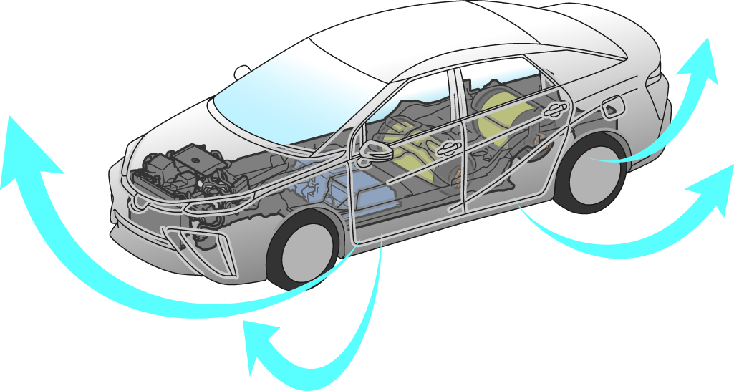

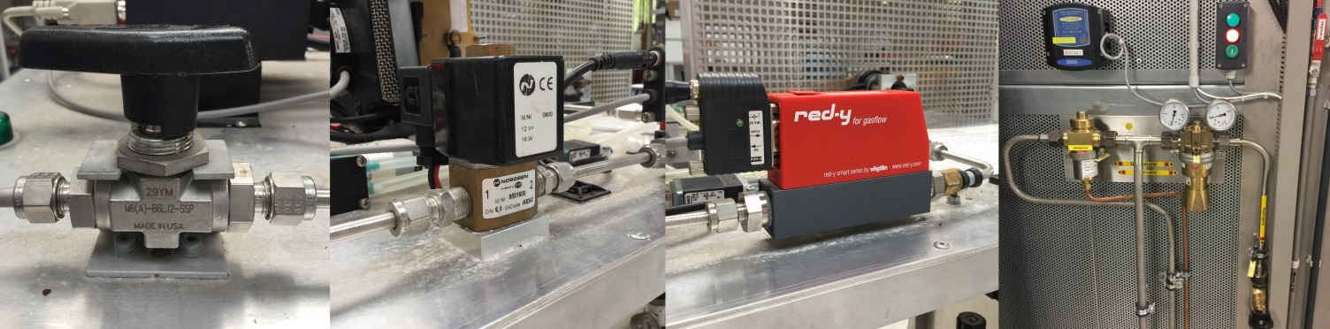
Auxiliaries associated to a fuel cell
2. Hydrogen pipes: we consider safety first
The hydrogen system, tanks and pipes, is located outside the car volume for safety reasons. Hydrogen has no chance to enter the passenger compartment.

Slide 19
The pressure regulator reduces the hydrogen gas pressure from 700 bars to around 1 bar. Any pressure higher than 1 bar of hydrogen could destroy the fuel cell membrane.
The air intake is also managed. The air pressure is managed with a counter-pressure valve as it must be equal to the hydrogen pressure. The air flow is managed with a bypass valve.
The air flow must contain humidity in order to avoid electrolyte membrane drying and allow protonic transport.
A humidifier can be used to keep the humidity content of intake air around 50%
A dry air will dry the fuel cell membrane and stop the production of electricity.
A cooling circuit is essential to maintain the fuel cell temperature under 80°C.
The coolant is special and non conductive of electricity.
A resin filter is used to remove ions from the coolant.

Slide 20
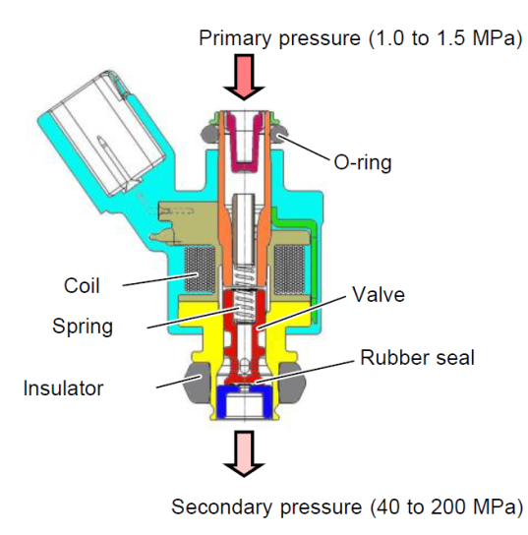
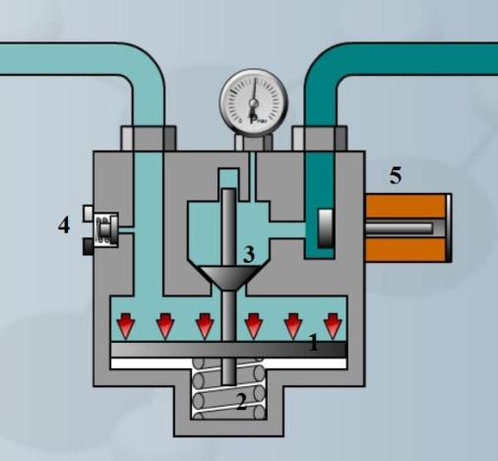
Auxiliaries associated to a fuel cell
3. The pressure regulator is necessary to reduce the pressure from the tank (up to 700 bars) to the fuel cell (around 1 bar). This operation is generally performed in two steps, a mechanical pressure reducer followed by an electronically regulated valve or injector.
1 to 1,5 MPa
70 MPa
40 to 200 kPa
Source : Toyota TME

Slide 21
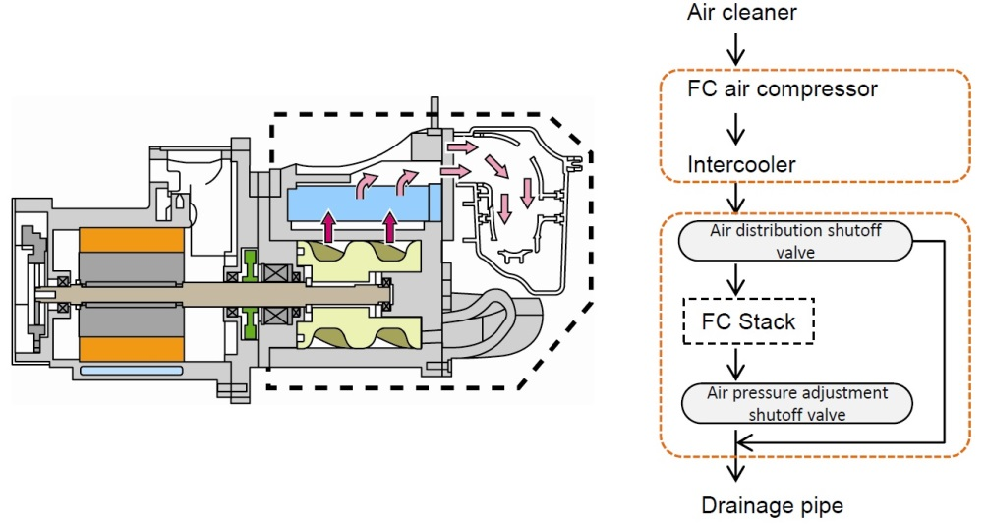
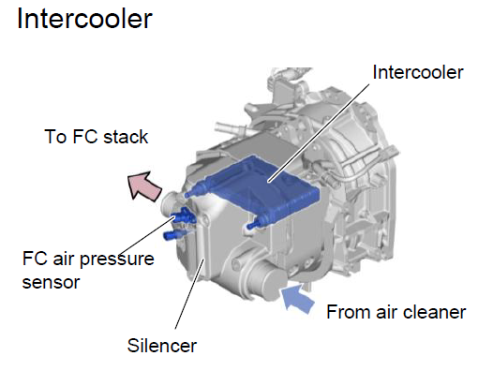
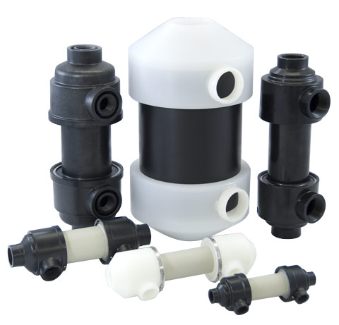
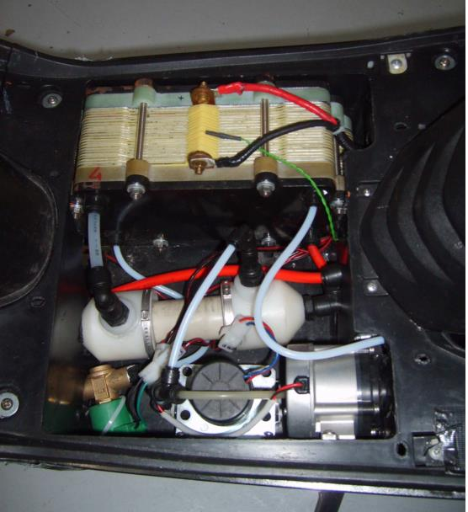
Auxiliaries associated to a fuel cell
The intake air circuit is composed of a filter, compressor, intercooler, humidifier, fuel cell & exhaust
5. Air intercooler
4. Air compressor
Source : Toyota TME
6. The humidifier is located just before the fuel cell and increases the humidity % of intake air. The water is extracted from wet air in the exhaust
Source : Perma Pure humidifiers

Slide 22
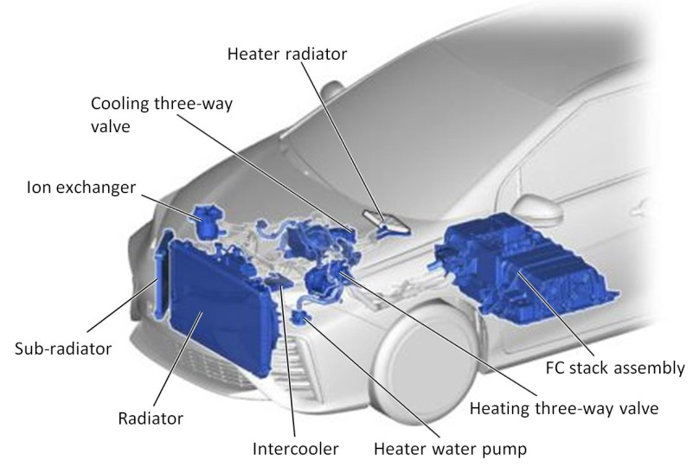
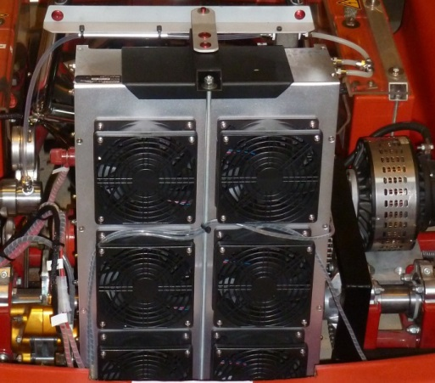
Auxiliaries associated to a fuel cell
The fuel cell efficiency is about 50% to 60%. This means that a significant part of the energy produced is heat and must be valorised or evacuated through the radiator.
7. Typical cooling circuit components of a fuel cell vehicle
Sometimes, air cooling is enough
Source : Toyota TME

Slide 23
The fuel cell is like a battery, it produces DC current.
DC current must be transformed into AC current as most practical loads use AC current.
DC current is transformed into AC current thanks to an inverter bridge.
An inverter bridge is quite simple. It uses 6 transistors in saturated mode, open or closed. The inverter is reversible and works then like a diode bridge to convert AC into DC.
AC current is used to supply the 3 phase stator of an electric motor.
The 3 phase stator coils generate a rotating magnetic field or RMF.
The rotating magnetic field is followed by a rotor connected to a transmission.

Slide 24
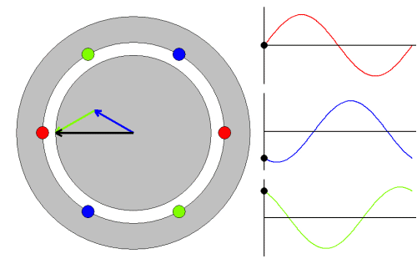
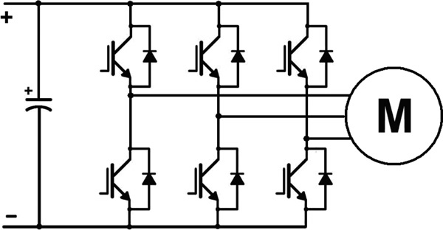
The fuel cell in a system
The DC current produced by the fuel cell must be transformed by power electronics in order to be used. An inverter is often considered to transform DC current into 3 phase AC current. In vehicular applications, the load will be an electric motor. In this machine, the rotor is moving due to a force induced by the rotating magnetic field (RMF) generated by the stator coils.
High voltage Batt or FC
Diagram of a DC/AC reversible converter
3 coils supplied with AC current are generating a rotating magnetic field

Slide 25
The fuel cell is associated to auxiliaries in order to work like a battery. It is then considered as a fuel cell system.
In mobile applications, the fuel cell is not reversible. It is not possible to send electricity and produce hydrogen at 700 bar to fill the tank.
The fuel cell system is finally included in a fuel cell powertrain.
A fuel cell powertrain is similar to a hybrid powertrain, including a small battery in parallel.
The fuel cell needs air and hydrogen to produce electricity. These are supplied with a compressor and a pump. There is a delay of 1 to 2 seconds when higher current is requested. This delay is not visible for the user as the battery compensates immediately.
The battery is also used to recover energy during braking.

Slide 26
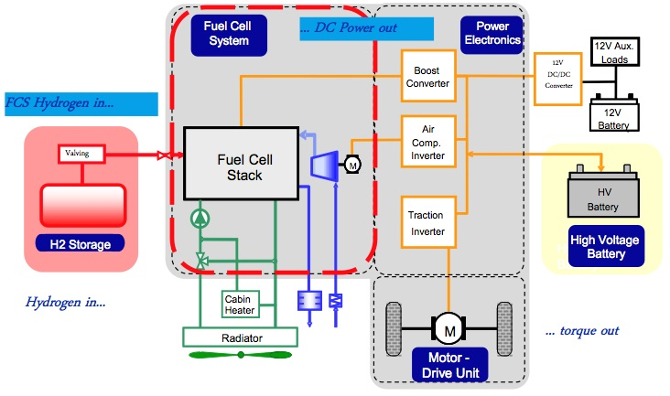
The fuel cell in a system
The fuel cell and the auxiliaries deliver electricity to the inverter that powers an electric motor. A high voltage battery connected in parallel serves as an energy buffer.
A complete fuel cell powertrain of a vehicle
Source: greencarcongress.com

