Slide 1
Technologies
Teacher Answers to Practical Activities 1-3
Content created by
<Partner logo>
Last updated 18th October 2019

Slide 2
Practical exercise:
locating and connecting the components
of a fuel cell vehicle powertrain
Components of a FCV powertrain
Example based on the Toyota Mirai

Slide 3
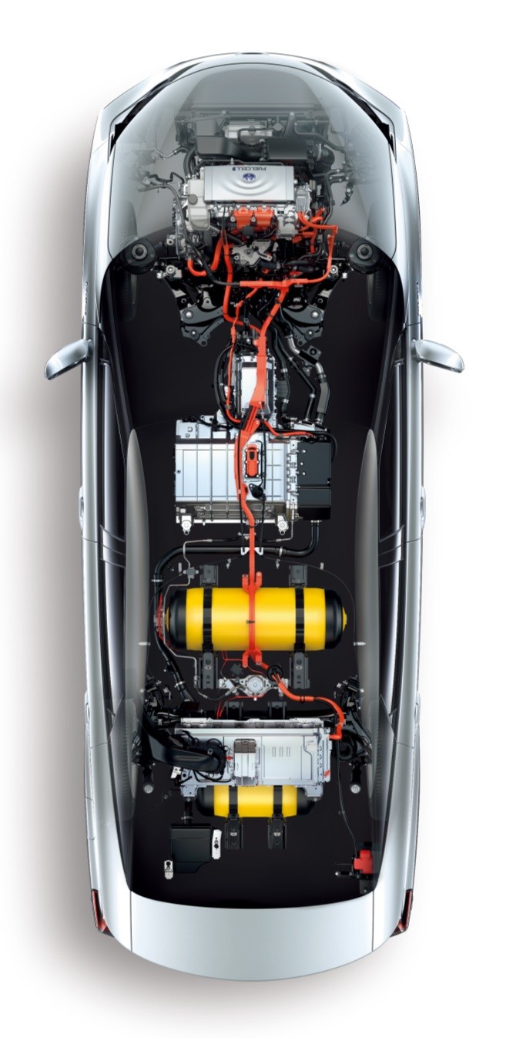
List of the components
Chassis frame
Filling plug
Hydrogen tank(s)
Pressure regulator
Fuel cell
Fuel Cell auxiliaries (sub-exercise)
Radiator & cooling circuit
Hydrogen pump & inverter
Air Filter
Air compressor & intercooler
Humidifier
Exhaust
High Voltage Battery
Traction Inverter
Electric motor
Transmission & wheels
1
6a,c,d
10
8
9
10
5
6b,e
3
4
7
2
6f

Slide 4
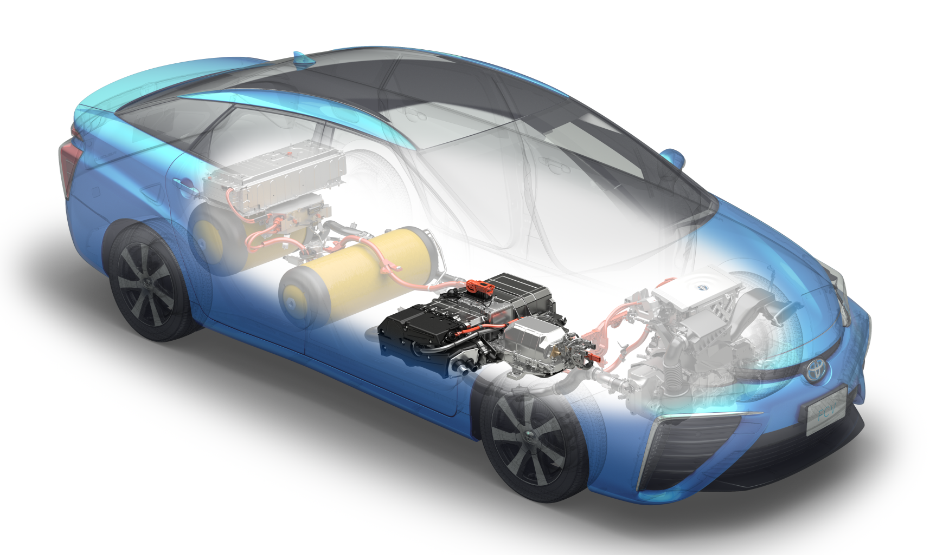
1. Chassis design and major components
This picture shows the chassis of a FCV and main components of the powertrain. Let’s design it together from scratch.

Slide 5
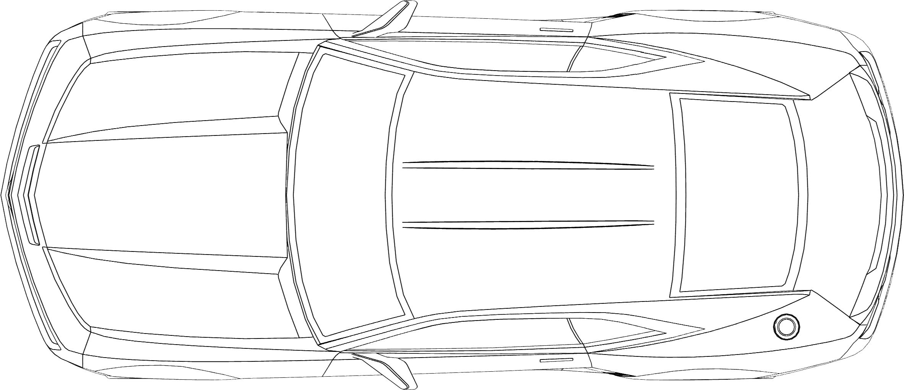
1. Chassis design, we keep the external shape, or we draw a rectangle
This picture shows the general shape of a car and an equivalent rectangle.

Slide 6
List and short description
of the components used
in the FCV powertrain

Slide 7
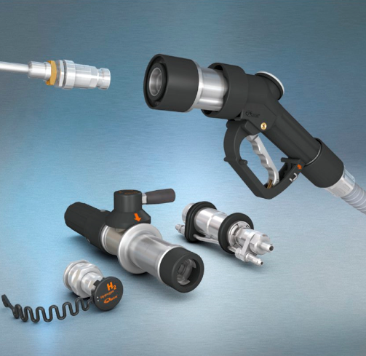
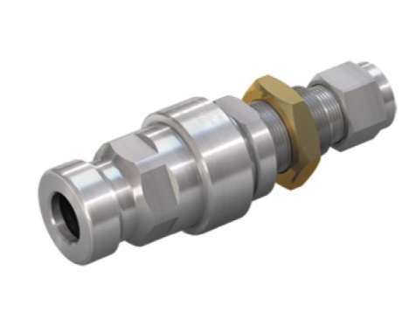
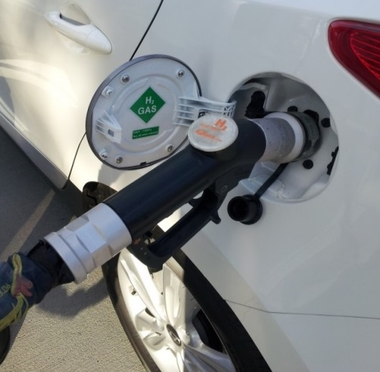
2. Filling plug
This plug is located on the bodywork, near the trunk and not far from the tanks. It is connected to the pressure tanks and will be connected to the filling station pistol grip each time the driver needs to refill the tank.
Source: WEH

Slide 8
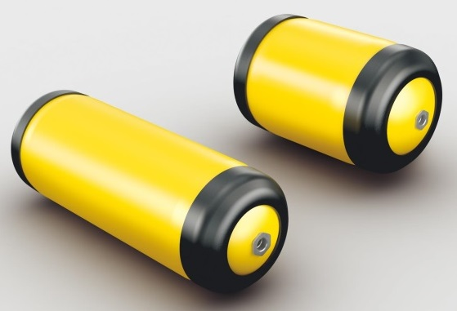
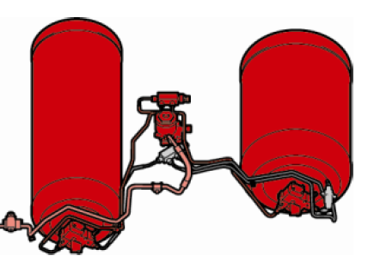
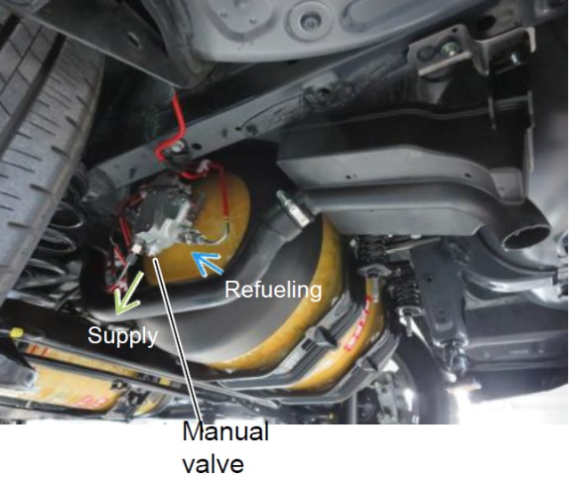
3. Hydrogen pressure tanks
These tanks are used to store 5 kg of hydrogen gas under a pressure of 700 bars. They are manufactured with 3 layers which are made of plastic (liner), carbon fibre composite (intermediate) and glass fibre (exterior)

Slide 9
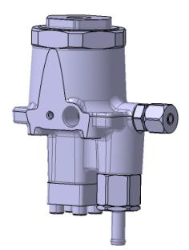
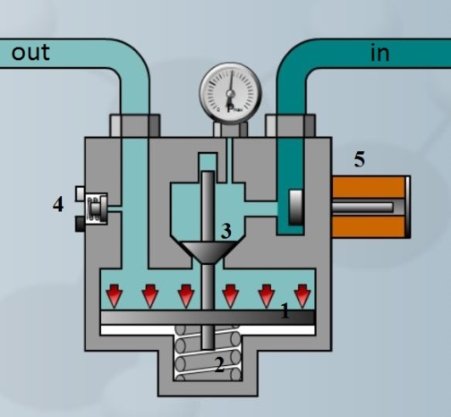
4. Pressure regulator
out
in
in
in
out
This mechanical device is used to reduce the pressure from the tank pressure to an intermediate one, generally 10-15 bars. FC injectors are then reducing the pressure to approximately 1 bar corresponding to the FC H2 intake pressure.

Slide 10
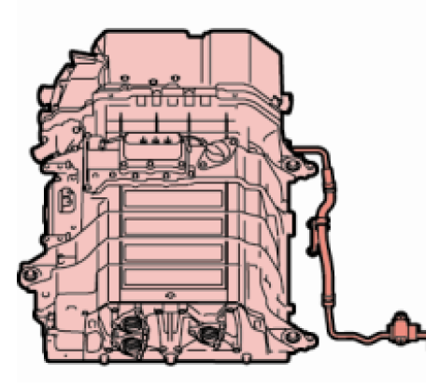
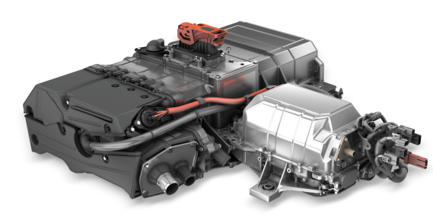
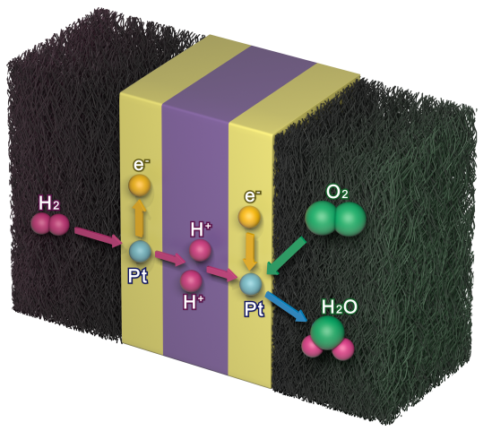
5. Fuel cell stack
This fuel cell is used to produce electricity which will power the vehicle. An average power is around 100 kW. The fuel cell is sometimes associated to a booster circuit for an increase of the voltage.

Slide 11
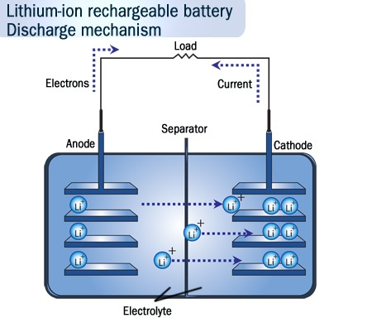
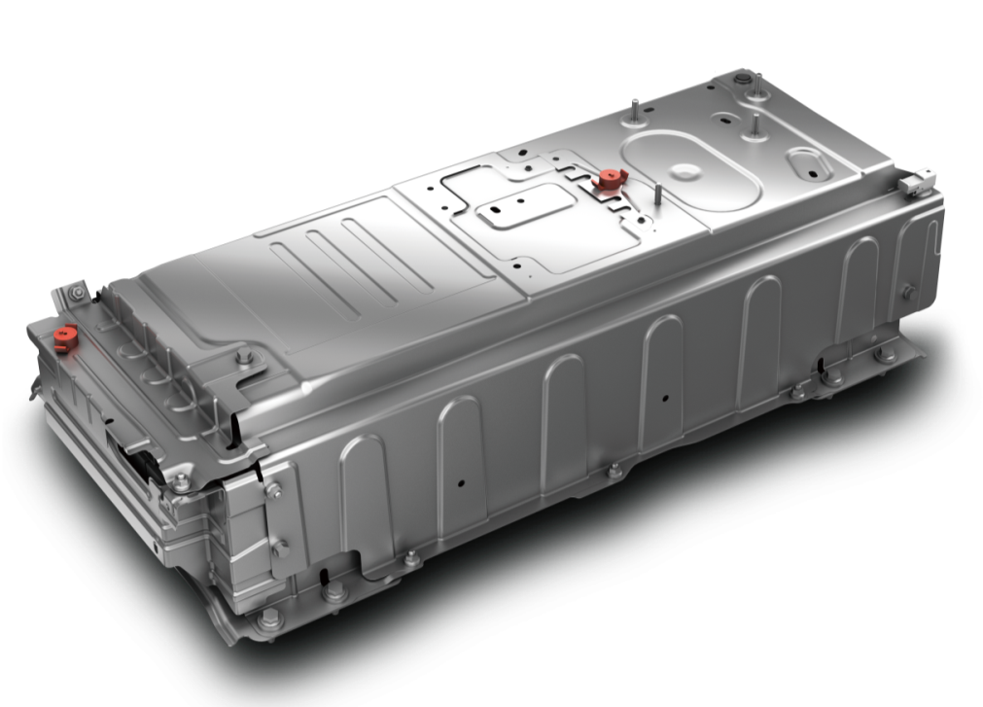
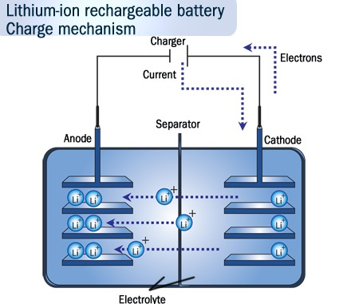
6. High Voltage Battery
This battery is used as a peak power system. Energy can be used immediately during the acceleration of fuel cell auxiliaries. It is also used to store energy recovered during braking

Slide 12
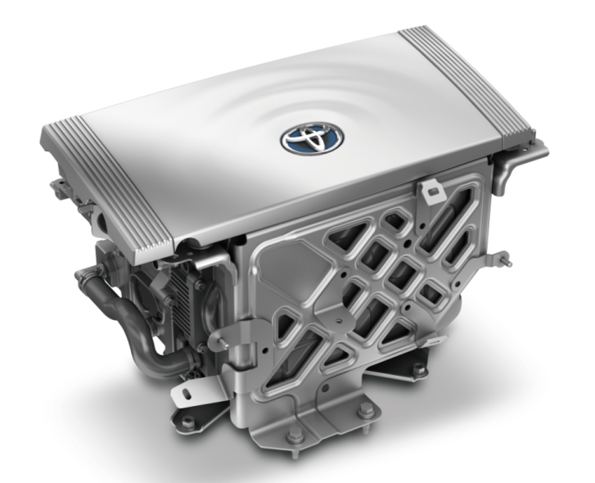
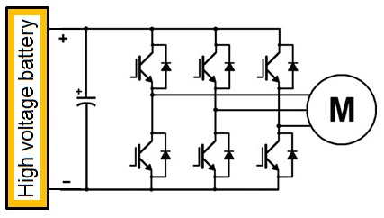
7. Traction Inverter (power electronics)
The traction inverter is a high voltage electronic component. It is used to transform DC from the battery and fuel cell into AC current to power the electric motor. By controlling the frequency and voltage of AC current it also controls the speed of the motor.

Slide 13
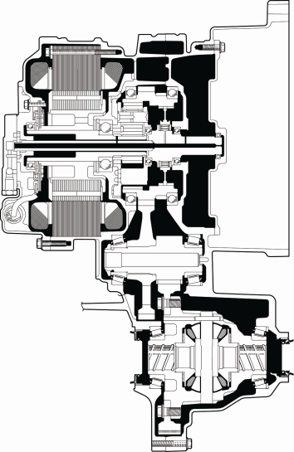
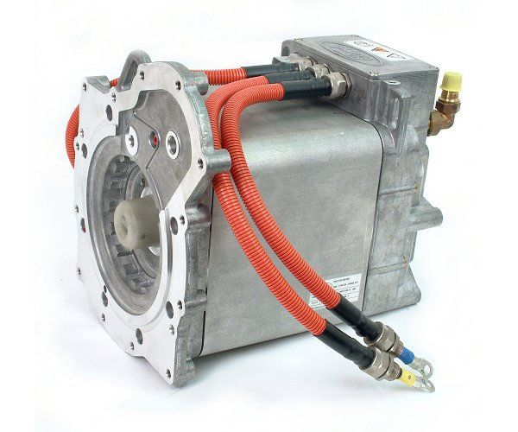
8. AC 3 phases Electric Motor (e-Motor)
The electric motor is used to transform electric energy into mechanical energy. It is a 3 phase reversible machine supplied by AC voltage. The rotational speed depends on the voltage and on the frequency.

Slide 14
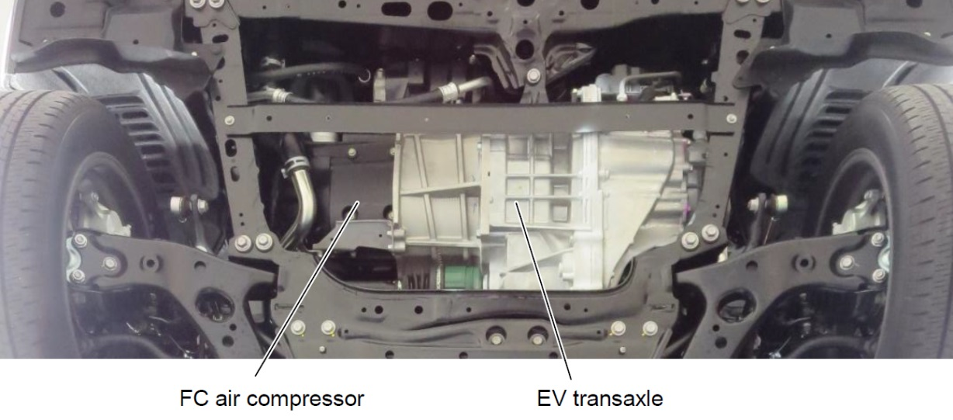
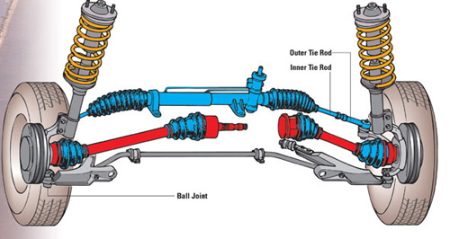
9. e-Motor + Transmission & wheels
The output of the e-motor is connected to a simplified gearbox including one speed and a differential. The gimbals are then connected to the wheels.

Slide 15
Practical exercise:
locating and connecting the components
of a fuel cell vehicle powertrain
Exercise: Print the pictures of the components and draw the shape of a car, top view, on a sheet of paper or at the black/whiteboard. Then locate the components following the theory explained previously. Comment each component role and connect them to each other in order to build a functional powertrain.
Example based on the Toyota Mirai

Slide 16
Practical exercise:
locating and connecting the components
of a fuel cell vehicle powertrain
SOLUTIONS
Example based on the Toyota Mirai

Slide 17
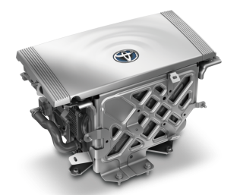
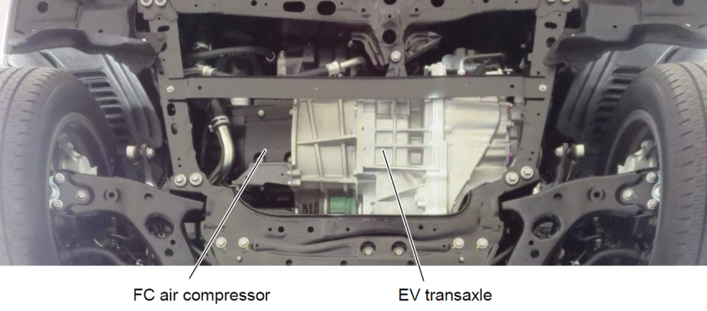
Solution 1: location of the components in a sedan car
Locate the components step by step, start by the filling plug and follow the energy flow to the end, to the e-motor. The battery will be installed just after the fuel cell.

Slide 18
Solution 1: Understand how it works and complete the missing links
Locate the components step by step, start by the filling plug and follow the energy flow to the end, to the e-motor. The battery will be installed just after the fuel cell.

Slide 19
Practical exercise:
locating and connecting the components
of a fuel cell vehicle powertrain
SIMPLE SOLUTION
Example based on the Toyota Mirai

Slide 20
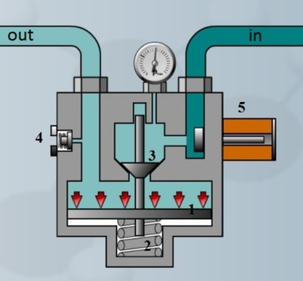
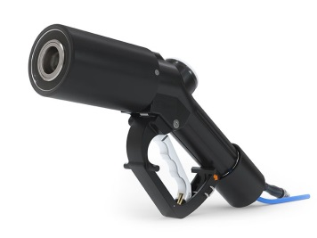
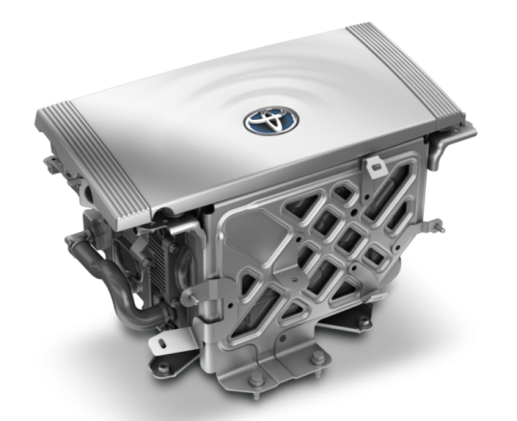
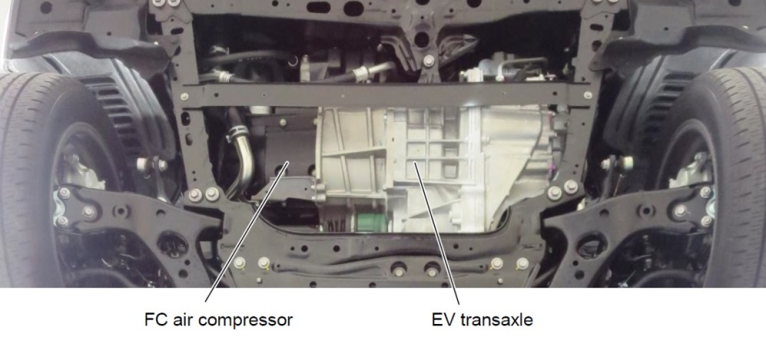
Solution 2: interactions between the components of a FC powertrain
ENERGY FLOW
H2 fuelling nozzle
H2 receptacle
Hydrogen tank
Pressure reducer
Electric motor
Inverter
Hydrogen fuel cell
High Voltage battery

Slide 21
Practical sub-exercise:
connecting the auxiliaries
of a PEM fuel cell system for vehicles
Auxiliaries of a FC system
Example based on the Toyota Mirai

Slide 22
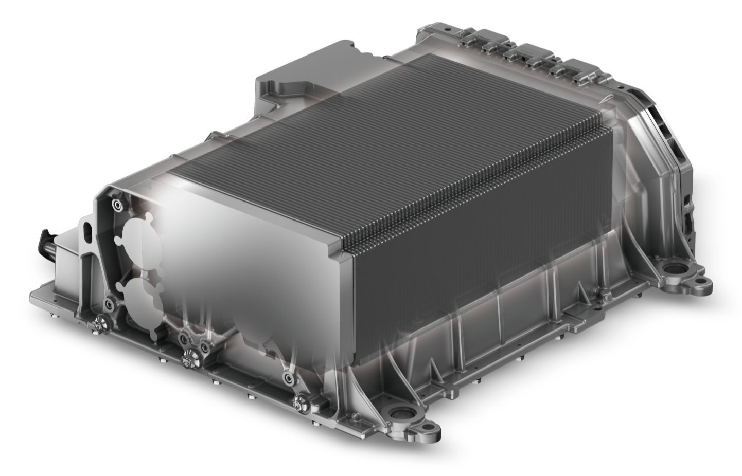
Sub-exercise: the fuel cell auxiliaries
The fuel cell needs auxiliaries to work properly. It must be supplied with hydrogen and with moist filtered air, it must be cooled and the water produced must be eliminated by the exhaust.

Slide 23
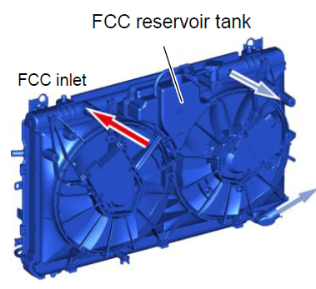
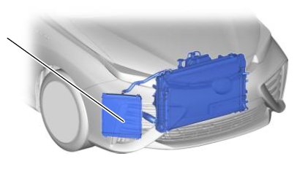
Sub-exercise: the fuel cell auxiliaries
Radiator & sub-radiator
The radiator & cooling circuit is used to cool the fuel cell during operation. A fluid captures the heat produced by the fuel cell and circulates in pipes until exchanging heat with ambient air in the radiator.

Slide 24
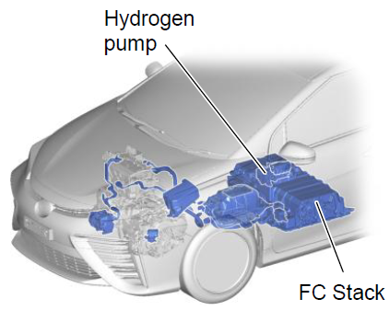
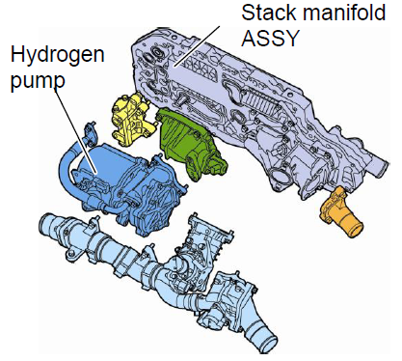
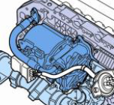
Sub-exercise: the fuel cell auxiliaries
The hydrogen pump is often integrated in the fuel cell casing. It is used to assume a sufficient flow of hydrogen in all cells. It is necessary because intake pressure is low, around 1 bar.

Slide 25
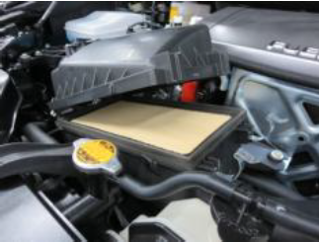
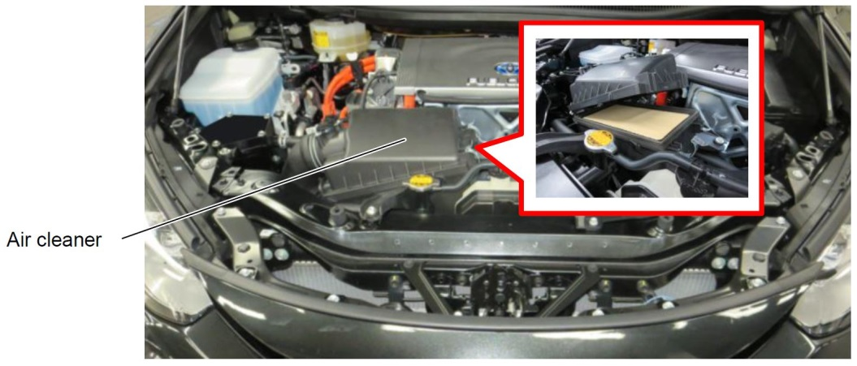
Sub-exercise: the fuel cell auxiliaries
The air filter is used to avoid that dust particles enter the fuel cell and contaminate surfaces. We are using a chemical reaction which needs active surfaces. Any kind of contamination will reduce the fuel cell efficiency.

Slide 26
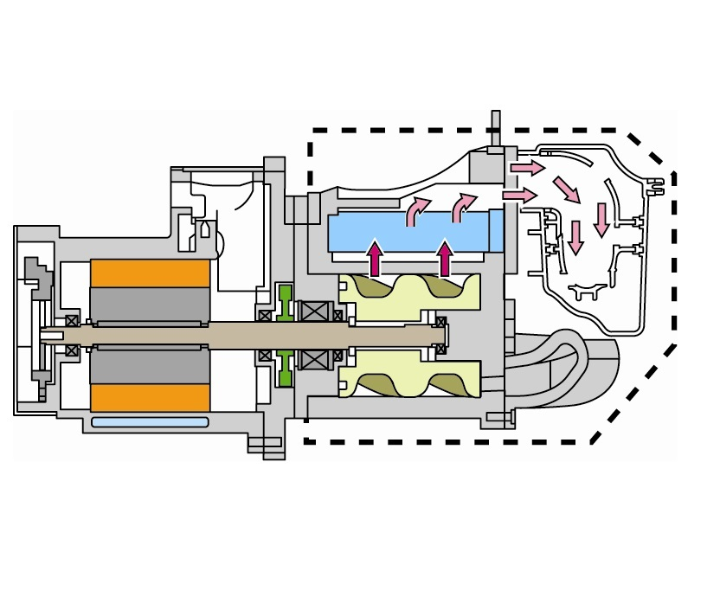
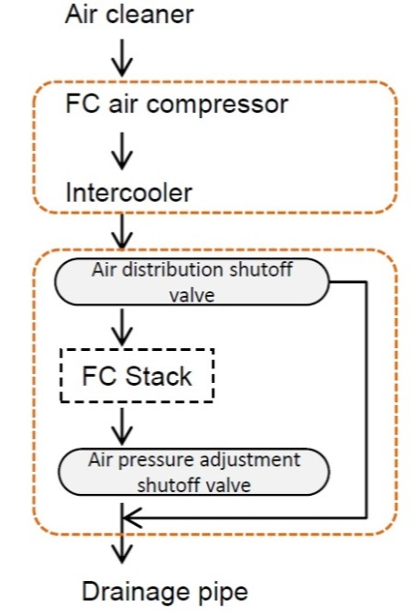
Sub-exercise: the fuel cell auxiliaries
The air compressor is used to assume the flow of air corresponding to the current requested. The more we need current, the more air and hydrogen we must push in the fuel cell.

Slide 27
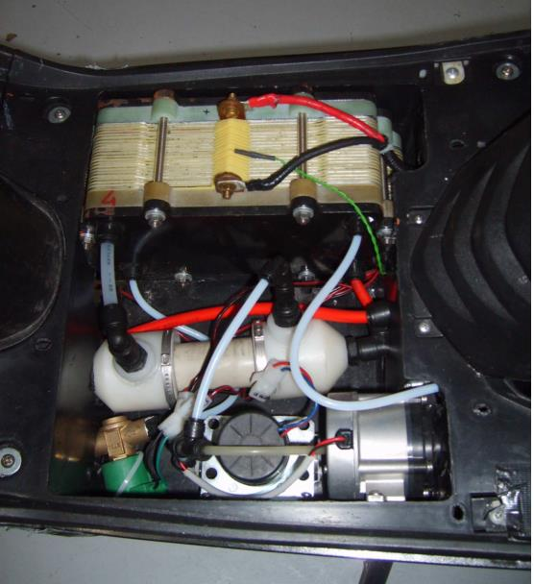
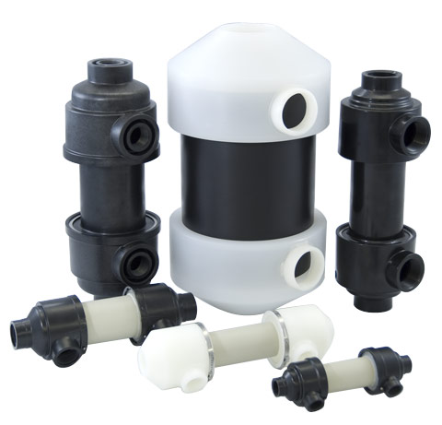
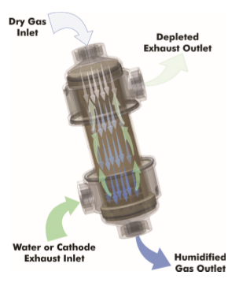
Sub-exercise: the fuel cell auxiliaries
The air humidifier is necessary because the fuel cell membrane does not work properly when it is dry. The moisture level must nevertheless be kept under a limit (50%) in order to avoid the flooding of the fuel cell.
Source: permapure

Slide 28
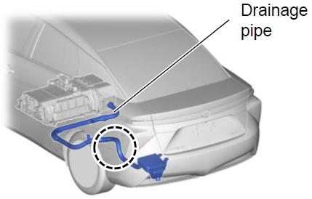
Sub-exercise: the fuel cell auxiliaries
The exhaust of the fuel cell is used to eliminate water produced in the air side of the fuel cell.

Slide 29
Practical sub-exercise:
Connecting the auxiliaries
of a fuel cell system for vehicles
SOLUTION
Example based on the Toyota Mirai

Slide 30
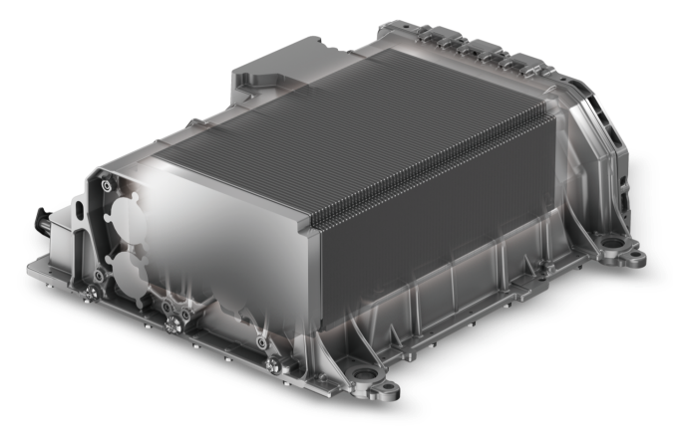
Solution 3: connexion of the auxiliaries
AIR IN
in
out
FCC out

